Slide 1
6G Wireless Communications: Security Technologies and Research Challenges
Presented by
ZEESHAN A. BANDAR

Slide 2
CONTENTS
Introduction to 6G Technology
Key Features
Evolution of Technology
Key Enabling Technologies
Application
Research Challenges
Advantages
Conclusion

Slide 3
Introduction to 6G Technology
Sixth Generation of wireless technology
6G System will have integration of 5G along with satellite network
Complete Wireless Network With No Limitation
6G technology considered to be cheap and fast internet technology having the transmission speed in terabit range
6G technology provides zero distance connectivity between peoples

Slide 4
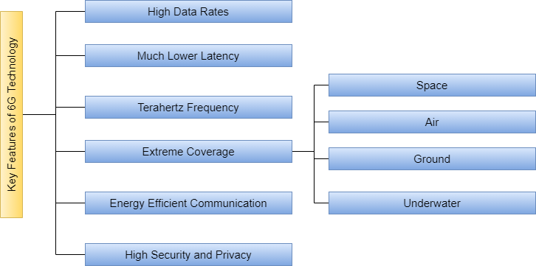
Key Features

Slide 5
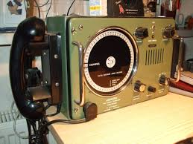
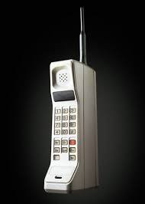
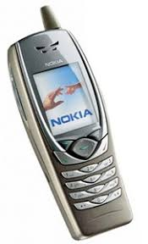
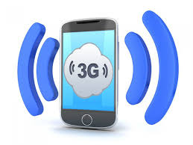



Evolution of Technology
0G Technology
1G Technology
2G Technology
3G Technology
4G Technology
5G Technology
6G Technology

Slide 6
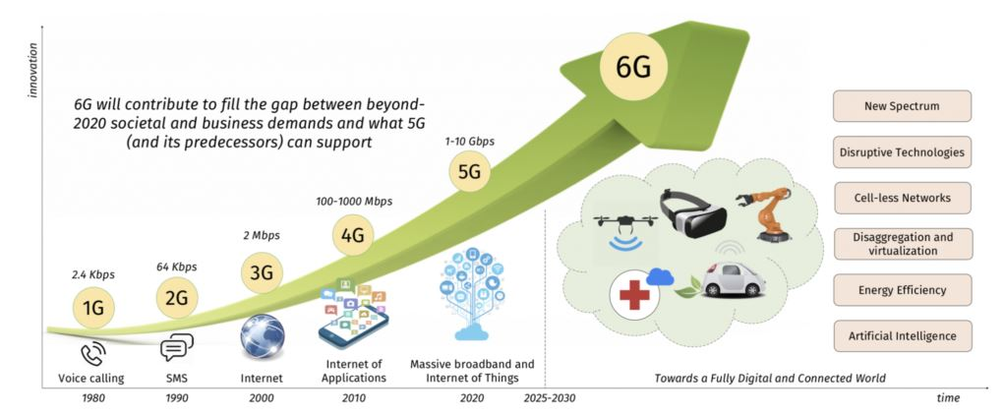
Continue...

Slide 7
4G vs 5G vs 6G Technology
 | 4G | 5G | 6G
Peak Data Rates | 100 MB/s | 20GB/s | 1TB/s
Experienced Data Rates | 10MB/s | 0.1Gb/s | 1GB/s
Area Traffic Capacity | 0.1MB/s/m² | 10MB/s/m² | 10MB/s/m²
Latency | 10ms | 1ms | 0.01-0.1ms
Connection Density | 10⁵ Devices/km² | 10⁶ Devices/km² | 10⁷ Devices/km²

Slide 8
Key Enabling Technologies
Artificial Intelligence
Quantum computing and communication
Blockchain

Slide 9
Applications
Super smart society
Extended reality
Connected robotics and autonomous systems
Wireless brain–computer interactions
Smart healthcare
Automation and manufacturing
Internet of everything(IoE)

Slide 10
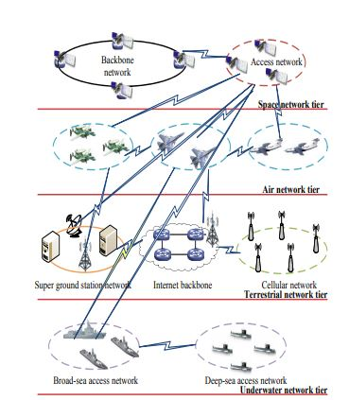
Research Challenges
Integrated Security Architecture of Space-air-ground-underwater Network

Slide 11
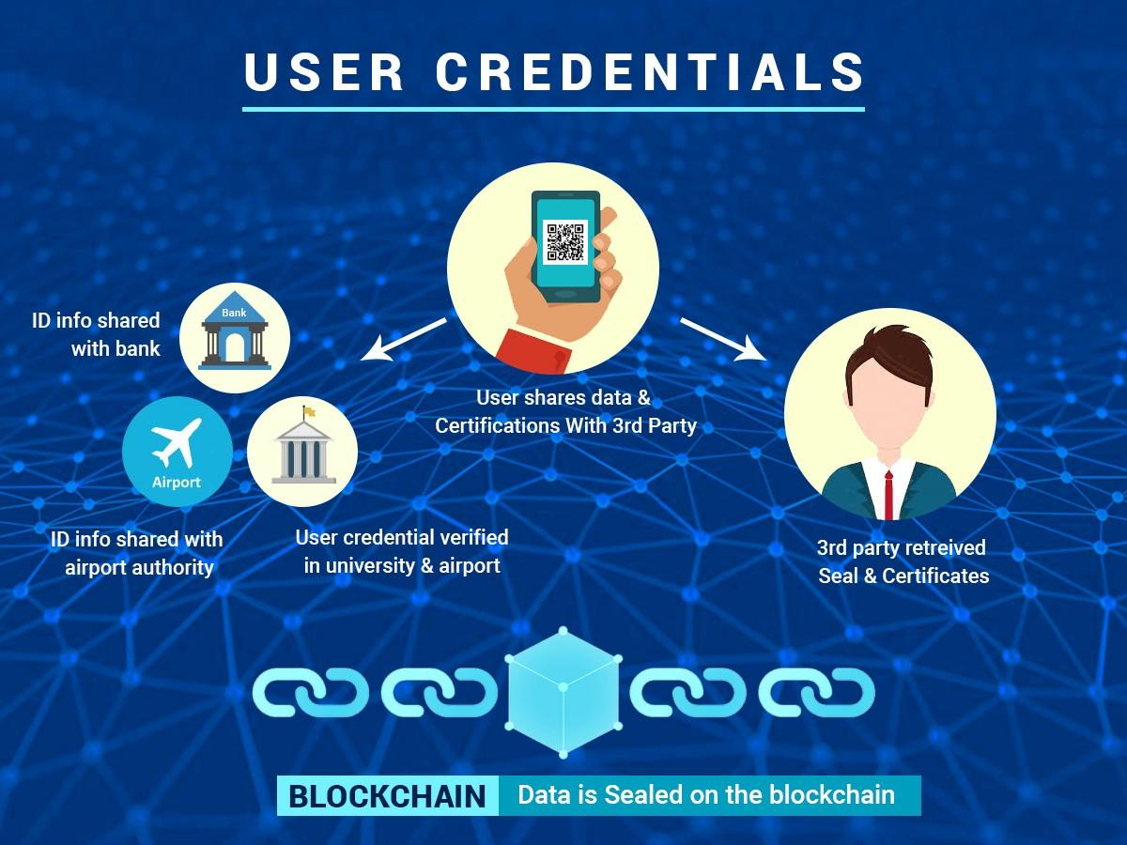
Continue...
Blockchain-based Identity Authorization System

Slide 12
Advantages
It is designed to support higher number of mobile connections
6G will revolutionize the health-care sector which eliminates time and space barriers through remote surgery and guaranteed health-care workflow optimizations
6G offers very high data rate (Tb/sec) and very low latency (ms).
High Security
Solve connection problems that may have cellular networks in enclosed spaces
Space technology and Defense applications will be modified with 6G networks

Slide 13
Conclusion
6G wireless network would provide more broad coverage and much better quality of user experience.
The security technologies including AI, quantum technologies and blockchain can be used for 6G to ensure network security

Slide 14
THANK YOU

