Slide 1

CONTACT MANAGEMENT SYSTEM
GHARDA INSTITUTE OF TECHNOLOGY
Project Guide :
Prof. Sameer Tathare

Slide 2
TEAM MEMBERS
Member Name | Roll No.
Rajesh Kumbhar | 34
Sarvesh Kamble | 26
Aditi Kawathekar | 28
Nutan Pawar | 44
Shantanu Kothavale | 33

Slide 3
ABSTRACT
We have discussed so far various features of C language and are ready to write and execute program of modest complexity. However, before attempting to develop complex programs, it is worthwhile to consider some programming techniques that would help design efficient and error free. The program development process includes three important stages, namely, program design, program coding and program testing. All the three stages contribute to the production of high quality program.
In “CONTACT MANAGEMENT SYSTEM” we will construct system design, source coding, and program testing and add many more features to facilitate the user with the best. We will give the user the facility to enter the person’s record and providing the option to save and delete that record and many more options.

Slide 4
We can improve the efficiency of the system, thus overcome the drawbacks of the existing system :
Less human error
Strength and strain of manual labour can be reduced
High security
Data consistency
Easy to handle
Easy data updating
Easy record keeping

Slide 5
INTRODUCTION
The mini project ‘Contact Management System’ is the sample project for managing contact details. The project aims at developing contact management system using the C language that enables an organization to maintain its library.
The project demonstrates the creation of a user interface of a system, without the use of C Graphics library.
The application uses basic C function to generate menus, show
message boxes and print text on the screen.

Slide 6
ABOUT PROJECT
Project Name
Project Platform
Programming Language Used
IDE Tool (Recommended)
Project Type
Database
PROJECT DETAILS
: Contact Management System
: C/C++
: C Programming Language
: Codeblocks / Turbo C
: Desktop Application
: Stores data in .DAT file

Slide 7
Survey of Existing System
Existing system refers to the traditional way of writing contacts in books.
Today also there are many small businessmen who store their customer details in a traditional way i.e writing the details in a bunch of note books.
Limitation of Existing system or research gap
It is very difficult to manage, store and even retrieve the data of customers.
There are higher possibilities of losing the data, due to many reasons like natural disasters like floods.

Slide 8
ABOUT PROJECT
The Title of the Program is to develop a program which deals with the combination of structures, arrays, File pointers and other functions.
By implementing this program we can execute the inserted contact data, deletion of the data, searching, updating, append, exit with numbers by using arrays and file pointers. This program is implemented for only numbers that can enter into an array.
To do this analysis manually it takes a lot of time and patience but by implementing this program using a high level language like C it becomes much easier. But before going to make final solution for the problem, the problem must be analysed.

Slide 9
First of all the basic information regarding the program which consists of complex numbers. This program is solved by using several methods like one can solve this program using user defined functions concept, loops conditions, go to statements. In this project, we will use the concept of functions, while loop, for loop, switch case and if conditions which helps to execute the problem much easier. The following steps are followed while implementing the given program using if and while loop :
The input is entered i.e., the value of choice (menu number), which selects the particular menu.
Next it goes to a particular menu and then goto the particular function.
It prints the resultant value which came from the execution.
The outcome of the work is one can get the required changes like inserting or deleting or sorting or merging or append or retrieve or update or exit for a given array.

Slide 10
ADVANTAGES & DISADVANTAGES
ADVANTAGES :
It becomes easy for the user to store complete information (e-mail id, address, etc.) about his contact.
It is easy for the user to just search his required contact number by just typing name of the contact.
DISADVANTAGES :
It becomes even difficult to store contacts with two or more contact numbers.

Slide 11
HARDWARE & SOFTWARE USED
SOFTWARE REQUIREMENTS (MINIMUM) :
This application is developed in Microsoft Windows xp or later operating system.
This application is coded and tested using the following compilers :
Code::blocks
Turbo C
HARDWARE REQUIREMENTS (MINIMUM) :
The application size is 33 KB and the size of the Code is 4.9KB. So, such amount of memory is required from the hard disk.
RAM: Minimum 256MB.
Mouse & Keyboard.

Slide 12
ALGORITHM
STEPS :
1} Declare required header files and variables.
2} Display Main menu as below :
[1] Add a new Contact
[2] List all Contacts
[3] Search for Contact
[4] Edit a Contact
[5] Delete a Contact
[0] Exit

Slide 13
3} Get choices from user
Choice 1: Add new contacts
Steps:
1) Open file 'fp' to write.
2) Assign the pointer to the end of the file to write.
3) Display enter name.
4) Get data from user.
5) Write input data on a file.
6) Close file.
7) Go back to the Main menu or Exit the program.

Slide 14
Choice 2: List all contacts
Steps:
1) Open file 'fp'.
2) Assign the pointer to the beginning of the file to be read.
3) Create loop to read data from file until 'End of file' is not encountered.
4) Display list of contact with all details.
5) Go back to the Main menu or Exit the program.

Slide 15
Choice 3: Search contacts
Steps:
1) Open the file 'fp' to read.
2) Assign the pointer to the beginning of the file to be read.
3) Get contact name from user.
4) Create loop to read data from file until 'End of file' is not encountered.
5) Is user input name = name in file
Yes:- Display all information about that name.
No:- Print 'No match found !'
6) Close file.
7) Print 'Do you want to Try again?'
Yes:- goto step 3
No:- exit from search loop
8) Go back to the Main menu or Exit the program.

Slide 16
Choice 4: Edit contacts
Steps:
1) Open the file 'fp'.
2) Assign the pointer to the beginning of the file to be read.
3) Enter the name which is to be edited.
4) Create loop to read data from file until 'End of file' is not encountered.
5) Overwrite the new data on old data of that contact.
6) Close file.
7) Go back to Main menu or Exit the program.

Slide 17
Choice 5: Delete contacts
Steps:
1) Open the file 'fp'.
2) Assign the pointer to the beginning of the file to be read.
3) Get name from user to delete from contact list.
4) Create loop to read data from file until 'End of file' is not encountered.
5) Open another file 'temp'.
6) Is user input name = name on a file.
Yes:- Copy all data of 'fp' file in 'temp' file except that data which we want to delete. Delete 'fp' file and rename 'temp' file by 'fp' file name and goto step 7.
No:- Delete 'temp' file.
7) Close file.
8) Go back to Main menu or Exit the program.

Slide 18
Choice 0: Exit program
Steps:
1)Print 'Do you want to exit ?'
Yes:- Call exit function to terminate program.
No:- Go back to Main menu.
Default choice:
Print 'Invalid choice'.

Slide 19
PROJECT CODE
#include<stdio.h>
#include<conio.h>
#include<string.h>
#include<process.h>
#include<stdlib.h>
#include<dos.h>
struct contact
{
long ph;
char name[20],add[20],email[30];
} list;
char query[20],name[20];
FILE *fp, *ft;
int i,n,ch,l,found;

Slide 20
int main()
{
main:
system("cls");
/* ************Main menu *********************** */
printf("\n\t **** Welcome to Contact Management System ****");
printf("\n\n\n\t\t\tMAIN MENU\n\t\t=====================\n\t\t[1] Add a new Contact\n\t\t[2] List all Contacts\n\t\t[3] Search for Contact\n\t\t[4] Edit a Contact\n\t\t[5] Delete a Contact\n\t\t[0] Exit\n\t\t=================\n\t\t");
printf("Enter the choice:");
scanf("%d",&ch);
switch(ch)
{

Slide 21
case 0:
printf("\n\n\t\tAre you sure you want to exit?");
break;
/* *********************Add new contacts************ */
case 1:
system("cls");
fp=fopen("contact.dll","a");
for (;;)
{
fflush(stdin);
printf("To exit enter blank space in the name input\nName (Use identical): ");
scanf("%[^\n]",&list.name);
if(stricmp(list.name,"")==0 || stricmp(list.name," ")==0)
break;
fflush(stdin);
printf("Phone: ");
scanf("%ld",&list.ph);
fflush(stdin);

Slide 22
printf("Address: ");
scanf("%[^\n]",&list.add);
fflush(stdin);
printf("Email address: ");
gets(list.email);
printf("\n");
fwrite(&list,sizeof(list),1,fp);
}
fclose(fp);
break;
/* *********************List of contacts************************* */
case 2:
system("cls");
printf("\n\t\t================================\n\t\t\tLIST OF CONTACTS\n\t\t================================\n\nName\t\tPhone No\t Address\t\tE-mail ad.\n=================================================================\n\n");

Slide 23
for(i=97; i<=122; i=i+1)
{
fp=fopen("contact.dll","r");
fflush(stdin);
found=0;
while(fread(&list,sizeof(list),1,fp)==1)
{
if(list.name[0]==i || list.name[0]==i-32)
{
printf("\nName\t: %s\nPhone\t: %ld\nAddress\t: %s\nEmail\t: %s\n",list.name,
list.ph,list.add,list.email);
found++;
}
}
if(found!=0)
{
printf("=========================================================== [%c]-(%d)\n\n",i-32,found);
getch();
}
fclose(fp);
}
break;

Slide 24
/* *******************Search contacts********************** */
case 3:
system("cls");
do
{
found=0;
printf("\n\n\t..::CONTACT SEARCH\n\t===========================\n\t..::Name of contact to search: ");
fflush(stdin);
scanf("%[^\n]",&query);
l=strlen(query);
fp=fopen("contact.dll","r");
system("cls");
printf("\n\n..::Search result for '%s' \n===================================================\n",query);
while(fread(&list,sizeof(list),1,fp)==1)
{
for(i=0; i<=l; i++)
name[i]=list.name[i];
name[l]='\0';

Slide 25
if(stricmp(name,query)==0)
{
printf("\n..::Name\t: %s\n..::Phone\t: %ld\n..::Address\t: %s\n..::Email\t: %s\n",list.name,list.ph,list.add,list.email);
found++;
if (found%4==0)
{
printf("..::Press any key to continue...");
getch();
}
}
}
if(found==0)
printf("\n..::No match found!");
else
printf("\n..::%d match(s) found!",found);
fclose(fp);
printf("\n ..::Try again?\n\n\t[1] Yes\t\t[0] No\n\t");
scanf("%d",&ch);
} while(ch==1);
break;

Slide 26
/* *********************Edit contacts************************/
case 4:
system("cls");
fp=fopen("contact.dll","r");
ft=fopen("temp.dat","w");
fflush(stdin);
printf("..::Edit contact \n===============================\n\n\t..::Enter the name of contact to edit: ");
scanf("%[^\n]",name);
while(fread(&list,sizeof(list),1,fp)==1)
{
if(stricmp(name,list.name)!=0)
fwrite(&list,sizeof(list),1,ft);
}
fflush(stdin);
printf("\n\n..::Editing '%s'\n\n",name);
printf("..::Name(Use identical): ");
scanf("%[^\n]",&list.name);
fflush(stdin);

Slide 27
printf("..::Phone: ");
scanf("%ld",&list.ph);
fflush(stdin);
printf("..::Address: ");
scanf("%[^\n]",&list.add);
fflush(stdin);
printf("..::Email address: ");
gets(list.email);
printf("\n");
fwrite(&list,sizeof(list),1,ft);
fclose(fp);
fclose(ft);
remove("contact.dll");
rename("temp.dat","contact.dll");
break;

Slide 28
/* ********************Delete contacts**********************/
case 5:
system("cls");
fflush(stdin);
printf("\n\n\t..::DELETE A CONTACT\n\t==========================\n\t..::Enter the name of contact to delete: ");
scanf("%[^\n]",&name);
fp=fopen("contact.dll","r");
ft=fopen("temp.dat","w");
while(fread(&list,sizeof(list),1,fp)!=0)
if (stricmp(name,list.name)!=0)
fwrite(&list,sizeof(list),1,ft);
fclose(fp);
fclose(ft);
remove("contact.dll");
rename("temp.dat","contact.dll");
break;

Slide 29
default:
printf("Invalid choice");
break;
}
printf("\n\n\n..::Enter the Choice:\n\n\t[1] Main Menu\t\t[0] Exit\n");
scanf("%d",&ch);
switch (ch)
{
case 1:
goto main;
case 0:
break;
default:
printf("Invalid choice");
break;
}
return 0;
}

Slide 30
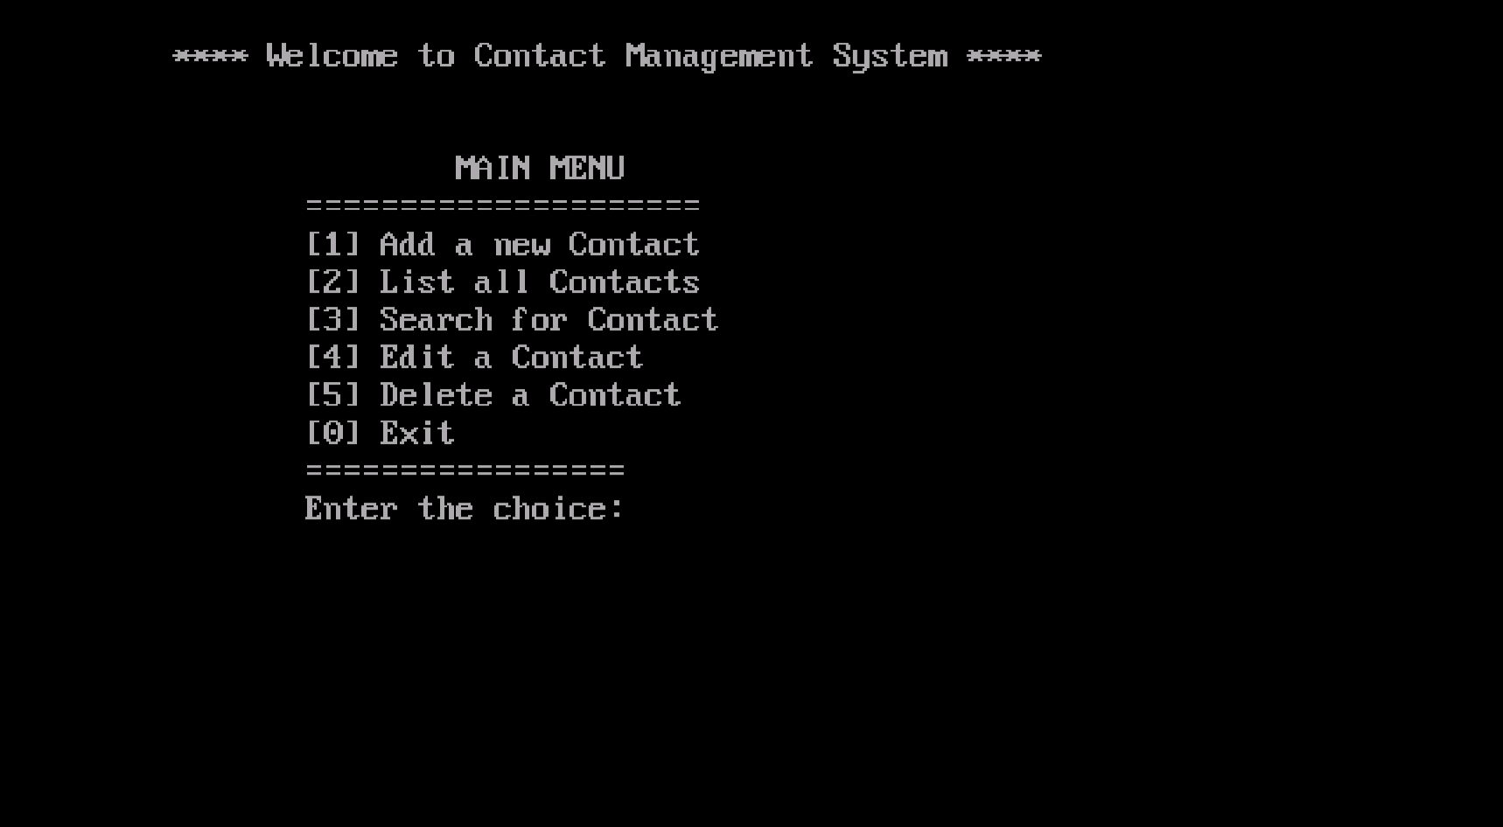
RESULT

Slide 31
APPLICATIONS
It can be used by colleges, organizations.
Same concept can be used by Library to organize contacts.
It can be used by small businesses to manage customer contacts.

Slide 32
CONCLUSION
On the daily basis, everyone depends on a lot of contacts which cannot be remembered so easily as it's tough to do so.
One of the most important aspects of the business throughout the history of the business world, has been the relationship with customers.
Contact Management is the act of storing, organising and tracking information about your customers, prospects and sales leads.
Contact Management System gives you easy access to all details regarding your contacts.
But, there are huge range of contact management system softwares available; and making the right choice can become really complicated, due to the fact that it depends largely on your specific business requirements.

Slide 33
Most of the organizations are facing the challenge of managing client information using Excel or CSV files.
CRM software companies understands that the biggest asset of an organization is its clients and is built to work as a standalone application for storing the data centrally.
Contact Management System helps business to be in constant touch with its customers through various marketing and promotional strategies and ultimately helps to build healthy customer relationship.

Slide 34
REFERENCES
https://www.google.com/amp/s/www.codewithc.com/mini-project-in-c-contact-management-system/amp/
https://itsourcecode.com/free-projects/c-projects/contact-management-system-in-c-with-source-code/
https://www.sourcecodester.com/cc/14843/contact-management-system-using-c-source-code.html

Slide 35
THANK YOU !
Presentation created by Rajesh Kumbhar

