Slide 1
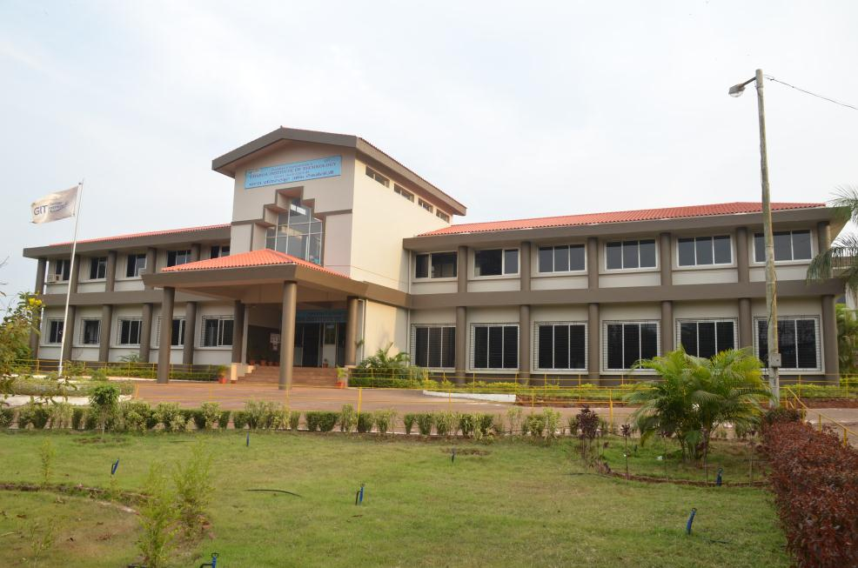
GIT
GHARDA INSTITUTE OF TECHNOLOGY
Features
Output
Source Code
Abstract
Introduction
Members
SECOND YEAR COMPUTER
MINI PROJECT

Slide 2

Members
Features
Output
Source Code
Abstract
Introduction
Jadhav Roshan Sandip Roll no: 22
Jadhav Soham Sunil Roll no: 24
Dayalkar Priyanka Balaram Roll no: 10
Chinkate Sonal Ganpat Roll no: 09
Guided by : Prof. Kranti Gajmal ma’am

Slide 3
Introduction
Customer Billing System
Customer Billing System Project is a simple console application designed to demonstrate the practical use of C programming language and its features as wells as to generate an application which can be used in any departmental store, shops, cafes etc. for billing to the customer.
we can use this application to keep the records such as name, address,mobile number, paid amount, due amount, payment date etc. of your regular costumer. Moreover, if you have a new customer, you can add and edit the account at any time.
We know that for in every store there are much customer will visit. They buy different product and they after day by they become as regular customer, so we are done here a project for the customer who will visit the store many times and calculate their new balance.
Features
Output
Source Code
Abstract

Slide 4
Introduction
This project will helpful for the owner of the store or other cafes and restaurants, etc. to bill the customers amount. We are using here c programming language to implement this project. Using this system owner or the seller can easily see the account status of the customer and at which date that customer paid how many cash at that time.
This system is very friendly to use. Easy to access. This system can store the data in file, so it will not erase. It keeps safe in the owner hands.
Features
Output
Source Code
Abstract

Slide 5
Abstract
Although graphics has not been used in this project, the application of user defined functions and structures have been effectively used here. The major user defined functions used in this C project are:
void input()
void writefile()
void search()
void output()
Void display()
Features
Output
Source Code

Slide 6
Abstract
function void input()
It is used to add the new customer account i.e. with the help of this functions the parameters such as name, address, phone number, amount paid etc. are asked and entered.
function void writefile()
It has been utilized to create a file on hard disc of computer for storing the information and data of a customer.
function void search()
It has been used to look for previously stored accounts either by name or by number of the customer.
function void output()
which has been defined to show the result as console output.
Function void display()
void means that the function will not return anything. It is also possible to define a function without any argument.
Features
Output
Source Code

Slide 7
Abstract
In this project,
Structures has very beautifully used to group the data type in single unit. The data variables (day, month, year) have grouped in structures named date where as other variable such as name, street, paid amount etc. are grouped under another structure named account.
Features
Output
Source Code

Slide 8
Source Code
#include<stdio.h>
#include<conio.h>
#include<stdlib.h>
#include<dos.h>
void input();
void writefile();
void search();
void display();
void output();
struct date{
int month;
int day;
int year;
};
struct account {
int number;
char name[15];
int acct_no;
float mobile_no;
char street[15];
char city[10];
char acct_type;
float oldbalance;
float newbalance;
float payment;
struct date lastpayment;
}customer;
Features
Output

Slide 9
Source Code
int tl,sl,ts;
int main()
{
int i,n;
char ch;
printf(" CUSTOMER BILLING SYSTEM:\n\n");
printf("===============================\n");
printf("\n1: TO ADD ACCOUNT ON LIST\n");
printf("2: TO SEARCH CUSTOMER ACCOUNT\n");
printf("3: ALL ACCOUNTS\n");
printf("4: INVOICE FOR ALL CUSTOMER\n");
printf("5: EXIT");
printf("\n================================\n");
do{
printf("\nselect what do you want to do?");
ch=getche();
}while(ch<='0' || ch>'5');
switch(ch){
case '1':
printf("\nhow many customer accounts?");
scanf("%d",&n);
for(i=0;i<n;i++){
input();
if(customer.payment>0)
(customer.acct_type=(customer.payment<0.1*customer.oldbalance));
else
customer.acct_type=(customer.oldbalance>0);
(customer.newbalance=(customer.oldbalance-customer.payment));
writefile();
}
main();
Features
Output

Slide 10
Source Code
case '2':
printf("search by what?\n");
printf("\n1 --- search by customer number\n");
printf("2 --- search by customer name\n");
search();
ch=getche();
main();
case '3':
printf("\n\n\n ALL CUSTOMER DETAILS ");
printf("\n __________________________________________________________________________________________________________________________________________ \n");
printf(" | | ");
display();
exit(1);
Features
Output

Slide 11
Source Code
case '4':
printf("0");
printf("\n\n\n\n\n _________________________________________________ ");
printf("\n | | ");
printf("\n | ##### # # # # ### ##### ### #### | ");
printf("\n SHOPPER'S DELIGHT | # ## # # # # # # # # # | ");
printf("\n BHARNA NAKA, KHED ROAD, KHED | # # # # # # # # # # #### | ");
printf("\n PHONE NO: 7378472058 | # # ## # # # # # # # # | ");
printf("\n | ##### # # # ### ##### ### #### | ");
printf("\n |_________________________________________________| \n");
printf(" \n");
printf(" \n");
printf(" \n");
printf(" \n");
printf(" __________________________________________________________________________________________________________________________________________ \n");
printf(" | | ");
printf("\n | CUSTOMER NO: | NAME | CITY | OLD PAYMENT | CURRENT PRAYMENT | NEW PAYMENT | DATE | \n |__________________________________________________________________________________________________________________________________________|\n");
display();
case '5':
printf("\n THANK YOU... VISIT AGAIN....\n\n\n");
exit(1);
}
}
Features
Output

Slide 12
Source Code
void input()
{
FILE *fp=fopen("bidur.dat","rb");
fseek (fp,0,SEEK_END);
tl=ftell(fp);
sl=sizeof(customer);
ts=tl/sl;
fseek(fp,(ts-1)*sl,SEEK_SET);
fread(&customer,sizeof(customer),1,fp);
printf("\ncustomer no:%d\n",++customer.number);
fclose(fp);
printf(" Account number:");
scanf("%d",&customer.acct_no);
printf("\n Name:");
scanf("%s",customer.name);
printf("\n mobile no:");
scanf("%f",&customer.mobile_no);
printf("\n Street:");
scanf("%s",customer.street);
printf("\n City:");
scanf("%s",customer.city);
printf("\n Previous balance:");
scanf("%f",&customer.oldbalance);
printf("\n Current payment:");
scanf("%f",&customer.payment);
printf("\n Payment date(mm/dd/yyyy):");
scanf("%d/%d/%d",&customer.lastpayment.month,&customer.lastpayment.day,&customer.lastpayment.year);
return;
}
Features
Output

Slide 13
Source Code
void writefile()
{ FILE *fp;
fp=fopen("bidur.dat","ab");
fwrite(&customer,sizeof(customer),1,fp);
fclose(fp);
return;
}
void search()
{ char ch;
char nam[100];
int n,i,m=1;
FILE *fp;
fp=fopen("bidur.dat","rb");
do{ printf("\nenter your choice:");
ch=getche();
}while(ch!='1' && ch!='2');
switch(ch){
case '1':
fseek(fp,0,SEEK_END);
tl=ftell(fp);
sl=sizeof(customer);
ts=tl/sl;
do{ printf("\nchoose customer number:");
scanf("%d",&n);
if(n<=0 || n>ts)
printf("\nenter correct\n");
else{
fseek(fp,(n-1)*sl,SEEK_SET);
fread(&customer,sl,1,fp);
output();
}
printf("\n\nagain?(y/n)");
ch=getche();
}while(ch=='y');
fclose(fp);
break;
Features
Output

Slide 14
Source Code
case '2':
fseek(fp,0,SEEK_END);
tl=ftell(fp);
sl=sizeof(customer);
ts=tl/sl;
fseek(fp,(ts-1)*sl,SEEK_SET);
fread(&customer,sizeof(customer),1,fp);
n=customer.number;
do{
printf("\nenter the name:");
scanf("%s",nam);
fseek(fp,0,SEEK_SET);
for(i=1;i<=n;i++)
{
fread(&customer,sizeof(customer),1,fp);
if(strcmp(customer.name,nam)==0)
{
output();
m=0;
break;
}
}
if(m!=0)
printf("\n\ndoesn't exist\n");
printf("\nanother?(y/n)");
ch=getche();
}while(ch=='y');
fclose(fp);
}
return;
}
Features
Output

Slide 15
Source Code
void display()
{
customer;
FILE*fp=fopen("bidur.dat","r");
while(fread(&customer,sizeof(customer),1,fp))
printf("\n | %-3d | %-20s | %-10s | %-6f | %-6f | %-6f | %2d/%-2d/%-2d | \n |__________________________________________________________________________________________________________________________________________|\n",customer.number,customer.name,customer.city,customer.oldbalance,customer.payment,customer.newbalance,customer.lastpayment.month,customer.lastpayment.day,customer.lastpayment.year);
printf("\n\n\n\n");
}
void output()
{
printf("\n\n Customer no :%d\n",customer.number);
printf(" Name :%s\n",customer.name);
printf(" Mobile no :%.2f\n",customer.mobile_no);
printf(" Account number :%d\n",customer.acct_no);
printf(" Street :%s\n",customer.street);
printf(" City :%s\n",customer.city);
printf(" Old balance :%.2f\n",customer.oldbalance);
printf(" Current payment:%.2f\n",customer.payment);
printf(" New balance :%.2f\n",customer.newbalance);
printf(" Payment date :%d/%d/%d\n\n",customer.lastpayment.month,customer.lastpayment.day,customer.lastpayment.year);
printf(" Account status : ");
if(customer.newbalance<0)
printf("OVERDUE.. \n\n");
else
if(customer.newbalance>0)
printf("DELINQUENT.. \n\n");
else
printf("CURRENT.. \n\n");
}
Features
Output

Slide 16
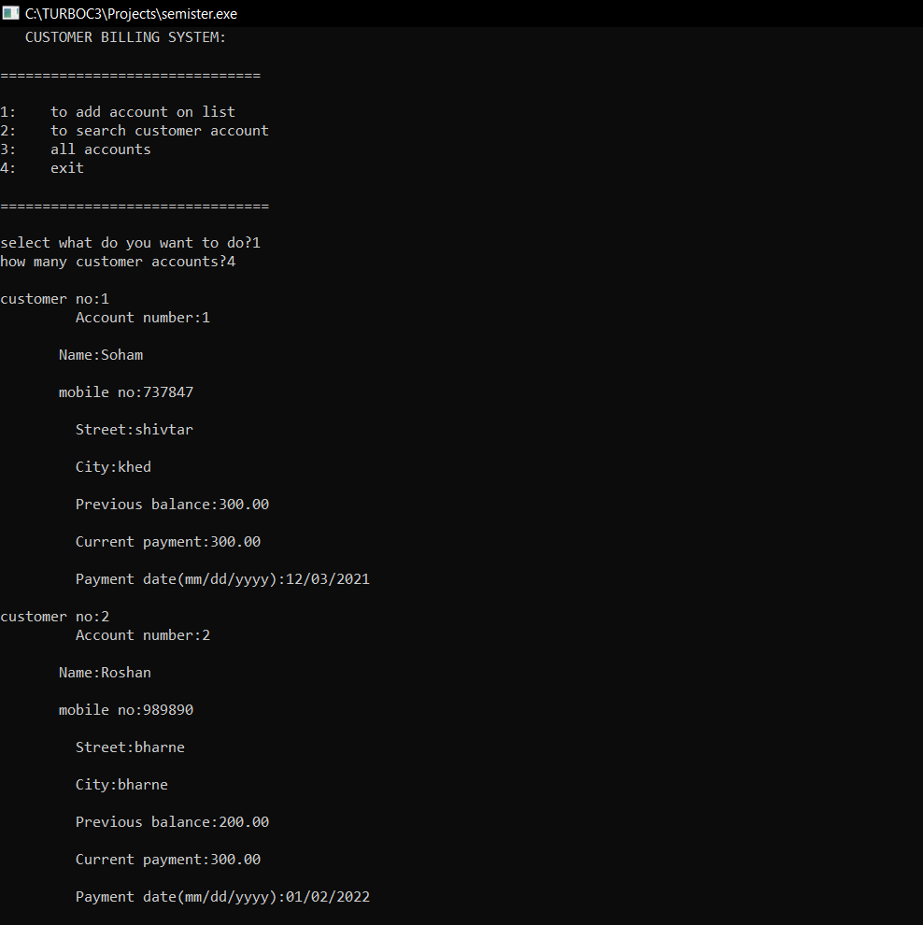
Output
Features

Slide 17
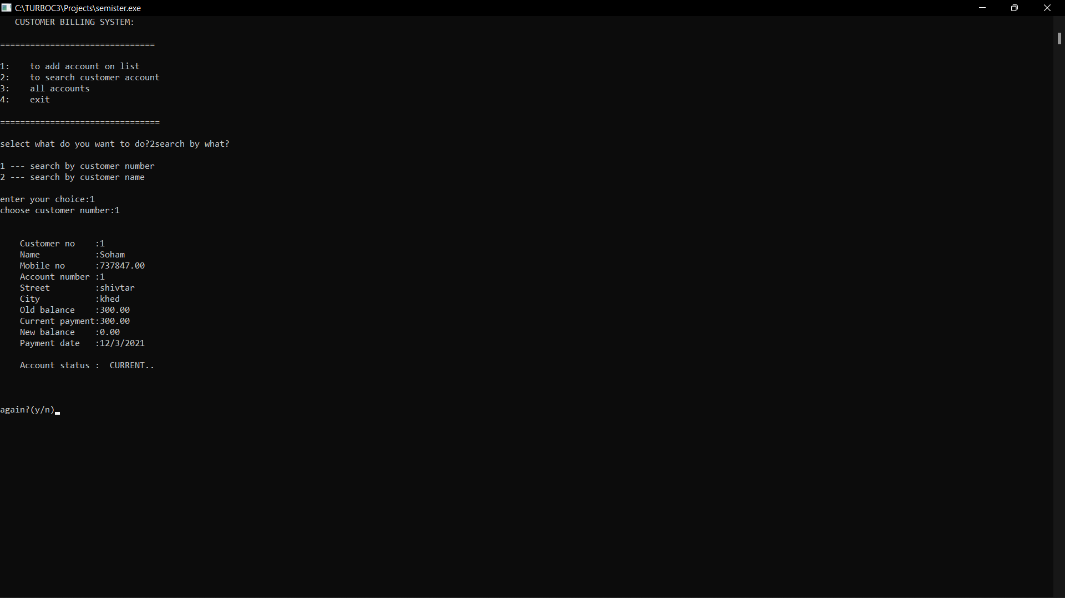
Output
Features

Slide 18
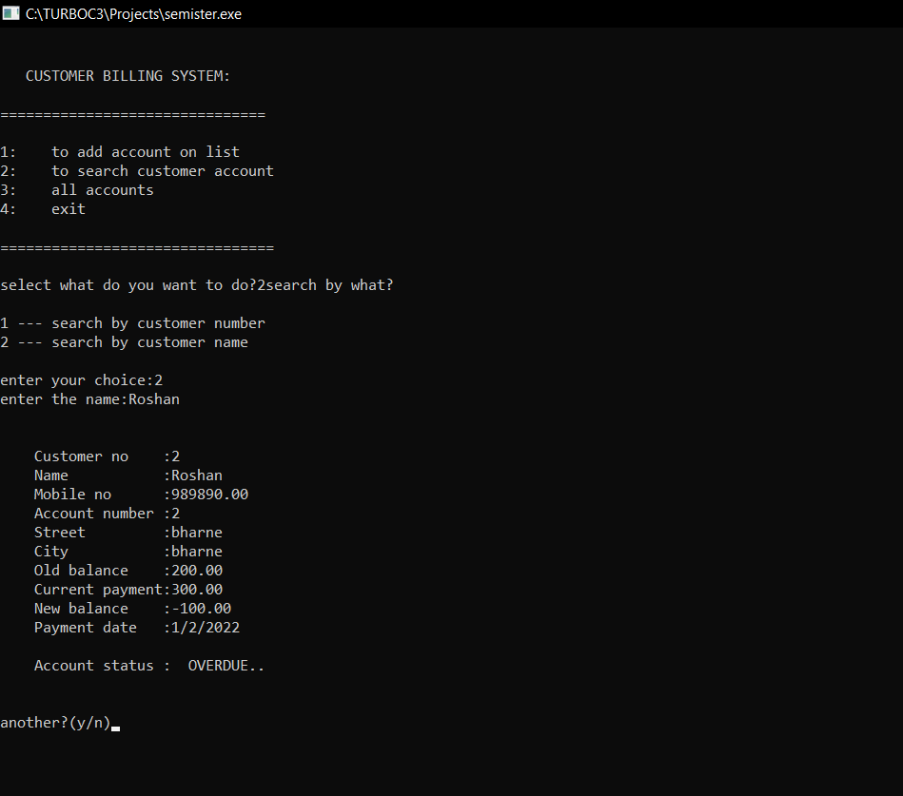
Output

Slide 19
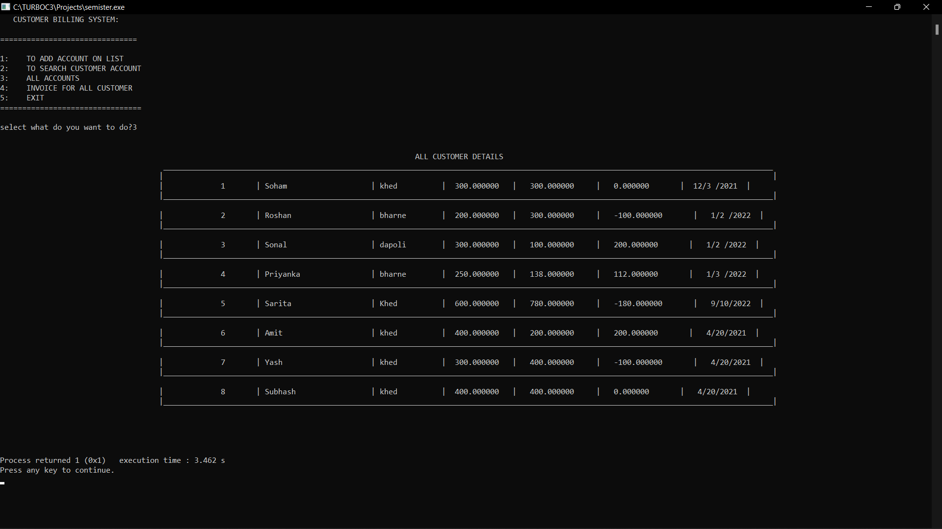
Output

Slide 20
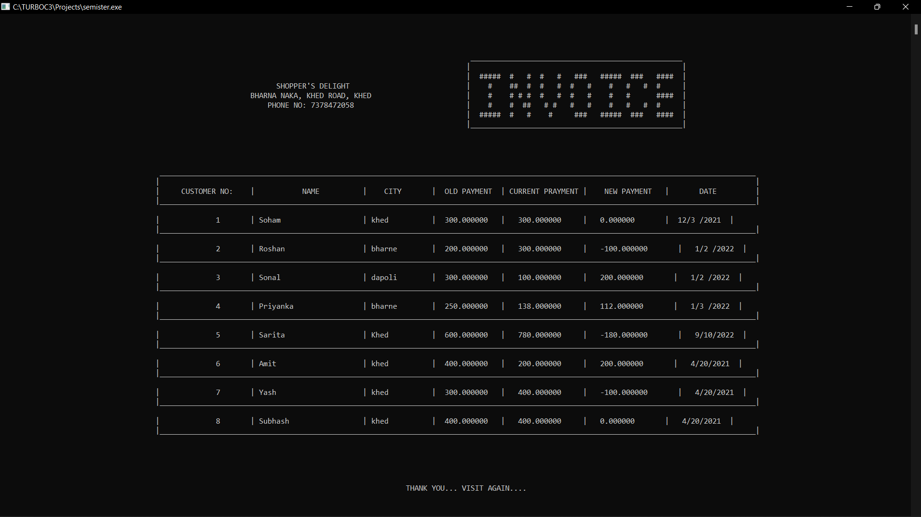
Output

Slide 21
Uses
You can use this application to keep the records such as name, address, mobile number, paid amount, due amount, payment date, etc. of your regular customer. Moreover, if you have a new customer, you can add and edit the account at any time.

Slide 22



Features
Easy to add customer
Details.
Easy to edit customer
Details.
Any time access able.

Slide 23

Thank you…

