Slide 1
HANGMAN GAME using Html ,CSS ,Java script
GHARDA INSTITUTE OF TECHNOLOGY,LAVEL
Guided By:
Prof. Sameer Tathare Sir

Slide 2
TEAM MEMBERS
SEJAL JADHAV 23
SIMA MHADLEKAR 37
PRIYANKA KADAM 25
SIDDDHI PATIL 43

Slide 3
Contents
1. Abstract
2. Introduction
3. Features
4. What is Hangman Game?
5. How to play?
6. Advantages
7. Scope of project
Conclusion
References
Output

Slide 4
Abstract
It is a Simple Hangman Game using html, CSS and Java script language.
We can use this as a project to boost their programming skills and understanding logic.
The Hangman program randomly selects a secret word from a list of secret words.
Hangman is a popular word game in which one player (the “chooser”) chooses a secret word and another player (the “guesser”) attempts to guess the word one letter at a time.
If a guessed letter appears in the word, all instances of it are revealed.
If not ,the guesser loses a chance.
If the guesser figures out the secret word before he or she runs out of chances, he or she wins .If not, the player who choose the word wins.

Slide 5
INTRODUCTION
Hangman is a popular word guessing game where player attempts to build a missing word by guessing one letter at a time.
Hangman game is a simple program which has been designed to demonstrate different application formats and syntaxes.
The game is very simple to play and coding has been done such as way that the application is an interesting and entertaining game .

Slide 6
Features
1.The source code of the game is easy, short, understandable and user friendly.
2.When you start the game, the game asks you to guess the letter.

Slide 7
What is Hangman Game?
Hangman is a simple game where
The player has to guess the letters in the word.
If you get a letter wrong ,a body part is added to the hangman.
Players tries to guess the word by entering letters.
If players enters too many wrong letters then players loss the game.
If the players has entered all the right letters then player has won the game.

Slide 8
How to play?
There is an array has a collection of words and choose one of these words by random way.
Then it will be shown on the screen like this (……..) according to the number of the letters of this word.
The player should guess this word what will be?
Then you should enter the first letter of the word which you guessed to be and then click check.
If you enter 7 letters wrong you will be dead but if you enter the right letters you will win.

Slide 9
Advantages
Increases vocabulary
There is a learning process suitable for everyone.
Improves spelling
Helps train concentration skills
Enhances cognitive skills
Improves memory
It promotes a self-improving competition
It’s relaxing
It’s a social bonding experience

Slide 10
Scope of Project
It can be used for vocabulary development.
It is applicable for providing basic ideas.
The main scope of the project is to polish our skills, entertainment purpose and to accomplish good grades.

Slide 11
Conclusion
Hangman is a traditional game, typically played with words.
To play Category Hangman rather than guessing words the player might guess names of cities, athletes, fictional characters, duke professors, top forty songs titles the list is endless.
You’ll also be doing some statistical analysis of the words used in the Hangman Game.

Slide 12
References
Websites:
https://ourcodesolution.com/blog/hangman-game-javascript-from-scratch/
https://youtu.be/85FamWPXy4c

Slide 13
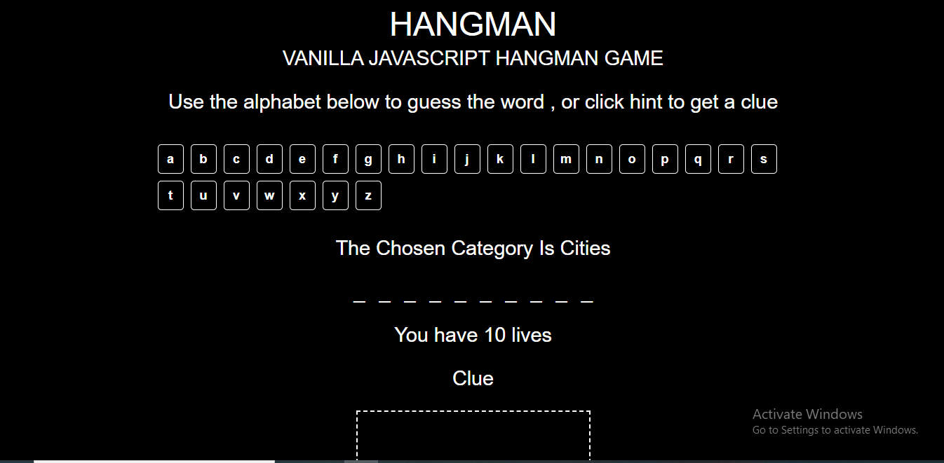
Output

Slide 14
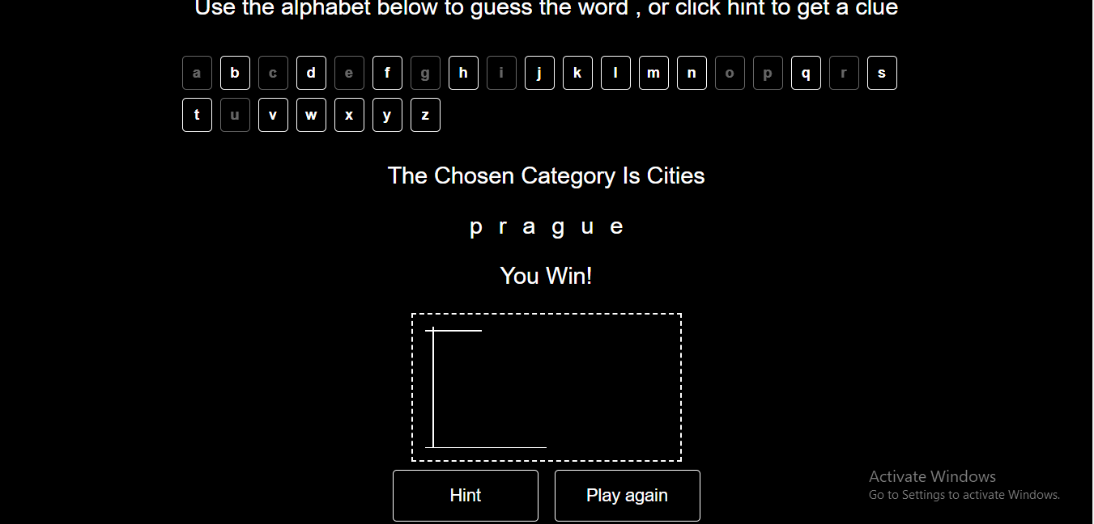
Win Case

Slide 15
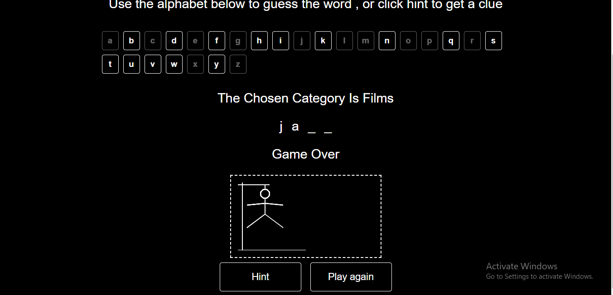
Lose Case

Slide 16


