Slide 1
Automatic Essay Grading System Using Machine Learning
Group Members:
Sabiha S. Mullaji
Asmita Suware
Vivek Sakpal

Slide 2
Introduction
Can you just imagine a higher education system doing all his overall work manually without any automatic software system ?
As we have many universities in overall world with high rate of students , the educational department faces many difficulties and issues for verifying the examination papers.
Automatic Essay grading system will be one of the most beneficial software which can lower down the burden of language educational department.
It specially wont create any kind of inconvenience about bribe which is very common to hear nowadays.
This system would give a perfect feedback about a particular essay so that the student/user can understand what are their basic errors i.e spelling mistakes, grammar, sentence formation etc. made by them.

Slide 3
Problem statement
The manual grading system has many difficulties in verifying the examination papers. It consumes a lot of time in verifying them. Automatic essay grading system would save a lot of time and would make it more easier.
The second thing which is mostly common to hear is about bribe. Really very shame to know, but it is true that bribe is also a very common trade used in educational system as well. Many innocent and hardworking students have to suffer this inconvenience in department. The following software wont allow such kind of issues as technology is not a victim of a bribe.

Slide 4
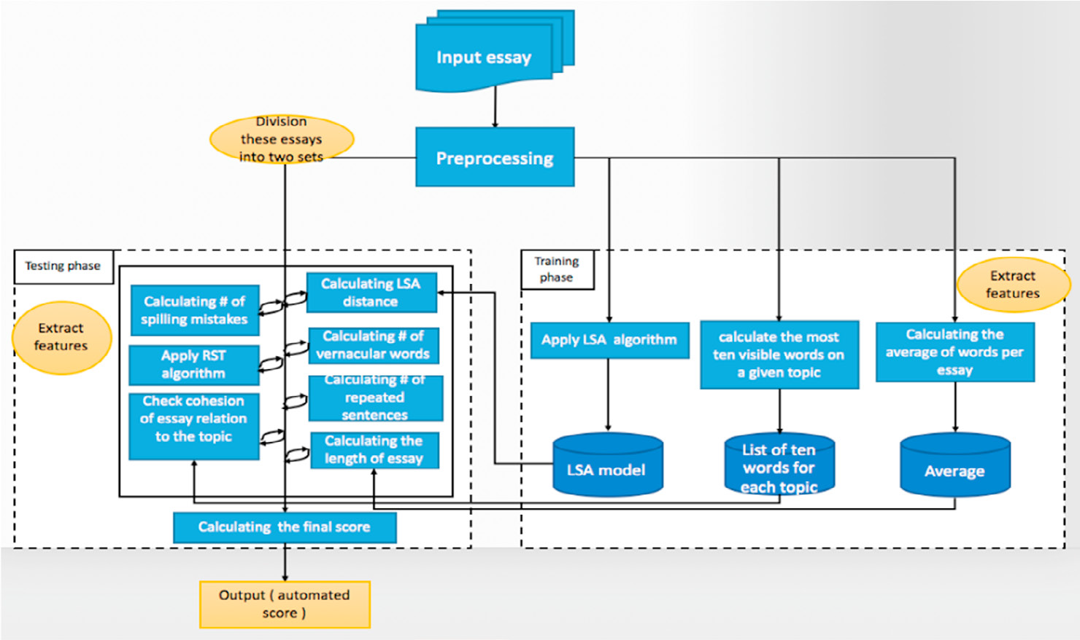
Methodology

Slide 5
Conti….
Linear regression is a linear approach to modeling the relationship between a scalar dependent variable Y and one or more explanatory variables denoted by X. The X represents the features extracted from the essays and the Y represents the corresponding score for training the model. We have used scikit-learn library in python to implement the linear regression model.
Latent semantic analysis (LSA) is a technique in natural language processing, in particular distributional semantics, of analyzing relationships between a set of documents and the terms they contain by producing a set of concepts related to the documents and terms. LSA assumes that words that are close in meaning will occur in similar pieces of text.

Slide 6
Conti….
Ontology is a formal explicit specification of the terms in the domain and the relations among them. It is a study about how entities can be grouped and related within a hierarchy. Entities can be subdivided based on distinctive and commonly occurring features. In this study, ontology can be used to identify the concepts needed for a specific topic in an automated essay scoring.
Spelling Mistakes:
An important parameter while scoring an essay is the spelling mistakes. So, number of spelling mistakes in an essay is also a feature for our model. To get this number, we use the spell checker provided in python by library named ‘enchant’.

Slide 7
Conti….
Singular Value Decomposition (SVD):
A matrix containing word counts per document (rows represent unique words and columns represent each document) is constructed from a large piece of text and a mathematical technique called Singular Value Decomposition (SVD) is used to reduce the number of rows while preserving the similarity structure among columns. Documents are then compared by taking the cosine of the angle between the two vectors formed by any two columns. Values close to 1 represent very similar documents while values close to 0 represent very dissimilar documents.

Slide 8
Literature Review
Sr. No. | Name Of Papers | Authors name | Content | Technology
1. | Automated Essay Scoring with Ontology based on Text Mining and NLTK tools. | S. Drolia P. Agarwal | In this study, we used OntoGen and NLTK libraries for text processing and feature extraction. Our goal is to build effective essay scoring algorithm by using model attributes like essay length, word counts, correctness, vocabulary and types of word used, domain information etc | Ontology Natural language processing
2. | Automated Bangla Essay Scoring System: ABESS | S. Valenti F. Neri | In this work, ASP.NET and C# (CSharp) have been used as programming languages to implement GLSA based essay scoring. | Generalized Latent Semantic Analysis (GLSA). SVD Matrices
3. | Automated Evaluation of School Children Essays in Arabic . | Alghamdi M. M.Alkanhal. | According to the survey. the criterias are: spelling and grammar mistakes, the coherence and organization of the essay, the essay should be related to the topic, and sticking to Modern Standard Arabic (MSA) words. | RSA Algorithm. LSA Algorithm.

Slide 9
Software and hardware requirements
Windows operating system
Python 3.7
Dataset
Internet connection
I 3 processor

Slide 10
Refferences
T. Miller, “Essay assessment with latent semantic analysis,” Dept. of Computer Science, University of Toronto, ON M5S 3G4, Canada,2002.
Alghamdi, M., M. Alkanhal, M. Al-Badrashiny, A. Al-Qabbany, A. Areshey, and A. Alharbi. (2014). “A hybrid automatic scoring system for Arabic essays,” AI Communications, 27(2):103-111.
S. Valenti, F. Neri, and A. Cucchiarelli, “An overview of current research on automated essay grading,” J. of Information Technology Education, vol. 2, pp. 319-330, 2003.
S. Drolia, P. Agarwal, S. Rupani and A. Singh, “Automated Essay Rater using Natural Language Processing,” International Journal of Computer Applications (0975-8887). Vol. 163 – No 10, April 2017

Slide 11
Awareness on covid-19
Corona virus disease (COVID-19) is an infectious disease caused by a newly discovered corona virus.
Most people infected with the COVID-19 virus will experience mild to moderate respiratory illness and recover without requiring special treatment. Older people, and those with underlying medical problems like cardiovascular disease, diabetes, chronic respiratory disease, and cancer are more likely to develop serious illness. People with COVID-19 generally develop signs and symptoms, including cough, headache, cold, breathing problem and fever.
Clean your hands often. Use soap and water, or sanitizer rub.
Maintain a safe distance from anyone who is coughing or sneezing.
Don’t touch your eyes, nose or mouth.
Cover your nose and mouth with your bent elbow or a tissue when you cough or sneeze.
Stay home if you feel unwell.
If you have a fever, cough and difficulty breathing, seek medical attention. Call in advance.
Follow the directions of your local health authority.
Be safe be healthy be happy.

