Slide 1
Personality Development: The Self Trainer
Project Members
Manasi Manohar Khedekar
Tanish Kishor Laddha
Project Guide
Prof P. V. Oak

Slide 2
Introduction
Personality development is becoming a significant aspect of the evolution of a student
The acquisition of ‘soft skills’ such as ethics, emotional intelligence, language, and communication.
Legal and management aspects besides one’s professional field are necessary and crucial for holistic education.
The desire in a young professional to create a strong positive impression about the self in intellectual and social circles is paramount.
The aptitude test has also become a crucial aspect among students.
So by considering this problem, we have decided to build this tool.
In which, tool will consist of two modules first will be of aptitude & technical test practice and second will be of the soft skill assessment.

Slide 3
Objectives
It has been observed that many students lag behind to crack the interview because of less practice, low confidence and poor soft skills / body language. We propose to work on these issues with following objectives:
To build a module to have a test or practice on the Aptitude and technical questions with assessment.
Soft skill assessment through video analysis.

Slide 4
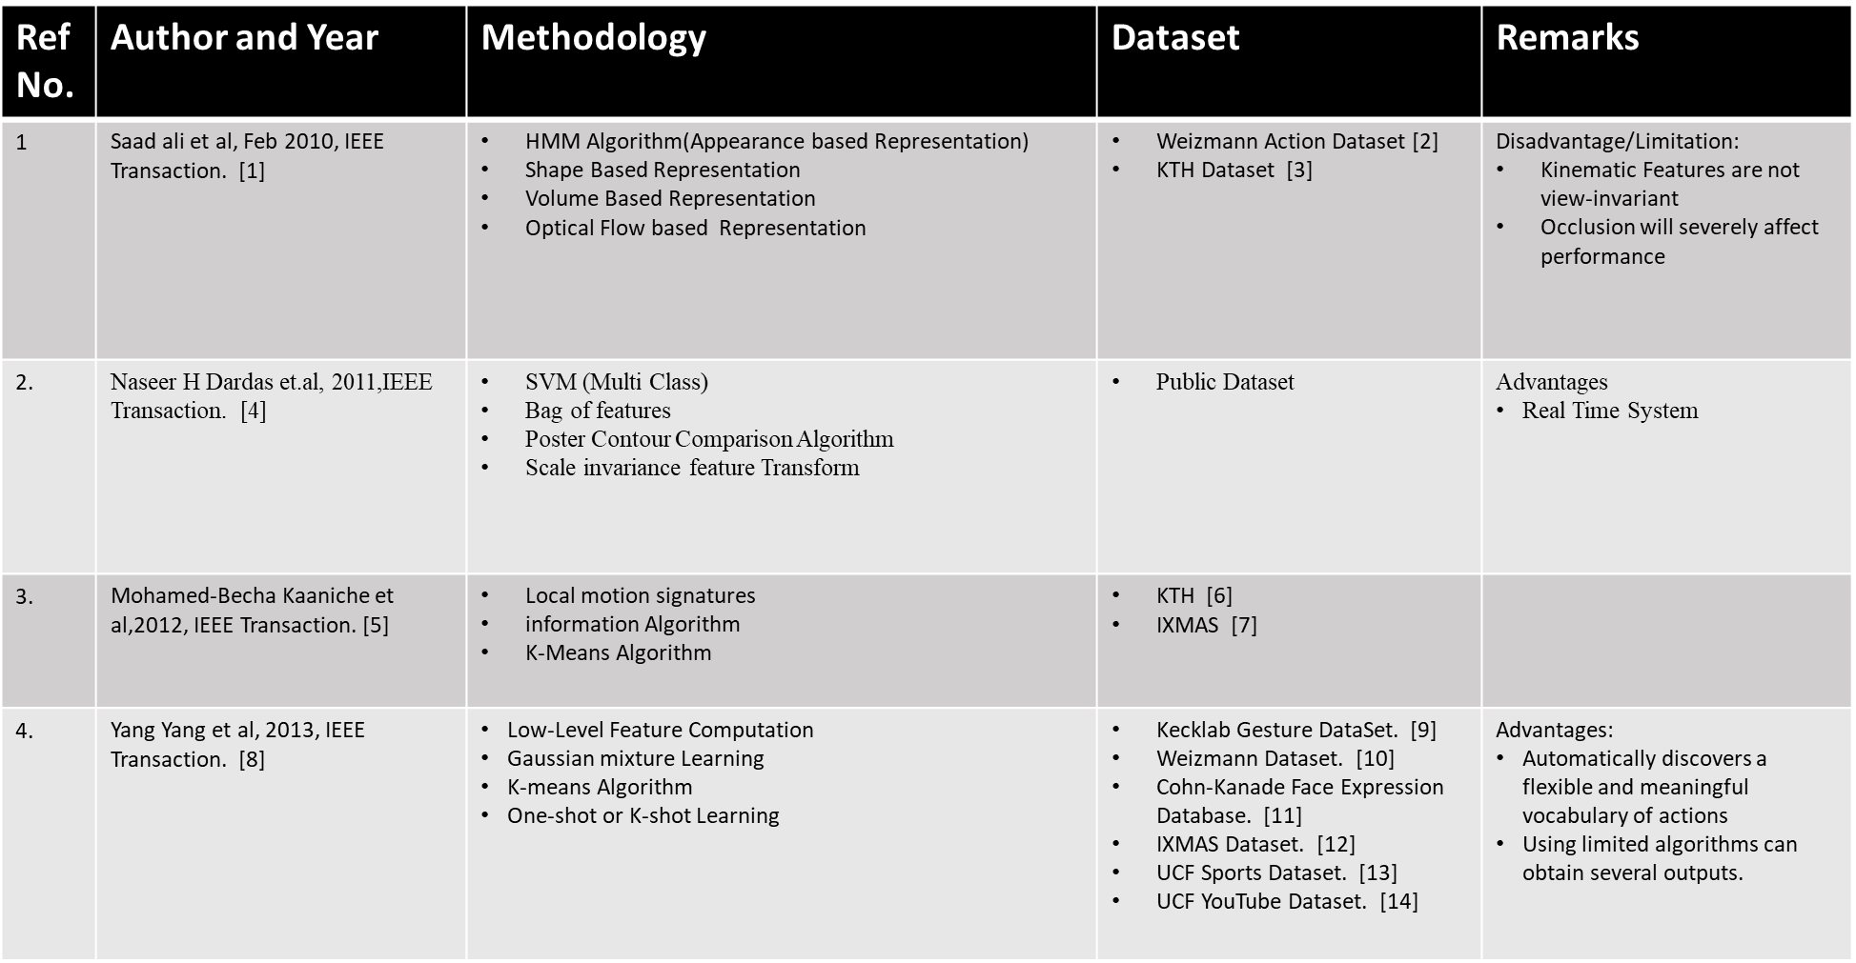
Literature Review

Slide 5
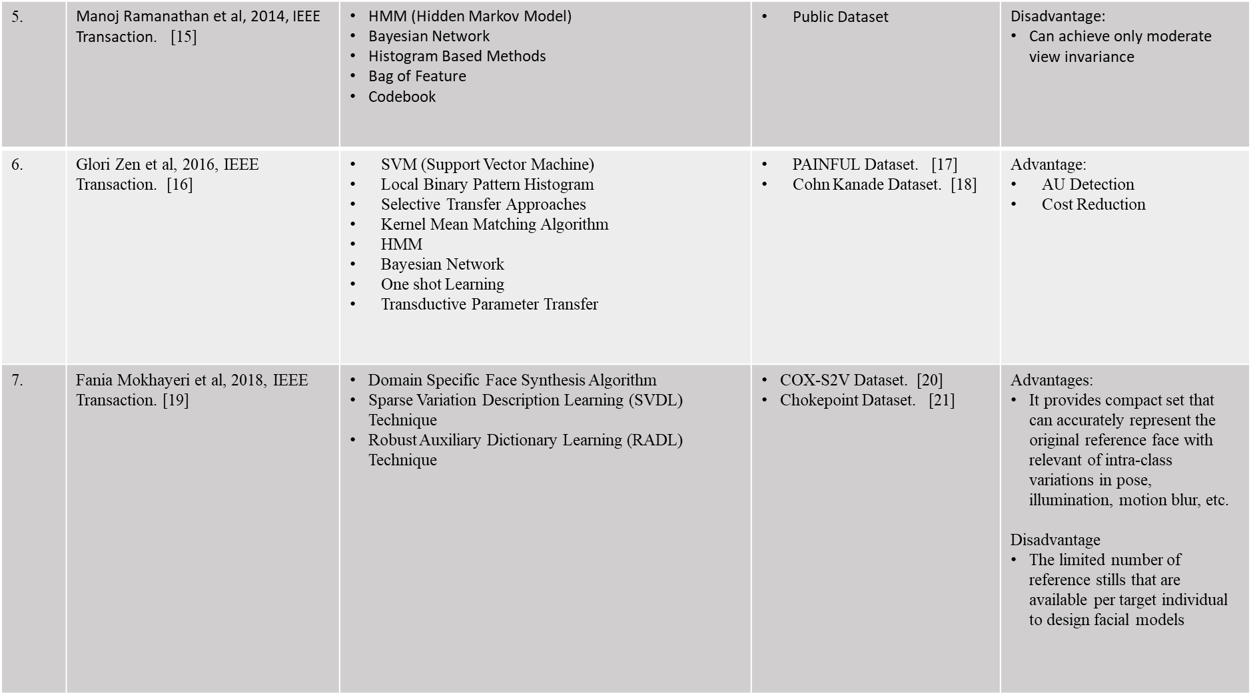

Slide 6
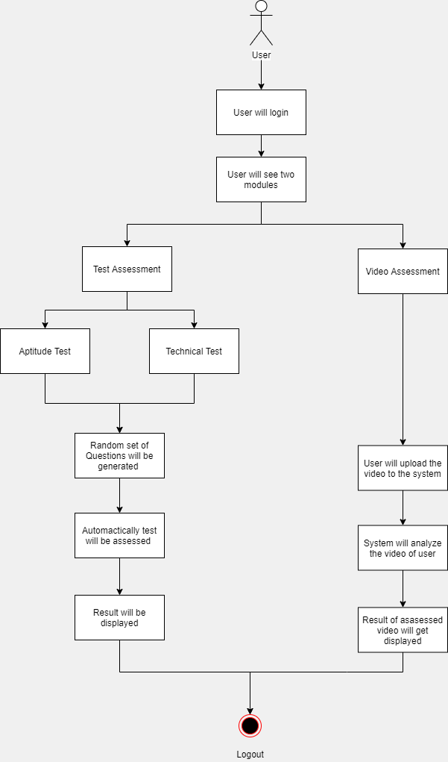
Methodology

Slide 7
Results till date
Dataset:
We have prepared the set of 263 Questions for the Quantitative Test. [22]
Generation of Question Paper:
The question paper is generated by collecting random questions from the Dataset.
Those random questions are then displayed to the user.
Automatic Assessment:
Answers which are given by the user are stored in the file with the answers to the actual questions.
Answers will be automatically assessed by the system by the comparison with original answer of that question.
The result is declared to the user.
Testing:
Testing is done by seeing that the random questions are generated or not for the user.
Any of the questions is not repetitive.

Slide 8
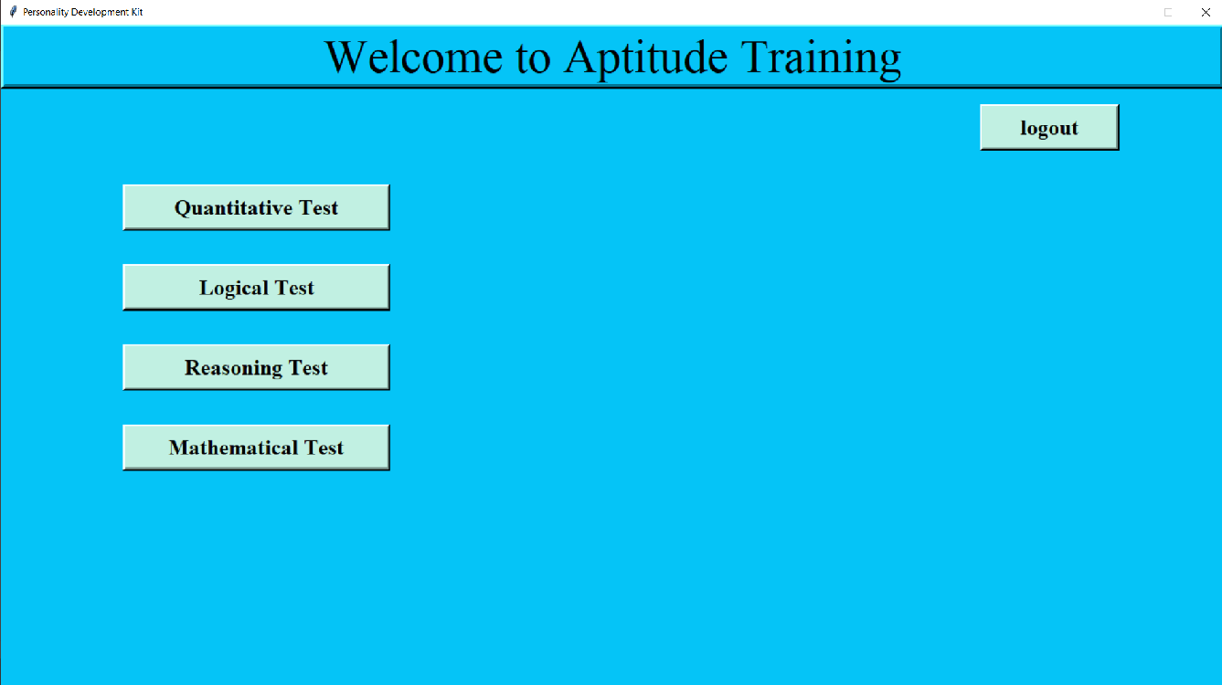
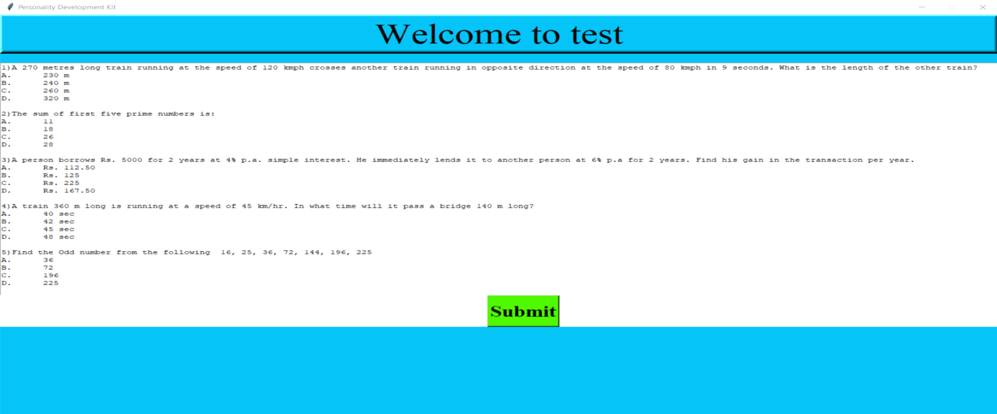
Option to attempt test for user
Question Paper generation
We are trying for further implementation, but due to some issues, we have got stuck in between the implementation.

Slide 9
Expected implementation before joining next semester
Completion of our first module of Aptitude & Technical Test.
Detail study of feature extraction along with implementation.
Implementation of basics of video analysis with study of HMM & k-means clustering.

Slide 10
References
[1] Saad ali et.al, “Human Action recognition in video using kinematics features and multiple instance learning”, IEEE Transaction on pattern analysis and machine intelligence, 2010.
[2] M. Blank, L. Gorelick, E. Shechtman, M. Irani, and R. Basri,“Actions as Space-Time Shapes,” Proc. IEEE Int’l Conf. Computer Vision, 2005.
[3] C. Schuldt, I. Laptev, and B. Caputo, “Recognizing Human Actions: A Local SVM Approach,” Proc. IEEE Int’l Conf. Pattern Recognition, 2004.
[4] Nasser H Dardas et.al, “Real Time Hand Gesture Detection and Recognition using Bag of Features and support vector Machine Technique”, IEEE Transaction on Instrumentation and Measurement, 2011.
[5] Mohamed-Becha kaaniche et.al, “Recognizing Gesture by learning local motion signatures of HOG Descriptors”, IEEE Transaction on pattern Analysis and Machine Intelligence,2012.
[6] C. Schuldt, I. Laptev, and B. Caputo, “Recognizing Human Actions: A Local SVM Approach,” Proc. IEEE Int’l Conf. Pattern Recognition vol. 3, pp. 32-36, Aug. 2004.
[7] D. Weinland, E. Boyer, and R. Ronfard, “Action Recognition from Arbitrary Views Using 3D Examplars,” Proc. IEEE Int’l Conf. Computer Vision, pp. 1-7, Oct. 2007.
[8] Yang Yang et.al, “Discovering Motion Primitives for unsupervised Grouping and One-Shot Learning of Human Action, Gestures and Expression”, IEEE Transaction on Pattern Analysis and Machine Intelligence,2013
[9] Z. Lin, Z. Jiang, and L. Davis, “Recognizing Actions by Shape- Motion Prototype Trees,” Proc. 12th IEEE Int’l Conf. Computer Vision, 2009.
[10] E. Shechtman, L. Gorelick, M. Blank, M. Irani, and R. Basri, “Actions as Space-Time Shapes,” IEEE Trans. Pattern Analysis and Machine Intelligence, vol. 29, no. 12, pp. 2247-2253, Dec. 2007.

Slide 11
[11] Y. Tian, T. Kanade, and J. Cohn, “Recognizing Action Units for Facial Expression Analysis,” IEEE Trans. Pattern Analysis and Machine Intelligence, vol. 23, no. 2, pp. 97-115, Feb. 2001.
[12] D. Weinland, E. Boyer, and R. Ronfard, “Action Recognition from Arbitrary Views Using 3D Exemplars,” Proc. 11th IEEE Int’l Conf. Computer Vision, 2007.
[13] M. Rodriguez, J. Ahmed, and M. Shah, “Action MACH: A Spatio- Temporal Maximum Average Correlation Height Filter for Action Recognition,” Proc. IEEE Conf. Computer Vision and Pattern Recognition, 2008.
[14] J. Liu, J. Luo, and M. Shah, “Recognizing Realistic Actions from Videos in the Wild,” Proc. IEEE Conf. Computer Vision and Pattern Recognition, 2009
[15] Manoj Ramanathan et.al, “Human Action Recognition With Video Dataset”, Research and Evaluation Chanllenges, IEEE Transaction on Human-Machine System.
[16] Gloria Zen et.al, “Learning Personalized Models For Facial Expression Analysis and Gesture Recognition”, IEEE Transaction on Multimedia, 2016.
[17] P. Lucey, J. F. Cohn, K. M. Prkachin, P. E. Solomon, S. Chew, and I. Matthews, “Painful monitoring: Automatic pain monitoring using the unbc-mcmaster shoulder pain expression archive database,” Image and Vision Computing, vol. 30, no. 3, 2012.
[18] P. Lucey, J. F. Cohn, T. Kanade, J. Saragih, Z. Ambadar, and I. Matthews, “The extended cohn-kanade dataset (ck+): A complete dataset for action unit and emotion-specified expression,” in CVPRW, 2010.
[19] Fania Mokhayeri et.al, “Domain Specific For Video Face Recognition From a Single Sample Per Person”, IEEE Transaction on Information Forensic and Security, 2018.
[20] Z. Huang, S. Shan, R. Wang, H. Zhang, S. Lao, A. Kuerban, X. Chen, A benchmark and comparative study of video-based face recognition on cox face database, IEEE Transactions on Image Processing 24 (12) (2015) 5967–5981.
[21] Y. Wong, S. Chen, S. Mau, C. Sanderson, B. C. Lovell, Patch-based probabilistic image quality assessment for face selection and improved video-based face recognition, in: CVPRW, 2011.
[22] Aptitude question-answers available at : https://www.indiabix.com/aptitude/questions-and-answers

