Slide 1
Event Report Generator _____________________
BY:
Onkar Rajabhau Malwadkar
Prathmesh Pravin Bhagade
Kranti Nayan Bhingarde
_________________________________________________________
PROJECT GUIDE:
Mrs.K.M.Gajmal

Slide 2
Introduction _______________________________
Implementation of Artificial Intelligence(A.I.) in various fields with purpose of producing advanced results can be seen in recent society.
The report generator allows you to generate advanced reports that include event logs for the needed processes running in the system.
As we know that event reports are the important source of information about the events held and they are mostly generated manually.

Slide 3
Problem Statement _______________________________
Event reports are generated manually by the staff.
Almost every field is getting automated day by day.
Event report generator allows to generate the report manually by using techniques of Machine Learning.
The objective is to reduce the problem faced by the staff.
The main goal is to automate the current system of manual generation of event reports.

Slide 4
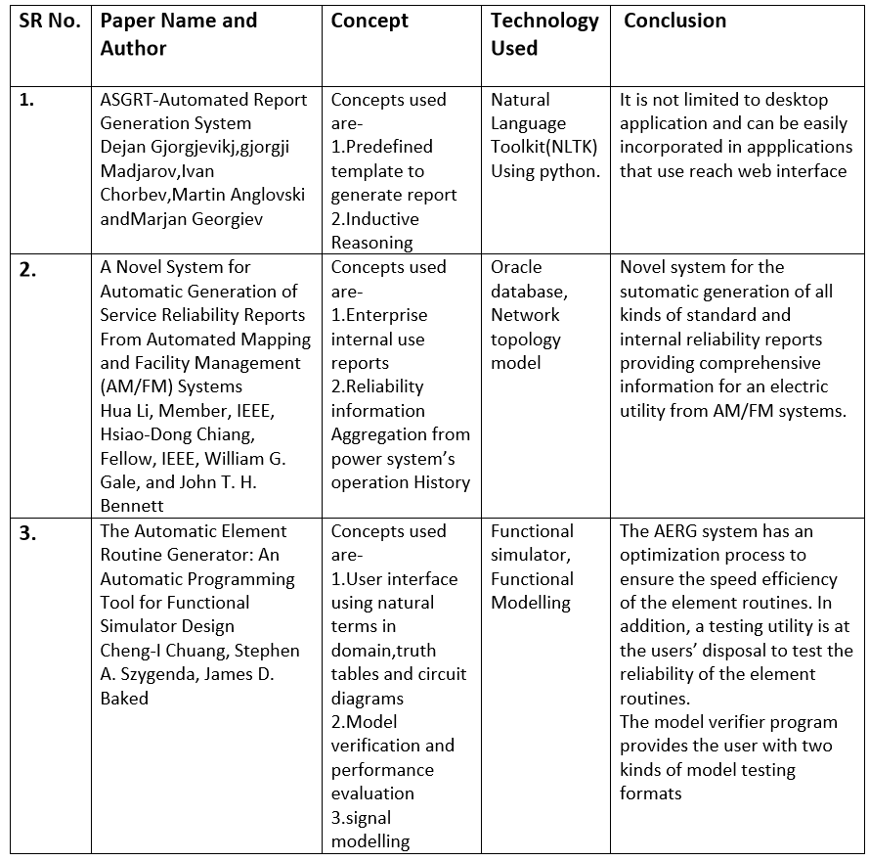
Literature Review _____________________________

Slide 5
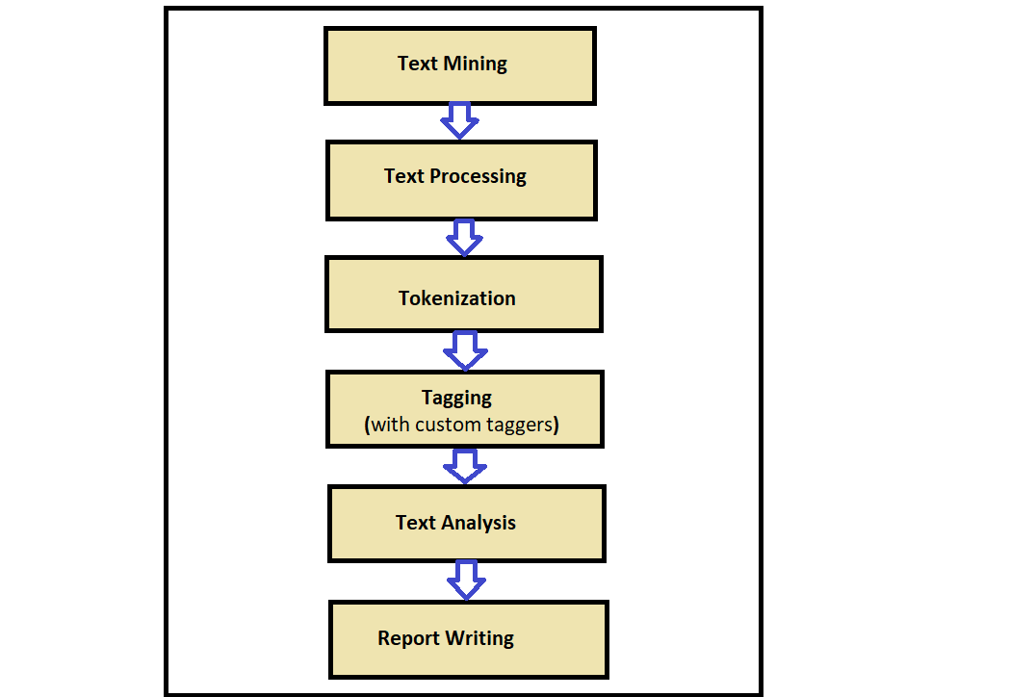
Methodology _____________________________

Slide 6
References _____________________________
ASGRT-Automated Report Generation System.Dejan Gjorgjevikj,gjorgji Madjarov,Ivan Chorbev,Martin Anglovski andMarjan Georgiev.
A Novel System for Automatic Generation of Service Reliability Reports From Automated Mapping and Facility Management (AM/FM) Systems.Hua Li, Member, IEEE, Hsiao-Dong Chiang, Fellow, IEEE, William G. Gale, and John T. H. Bennett.
The Automatic Element Routine Generator: An Automatic Programming Tool for Functional Simulator DesignCheng-I Chuang, Stephen A. Szygenda, James D. Baked

