Slide 1
Personality Prediction using CV Analysis

Slide 2
Introduction
Today most of the industries are facing slowdown due to global pandemic and these would result in inflation and economic slowdown.
Finding a candidate for particular job would be difficult for organization.
Personality prediction using CV analysis helps the organization to find a perfect candidate for the specific position.
It helps the organization to know his physical and mental abilities by looking into his personality traits.
The system also helps the HR Department with sorting of candidates applying for the job.

Slide 3
Problem Statement
There is a huge workload on the human resource department to select the right candidate for a particular job. Today there is a growing interest in the personality traits of a candidate by the organization to better examine and understand the candidate’s response to particular circumstances. Therefore, the system conducts a personality prediction test to determine the personality traits of the candidate. As the HR is unable to shortlist the huge amount of CV's these application comes into the picture. These application can sort the CV's according to the requirement. The format of CV will be given by us and through that specific CV format analysis will be done. Classification will be done using academics performance, skill sets and languages known by candidate.

Slide 4
Objective
The objective off “Personality Prediction using CV Analysis” is to sort the candidates as per the need of the organization and find the personality traits who are applying for the job.
It would help the organization to save the time and money as well as finding the perfect candidate for the job which would be beneficial for the organization in long run.

Slide 5
Abstract
Due to increase in number of unemployment and global inflation there is a huge competition for the jobs. We are designing and developing a system which will predict the personality of the candidate who has applied for the job. We are also filtering the candidate as per the need of the organization using the keywords into the CV. Personality traits are the relatively enduring patterns of thoughts, feelings and behaviour that show the tendency to respond in certain ways under certain circumstances. It is important for the organization to know the stress level interviewee can bear and his emotional bonding with family. From the previous studies it was found that the accuracy of the personality prediction system varies from 50% to 78.6%.
A questionnaire database will be added into the system to generate random questions which will be asked to the interviewee as per the difficulty selected by the interviewer. Main aim of the system is to find the right candidate for the job in minimum time. Shortlisting of the candidates will be done using his technical ability which will be searched by the organization using keyword.

Slide 6
Methodology
Methodology will consist of data preprocessing, feature extraction and feature selection. In data preprocessing we find the missing values and try to fill it up as well as well as eliminate the noisy data.
Feature extraction is used to extract the personality traits from the CV who have applied for the job
Feature selection means selecting a particular attribute from the extracted personality traits. It help to improve the efficiency as well as speed up by eliminating features which have least effect on personality of the candidate who have applied for the job.

Slide 7
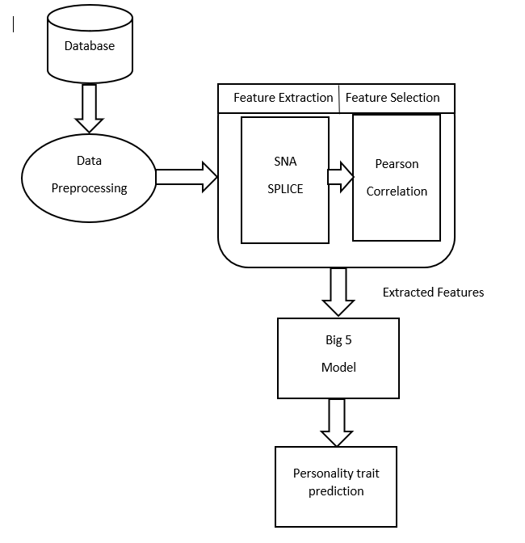
Diagram

Slide 8
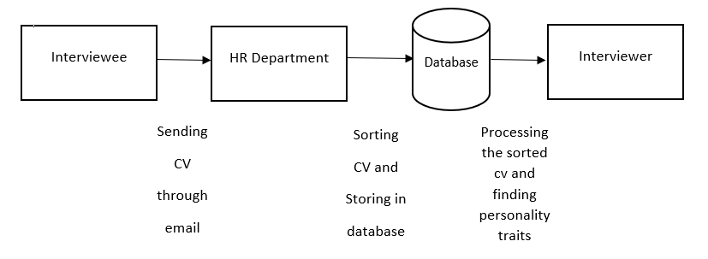
Data-flow Diagram

Slide 9
LITERATURE SURVEY
SR NO | Title | Author | Publisher & YOP | Methodology | Limitations
1. | Social Media Text – A Source for Personality Prediction | P.S.Dandannavar, S.R. Mangalwede, P.M. Kulkarni | IEEE 2018 | Social media is most widely used by user. A user’s behavior on social platform is reflected in his/her tweets, status updates, comments, interest, etc. we can prediction her/his age, gender, political orientation. | In the process of personality prediction data should continuously update.

Slide 10
LITERATURE SURVEY
SR NO | Title | Author | Publisher & YOP | Methodology | Limitations
2. | Personality trait prediction based on game character design using machine learning approach | Louis Khrisna Putera Suryapranata, Gede Putra Kusuma, Yaya Heryadi, Bahtiar Saleh Abbas, Lukas , Adang s. Ahmad | IEEE 2017 | Machine learning model to predict personality traits of game players based on game character design they choose before starting to play game. Based on choose character can predict personality. | There is imbalanced data set .the project purpose of model cannot handle imbalanced data well.

Slide 11
LITERATURE SURVEY
SR NO | Title | Author | Publisher & YOP | Methodology | Limitations
3. | Personality Prediction by Discrete Methodology | Gayatri Vaidya, Pratima Yadav, Reena Yadav, Prof. Chandana Nighut | I0SRJEN 2018 March | To distinguish internal property of the person from overall behavior. With the help of pictorial technique we can make this system | Data of the candidate must be updated

Slide 12
LITERATURE SURVEY
SR NO | Title | Author | Publisher & YOP | Methodology | Limitations
4. | Machine Prediction of Personality From Facebook Profile | Randall wald, Taghi Khoshgoftaar, Chris Summer | IEEE 2012 | The traits of Big Five personality model use in Facebook profile to predict personality of user. | The collection of Data should be available in prediction time.

Slide 13
References
P.S.Dandannavar, S.R. Mangalwede, P.M. Kulkarni (2018). Social Media Text – A Source for Personality Prediction. 2018 International Conference on Computational Techniques, Electronics and Mechanical Systems(CTEMS). doi.org/10.1109/ctems.2018.8769304
Louis Khrisna Putera Suryapranata, Gede Putra Kusuma, Yaya Heryadi, Bahtiar Saleh Abbas, Lukas ,Adang s. Ahmad (2017). Personality trait prediction based on game character design using machine learning approach. Indonesian Cognitive Engineering Research Group (CERG). doi.org/10.1109/innocit.2017.8319139
Gayatri Vaidya, Pratima Yadav, Reena Yadav, Prof. Chandana Nighut (2018). Personality Prediction by Discrete Methodology. International Conference on Innovative and Advanced Technologies in Engineering. doi.org/10.1109/iciate.2018.452365
Randall wald, Taghi Khoshgoftaar, Chris Summer (2012). Machine Prediction of Personality From Facebook Profile. International Reference Ionosphere (2012). doi.org/10.1109/iri.2012.6302998

