Slide 1
Automatic Timetable Generator
By:
SUMAN SOMVANSHI
SHUAIB NADKAR
NIHAL MUKADAM
PROJECT GUIDE:
MR.A.K.MANGORE

Slide 2
Introduction
Time table scheduling has been in human requirements since they thought of managing time effectively.
Our project will help to generate time table automatically also helps to save time.
This ensures the following features:
Easier slot assigning.
Less time consumption.
No slot clashes.
Various possible slot combinations can be acqiured.
User friendly.

Slide 3
Problem Statement
As the previous method of timetable generation included tedious process of assigning each subjects to staff manually.
Scheduling the timetable as in a way so that no clashes occur.
But this process also took more use of time and also use of paper work.
For this approach we decide a solution of using our computing skills and technology to generate time table.

Slide 4
Literature review
Sr no | Paper Name and Author | Conference/Journal | Concept | Technology used | Remark
1 | System of Automated Timetabling. Wojciech Legierski, Rafal Widawski | 25th Int conf. Information Technology ITI 2003 ,Cavtat Croatia | Timetable structure will be generated automatically on the server that will provide database. | Programming (CP). | Only Timetable manager will be working on the client computer.
2 | Development of an Efficient Timetable System. Perumal.S.A. Tabassum,M.Nowawi.N.M.Samy. | IEEE conference | This framework will optimize system performance classes, students and lecture overlapping | Angular JS,bootstrap 3,Constraint | Application is being developed using open source framework

Slide 5
Literature review
Sr no | Paper Name and Author | Conference/Journal | Concept | Technology used | Remark
3 | The Design and implementation of timetable system based on genetic algorithm. By-Ping Guo,Jing-xin Chen,Lin Zhu | IEEE conference | Events have to be arranged into number of timeslots such that conflicts in using a given set of resources are avoided. | 1)Greedy method. 2)Genetic algorithm | Different courses have different course types such as theory and practical.

Slide 6
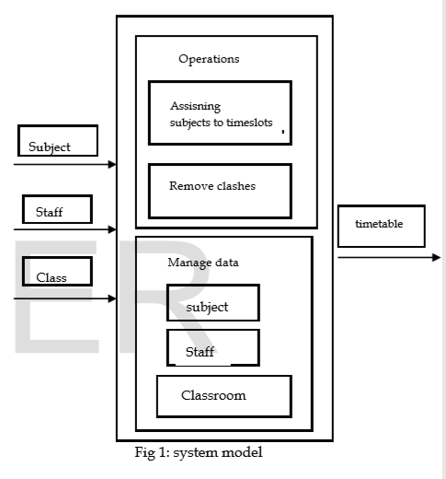
METHODOLOGY

Slide 7
References
IEEE Software Engineering Standards Committee, “IEEE Std 830-1998, IEEE Recommended Practice for Software Requirements Specifications”, October 20, 1998.
"IEEE P1233", Draft Guide to Developing System Requirements Specifications., October 1993.
"IEEE Std 828-1990", IEEE Standard for Software Configuration Management Plans (ANSI).
Dipti Srinivasan Tian Hou Seow Jian Xin Xu “Automated timetable generation using multiple context reasoning for university models”, 2002 IEEE conference

