Slide 1
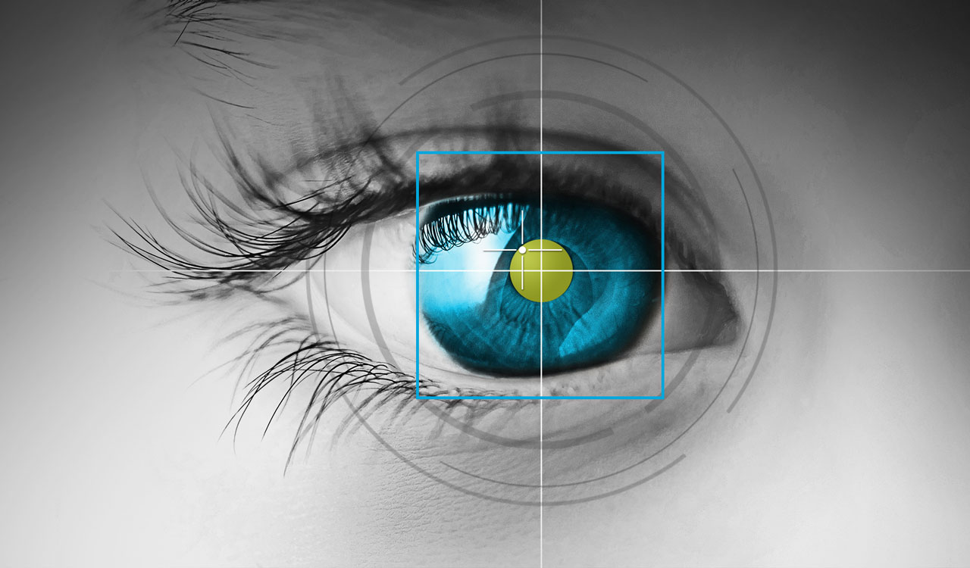
Eye Tracking on Screen Keyboard
Presented By
Miss. Namrata Chandrakant Sonawane.
Miss. Sarika Dattaram Tawate
Miss. Papiha Sanjay Wagh
Project Guide:
Prof. S. S. Tathare

Slide 2
Contents
Introduction
Problem statement
Literature review
Methodology
Result till date
Expected implementation
References

Slide 3
Introduction
What is Eye tracking on screen keyboard?
Aim of this project.
How can we access through keyboard?
What are the facilities it will provide?
Working Principles.

Slide 4
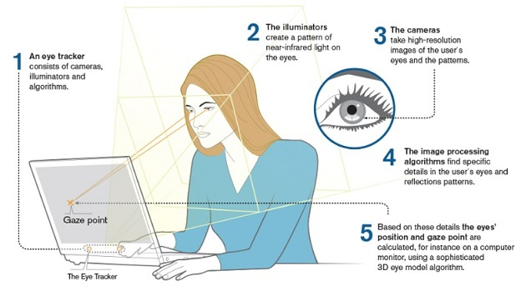
Working principle

Slide 5
Problem Statement
To offer people with extreme disabilities, an opportunity to control a computer simply by moving his/her eyes.
To design inexpensive and easy-to-use system which solve the communication problem of disabled people like who don’t have hands by writing with their eyes is introduced.

Slide 6
Literature review
Sr. No | Year | Paper Name and Authors | Contents | Technology Used | Remark
1. | 2008 | Eye controlled virtual keyboard using a new co-ordinate transformation of long and narrow region. (chern-sheng Lin, Yun-Lang Lay) | In this paper development of an eye tracking and virtual keyboard control system using a PC camera is presented. | In this the infrared CCD camera was employed to capture images of eye movement & to record the changes of relative position of a glint & the center of cornea with dynamic tracking technique. | In this paper we have some idea about keyboard & also got information about CCD camera.
2. | 2011 | Designing a Virtual Keyboard with Multi-Modal Access for People with Disabilities Intelligent Systems Research Centre (ISRC) University of Ulster, Magee Campus, Derry, N. Ireland, UK Vijit Prabhu & Girijesh Prasad | This paper present a virtual keyboard that can support multiple modes of access and has an optimum layout based on the frequency of occurrence of alphabet in English text. | For operating a Virtual Keyboard using access switches or BCI, scanning is used | In this paper we have learnt how to access keyboard with scanning system.

Slide 7
Sr. No | Year | Paper Name and Author | Concept | Technology Used | Remark
3 | 2017 | Implementation of Eye Gaze Tracking Technique on FPGA-based On-screen Keyboard System Using Verilog and MATLAB | Eye tracking can be defined into software and hardware based. A dedicated hardware is used for eye gaze detection and has been implemented on an FPGA. | Field Programmable Gate Array(FPGA) | We have understood hardware & software requirements.
4 | 2017 | Eye Tracking Based Control System For Natural Human Computer Interaction (Shyan-Ming Yuan & Shu-fan-Lin) | In this project eye tracking measures the eyeball position and determines gaze direction of person and the movements of the eye can be tracked using diff. technology | 1.Infrared Oculography 2.Scheral Search Coil method 3.Electro Oculography 4.Video Oculography | We get information about Eyeboll position, movements which will required for implemantation of our project.

Slide 8
Sr.No | Year | Paper Name and Authors | Contents | Technology Used | Remark
5. | 2019 | Computer Information Systems University of Alaska Anchorage Anchorage, AK, USA | This paper describe the EyeDent system—in which users authenticate by looking at the symbols on an on-screen keyboard to enter their password. | In this paper EyeDent device is used . | We got information about EyeDent device which is used for face detection & will useful for security system in our project.

Slide 9
Methodology
Image capturing and processing
Face detection
Eye detection
Gaze detection
Eye tracking
Blink detection
Keyboard
Cursor movement
Clicking event

Slide 10
Result Till Date
We have read IEEE research papers related with our project.
We have an idea about what will be hardware and software required.
Also we got some knowledge about python language which will useful to implement our project.

Slide 11
Expected Implementation
Detail study of feature extraction along with implementation.
Completion of designing of Virtual keyboard.
Detail study of image processing algorithm.

Slide 12
References
Implementation of Eye Gaze Tracking Technique on FPGA-based On-screen Keyboard System Using Verilog and MATLAB.
Eye Tracking Based Control System For Natural Human Computer Interaction
(Shyan-Ming Yuan & Shu-fan-Lin).
Eye controlled virtual keyboard using a new co-ordinate transformation of long and narrow region.
(chern-sheng Lin, Yun-Lang Lay)
Intelligent Systems Research Centre (ISRC)University of Ulster, Magee Campus, Derry, N. Ireland, UK.
Computer Information Systems University of Alaska Anchorage
Anchorage, AK, USA.

