Slide 1
E-COURIER SERVICE Guide name: Prof. V.M.Nair
Presented By:
Mr. Akash Kotkar (Roll No. 20)
Mr. Shubham Sawant (Roll No.37)
Mr.Tejesh Utekar(Roll No.42)

Slide 2
ABSTRACT
In recent research shows that the public have expressed average satisfaction with the existing system and there is an obvious need to improve upon current method of distributing goods and services via courier services.
For delivery of a product from one place to other we have to personally approach the courier system. But it gets next to impossible to compare each service even by approaching personally.
It can cost a lot of time and thus we may again end up with wrong logistic service comparatively. So it’s better to have a platform that can suggest ratings, prices and services for user to compare.
In light of this we are proposing a platform which will act as middle agent between customers and courier services.
Our proposed model offers the quickest & safest way to send courier, search your source and dropping point and choose from a wide choice of courier services based on your preferred courier company, pickup times, prices, courier types, pickup & drop off points, ratings & reviews. Choose service & pay securely using popular payment options based on respective regions.
Keywords: Pickup, courier services, tracking system, logistics

Slide 3
Introduction
The main objective of our project is to improve the courier service to customer. We describe a proposed online website suite for end-users and logistic firms. This application will bridge the gap between end-users and courier companies. They can login into their profiles by their login ID and passwords. Once the user enters the pick up and drop point they will be provided with the nearest available logistic companies, user can select courier firm from the results as per their wish. After completing the registration formalities for courier company pick up man will approach customer and pick the courier. The user will be updated with notification as the parcel reaches its destination.

Slide 4
ADVANTAGES OVER EXISTING SYSTEM
Wide-range of courier firms on single platform
Cost comparison between various courier firms
Pick up service
Customer review system

Slide 5
LITERATURE REVIEW
Name | Author | Year of Publication | Useful Content
"Effective and Efficient: Large-Scale Dynamic City Express," in IEEE Transactions on Knowledge and Data Engineering, vol. 28, no. 12, pp. 3203-3217, 1 Dec. 2016. | S. Zhang, L. Qin, Y. Zheng and H. Cheng | DEC.2016 | How to effectively manage the package delivery.
Courier Service Tracking System: NIPOST Adamawa State Nigeria | Ibrahim Inuwa Department of Information Technology Modibbo Adama University of Technology Yola, Nigeria. And Dr. Oye N.D. Computer Science Department Modibbo Adama University of Technology Yola, Nigeria | 2015 | Efficient ways to tracking package
“Front-End & Back-End Web-Technologies in social networking sites”,2014 | Ahmed M. Zeki Hanin M.Abdullah | 2014 | There is comparison between .JSP,ASP,PHP. Through this paper we can say that PHP is better.
“Analysis Tracking Online Payment System” | Sudarno, Bambang Eka Purnama | NOV.2012 | Online Payment

Slide 6
REQUIREMENTS
Software Requirement
PHP
HTML
CSS
SQL
Wamp server

Slide 7
Login
Enter Pickup & Destination point
Enter Parcel Details & Pickup time
List of Courier Service Providers with charges
Service Provider Selection
Payment Option
User will be notified with pickup man’s ID & Contact
Finish

Slide 8
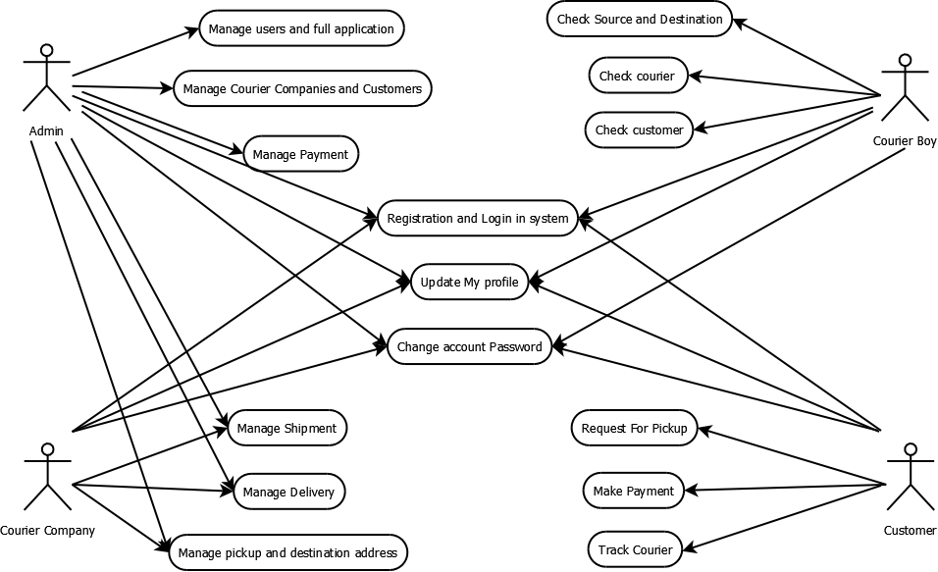
Use-Case Diagram

Slide 9
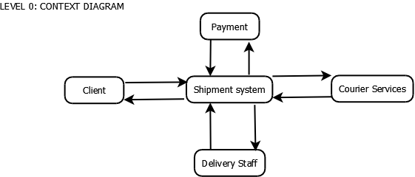
Data Flow Diagram

Slide 10
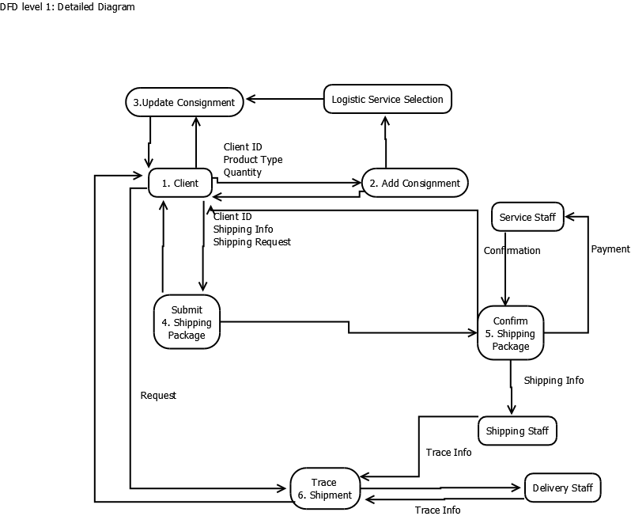

Slide 11
Thank You

