Slide 1
Sign Language Recognition System
Presented by:-
1) Atharv Redij (B.E. Comp)
2) Shubham Berde (B.E. Comp)

Slide 2
Abstract
Communication is one of the important ways of interacting with people. While many people are born with the ability to speak, unfortunately some aren’t. Inability to speak is considered as one of the most challenging disabilities. Sign language is the only way by which deaf people can communicate with each other but the main problem arises while communicating with normal people who don't understand sign language. This is the issue they face daily and are often at a disadvantage in every aspect of their life.
Our project is aimed at bridging the communication gap between normal people and deaf people using sign language recognition system. The main focus of this project is to create a system that identifies sign language gestures from real time camera feed. Gestural interfaces can help deaf people to have easy communication.

Slide 3
Introduction
Our project aims at solving this problem using Machine learning.
We will start with acquisition of data-set.
This data-set will be containing multiple images of each hand sign.
We will be training a model on this data-set.
Once this model achieves a good accuracy, we will interface it with web-cam.

Slide 4
Literature Review
Sr. No. | Paper Name | Author Name | Year of Publication | Concept | Advantages | Disadvantages
1 | Simple convolutional neural network on image classification | T. Guo, J. Dong, H. Li and Y. Gao | 2017 | Convolutional Neural Network | Good for image classification | -
2 | Hand Gesture Feature Extraction Using Deep Convolutional Neural Network for Recognizing American Sign Language | M. R. Islam, U. K. Mitu, R. A. Bhuiyan and J. Shin | 2018 | Application of CNN in sign language recognition. Model use 5 Convolutional Layers along with Max Pooling layers and then 2 fully connected layers | Good Accuracy | Only works for American sign language

Slide 5
Dataset
Collecting a proper dataset is a primary requirement of any machine learning dataset.
Dataset 1:- This dataset was captured by a mobile phone’s camera. Three hundred images per sign from three individuals were taken. This contains twenty six alphabetic signs and one special symbol for space. So in total dataset has eight thousand one hundred images. All the images were resized to the resolution of 640*480.
Dataset 2:- Second dataset created contained images in thresholded fashion. Five hundred images per symbol were captured. So in total there were thirteen thousand five hundred images. All the images were resized to 200*200 pixels and were captured using a 720p laptop webcam.

Slide 6
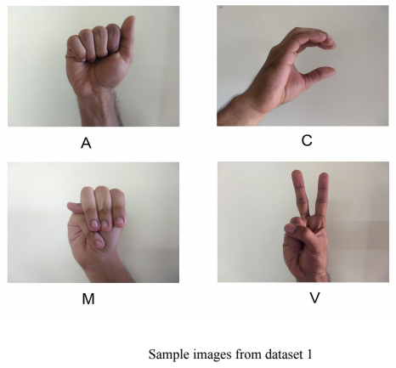
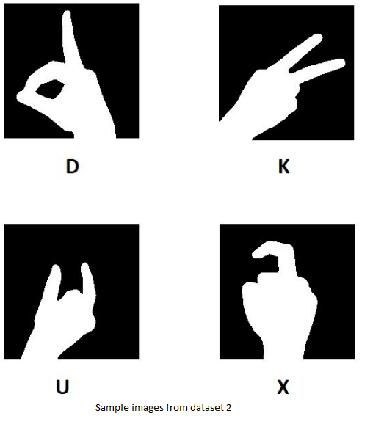
Dataset Images

Slide 7
Classification using CNN
First attempt for sign classification was using CNN.
This CNN was a modified version of another CNN called AlexNet.
We replaced last fully connected layer of CNN according to the need of the project.
We trained model for five epochs.
Now the issue faced was CNN was correctly classifying images that contained hand gesture. But it was also classifying images that contained no hand gesture with high confidence.
To solve this issue we tried using image processing techniques.

Slide 8
Image processing techniques used
Watershed algorithm:- It is typically used in image segmentation i.e. separating objects in images. This technique of transformation treats the image as a topographic map, with the intensity of each pixel representing the height. Assume that a source of water is placed in the catchment basins. These basins are flooded and areas where the floodwater from different basins meet are identified. Barriers in the form of pixels are built in these areas. Consequently, these barriers act as partitions in the image, and the image is considered to be segmented.
Canny edge detection:- The Canny edge detector is an edge detection operator that uses a multi-stage algorithm to detect a wide range of edges in images.

Slide 9
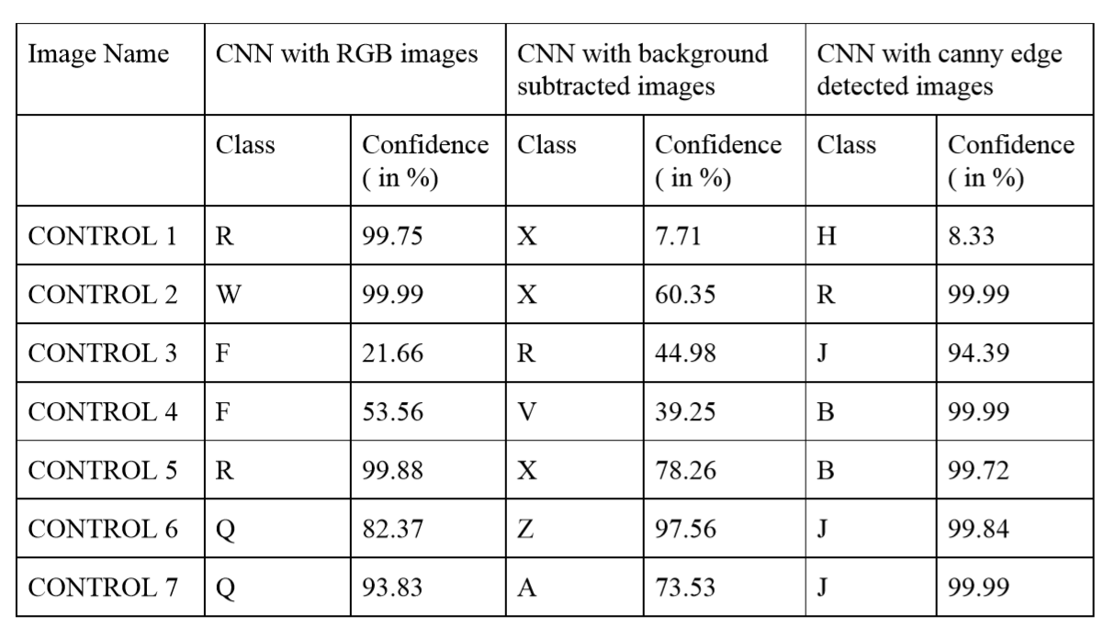
Results of using image processing
To test the issue across different image processing techniques seven test images were used which contained no hand gesture but rather objects like mobile phone, water bottle, watch, etc.

Slide 10
Switching to SVM
Even after using image processing techniques the issues with CNN were still present. Thus we decided to switch to different machine learning algorithm such as SVM.
Support vector machines (SVMs) are a set of supervised learning methods used for classification and regression. It can easily handle multiple continuous and categorical variables.
The main objective is to segregate the given dataset in the best possible way. The distance between the either nearest points is known as the margin. The objective is to select a hyperplane with the maximum possible margin between support vectors in the given dataset.
SVM for image classification works better with thresholded images. Image thresholding is the best way of portioning an image into foreground and background. Image thresholding is a type of image segmentation that isolates objects by converting a grayscale image into binary image.

Slide 11
Results
It can be observed that SVM has solved the issue of classification with high confidence for images that contained no hand gesture.
The confidence on such images is below 50-60%. So a threshold of 70% can be set for classification.

Slide 12
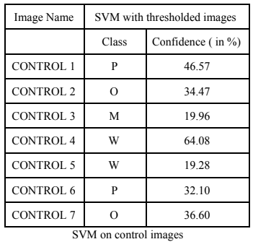
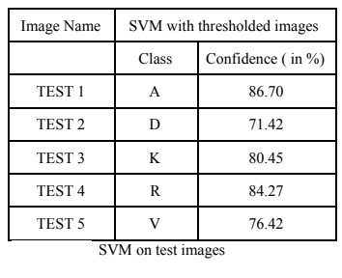
Results

Slide 13
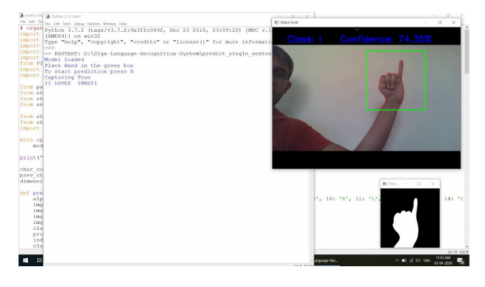
Screenshot of working

Slide 14
References
1. http://www.massey.ac.nz/ albarcza/gestured ataset2012:html
2. https://www.kaggle.com/datamunge/sign-language-mnist
3. https://www.kaggle.com/grassknoted/asl-alphabet
4. T. Guo, J. Dong, H. Li and Y. Gao, "Simple convolutional neural network on image classification," 2017 IEEE 2nd International Conference on Big Data Analysis (ICBDA),Beijing, 2017, pp. 721-724
5. M. R. Islam, U. K. Mitu, R. A. Bhuiyan and J. Shin, "Hand Gesture Feature Extraction Using Deep Convolutional Neural Network for Recognizing American Sign Language," 2018 4th International Conference on Frontiers of Signal Processing (ICFSP), Poitiers, 2018, pp. 115-119

Slide 15
Thank You

