Slide 1
TCP/IP and OSI
Business Data Communications

Slide 2
What is a Protocol?
Allows entities (i.e. application programs) from different systems to communicate
Shared conventions for communicating information are called protocols
Includes syntax, semantics, and timing

Slide 3
Why Use Protocol Architecture?
Data communications requires complex procedures
Sender identifies data path/receiver
Systems negotiate preparedness
Applications negotiate preparedness
Translation of file formats
For all tasks to occur, high level of cooperation is required

Slide 4
Modular Approach
Breaks complex tasks into subtasks
Each module handles specific subset of tasks
Communication occurs
between different modules on the same system
between similar modules on different systems

Slide 5
Advantages of Modularity
Easier application development
Network can change without all programs being modified

Slide 6
Three-Layer Model
Distributed data communications involves three primary components:
Networks
Computers
Applications
Three corresponding layers
Network access layer
Transport layer
Application layer

Slide 7
Network Access Layer
Concerned with exchange of data between computer and network
Includes addressing, routing, prioritizing, etc
Different networks require different software at this layer
Example: X.25 standard for network access procedures on packet-switching networks

Slide 8
Transport Layer
Concerned with reliable transfer of information between applications
Independent of the nature of the application
Includes aspects like flow control and error checking

Slide 9
Application Layer
Logic needed to support various applications
Each type of application (file transfer, remote access) requires different software on this layer

Slide 10
Addressing
Each computer on a network requires a unique address on that network
Each application requires a unique address within the computer to allow support for multiple applications (service access points, or SAP)

Slide 11
Data Transmission
Application layer creates data block
Transport layer appends header to create PDU (protocol data unit)
Destination SAP, Sequence #, Error-Detection Code
Network layer appends another header
Destination computer, facilities (e.g. “priority”)
See figure 4.5 in the book

Slide 12
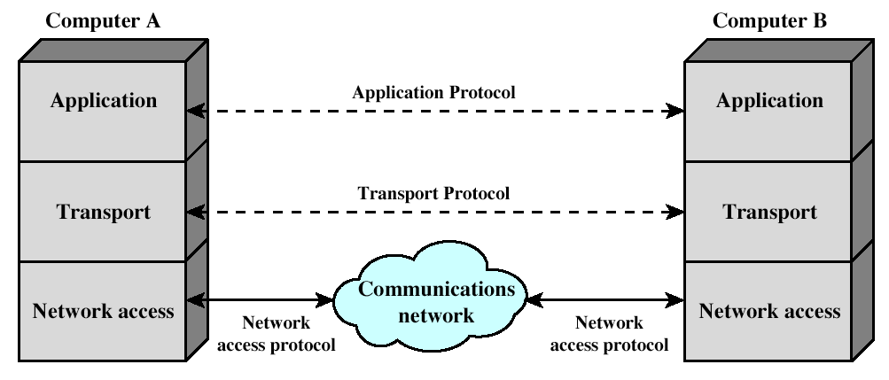
Simplified Architecture

Slide 13
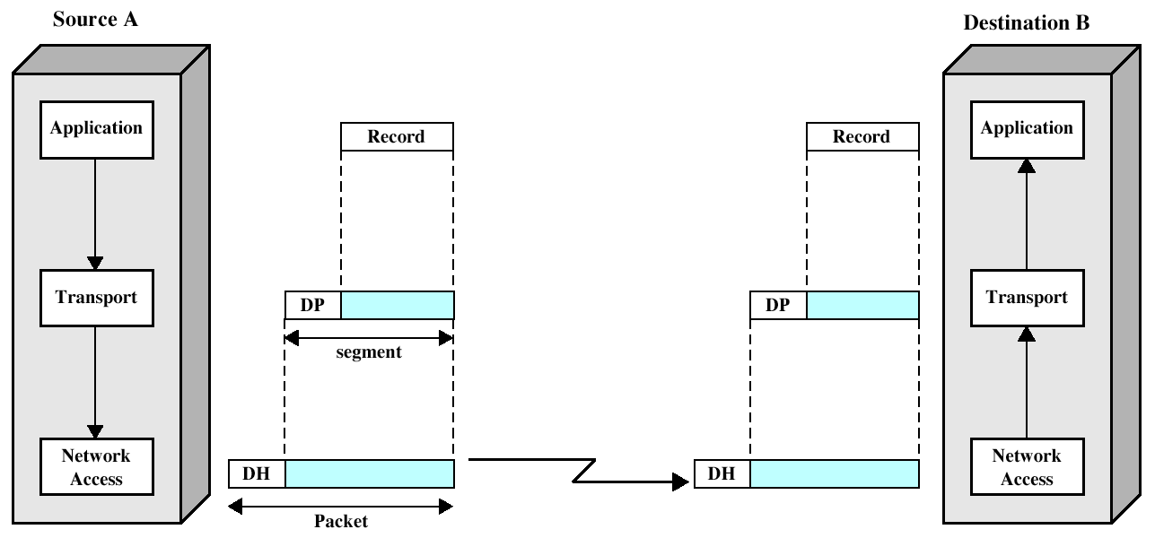
Protocol Architecture Operation

Slide 14
Standardized Protocol Architectures
Vendors like standards because they make their products more marketable
Customers like standards because they enable products from different vendors to interoperate
Two protocol standards are well-known:
TCP/IP: widely implemented
OSI: less used, but widely known and still useful for modeling/conceptualizing

Slide 15
TCP/IP
Transmission Control Protocol/Internet Protocol
Developed by DARPA
No official protocol standard
Identifies 5 Layers
Application
Host-to-Host (transport)
Internet
Network Access
Physical

Slide 16
TCP/IP Physical Layer
Physical interface between a DTE (e.g. computer or terminal) and a transmission medium
Specifies:
Characteristics of medium
Nature of signals
Data rate

Slide 17
TCP/IP Network Access
Exchange of data between systems on a shared network
Utilizes address of host and destination
Can also prioritize transmission
Software at this layer depends on network (e.g. X.25 vs. Ethernet)
Segregation means that no other software needs to be concerned about net specifics

Slide 18
TCP/IP Internet Layer
An Internet is an interconnection of two or more networks
Internet layer handles tasks similar to network access layer, but between networks rather than between nodes on a network
Uses IP for addressing and routing across networks
Implemented in workstations and routers

Slide 19
TCP/IP Transport Layer
Also called host-to-host layer
Reliable exchange of data between applications
Uses TCP protocols for transmission

Slide 20
TCP/IP Application Layer
Logic needed to support variety of applications
Separate module supports each type of application (e.g. file transfer)

Slide 21
TCP & UDP
Most TCP/IP applications use TCP for transport layer
TCP provides a connection (logical association) between two entities to regulate flow check errors
UDP (User Datagram Protocol) does not maintain a connection, and therefore does not guarantee delivery, preserve sequences, or protect against duplication

Slide 22
IP and IPv6
IP provides for 32-bit source and destination addresses
IPv6 (1996 standard) provides for 128-bit addresses
Migraqtion to IPv6 will be a very slow process

Slide 23
TCP/IP Applications
SMTP (Simple Mail Transfer Protocol)
Basic e-mail facility, transferring messages among hosts
FTP (File Transfer Protocol)
Sends files from one system to another on user command
Telnet
Remote login capability, allowing a user to emulate a terminal on the remote system

Slide 24
Internetworking
Interconnected networks, usually implies TCP/IP
Can appear to users as a single large network
The global Internet is the largest example, but intranets and extranets are also examples

Slide 25
Routers
Equipment used to interconnect independent networks
Several essential functions
Provide a link between networks
Provide routing and delivery of data between processes on systems from different networks
Provide the above functions without requiring modification of the attached networks

Slide 26
Router Issues
Addressing schemes
Maximum packet size
Interfaces
Reliability

Slide 27
TCP Segment (TCP PDU)
Source port (16 bits)
Destination port (16 bits)
Sequence number (32 bits)
Acknowledgment number (32 bits)
Data Offset (4 bits)
Reserved (6 bits)
Flags (6 bits) : URG, ACK, PSH, RST, SYN, FIN
Window (16 bits)
Checksum (16 bits)
Urgent Pointer (16 bits)
Options (variable)

Slide 28
IPv4 Header
Version (4 bits)
Internet header length (4 bits)
Type of Service (8 bits)
Total Length (16 bits)
Identification (16 bits)
Flags (3 bits
Fragment Offset (13 bits)
Time to Live (8 bits)
Protocol (8 bits
Header Checksum (16 bits)
Source Address ( 32 bits)
Destination Address (32 bits)
Options (variable)
Padding (variable)

Slide 29
Why Study OSI?
Still an excellent model for conceptualizing and understanding protocol architectures
Key points:
Modular
Hierarchical
Boundaries between layers=interfaces

Slide 30
OSI
Open Systems Interconnection
Developed by ISO
Contains seven layers (see page 358)
Application
Presentation
Session
Transport
Network
Data Link
Physical

Slide 31
OSI Lower Layers
Physical
Data Link
Network

Slide 32
OSI Physical Layer
Responsible for transmission of bits
Always implemented through hardware
Encompasses mechanical, electrical, and functional interfaces
e.g. RS-232

Slide 33
OSI Data Link Layer
Responsible for error-free, reliable transmission of data
Flow control, error correction
e.g. HDLC

Slide 34
OSI Network Layer
Responsible for routing of messages through network
Concerned with type of switching used (circuit v. packet)
Handles routing between networks, as well as through packet-switching networks

Slide 35
OSI Upper Layers
Transport
Session
Presentation
Application

Slide 36
OSI Transport Layer
Isolates messages from lower and upper layers
Breaks down message size
Monitors quality of communications channel
Selects most efficient communication service necessary for a given transmission

Slide 37
OSI Session Layer
Establishes logical connections between systems
Manages log-ons, password exchange, log-offs
Terminates connection at end of session

Slide 38
OSI Presentation Layer
Provides format and code conversion services
Examples
File conversion from ASCII to EBDIC
Invoking character sequences to generate bold, italics, etc on a printer

Slide 39
OSI Application Layer
Provides access to network for end-user
User’s capabilities are determined by what items are available on this layer

Slide 40
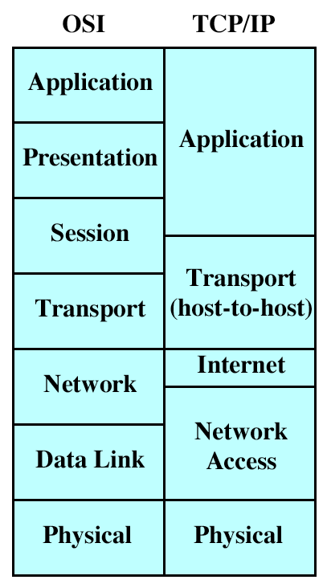
TCP/IP - OSI Comparison

