Slide 1
Technologies for e-commerce and web hosting

Slide 2
Learning Objectives
Role of technologies in e-commerce
Web architecture
Hypertext Transfer Protocol
Web pages (static and dynamic)
Cookies
How to design web pages
The steps required to make the design error free
Process for publishing web page
Process for hosting web page

Slide 3
E-commerce technology
E-commerce has three-tiered system
three tier refers to three main components
Client side,
server side and
the connecting bridge which is known as internet
For fulfilling any order, we need
Three tier model PLUS
supplier system,
warehouse system,
logistics system

Slide 4
Contd..
Webpage has
GUI
Back end server
Combination of data and application
Rule based protocol (called the Hypertext Transfer Protocol (HTTP))

Slide 5
Architecture
Internet is a combination several networks
networks are connected through routers
These routers are connected through Internet Service Providers (ISP)
transfer information through packets
internet is on layered model - Transmission Control Protocol/ Internet Protocol (TCP/IP)

Slide 6
Network diagram
Network no.1
Network no.2
Modem
ADSL
Dedicated Connection
Internet Service Provider
Network No.3
ROUTERS

Slide 7
TCP/IP
Transmission Control Protocol/ Internet Protocol
process of transferring packets from one computer to another computer
Medium internet
These layers are connected through different rules and definitions in four layers
Network layer : network layer helps in forwarding packets to different layers depending on the address on the packet
Transport Layer: forwarding takes place through transport layer
Application Layer: supports transport of each and every application across networks
and Link Layer: Links between layers

Slide 8
TCP/IP Diagram
Application Layer
TCP Layer
Carries Applications
START
Carries Application, TCP details, IP details and Link details
END
Carries Application, and TCP details
Link Layer
IP Layer
Carries Application, TCP details, and IP details
routers

Slide 9
Routing connection for packet transmission
Network 1
Network 2
Router 1
Router 2
Router 3
Network 3

Slide 10
Link layer is the starting point for the network - deals with physical and medium of access
network layer forwards packets to their destinations - similar to usage of a courier - address of the destination and mode of routing the packet
IP address layer - Each IP address has 32 bits - IP address has two parts: the networmk number and the host number
Routing helps in forwarding the packets to and from internet - Each routing has rules in the form of table which directs where a packet should be forwarded

Slide 11
IPv4 vs IPv6
New version of IP called IPv6 and current version is IPv4
IPv4 uses 32 bit address
A packet is transmitted by multiplicating and then sent to different locations
results in clogging the network bandwidth
wastages of the network
IPv^6 multicast is used
single packet can be transmitted to multiple locations
security control : IPSec has been used

Slide 12
Technology evolution
Internet is the infrastructure that links thousands of networks together
Internet owes its existence to the Pentagon and the cold war
Original networked sites were military installations, universities, and business firms with defense department contracts
Initial goal was to design a network that would maintain the safe transition of data between military computers at select sites through redundant communication routes

Slide 13
cont'd…
Researchers devised a way of bundling information into packets that carried the network address of the recipient
Each packet is sent into a so-called network “cloud” across the vast array of computers on the network
Each computer checks to see if the information belongs to any of its clients and forwards it to the next computer to which it might belong
Once claimed by the right computer, the packet is opened to reveal the message
This message delivery system is moved by a protocol

Slide 14
cont‘d
At first, Internet traffic was government related and government subsidized: No ordinary person or company could use the Internet
April 1995 the U.S. government relinquished control of the Internet to independent governing bodies, which relaxed entry for almost everyone
Web Applications
Web user/ web client
Internet
Web Server
Database

Slide 15
COPYRIGHT INFRINGEMENTS
Making infringing copies for sale or hire or selling or letting them for hire;
Permitting any place for the performance of works in public where such performance constitutes infringement of copyright;
Distributing infringing copies for the purpose of trade or to such an extent so as to affect prejudicially the interest of the owner of copyright ;
Public exhibition of infringing copies by way of trade; and
Importation of infringing copies

Slide 16
IP Addresses
A Web site’s address includes the name of the host computer’s link the Web site resides on
Each host is identified by a unique host number (called an IP address) and by a name that is easier to remember than the number

Slide 17
IP Address Arithmetic
An IP address consists of 32 binary digits or bits (zeros and ones)
Divide the 32 bits into 4 groups of 8 bits called a byte, or octet
Each octet represents a decimal value from 0 through 255
Write the four decimal values separated by dots
191.170.64.12 - computer friendly, but not human friendly
Every host on the Internet has a host number

Slide 18
Host Naming
A host name is an Internet address consisting of text labels separated by dots
Host name is people friendly
Host names used instead of IP addresses or host numbers

Slide 19
Networks and Numbers
Host number divided into two parts
Network part - 2 octets
Local part - 2 octets
University of Virginia host number
191 . 170 . 64 . 12
network local
part part
All UVa addresses begin with 191 . 170
64 identifies a subnet at UVa
12 is the machine on the subnet
{
{

Slide 20
Networks and Sizes
Networks are classified in three sizes:
Class A (large)
Class B (medium)
Class C (small)
Class D is a multicast network
The initial bits of the IP address tells the size of the network host

Slide 21
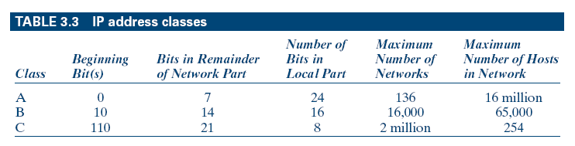
IP Address Classes

Slide 22
Web Search Elements
Internet contains thousands of Web sites dedicated to tens of thousands of topics
Key elements that make the search process feasible:
Browser
Plug-Ins
Search Engine

Slide 23
The Browser (cont'd)
A browser is a piece of software that allows users to navigate the Web
Netscape Navigator
Microsoft Internet Explorer
Firefox
Opera

Slide 24
The Browser (cont'd)
A browser is a Web client program that uses Hypertext Transfer Protocol (HTTP) to make requests of Web servers throughout the Internet on behalf of the browser user
Text-only mode such as Lynx
Graphic mode involves a graphical software program that retrieves text, audio, and video

Slide 25
Plug-Ins
Software programs configured to a Web browser to improve its capabilities
Working together with plug-ins, browsers today offer seamless multimedia experiences
A popular plug-in on the Web is Adobe Acrobat Reader
Microsoft developed software called Active X, which makes plug-ins unnecessary
This software makes it possible to embed animated objects and data on Web pages
Being a Microsoft product, Active X works best with Microsoft’s Internet Explorer browser

Slide 26
Internet Service Providers
Internet service provider (ISP) is a company that links users to the Internet for a fee
Services offered by ISPs
Linking consumers and businesses to the Internet
Monitoring and maintaining customers’ Web sites
Providing network management and system integration
Providing backbone access services for other ISPs (like PSI and UUNET)
Offering payment systems for online purchases

Slide 27
Uniform Resource Locator (URL)
Used for providing unique address for a web page
General representation of any URL : Protocol://domain_name/directory/resource
protocol represents definition of protocols
http stands for hypertext transfer protocol
https represent secure hypertext transfer protocol
ftp represents file transfer protocol
telnet represents protocol for accessing a remote computer

Slide 28
Hypertext Transfer Protocol (HTTP)
HTTP is used for communicating between web client and web server
browser obtains the IP address of the domain through DNS
then web client establishes a TCP connection to port 80 of the web server
port number 80 is the default port for HTTP
response is specified in Multipurpose Internet Mail Extension (MIME) format
a proxy server for security and other administrative reasons

Slide 29
Cookies
HTTP does not keep any information related to users
web server receives a HTTP request for any information, it can be for a new client or an extended session
Data about the users state and requests are important - business analytics are developed
‘cookies’ were developed by which a web server would save these data at the web client

Slide 30
Client side or web programming
programming can be done in HTML, JavaScript, Java Applets, ActiveX controls
plugins can be used which are small applications that are embedded in a web page
special functions (such as animations)
client side programming techniques such as HTML and JavaScipt, LINKS, Images, Tables, Frames, Form, Stylesheets

Slide 31
Managerial Implications
The Web has changed the way business and information technology work together.
E-commerce is transforming the Internet from a “browse-and-surf” environment into a mammoth information exchange.
The important thing is to keep an eye on the technologies, as they evolve, and to be familiar with the changes before taking a dive into the Internet.
Strategize first, test the waters, and be sure you have a unique product supported by qualified staff to follow up on the Web traffic that it attracts.

Slide 32
Summary
The Internet has many uses; it also has many limitations.
World Wide Web is a global hypertext network of millions of Web servers and browsers connected by hypertext transfer protocol (HTTP) and its many derivatives.
It is important to learn the language of the Internet before starting an e-commerce project.
The Internet and the Web have changed the way business and technology work together.

Slide 33
Chapter 3 Learning objectives
How to design web pages
The steps required to make the design error free
Process for publishing web page
Process for hosting web page

Slide 34
What Is a Network?
A connection between at least two computers for the purpose of sharing resources
All networks are based on the concept of sharing

Slide 35
Types of Networks
Peer-to-Peer Networks are the linking of several PCs so that each acts as a peer, sharing and exchanging information without the need for a centralized server
Client / Server Networks are a cluster of computers (called clients) connected to one or more servers to form a network

Slide 36
Peer-to-Peer Networks
Computers are linked together as equals
No centralized server or control
Any computer can share its resources with any other computer on the same network in any way and whenever it chooses
Users are network administrators in that they control access to the resources residing on their own computer
Can result in institutionalized chaos, and security can be a problem

Slide 37
Peer-to-Peer Networks (cont'd)
Setup usually connects fewer than 10 computer
As the number of users increases, the peer-to-peer environment becomes impractical

Slide 38
How to Pick a Domain Name
Pointer for picking domain names
If you sell bricks, pick a domain name containing a word like brick
Consider name length and ease of remembering the name
Hyphens to force search engines to see keywords in your domain name
Make sure the domain name is easy for Web users to remember and find
The domain name should suggest the nature of your product or service
The domain name should serve as a trademark
The domain name should be free of legal conflicts

Slide 39
How to Register a Domain Name
Check if the domain name you propose has been taken
www.FasterWhois.com
One of the most popular and reliable registration sites is www.internic.net/alpha.html

Slide 40
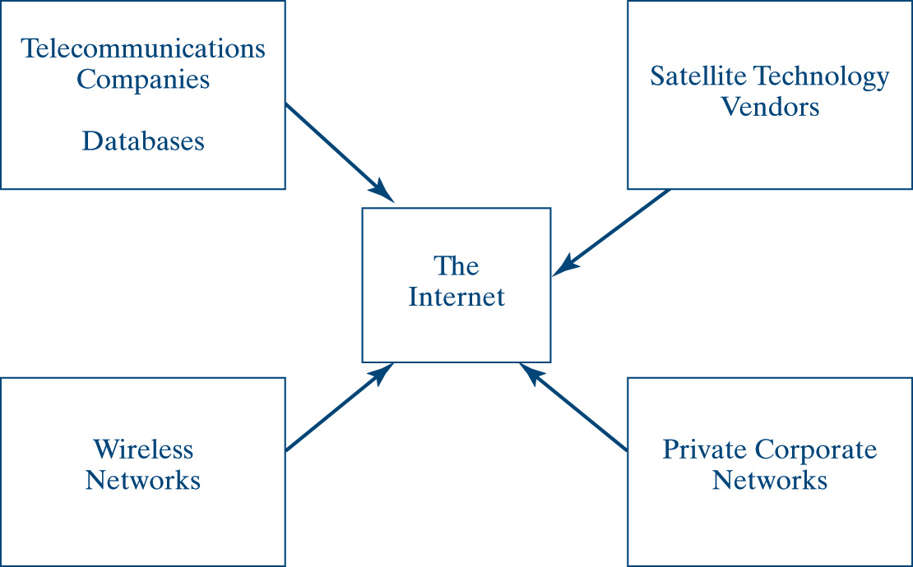
Web page elements

Slide 41
Designing web page elements
web browser displays ASCII text file with extensions .htm or .html
offline web page are to be prepared first
web server and internet connection not required immediately
Initially original formatting is not seen
display of final web page done such that laptops, desktops with different screen sizes can see all the web pages

Slide 42
Designing web page elements Contd..
four basic elements that should be presented in any web page
HTML, HEAD, TITAL and BODY
HTML : This contains information that the web browser should know about the web page such as title
<HEAD> This information is not displayed in the browser’s web page display
<TITLE> This information is displayed in the browser window’s title bar
<BODY> This information is displayed in the browser’s web page display (both text and graphics)

Slide 43
Web page development life cycle
Stages in life cycle are
1) Prepare a file with .HTM or >HTML extension and save it to your hard disk
(2) Open the file through browser
(3) Review the web page and
(4) Rework on the page using a text editor or HTML editor
Formatting,
troubleshooting,
Publishing
Installing on a web server

Slide 44
Web publishing steps
mode of access to web page
DNS address
Path Name
Uploading the files
Find the URL
Final Touch
{GIVE A SAMPLE OF CODE AS GIVEN IN THE TEXT}

Slide 45
Legal and Ethical Issues
Following considerations need to be made
Are the files being published have already been published elsewhere
Are the files being published are modified versions of already existing and published files
Are the materials to be published are excerpts of existing materials (already published somewhere else)
Are there sufficient permissions to download the materials and then publish them as mine
Can the pictures and figures that have been published by someone else and available in the public domain be made available by another publisher (in partial or full display)

Slide 46
Plagiarism
Tools can be used for checking plagiarism
Check before publishing
Websites that offer plagiarism services
www.plagiarism-detector.com,www.writecheck.com,
www.plagiarismchecker.com,
www.dustball.com,
www.plagiarisma.net

Slide 47
Copyright Issues
Copyright is a right given by the law to creators of literary, dramatic, musical and artistic works and producers of cinematograph films and sound recordings
Copyright ensures certain minimum safeguards of the rights of authors
Some of the exemptions are the uses of the work
for the purpose of research or private study,
for criticism or review,
for reporting current events,
in connection with judicial proceeding,
performance by an amateur club or society if the performance is given to a non-paying audience, and
the making of sound recordings of literary, dramatic or musical works under certain conditions

Slide 48
Terms used in copyright
Work : A work means a literary, dramatic, musical or artistic work, a cinematograph film, or a sound recording
work of joint authorship: work produced by the collaboration of two or more authors
What is an artistic work :
a painting, a sculpture, a drawing (including a diagram, map, chart or plan), an engraving or a photograph, whether or not any such work possesses artistic quality;
a work of architecture; and
any other work of artistic craftsmanship
musical work: work consisting of music and includes any graphical notation of such work
sound recording: recording of sounds from which sounds may be produced regardless of the medium

Slide 49
Terms used in copyright..contd..
cinematograph film; work of visual recording on any medium
government work: work which is made or published by or under the direction or control of the government or any department of the government

Slide 50
Terms used in copyright..contd..
MORAL RIGHTS: the right to claim authorship of the work and to restrain or claim damages in respect of any modification
The moral rights are independent of the author’s copyright and remains with him even after assignment of the copyright
Failure to display a work or to display it to the satisfaction of the author shall not be deemed to be an infringement of the moral rights of the author

Slide 51
E-Commerce Issues
Financial Exposure
IP Exposure
Legal Security
Packet Sniffing
Firewalls
IPSec
Intrusion Detection Systems (IDS)

Slide 52
Summary
To communicate over a line, you need a modem, which converts incoming analog signals into digital signals.
Several factors need to be considered in designing a network: location, capacity, distance limitations, cost, potential growth, and security.
Web page publication should follow proper steps
Plagiarism check should be done (using tools)
Copyright issues and moral issues should be taken care of while publishing

