Slide 1
Ultrasonic Sensor IR Temperature Sensor

Slide 2
Ultrasonic Sensors History
Ian Donald and Tom Brown
Used to test ships
Built first Ultrasound in 1958
Notes:
Ian Donald served in the royal air force and was fascinated with sonar and radar. Ian spoke with people that used ultrasonic to test the ships and then paired with engineer tom brown after the war to develop the first ultrasound machine. The technology was not believed until he successfully found and diagnosed an ovarian cyst more safely than current techniques at the time

Slide 3
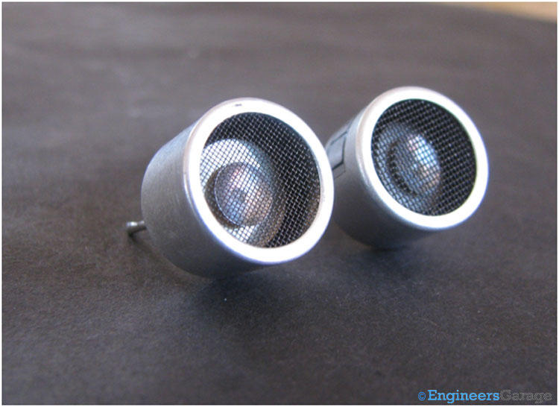
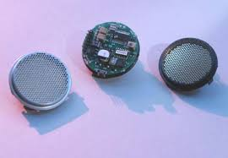
Ultrasonic Sensors
Piezoelectric vs. Electrostatic
Working Environments
Near-Sightedness
Traditional vs. New
Piezoelectric Ultrasonic Sensor
Electrostatic Ultrasonic Sensor
Notes:
Piezoelectric can be used in rugged environments because the ceramic can be sealed in a housing. Electrostatic blanking distance is just 4-6 inches, while piezoelectric is 12-18 inches. Piezoelectric have been around for many years when crystals first began being used for transducers. Electrostatic first was used when silicon machining process began.

Slide 4
Piezoelectric Effect
Discovered in 1880 by Pierre and Paul-Jacques Curie
Name comes from piezein – Greek for “to press”
Solid Material (Crystal, Ceramic, etc…)
Voltage is created across solid material
Piezoelectric Transducer does conversion
Inverse Piezoelectric Effect creates rapid mechanical vibrations.
Notes:
Piezoelectric – mechanical stress in certain solid materials (crystals, ceramics, etc…) creates an electric charge across the solid material. Used in watches to keep time, microphones to convert sound, and even vinyl to “read” sound. Reversible process is used in ultrasonic sound waves. Transducer is a device that converts energy from one kind to another. Inverse effect turns energy created across the crystal or solid device into mechanical vibrations. These vibrations are so fast they create high pitched noise our ears can’t hear. These vibrations are the ultrasonic signals for the sensors.

Slide 5
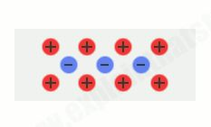
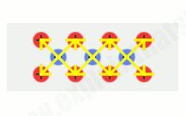
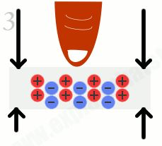
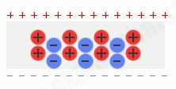
Balanced Charges
Electric Dipole Moments Cancel Out
Charges out of Place
Voltage is Created
Notes:
No matter of the arrangement, charges are balanced.
Charges cancel out leaving no charges remaining on the solid.
Squeezing crystals forces the charges out of place.
Dipole moments no longer cancel each other out and positive and negative charges are on opposite faces of the solid. A voltage is produced across the solid.

Slide 6
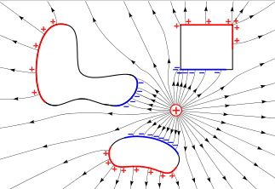

Electrostatics
Thales of Miletus (600 BC)
Machined Metal-Membrane
Coulomb's Law $F=\frac{k∗Q1∗Q2}{d^{2}}$
Voltage is created across metal membrane
Electrostatic Transducer converts energy
Inverse conversion converts energy back
Charges induced by a nearby charge.
Notes:
Thales was one of the first to study electricity in ancient Greece 600 BC. He rubbed materials together and watched how they attracted feathers and dust. He was the first to study electrostatics, but did not fully understand it. Instead of ceramic or crystal as the solid material a machined metal membrane made from silicon machining is used. Natural examples of the phenomenon include small things like plastic sticking to your hand to useful things like a photocopier. Coulomb’s Law allows the calculation of the electrostatic force between two materials. Voltage is created across the metal membrane because positive atoms are brought nearby conducting metal membrane and the electrons are opposite charge the atoms inducing a charge across the metal. A transducer converts the energy to mechanical and back just like the piezoelectric. The electric field is always zero inside a conductive object due to electrostatic induction. An opposing electric field is created to balance the field of the external charge.

Slide 7
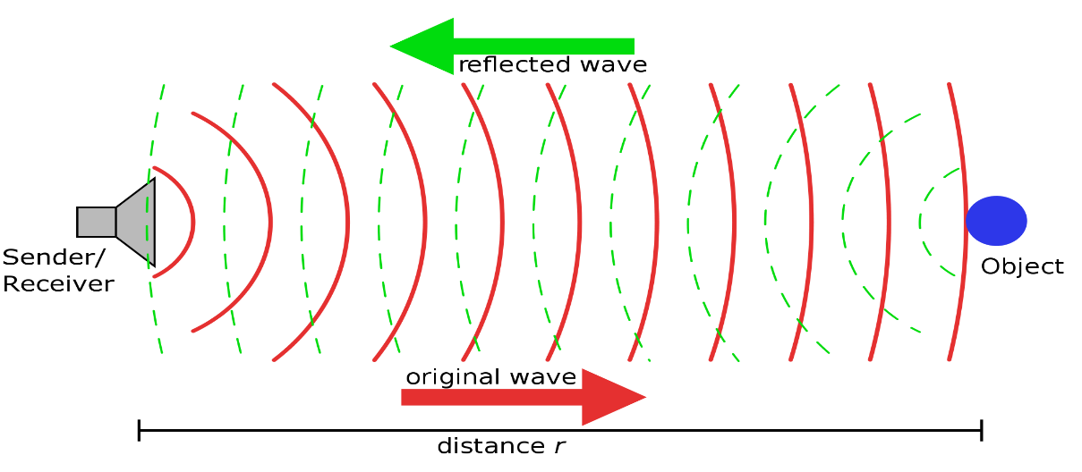
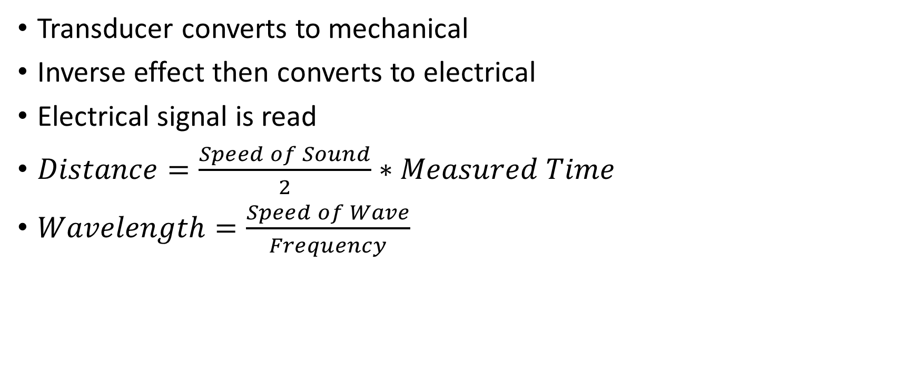
How Does the Sensing Occur?
Transducer converts to mechanical
Inverse effect then converts to electrical
Electrical signal is read
$Distance=\frac{Speed of Sound}{2}∗Measured Time$
$Wavelength=\frac{Speed of Wave}{Frequency}$
Notes:
Transducer converts induced electric voltage into mechanical signal that vibrates rapidly at a very high frequency. The waves are transmitted and then reflect off of materials. The wave is then reflected back and read by a receiver. The receiver knows how many seconds it took the original wave to return. You can use the listed formula to then convert to a distance.

Slide 8
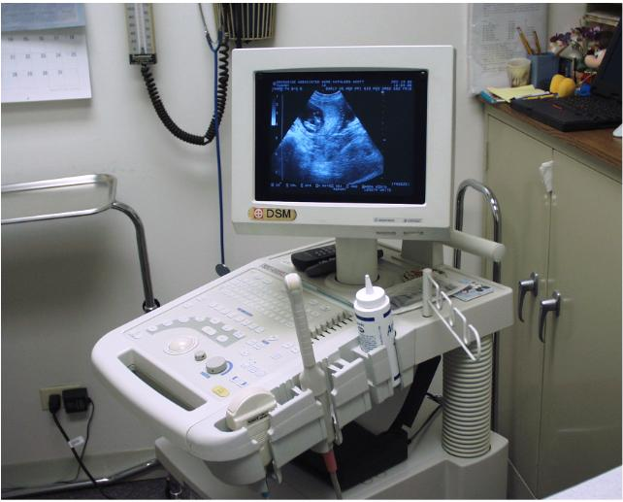
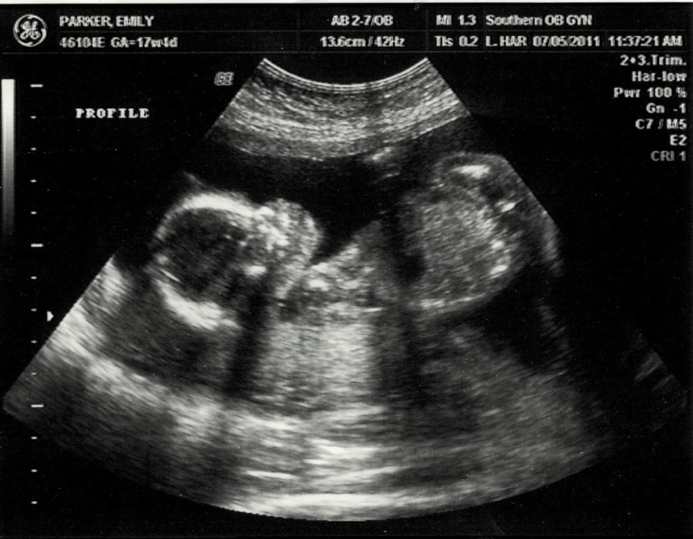
Ultrasound
Popular Imaging Technique
Determining tissue formation in pregnant women
Visualizing blood flow in body or fetus
Early detection of cancerous and benign tumors
Notes:
The ultrasound machine transmits high-frequency (1 to 5 megahertz) sound pulses into your body using a probe.This sound waves travel into your body and hit a boundary between tissues (e.g. between fluid and soft tissue, soft tissue and bone).
Some of the sound waves get reflected back to the probe, while some travel on further until they reach another boundary and get reflected.
The reflected waves are picked up by the probe and relayed to the machine.
The machine calculates the distance from the probe to the tissue or organ (boundaries) using the speed of sound in tissue (5,005 ft/s or1,540 m/s) and the time of the each echo's return (usually on the order of millionths of a second).
The machine displays the distances and intensities of the echoes on the screen, forming a two dimensional image that is seen in ultra sound.

Slide 9
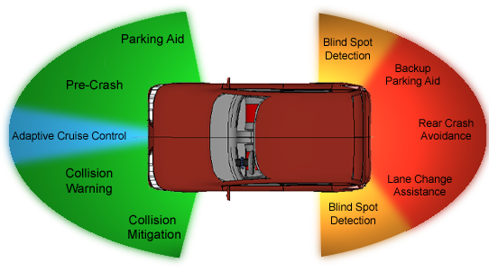
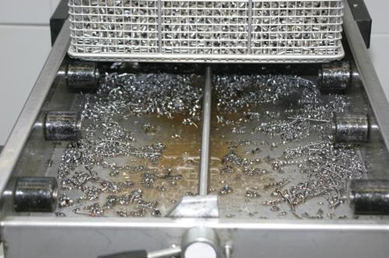
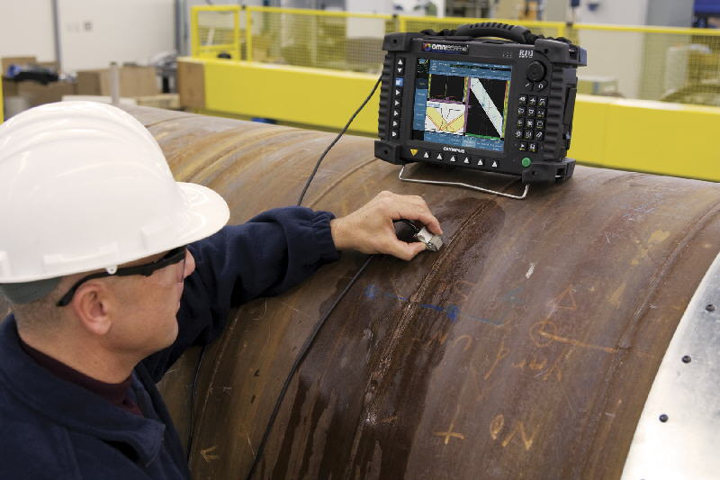
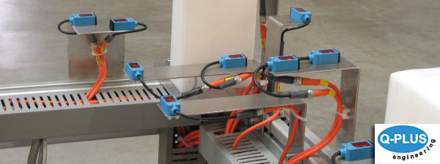
Industry Uses
Car Distance Sensors
Assembly Lines
High-Powered Cleaning
Non-Destructive Testing
Notes:
The ultrasonic sensor is not only useful for our capstone design project, but used in many industry applications. Ultrasound can be used to in self parking cars, automating assembly lines, ultrasonic cleaning, and non-destructive testing. Ultrasonic cleaning uses ultrasound and cleaning solvent to clean jewelry, surgical tools, coins, etc. Ultrasonic waves can be used to test flaws in materials. For our company, ArcelorMittal, ultrasonic testing is used to detect flaws in steel bars and sheets to ensure quality. Assembly lines can be automated using distance sensing of objects.

Slide 10
IR Temperature Sensor
Technology and Use In Industry

Slide 11

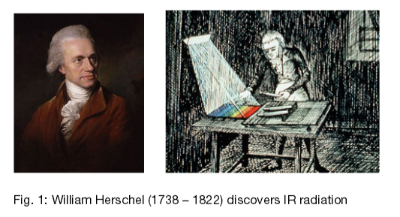
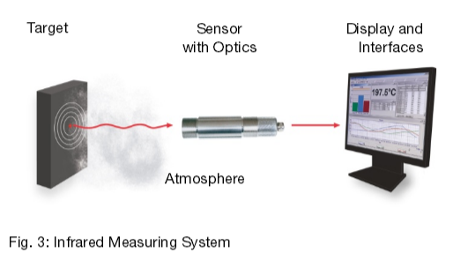
What is an IR Temperature Sensor?
Infrared thermometer
Thermal radiation thermometers
First Thermoscope invented in 17th century
Heavy and hard to use
Infrared Radiation discovered in 19th century
Infrared thermometers in 21st century
Easy to operate
Small
Placed in machinery
Various types
Spot Infrared
Infrared Scanning Systems
Infrared Thermal Imaging Cameras
Notes:
a therometer which infers temperature from a portion of the thermal radiation sometimes called blackbody radiation emitted by the object being measured
Spot Infrared - which measures the temperature at a spot on a surface
Infrared Scanning Systems - scan a larger area, typically by using what is essentially a spot thermometer pointed at a rotating mirror. These devices are widely used in manufacturing involving conveyors or "web" processes, such as large sheets of glass or metal exiting an oven, fabric and paper, or continuous piles of material along a conveyor belt.
Infrared Thermal Imaging Camera - are essentially infrared radiation thermometers that measure the temperature at many points over a relatively large area to generate a two-dimensional image, called a thermogram, with each pixel representing a temperature. This technology is more processor- and software-intensive than spot or scanning thermometers, and is used for monitoring large areas.
Not until the invention of the first thermoscope in the first half of the 17th Century that temperatures could begin to be measured. An evolution of the thermoscope (which had no scale) the thermometer had various scales proposed. Between 1724 and 1742 Daniel Gabriel Fahrenheit and by Anders Celsius defined what we probably consider as the 2 most common.

Slide 12
Advantages
Speed
Lack of Interference
Ability to measure in high temperature
Up to 3000 ° C
Long lasting measurement, no mechanical wear
Notes:
- It is fast (in the ms range)– time is saved, allowing for more measurements and accumulation of more data (temperature areas can be determined).
There is no interference as no energy is lost from the target. For example, in the case of a poor heat conductor such as plastic or wood, measurements are extremely accurate with no distortion of measured values, as compared to measurements with contact thermometers.
Measurements can be taken of hazardous or physically inaccessible objects (high voltage parts, large measurement distances)

Slide 13
Disadvantages
Cannot be used in all environments
Require adjustments depending on the surface being measured
Emissivity Table
Only measure surface temperatures and NOT the internal temperature of food or other materials
Can be temporarily affected by proximity to a radio frequency with an electromagnetic field strength of three volts per meter or greater
Notes:
Can be temporarily affected by frost, moisture, dust, fog, smoke, dust, dirt, and oil or other particles in the air
Do not "see through" glass, liquids or other transparent surfaces - even though visible light (like a laser) passes through them (i.e. if you point an IR gun at a window, you'll be measuring the temperature of the window pane, not the outside temp)
OMRON set the FOV in consideration of the constraints imposed by the Thickness and refractive index of the silicon lens. In order to widen the range install multiple sensors, or mount the sensor on a movable/rotating base
Due to not having a power save mode the only way to reduce power consumption you have to turn off the power
Must develop software/code to increase the determination accuracy

Slide 14
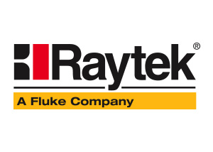




Manufacturers
Raytek
CI Systems
Dickson
Honeywell

Slide 15
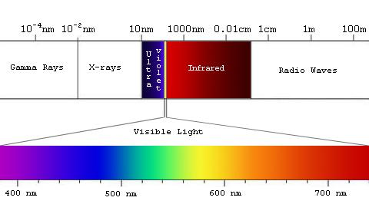
What is Infrared?
Electromagnetic Spectrum
The wavelength of visible light is 380-750nm
Infrared is about 780-1million nm
Range is a lot more

Slide 16
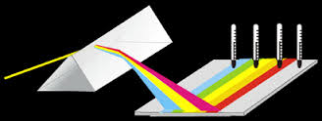
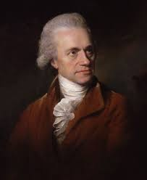
Discovery
William Herschel

Slide 17
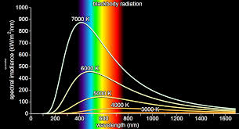
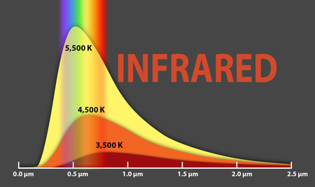
The Black Body Thermal Radiation
All objects emit light according to their temperature
This infrared light can be used to detect warmth
Black body absorbs wavelengths

Slide 18
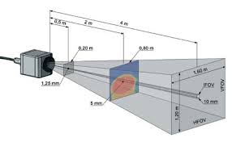
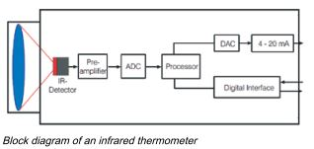
Basic Design
Pick up Infrared signal
Amplify
Convert to useable information through calculations

Slide 19
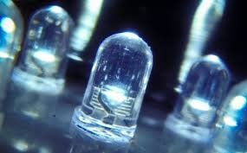
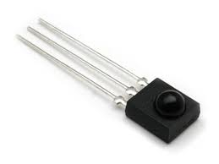
LED IR Detectors
Common are light emitting diodes (LED)
Even though they produce a wavelength of light when an electric current is applied, they can also produce a current as a wavelength of light is shined

Slide 20
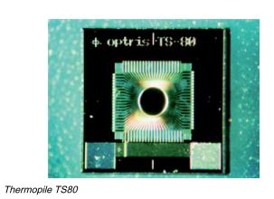
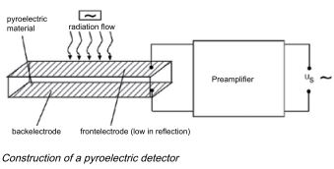
Thermal Detectors
Thermopiles
Pyroelectric Detector
Bolometers

Slide 21
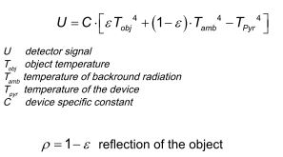

Calculating of an object temperature
Derivations of Stefan-Boltzmann’s law of electric signal from detectors

Slide 22
IR Thermal Sensor Application
Optimization of manufacturing processes
Fever inspection of patients or travelers
Line scanning in glass toughening lines
Checking mechanical or electrical equipment for temperature and hot spots
Checking heater or oven temperature, for calibration and control
Checking for hot spots in fire-fighting
Food Processing

Slide 23
Optimization of manufacturing process
The production of plastic parts such like PET bottles requires a defined heat up of the so called preforms in order to guaranty a homogeneous material thickness during the blow modeling
IR Camera is positioned to follow motion of the material, deliver right temperature profile which is important for the adjustment of heating parameters
Allow exact determination of the cooling behavior at partial area during vacuum forming of big plastic parts
Notes:
Different cooling speeds may result in a warp of the material. Also optimizing the cooling speed may avoid memory effects in the plastic

Slide 24
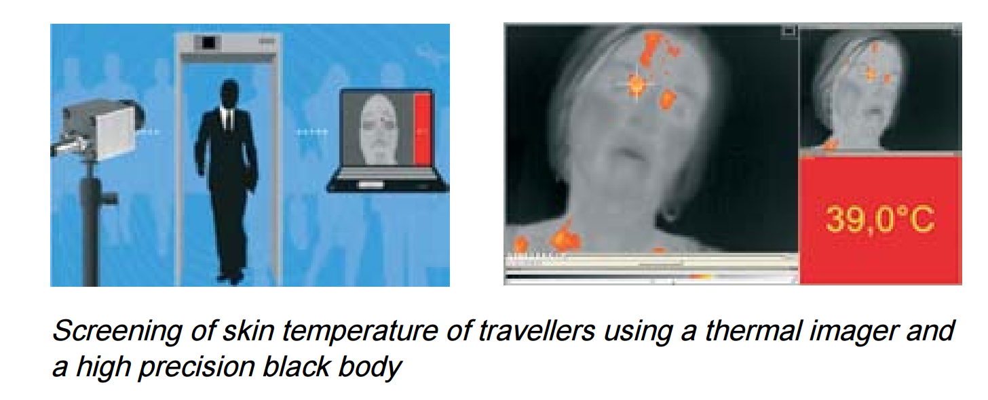
Fever inspection of travelers
Worldwide demand of suitable screening techniques allowing a fast non contact detection of travelers with possible fever
Base is measurement of the face temperature
Notes:
Infectious disease such like H1N1 is usually carried and transfer to another location by travelers
The virus epidemic of the swine flue disease created
Not represent an absolute accurate fever temperature measurement, but great for screening bigger groups of travelers with sufficient high detection reliability.

Slide 25
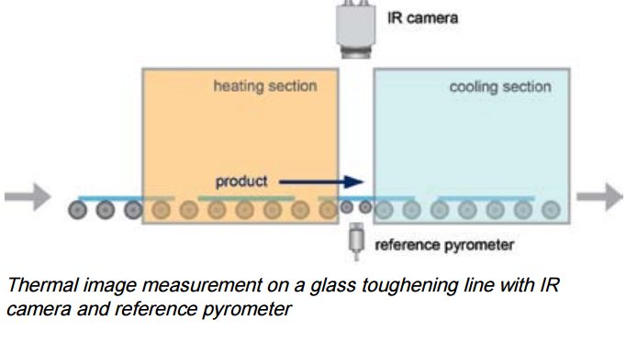
Line scanning in glass toughening lines
After construction glasses had been cut to their final form, quite often they have to be toughened on their surface.
The fine structure and especially the braking strength of the glass depends on a uniform heating and cooling pattern for all partial areas of the glass material.
Notes:
Cut Glasses are heated up to 600 C, then transferred from oven to a cooling section
It’s important especially for safety glasses to cool down the surface quickly with the same speed so a fine crystalline hardened structure is generated.

Slide 26
Questions?

Slide 27
Thank You!

