Slide 1
Infrared Data Association and Bluetooth Technology

Slide 2
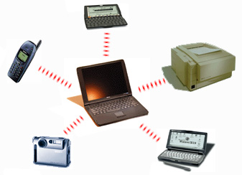
Topics
(IrDA) Infrared Data Association
Basics of Infrared
Infrared and Communication
IrDA Application
Transmitting Data Between Two Different Electronic Devices
Advantages and Disadvantages of IrDA

Slide 3
Topics (cont.)
Bluetooth
Basic of Bluetooth
Basic Structure of Bluetooth Architecture
Challenges with Bluetooth Communication
Bluetooth Applications
Advantage and Disadvantages of Bluetooth
Companies Supporting IrDA or Bluetooth
Other Types of wireless Communications
Conclusion
References

Slide 4

(IrDA) Infrared Data Association
Infrared Data Association
Non-profit Organization
IrDA’s Strategy
IrDA Members

Slide 5
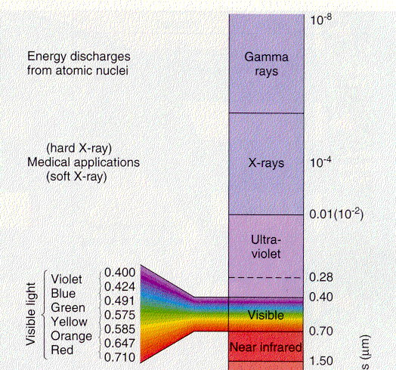
Basics of Infrared
Infrared Wavelength
Infrared in the Environment
Figure 1. Wavelength Spectrum

Slide 6
Infrared and Communication
First IrDA
Specify a standard and a protocols for data transmission
IrDA devices communicate using infrared LED’s
Wavelength 875nm +-30nm
IrDA support data transmission of 1.15Mb/s and 4Mb/s

Slide 7
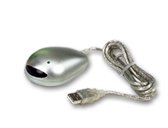
Ir Application
PDAs
Phones
Organizer
Printers
Cameras
Laptops and Notebooks
Other Applications

Slide 8
Transmitting Data Between Two Different Electronic Devices
Can you transmit data between two Infrared capable devices even though they are manufacture by different companies?
Example
Between a Kyocera Smart-phone and Dell Axim
Between a Kyocera Smart-phone and a Dell Latitude

Slide 9
Advantages and Disadvantages of Infrared
Advantages
Point-to-point
Line of sight
Transfer data up to 1m
Security
Low power consumption
Low cost
Disadvantages
Line of sight
One device at a time
Transfer rate 4Mbps
Have to keep the device stable when transferring data

Slide 10
Bluetooth
The Bluetooth special interest Group founded by Ericsson, IBM, Intel, Nokia, and Toshiba in 1998. It was created to develop an open specification for short-range wireless connectivity between laptops, computers, cellular telephones and other electronic devices.

Slide 11
Basics of Bluetooth
Short range Radio Frequency at 2.4 GHz
Point-to-point or point-to-multiple points
Voice and Data
Transmit through walls up to 10m
Supports both synchronous and asynchronous services

Slide 12
Basic Structure of Bluetooth Architecture [5]
Radio
Baseband/link controller
Link manager
Application-level software

Slide 13
Challenges with Bluetooth Communication
Many devices already uses the 2.5GHz radio frequency band
Send a weak signal of 1mW so that signals can travel a distance of 10m
Spread-Spectrum Frequency Hopping
Avoiding Interference

Slide 14
Bluetooth Applications
Wireless Head Sets
Cell Phones
Laptops and Notebooks
PDA’s
Printers
Wireless communication (WAN)

Slide 15
Advantage and Disadvantages of Bluetooth
Advantages
No line of Sight
Lower power consumption
2.5 GHz radio frequency ensures worldwide operation
Very adaptive
Disadvantage
New type of technology
Sharing the same frequency rang.

Slide 16
Companies Supporting IrDA or Bluetooth
IrDA [6]
Bluetooth[2]

Slide 17
References
[1] Images of Infrared http://coolcosmos.ipac.caltech.edu/cosmic_kids/
[2] Description of Bluetooth http://www.howstuffworks.com
[3] List of companies that are part of Bluetooth http://www.bluetooth.com
[4] Marcus Nilsson, Josef Hallberg “positioning with Bluetooth, IrDA and FRID”
[5] Jay Velasquez “wireless personal Area Network: A comparative Look at IrDA-Data and Bluetooth April 26, 2000
[ 6] List of IrDA Members http://www.irda.org/members/members.asp

Slide 18
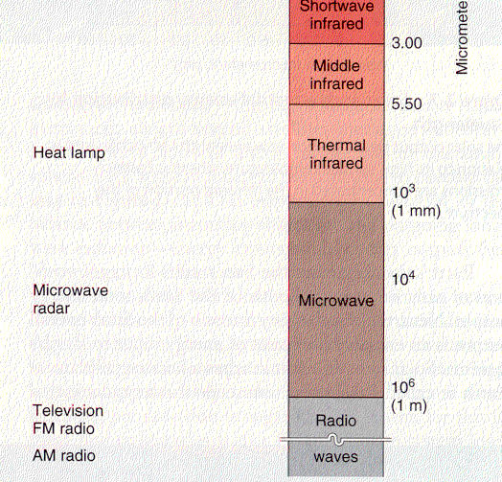
Wavelength Spectrum
Figure 1. Wavelength Spectrum

Slide 19
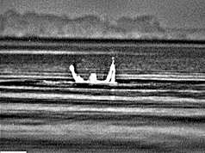
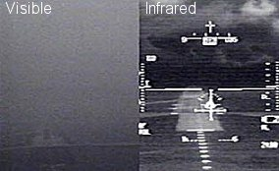
Infrared in the Night
Figure [x] Images of Infrared object in the night [1]

