Slide 1
Automatic Essay Scoring

Slide 2
Automatic Essay Scoring: Intorduction
Why automatic essay scoring?
to reduce laborious human effort
Software systems do the task fully automatically
Computer generated scores match human accuracy
to test theoretical hypothesis in NLP
e.g What is the role of Rough-Shifts in Centering Theory?
to explore practical solutions
e.g Is it possible to improve the systems’ performance ?

Slide 3
Essay scoring systems: Approaches
Length based, Indirect approach
Fourth root of number of words in an essay
as an accurate measure(Page,1966)
Surface features -- Features proxies
essay length in words
number of commas
number of prepositions
number of uncommon words
Rationale: Using direct measures is a computationally expensive task

Slide 4
Essay scoring systems: Approaches
Two main weaknesses of indirect measures
Susceptible to deception, why?
Lack explanatory power
e.g: difficult to give instructional feed back to students
The need for more direct measures
How do human experts evaluate an essay?
Writing features
ETS’s GMAT writing evaluation criteria
Linguistic features

Slide 5
Essay scoring systems: Approaches
Intelligent Essay Assessor (IEA)
Employs Latent Semantic Analysis
The degree to which vocabulary patterns reflect semantic and linguistic competence
Transitivity relations and collocation effects among vocabulary terms
Measures semantic relatedness of documents regardless of vocabulary overlap
More closely represents the criteria used by human experts

Slide 6
Essay scoring systems: Approaches
Electronic Essay Rater, e-rater
Employs NLP techniques
Sentence parsing
Discourse structure evaluation
Vocabulary assessment, …..
Writing features chosen from criteria defined for GMAT essay evaluation
Syntactic variety, argument development, logical organization and clear transitions ……
The GMAT test

Slide 7
Electronic Essay Rater, e-rater
Research Questions
Coherence features not explicitly represented
Is it possible to enhance e-raters performance by adding coherence features?
What is the role of Rough-shift transitions in Centering Theory?
Is it possible to use Rough-shift transitions as a potential measure for discourse incoherence?

Slide 8
The Centering Model
Discourse
Sequence of textual segments
Segments consist of utterances, U_{i} – U_{n}
Forward-looking Center, Cf(U_{i})
Preferred Center, Cp
Backward-looking Center, Cb

Slide 9
The Centering Model
Centering transitions
Four types: Continue, Retain, Smooth-shift, Rough shift
Transition Ordering Rule
Continue > Retain > Smooth-Shift > Rough-Shift
Rules for computing transitions

Slide 10
The Centering Model
Centering transitions
Example
John went to his favorite music store to buy a piano.

Slide 11
The Centering Model
Centering transitions
Example
John went to his favorite music store to buy a piano. Cb = ?, Cf = John > store > piano, Transition = none
He had frequented the store for many years.

Slide 12
The Centering Model
Centering transitions
Example
John went to his favorite music store to buy a piano. Cb = ?, Cf = John > store > piano, Transition = none
He had frequented the store for many years.
Cb =(He=John), Cf = (He=John) > store, Transition = continue

Slide 13
The Centering Model
Cf ranking
Preferred center = the highest ranked member of the Cf set
Ranking by salience status of entities in an utterance
Cf ranking rule
M-Subject > M - indirect object > M- direct object > M – QIS, Pro-ARB > S1-subject > S1- indirect object > S1- direct object > S1-other > S1-QIS, Pro-ARB > S2-subject >…

Slide 14
The Centering Model
Cf Ranking
Example:
John had a terrible headache

Slide 15
The Centering Model
Cf Ranking
Example:
John had a terrible headache
Cb = ?, Cf = John>Headache, Transition = none

Slide 16
The Centering Model
Cf Ranking
Example:
John had a terrible headache
Cb = ?, Cf = John>Headache, Transition = none
When the meeting was over, he rushed to the pharmacy store

Slide 17
The Centering Model
Cf Ranking
Example:
John had a terrible headache
Cb = ?, Cf = John>Headache, Transition = none
When the meeting was over, he rushed to the pharmacy store
Cb = John, Cf = John > pharmacy store > meeting, Transition = continue

Slide 18
The Centering Model
Cf Ranking
Modifications
Pronominal I
Penalize the use of I’s, why?
Constructions containing verb to be
Predicational case
E.g: John is happy/a doctor/ the President
Specificational case
E.g: The cause of his illness is this virus here

Slide 19
The Centering Model
Cf Ranking
Modifications
Pronominal I
Penalize the use of I’s, why?
Constructions containing verb to be
Predicational case
E.g: John is happy/a doctor/ the President
Specificational case
E.g: The cause of his illness is this virus here
Another example of an individual who has achieved success in the business world through the use of conventional methods is Oprah Winfrey

Slide 20
The Centering Model
Cf Ranking
Complex NP’s
Property evoking multiple discourse entities
E.g: his mother, software industry
Ordering from left to right
Possessive constructions
Linearization according to the genitive construction
E.g: The secret of TLP’s success → TLP’s success’s secret, the rank from left to right

Slide 21
The role of Rough-Shift transitions
Are Rough-shifts valid transitions?
Hypothesis: “the incoherence found in students essays is not due to the processing load imposed on the reader to resolve anaphoric references”

Slide 22
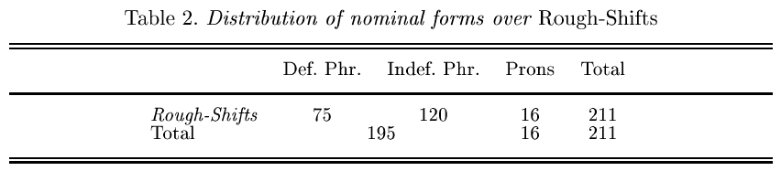
The role of Rough-Shift transitions
Incoherence due to introducing too many undeveloped topics
Rough-shifts measure discourse continuity even when anaphora resolution is not an issue
Rough shifts are the result of absent and extremely short-lived Cb’s

Slide 23
Implementation
Used corpus of 100 essays randomly selected from pool of GMAT essays
The essays cover full range of the scoring scale, where 1 is the lowest and 6 is the highest
Applied the Centering algorithm to the corpus and calculated the percentage of Rough-shifts in each essay
Run multiple regression to evaluate the contribution of Rough-Shifts to the performance of e-rater

Slide 24
Implementation
Manually tagged Co-referring expressions and Preferred Centers
Automated Discourse segmentation and the Centering Algorithm
The percentage of Rough-Shifts = number of Rough-shifts / the total number of identified transitions

Slide 25
An example of coherent text
Yet another company that strives for the “big bucks“ through conventional thinking is Famous name’s Baby Food. This company does not go beyond the norm in their product line, product packaging or advertising. If they opted for an extreme market-place, they would be ousted. Just look who their market is! As new parents, the Famous name customer wants tradition, quality and trust in their product of choice. Famous name knows this and gives it to them by focusing on “all natural“ ingredients, packaging that shows the happiest baby in the world and feel good commercials the exude great family values. Famous name has really stuck to the typical ways of doing things and in return has been awarded with a healthy bottom line.

Slide 26
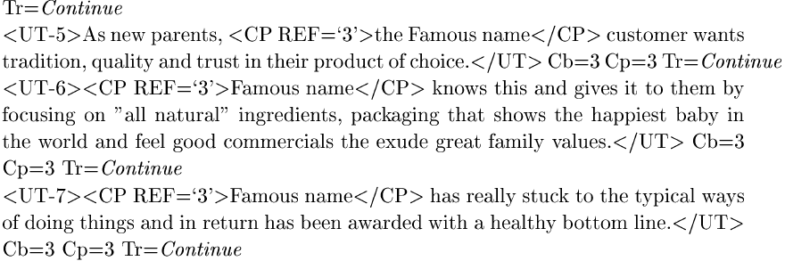
An example of coherent text

Slide 27
An example of incoherent text

Slide 28
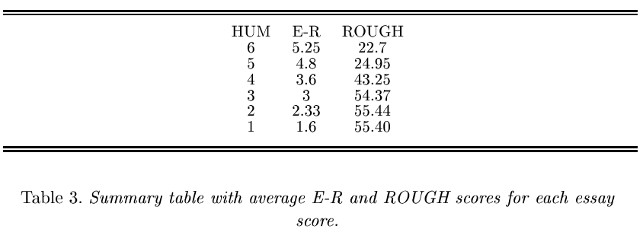
Study Results

Slide 29
Study Results

Slide 30
Summary
Essay scoring systems provide the opportunity to test theoretical hypotheses in NLP
Local discourse coherence is a significant contributor to evaluation of essays
Centering theory’s Rough-shift transitions capture the source of incoherence in Essays
Rough-shifts reflect the incoherence perceived when identifying the topic of a discourse structure
Rough-shift based metric improves performance, provides capability of instructional feedback

Slide 31
References
E. Miltsakaki and K. Kukich: The Role of Centering Theory's Rough-Shift in the Teaching and Evaluation of Writing Skills. In: Proceedings of ACL 2000
E. Miltsakaki and K. Kukich: Evaluation of text coherence for electronic essay scoring systems, In: Natural Language Engineering 10:1, 2004
Hearst, M., Kukich, K., Hirschman, L., Breck, E., Light, M., Burge,J., Ferro, L., Landauer, T. K., Laham, D., and Foltz, P. W., The Debate on Automated Essay Grading, in IEEE Intelligent Systems (Sept/Oct 2000)

Slide 32
The End! Many thanks!!

