Slide 1
Big Data
Akshit Gokuldas Karande
10303320191124510057

Slide 2
Agenda
Evolution of Data
What is Big Data ?
Big Data as an Opportunity
Problems in Encasing Opportunity
Hadoop As a solution

Slide 3



Evolution of Technology
Evolution of Technology
IOT
Social Media

Slide 4
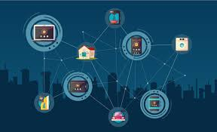
IOT
Evolution of Technology
IOT
Social Media
IOT : 50 Billion devices till now

Slide 5





Social Media
4,166,667 likes & 200,000 photos
204,000,000 emails
347,222 tweets
300 hours of video uploaded
1,736,111 Instagram pictures
Evolution of Technology
IOT
Social Media

Slide 6
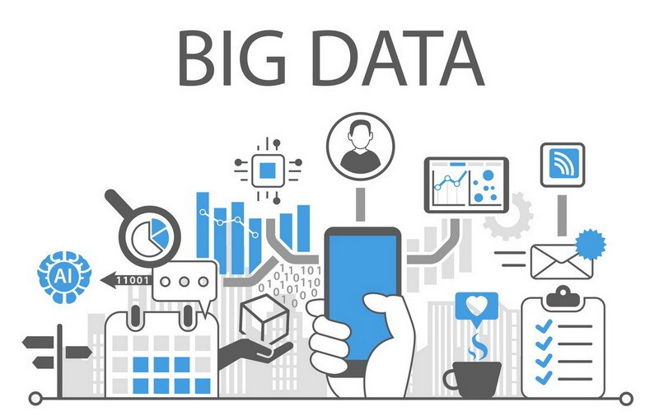
What is Big Data
Big Data is the term
for collection of data set
so large and complex that
it is difficult to process
using on-hand database
tools or traditional data
processing applications

Slide 7
Characteristic of Big Data
Big Data
Volume
Velocity
Variability
Variety
Veracity

Slide 8
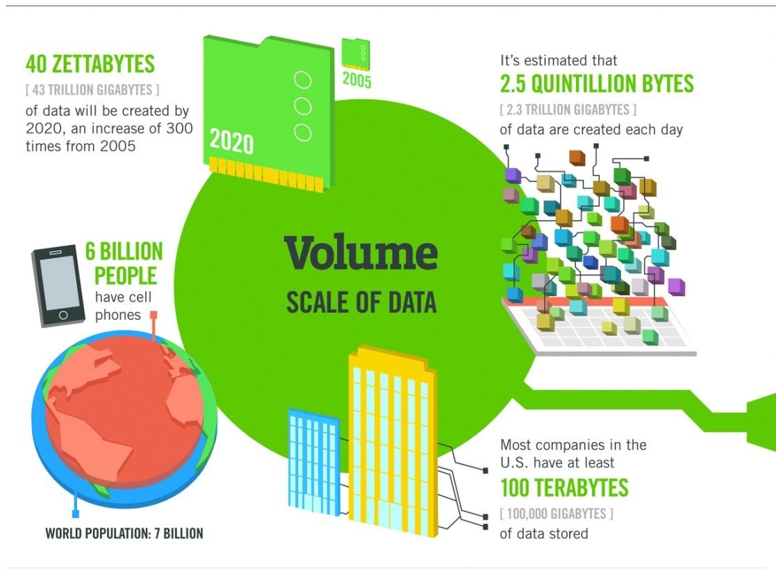
Volume
By now, accumulated
digital universe of data
will grow from 4.4 zeta bytes
today to around 44 zettabytes
or 44 trillion gigabytes

Slide 9
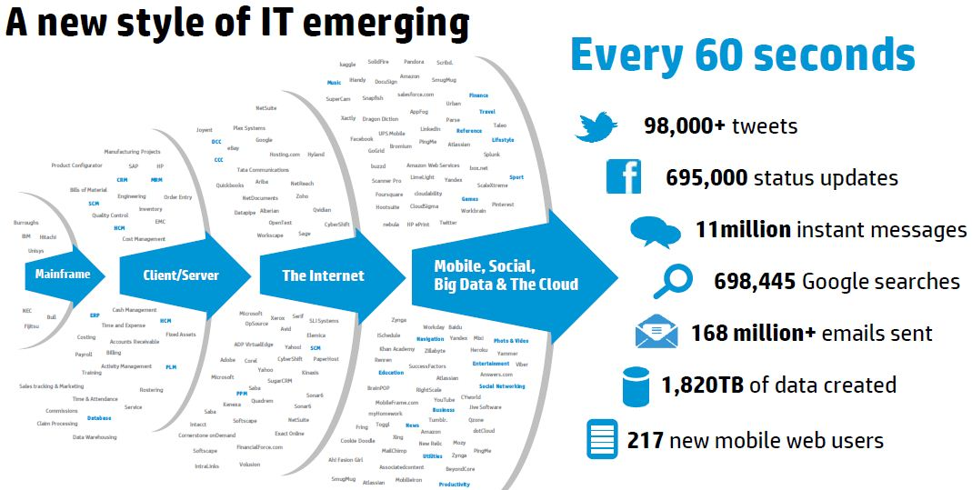
Velocity
Data is being generated at an alarming rate

Slide 10

Variability
Mechanism to bring
the correct meaning out
of the data

Slide 11
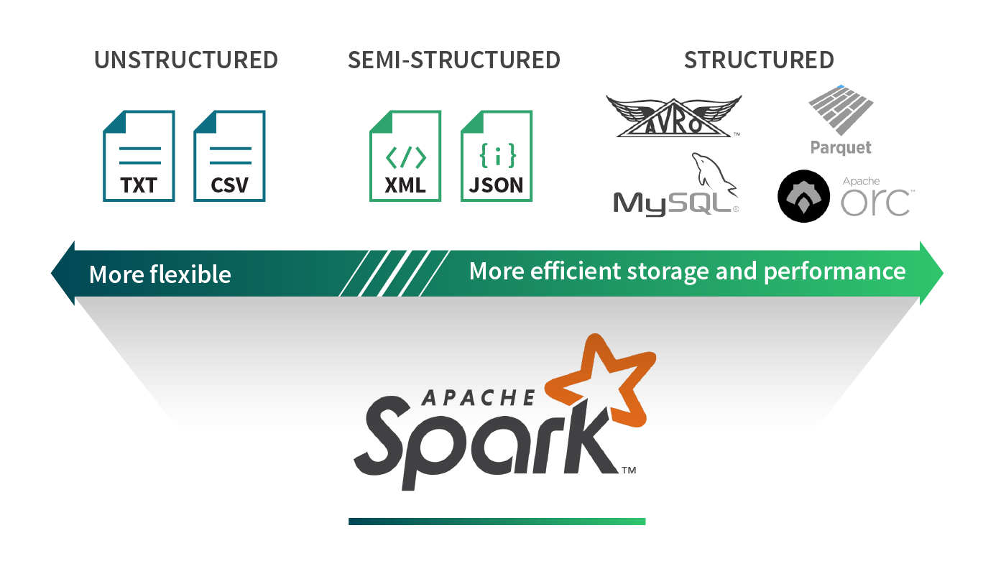
Variety
Different kinds of data being generated from various sources.

Slide 12
Veracity
Mean | Min | Max | Standard deviation
6.5 | 6.84 | 1000000 | 0.54
2.58 | 2.00 | 514 | 0.12
5.64 | 101 | ?? | 514798
415780 | ?? | 742 | 0.47
Uncertainty and inconsistencies in data

Slide 13
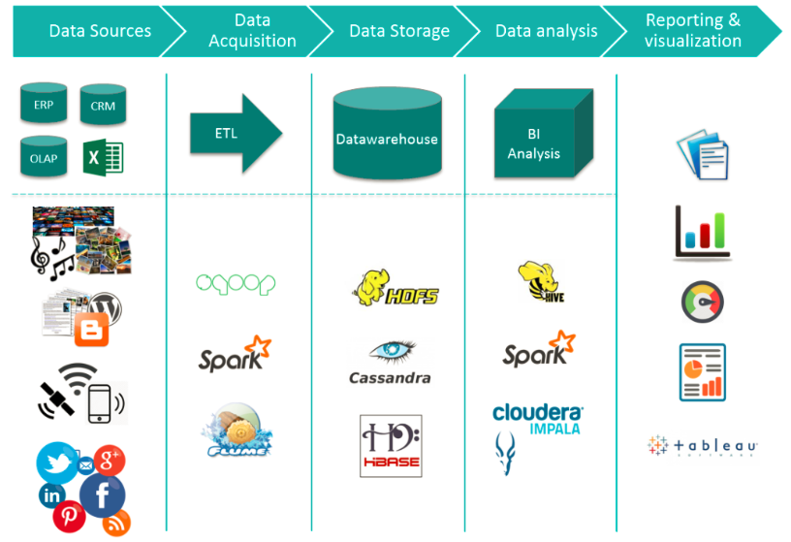
Big Data Eco-System
Notes:
ETL stands for 'Extract, Transform, and Load'. ETL is the process of moving your data from a source to a data warehouse. This step is one of the most crucial steps in your data analysis process.

Slide 14
Big Data Eco-System
Data Source
Data Acquisition
Data Storage
Data Analysis
Reporting & Visualization
Data Source : The bulk of big data generated comes from primarily
Social Data : Tweets & Rewets, Comments, Video Uploads, and general media that are uploaded and shared via the world’s favourite social media platforms.
Machine Data : Information which is generated by industrial equipment, sensors that are installed in machinery, and even web logs which track user behaviour.

Slide 15
Big Data Eco-System
Data Source
Data Acquisition
Data Storage
Data Analysis
Reporting & Visualization
Data acquisition is the process of sampling signals that measure real world physical conditions and converting the resulting samples into digital numeric values that can be manipulated by a computer.

Slide 16
Big Data Eco-System
Data Source
Data Acquisition
Data Storage
Data Analysis
Reporting & Visualization
A data warehouse is a type of data management system that is designed to enable and support business intelligence (BI) activities, especially analytics. Data warehouses are solely intended to perform queries and analysis and often contain large amounts of historical data. The data within a data warehouse is usually derived from a wide range of sources such as application log files and transaction applications.
Notes:
A relational database to store and manage data
An extraction, loading, and transformation (ELT) solution for preparing the data for analysis
Statistical analysis, reporting, and data mining capabilities
Client analysis tools for visualizing and presenting data to business users

Slide 17
Big Data Eco-System
Data Source
Data Acquisition
Data Storage
Data Analysis
Reporting & Visualization
Business Intelligence in simple terms is the collection of systems, software, and products, which can import large data streams and use them to generate meaningful information that point towards the specific use-case or scenario.

Slide 18
Big Data Eco-System
Data Source
Data Acquisition
Data Storage
Data Analysis
Reporting & Visualization
Business Intelligence in simple terms is the collection of systems, software, and products, which can import large data streams and use them to generate meaningful information that point towards the specific use-case or scenario.

Slide 19
Big Data as an Opportunity
Big Data Analytics
Cost Reduction
Next generation products
Improved services
Faster and better decision making

Slide 20
Big Data in Healthcare
Medical Research
With the available big data, medical researches are done very efficiently, and new treatments and medicines are discovered
Personalized treatment
Hyper-personal care is provided to each depending on their past medical history
Health of population
Cost reduction
Readmissions account for a significant reason for increased healthcare costs.
Analysing big data helps in identifying disease trends based on geography and demographics

Slide 21

Problems with Big Data
Problem 1: Storing exponentially growing huge datasets
Data generated in past 2 years is more than the previous history in total
By now, total digital data will grow to 44 Zettabytes approximately.
By now, about 1.7MB of new information will be created every second for every person.

Slide 22
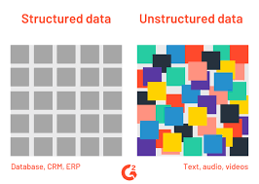
Problems with Big Data
Problem 2: Processing data having complex structure
Structured Data :
Organized data format
Data schema is fixed
Ex. RDBMS, Excel
Unstructured Data :
Unorganized data format
Unknown schema
Ex. Multimedia files

Slide 23
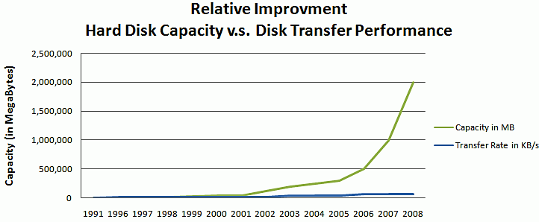
Problems with Big Data
Problem 3: Processing data transfer
The data is growing at much faster rate than that of disk read/write speed

Slide 24

Hadoop as Solution
Hadoop is a framework that allows us to store and process large data sets in parallel and distribution fashion

Slide 25
HDFS
MapReduce
Allows to dump any kind of data across the cluster
Allows parallel processing of data stored in HDFS

Slide 26
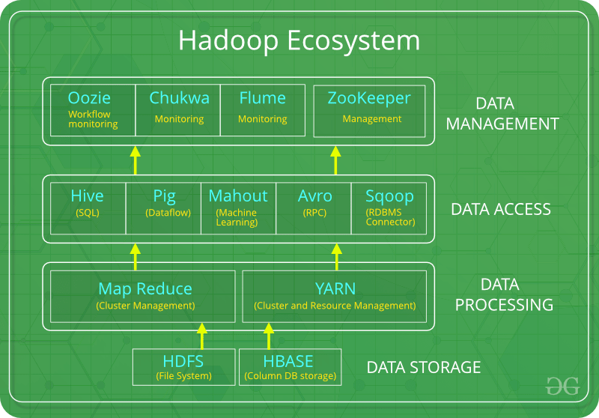
Hadoop Eco-system

Slide 27
Hadoop Eco-system
DATA STORAGE
DATA PROCESSING
DATA ACCESS
DATA MANAGEMENT
HDFS : The Hadoop Distributed File System (HDFS) is a distributed file system. HDFS is highly fault-tolerant and is designed to be deployed on low-cost hardware.
Hbase : Is a column-oriented non-relational database management system that runs on top of Hadoop Distributed File System (HDFS). HBase provides a fault-tolerant way of storing sparse data sets.

Slide 28
Hadoop Eco-system
DATA STORAGE
DATA PROCESSING
DATA ACCESS
DATA MANAGEMENT
MapReduce is a processing technique and a program model for distributed computing based on java. The MapReduce algorithm contains two important tasks, namely Map and Reduce. Map takes a set of data and converts it into another set of data, where individual elements are broken down into tuples (key/value pairs). Secondly, reduce task, which takes the output from a map as an input and combines those data tuples into a smaller set of tuples.

Slide 29
Hadoop Eco-system
DATA STORAGE
DATA PROCESSING
DATA ACCESS
DATA MANAGEMENT
Pig :
Pig was basically developed by Yahoo which works on a pig Latin language, which is Query based language similar to SQL.
It is a platform for structuring the data flow, processing and analysing huge data sets.
Hive
With the help of SQL methodology and interface, HIVE performs reading and writing of large data sets. However, its query language is called as HQL (Hive Query Language).
It is highly scalable as it allows real-time processing and batch processing both.

Slide 30
Hadoop Eco-system
DATA STORAGE
DATA PROCESSING
DATA ACCESS
DATA MANAGEMENT
Oozie:
Oozie simply performs the task of a scheduler, thus scheduling jobs and binding them together as a single unit.
Zookeeper:
There was a huge issue of management of coordination and synchronization among the resources or the components of Hadoop which resulted in inconsistency, often. Zookeeper overcame all the problems by performing synchronization, inter-component based communication, grouping, and maintenance.

Slide 31
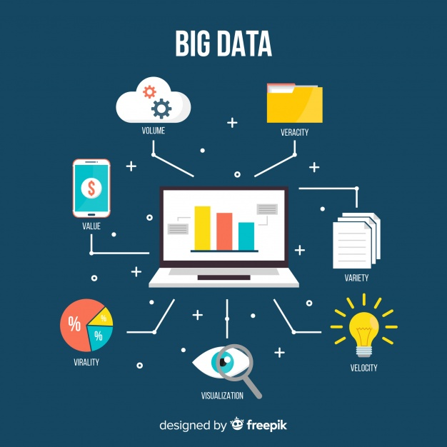
Thanks you

