Slide 1
Tor Browser and the onion routing

Slide 2
What is anonymity?
situations where the acting person's identity is unknown
person be non-identifiable, unreachable, or untrackable

Slide 3
Need for anonymity
To hide user identity from target websites.
To hide browsing patterns from employer or ISP
To protect privacy and liberty
To be safe any secure from hackers
For secret communications(like spy, military etc)
Protect websites
Can be used to access banned websites in country
Easily run illegal websites
Purchase illegal products on dark web
Do illegal activities over internet

Slide 4
Tor Benefits
User can access normal websites in an anonymous manner
Site owners can also host sites anonymously

Slide 5

Understanding PGP(Pretty Good Privacy)
Person A
Person B
The Internet
This Photo by Unknown Author is licensed under CC BY-SA
This Photo by Unknown Author is licensed under CC BY-SA

Slide 6

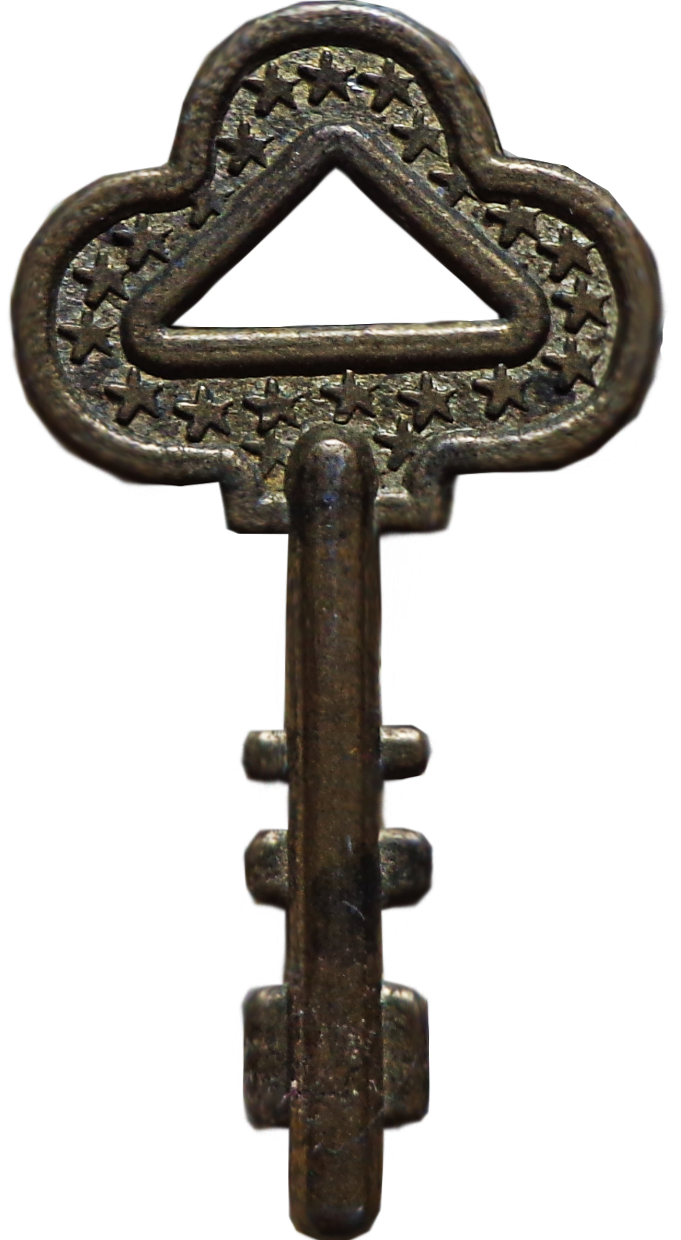
Person A
Person B
My pin
is 1423
The Internet
wpL010
nCI4E0
Private
Key
Public
Key
This Photo by Unknown Author is licensed under CC BY-SA
This Photo by Unknown Author is licensed under CC BY-SA

Slide 7
Perfect forward Secrecy

Slide 8



User
Entry
Node
Middle
Node
Exit node
Node 2
Node 3
Node 1
Web site
Director Server
This Photo by Unknown Author is licensed under CC BY-SA

Slide 9




Request Chain
Public Key
of Node 3
Public Key
of Node 2
Get link
linkedin.com
Public Key
of Node 1
Message for
Node 3
Message for
Node 2
Message for
Node 1

Slide 10

Request Chain
For
Node 2
For
Node 2
linkedin.com
Message for
Node 1
Message for
Node 2
Message for
Node 3

Slide 11
Directory Servers
Maintain list of all Tor nodes

Slide 12
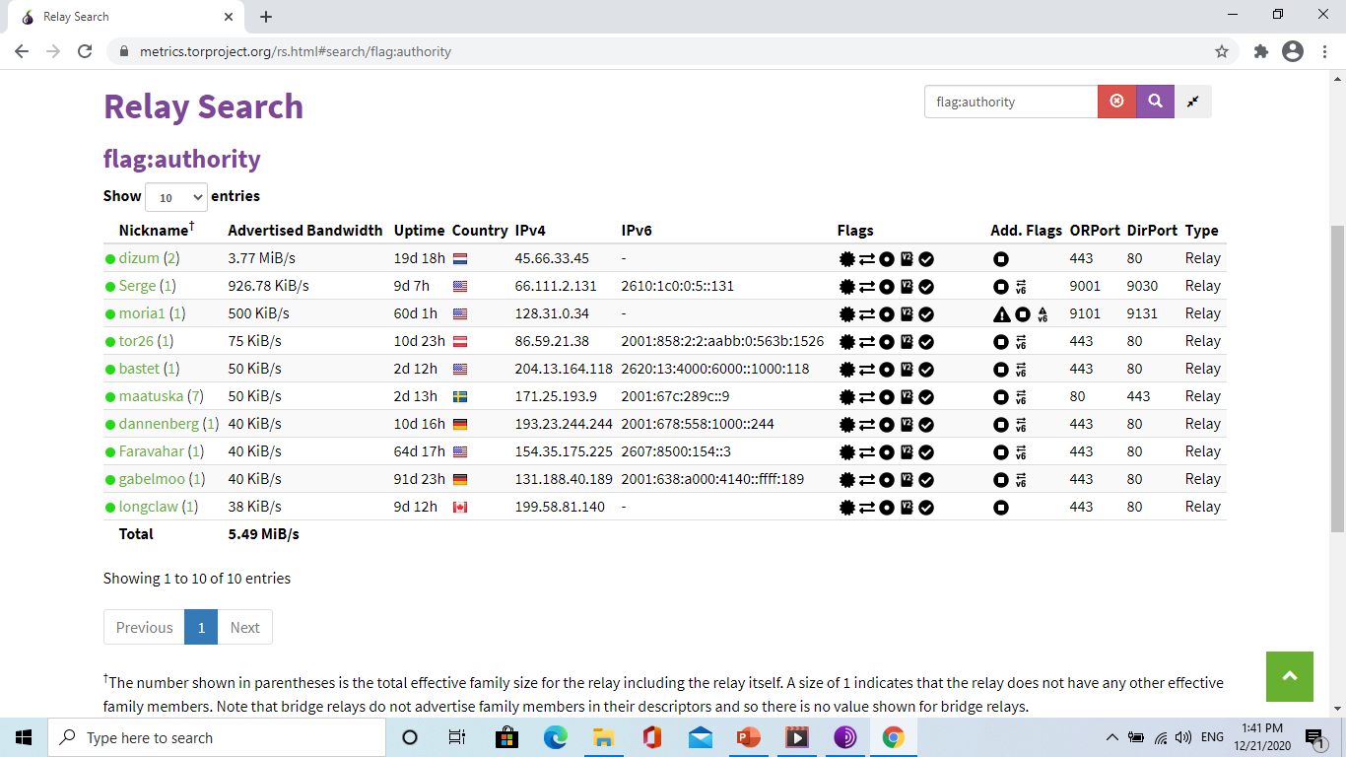

Slide 13
 | Bandwidth | Uptime | IPv4 | Type
 | 3.22 MiB/s | 4d 23h | 194._._.212 | Relay
 | 500 KiB/s | 50d 9h | 66._._.131 | Relay
 | 75 KiB/s | 85d 3h | 128._._.34 | Relay

Slide 14
Bridge Nodes
Advertised nodes
These nodes are listed in Tor directory.
Bridge Nodes
Nodes that are not listed on tor directory servers.

Slide 15

Hidden Sites and the Dark Web
https://jcw5q6uyjioupxcc.onion
Onion URL
Washington Post SecureDrop

Slide 16


Introduction points
IP
IP
Hidden Site
Registers onion address
and introduction points
Onion Database

Slide 17

Introduction points
IP
2) Selects rendezvous points(RP)
User
IP
Hidden Site
1)Requests Introduction points
On onion address
Onion Database

Slide 18
Introduction points
IP
User
IP
Hidden Site
Sends rendezvous points (RP)
Address to the hidden server
Through the Instruction points(IP)
Onion Database

Slide 19
Introduction points
IP
User
IP
Hidden Site
Instruction points(IP)
Sends server the rendezvous points (RP)
Through a different Tor
circuit
Onion Database

Slide 20
Introduction points
IP
User
IP
Hidden Site
User and server each
Build a new Tor circuit
To RP and communicate
Through RP (Rendezvous Point)

Slide 21
TOR alternatives
FreeNet
Tails
I2P
Subgraph os
Freepto

Slide 22
The End Thank you

