Slide 1
A seminar on
HYDROPONIC FARMING
Submitted To,
Mr.Vinayak V. Mukkawar

Slide 2
INTRODUCTION
“cultivation of plants in water”
It is technique for growing plants without soil. Utilizing this technology, then roots absorb balanced nutrient dissolved in water that meets all the plant developmental require.
Many agreements and media support plant growth.
Also called as “the cultivation of plants without using soil”

Slide 3
HISTORY OF HYDROPONIC
Hydroponic become popularized by the news media in the 1920s when a scientist named dr. William f. Gericke of the university of California when he laboratory experiments in plants nutrition on commercial scale. So he termed these nutriculture system hydroponics.
The word was derived from Greek words, HYDRO (water),and PONOS (labor), literally “water working”.

Slide 4
How does hydroponic system work
Stand your plant in plastic through and let a nutrient solution trickle past their root(with the help of gravity)
The following are the basic function of the soil which have to be provided in water based farming in the absence of soil.
Plant root system support
supply of nutrients
Supply of oxygen
Supply of water

Slide 5
Types of Hydroponic System
Wick system
Water culture
Ebb and flow(drain and flow)
Drip system recovery
N.F.T.(Nutrient film Technique)
Aeroponic system

Slide 6
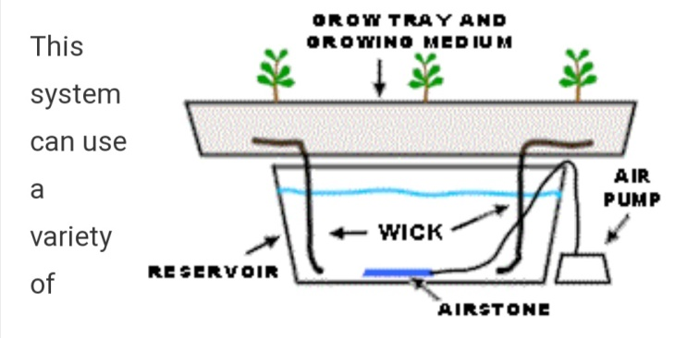
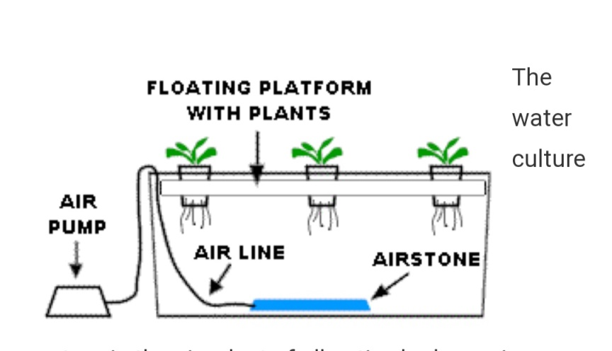
1.Wick system 2. water culture

Slide 7
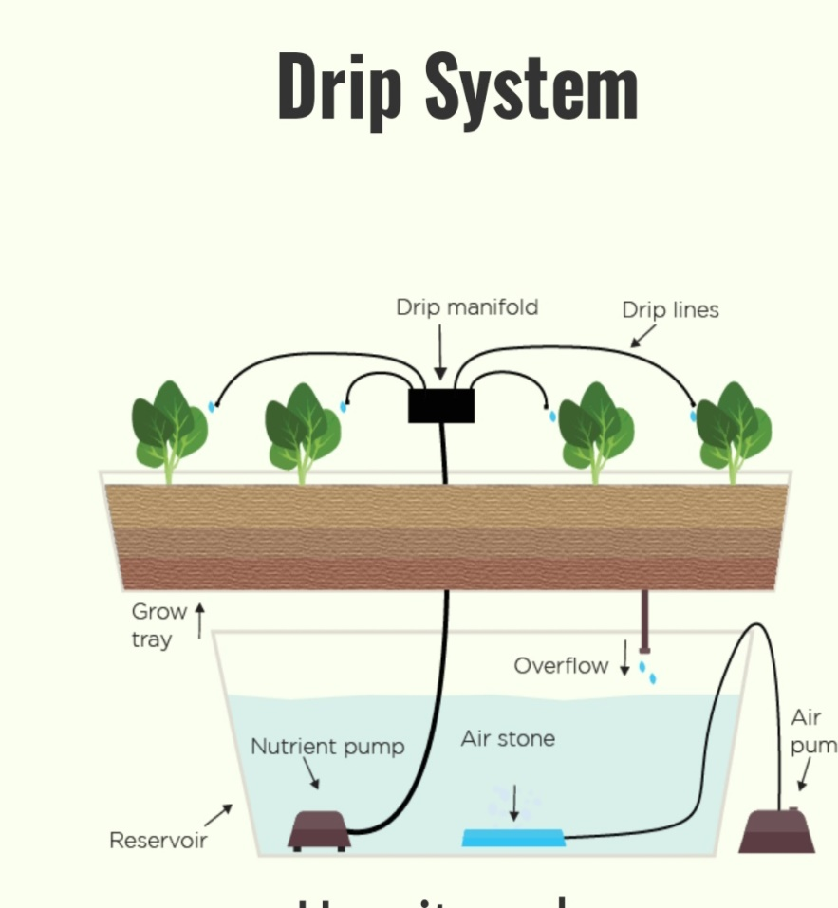
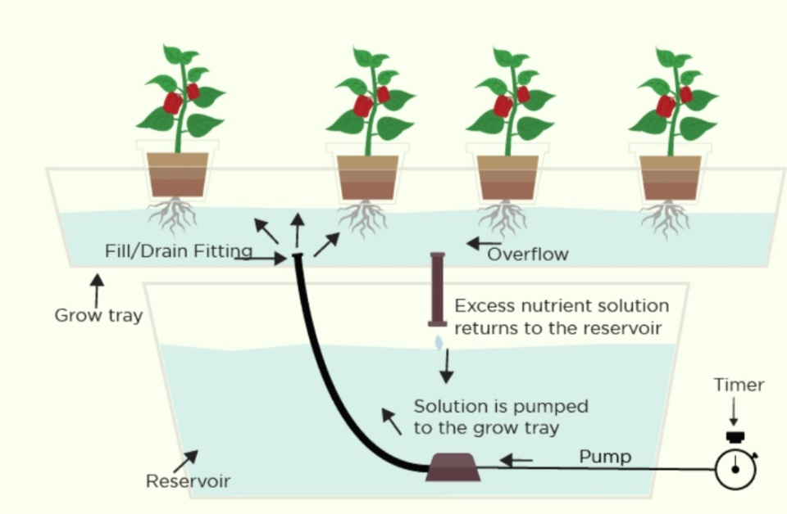
3.Drip system 4.Ebb and flow (flood and drain)

Slide 8
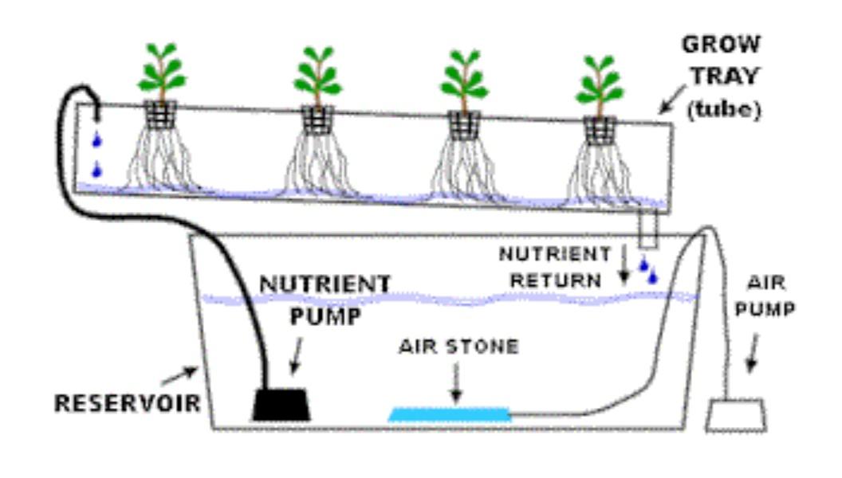
5.Nutrient Film Technique

Slide 9
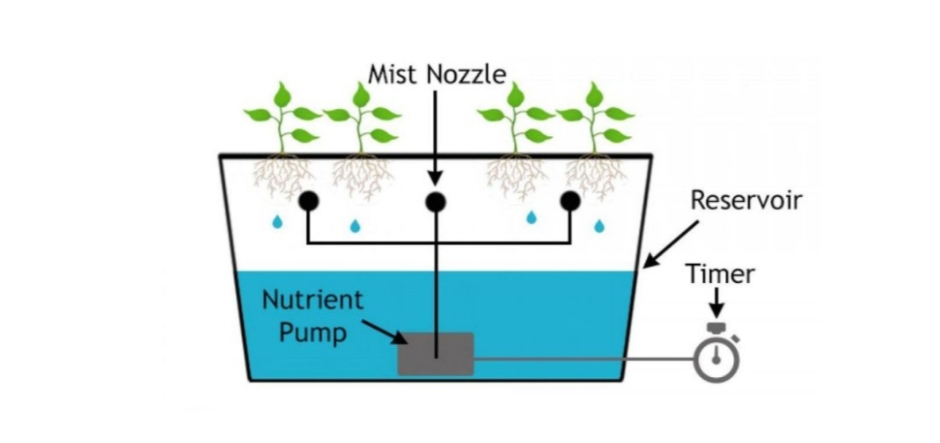
6.Aeroponic system

Slide 10
Material required for hydroponic farming
Nutrient solution : the nutrient solution should be a blend of important element such as the nitrogen, potassium, calsium ,magnesiumetc.
Hydroponic farming can be done either with the medium or without the medium. Some medimum are used given follow
Rock wool
Clay, gravel , sand
Vermiculite , perlite

Slide 11
List of plants cultivated using Hydroponic farming
Greens : spinach , chard, cabbage ,lettuce, celery, mint etc.
Vining plants: tomatoes, cucumbers, peas etc.
Root plants: potatoes , carrots, radish etc.
Fruits : raspberries , strawberries small papaya , peppers etc.
Herbs: basil , parsley, rosemary ,chives, sweet marjoram , watercress ,dill etc.

Slide 12
Hydroponic farming vs traditional farming
Soil is not able to produce as much nutrients per area as the root system.
Soil loses nutritional value.
Labor intensive work such as tilling, cultivating, fumigation,and watering is not required for hydroponic farming.
Diseases in hydroponic system can spread very quickly.

Slide 13
Advantages
Save space.
Water conservation
Fewer chemicals
Faster growth
Nutrient control
Weeds are eliminated
Plants are healthier

Slide 14
disadvantages
Knowledge and experiences
System failure threats
Water and electricity risks
Big initial investment
Plant disease

Slide 15
Conclusion
Progress has been rapid and results obtained in various countries have proved that this technology is thoroughly practical and has very definite advantages over conventional methods of crop production.
The main advantages of soil less cultivation is the much higher crop yield.
People living in crowded city streets , without gardens, can grow fresh vegetables and barren and sterile areas can be made productive at relatively low cost.

Slide 16
Thank you….

