Slide 1
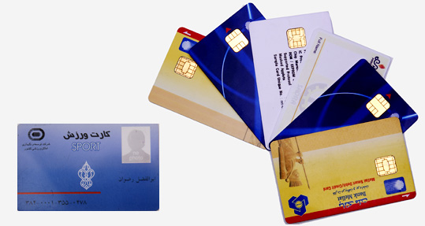
SMART CARDS
Ayush Patle
PRN:10303320181124510002

Slide 2
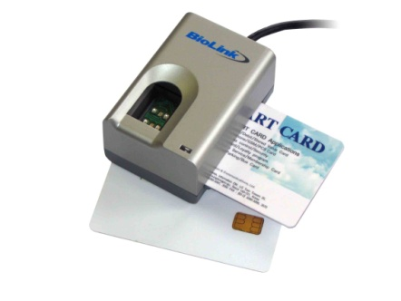
What is a Smart Card?
Plastic Card.
Microchip loaded with data.
Uses - telephone calling, electronic card payment.
Can be refreshed for further use.
Smart Cards can be used with a Smart-Card Reader attachment to a personal computer to authenticate a user.

Slide 3
History of Smart Cards
Smart Card has its origin in 1970s by inventors from Germany, Japan and France.Until mid 80s most of the work on Smart Cards was at the research and development level.
First mass use was for payment in French payphones.
The manufacturers of Smart Cards are Gemplus, IBM, Siemens,Telesec and many more.

Slide 4
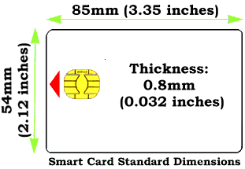
Standard Dimension of a Smart Card

Slide 5
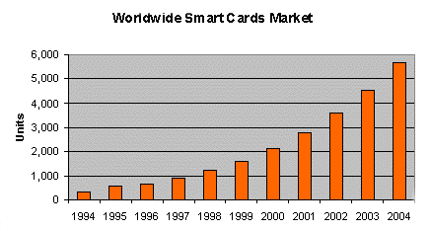
The current world population of Smart Cards is nearly 3 billion.

Slide 6
What is SMART about the Smart Card ??
Smart Cards are capable of not just storing data but also have processing power. They have larger storage capacity when compared to magnetic swipe cards. The data stored can be protected against unauthorized access and tampering. They are appropriate for secure and convenient data storage.

Slide 7
Types of Smart Cards
Based on the way the smart card interacts with the Reader, smart cards are of two types
Contact Smart Cards: These require insertion into the Card reader.
Contact less Smart Cards: These require close proximity of the reader.

Slide 8
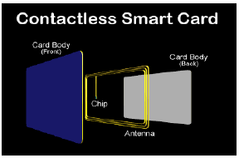
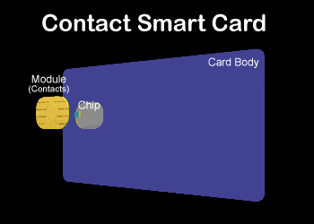
The contact smart card consists
of small contact plate on the
face, which is ½’’ in Diameter.
The transmission of data takes
place when this contact plate
comes in contact with the
connector of the reader.
This card consists of an IC Chip
and an antenna coil embedded
into it.
These cards are mainly used
when transactions must be
processed quickly.

Slide 9
Applications of Smart Cards
In Banks: They are used as credit/debit bank cards
Medical applications: they can be used as Health insurance card or Medical File Access Card.
In Transportation Services: for urban parking, Airline Application and Electronic Toll Collection.
used as identification cards

Slide 10
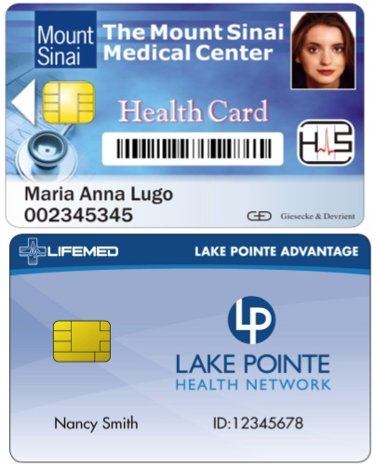
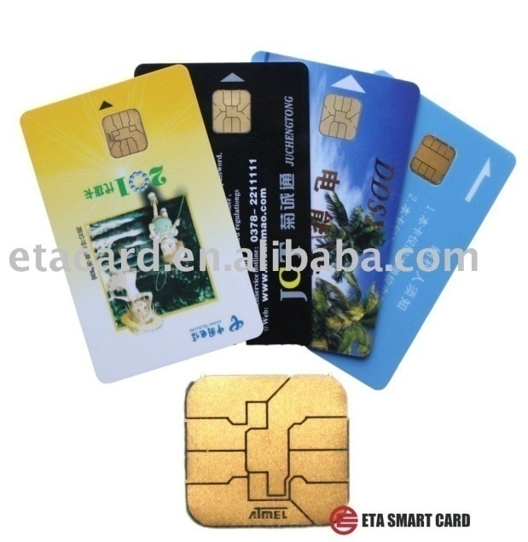
Why Smart Cards
Increased security,
Potential user mobility,
Sequential access to one machine by
multiple users..

Slide 11
THANK YOU….

