Slide 1

BED ALLOTMENT SYSTEM
1
By, Harshal Chaudhari
Guide: prof. Rahul rathod

Slide 2

INTRODUCTION
2
BACKGROUND
Hospitals deal with the life and health of their patients. Good medical care relies on well trained doctors and nurses and on high quality facilities an equipment. Good medical care also relies on good record keeping…
TODAY’S CONDITION
As the growth rate on a daily basis is increasing, the impact can be seen on the overall growth rate of the novel Coronavirus cases in India. India reported over 5.8 million cases of the coronavirus (COVID-19) as of September 25, 2020, with more than 4.7 million recoveries and about 92 thousand fatalities…

Slide 3

LITERATURE SURVEY
3
focused on minimizing patients' length of stay for pandemic by developing a web application for allocating bed in the hospital.
We have to consider the following points for side by research:
AUTOMATION
ALLOTMENT
BED MANAGEMENT SYSTEM

Slide 4

AUTOMATION
4
Automation is the creation and application of technologies to produce and deliver goods and services with minimal human intervention. The implementation of automation technologies, techniques and processes improve the efficiency, reliability, and/or speed of many tasks that were previously performed by humans.
Automation is being used in a number of areas such as manufacturing, transport, utilities, defense, facilities, operations and lately, information technology.

Slide 5

ALLOTMENT
5
the act of allotting.
a portion or thing allotted;
a share granted.

Slide 6
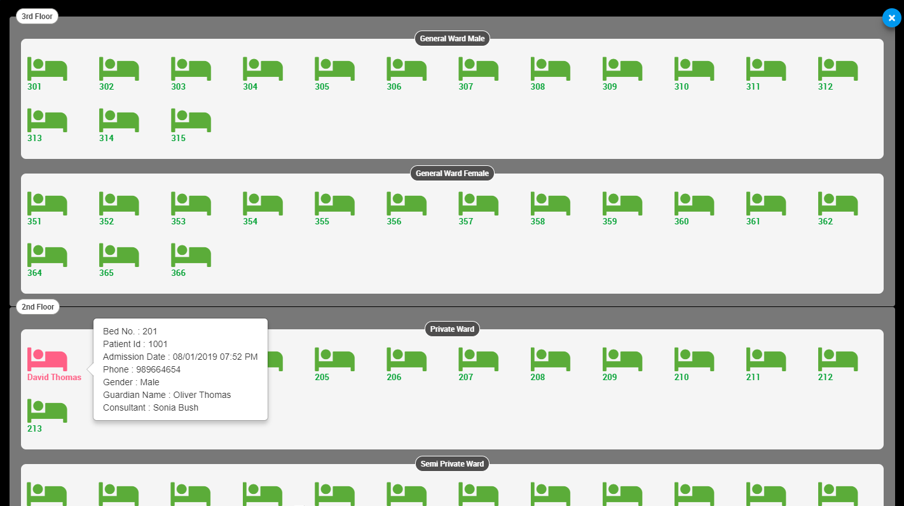
BED MANAGEMENT SYSTEM
6
State Specialist Hospital, government hospital with various departments in which patients are directed to depending on their health issues. Beds are allocated at the level of hospital ward which is based on hospital units; such as:
General Unit
Surgical Unit
Children's ward
Dentist Unit
Maternity Unit

Slide 7
PROBLEM STATEMENT
7
we have develope a web application for the bed allotment in hospitals for pandemic times and also for the regular use which is more eFFICient AND easy to usE.

Slide 8
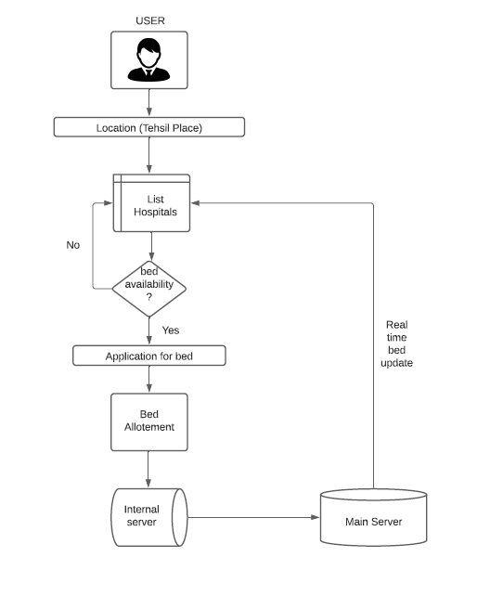
SYSTEM ARCHITECTURE
8
USER SYSTEM ARCHITECTURE:

Slide 9
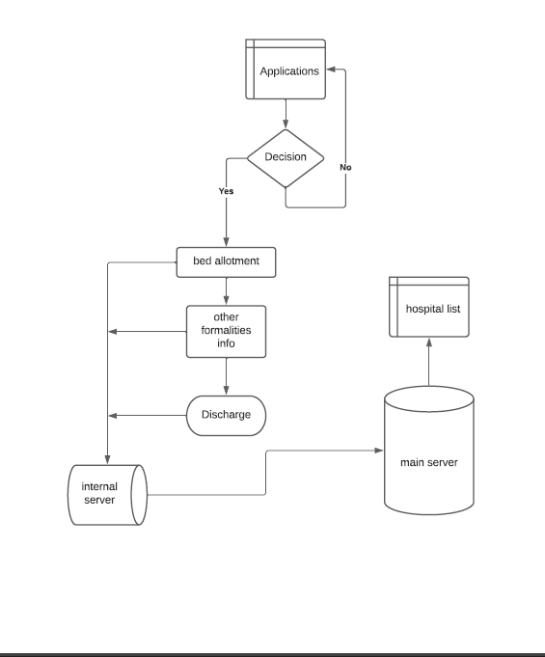
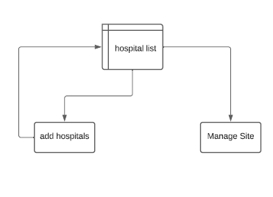
9
HOSPITAL SYSTEM ARCHITECTURE
ADMIN SYSTEM ARCHITECTURE

Slide 10


IMPLIMENTATION OF SYSTEM
10
LOCATION
APPLICATION
BED ALLOTMENT
APPROVED APPLICATION
CLARICAL FORMALITIES
UPDATES

Slide 11

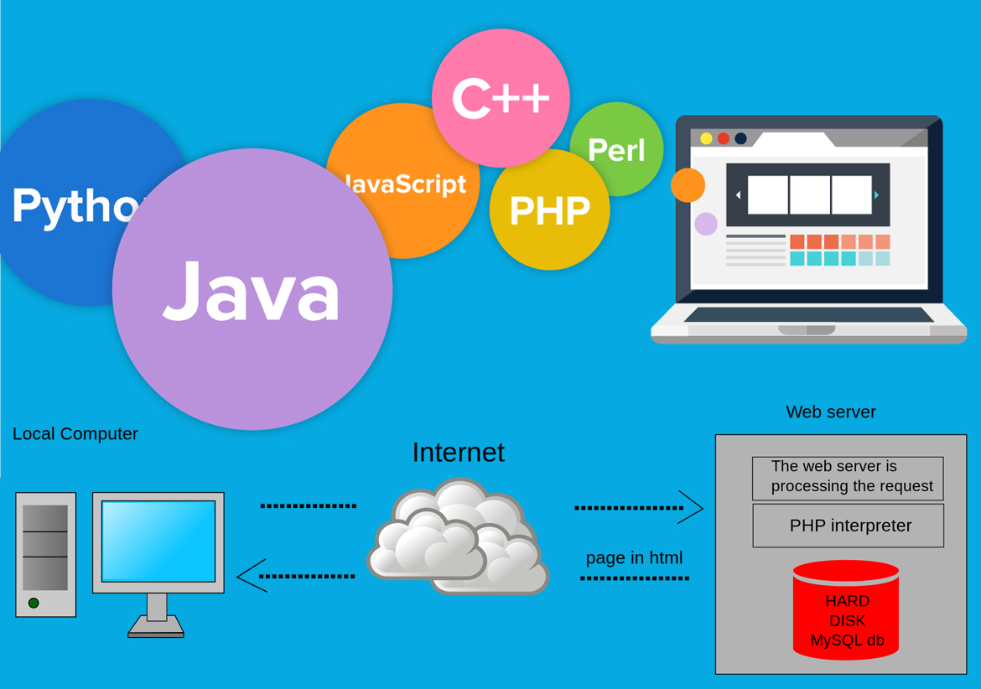
TECHNOLOGY
11
CLIENT SIDE :
HTML
CSS
REACTJS
JAVASCRIPT
SERVER SIDE:
PHP
MYSQL
APACHE

Slide 12
ADVANTAGES
12
Minimize the waiting time for patients during an emergency.
Reduces the rush for hospitals bed.
Online Application easy to access
Restrict the frauds in bed allotment.
Most usefull for the pandemic situations.
Reduces the hectic pen paper work for hospitals

Slide 13
CONCLUSION
13
we came to know how this system will help patients as well as hospital management also how automation work to make our day to day life easy. Also, we see what is automation, allotment and many more definitions related to the topic.
we also came to know that how this system will work and implementation of this system, system architecture, technology use for this system, literature survey for more related information of the system and at last the advantages of this system.

Slide 14
FUTURE SCOPE
14
As we see when their will be the pandemic situation. this system will help patients to manage all things by themselves also without rush for the searching of the bed availability in hospitals. Also helpful for hospitals to reduce pen paper work and go with digital way which will more helpful and accurate to work efficiently. Also it restrict the frauds and cheatings in bed allotments by hospitals and other powerful people.

Slide 15
THANK YOU!
15

