Slide 1
Dr. Babasaheb AmbedkarTechnological University , Lonere. Department of Computer Engineering seminar on Cryptography presentd by Dhumal Susmita Madhavrao (10303320191124510066) Guided by Pramod R. Patil (Research Dept.)

Slide 2
CONTENTS
Introduction
What is Cryptography ?
Types of Cryptography.
Benefits of cryptography
Classification of cryptography
Symmetric key cryptography
Asymmetric key cryptography
Substitution and Transposition
Stream cipher and Block cipher
Digital signature
Application
Conclusion
Reference

Slide 3

INTRODUCTION Cryptology can be defined as art of writing down the codes and solving them. The cryptology deals with the codes. Cryptography is a method of protecting information and communications through the use of codes, so that only those for whom the information is intended can read and process it. The prefix "crypt-" means "hidden" or "vault" -- and the suffix "-graphy" stands for "writing.“

Slide 4
What is cryptography?
Cryptography can be defined as the study and practice of construction and analysis of protocols that avoid the public or third parties from reading the private message of sender and receiver.
Cryptography allows sending the coded message to the receiver and receiver receives that message and decodes it and then read it. The message sent and received between sender and receiver is private and they might be sensitive and important.
More generally , it is about constructing and analyzing that overcome the influence of adversaries and which are related to various aspects in information security such as data confidentiality, data integrity, and authentication.

Slide 5
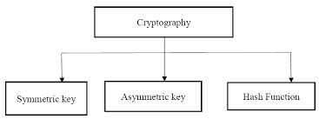
Types of cryptography In general there are three types Of cryptography: 1. Symmetric Key Cryptography: It is an encryption system where the sender and receiver of message use a single common key to encrypt and decrypt messages. ... 2. Hash Functions: There is no usage of any key in this algorithm. ... 3. Asymmetric Key Cryptography:

Slide 6
Benefits of cryptography
Cryptography is an essential information security tool. It provides the four most basic services of information security
CONFIDENTIALITY − Encryption technique can guard the information and communication from unauthorized revelation and access of information.
AUTHENTICATION − The cryptographic techniques such as MAC and digital signatures can protect information against spoofing and forgeries.
DATA INTEGRITY − The cryptographic hash functions are playing vital role in assuring the users about the data integrity.
NON-REPUDIATION − The digital signature provides the non-repudiation service to guard against the dispute that may arise due to denial of passing message by the sender.
All these fundamental services offered by cryptography has enabled the conduct of business over the networks using the computer systems in extremely efficient and effective manner.

Slide 7
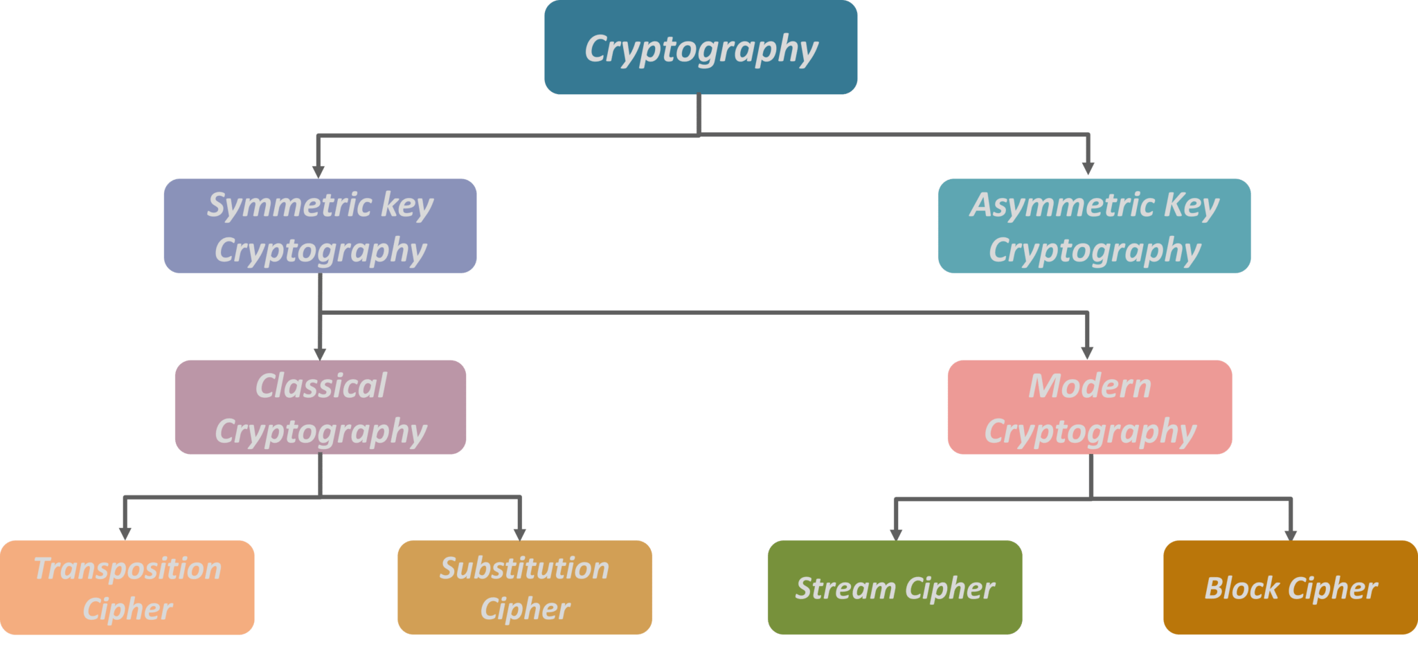
Classification of cryptography

Slide 8
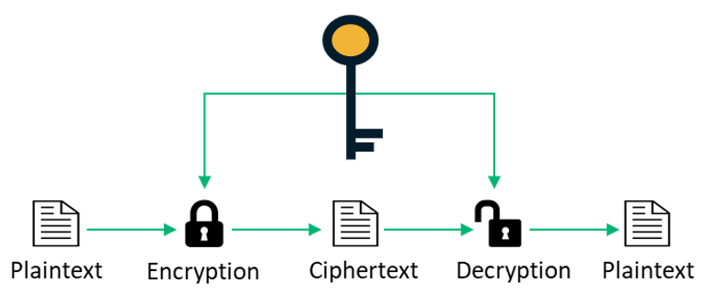
Symmetric key cryptography Symmetric Key Cryptography also known as Symmetric Encryption is when a secret key is leveraged for both encryption and decryption functions. This method is the opposite of Asymmetric Encryption where one key is used to encrypt and another is used to decrypt.

Slide 9
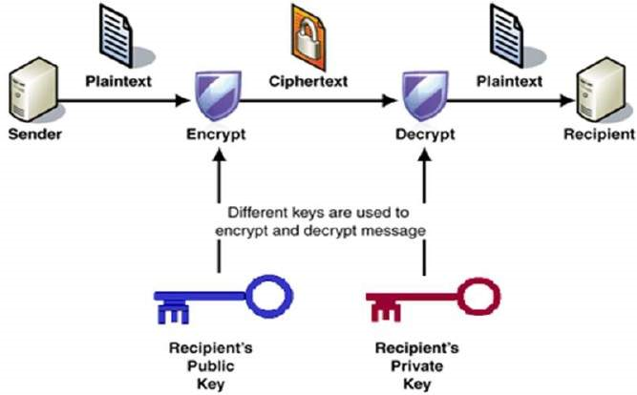
Asymmetric key Cryptographic Asymmetric encryption, also known as public-key encryption, is a form of data encryption where the encryption key (also called the public key) and the corresponding decryption key (also called the private key) are different. Therefore, a recipient could distribute the public key widely.

Slide 10
Substitution and Transposition Technique
Substitution and Transpositions is classical cryptography of symmetric key.
Substitution technique is a classical encryption technique where the characters present in the original message are replaced by the other characters or numbers or by symbols.
Substitution techniques are: Caesar’s cipher, Monoalphabetic and Polyalphabetic ,One-time pad.
Transposition technique is a cryptographic technique that converts the plain text to cipher text by performing permutations on the plain text i.e change the position of each character of plain text for each round.
Transposition technique are: Rail Fence Technique, columnar Transposition.

Slide 11
Stream Cipher and Block cipher
Stream cipher and block cipher is a modern cryptography of symmetric key.
A stream cipher is a method of encrypting text (to produce cipher text) in which a cryptographic key and algorithm are applied to each binary digit in a data stream, one bit at a time. This method is not much used in modern cryptography.
block cipher is an encryption method that applies a deterministic algorithm along with a symmetric key to encrypt a block of text, rather than encrypting one bit at a time as in stream ciphers.

Slide 12
Digital Signature
A digital signature is exactly what it sounds like a modern alternative to signing documents with paper and pen.
It uses an advanced mathematical technique to check the authenticity and integrity of digital messages and documents. It guarantees that the contents of a message are not altered in transit and helps us overcome the problem of impersonation and tampering in digital communications.
Digital signatures also provide additional information such as the origin of the message, status, and consent by the signer.

Slide 13
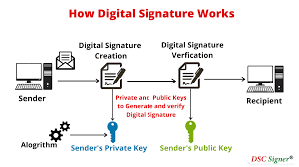
Figure of digital signature

Slide 14
Application of cryptography
Defence services
Secure data manipulation
E- Commerce
Business transactions
Internet payment systems
User identification system
Access control
Data security

Slide 15
Conclusion
Cryptography, being an art of encrypting and decrypting confidential information and private messages, should be implemented in the network security to prevent any leakage and threat.
By using of encryption techniques a fair unit of confidentiality, authentication, integrity ,access control and availability of data is maintained.

Slide 16
Reference
https://searchsecurity.techtarget.com/definition/cryptography#:~:text=Cryptography%20is%20a%20method%20of,%22%20stands%20for%20%22writing.%22
https://en.wikipedia.org/wiki/Cryptography
Books:
William Stallings, Cryptography and Network Security, 3rd edition, Pearson Education (2004).

Slide 17
Thank you

