Slide 1
Humanoid
A PRESENTATION ON
NAME: Dipak Dnyanoba Budde
ROLL : 10303320181124510030

Slide 2
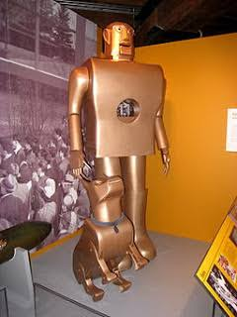
Introduction
Robotics deals with robots.
Recent enhancement in robotics - Humanoid robots
Humanoid robots - having human characteristics or form
Resemble human both in appearance and behavior
“Elektro” is the first Humanoid Robot.

Slide 3
Need for Humanoid Robots
• Human-like motion and kinetics help robots work in an environment suited for humans .
• Humanoid construction helps interaction with humans and learn new tasks from these interactions.
• Human appearance makes robots more acceptable and allows generation of speech and gestures.
Because it is a dream of generations .

Slide 4
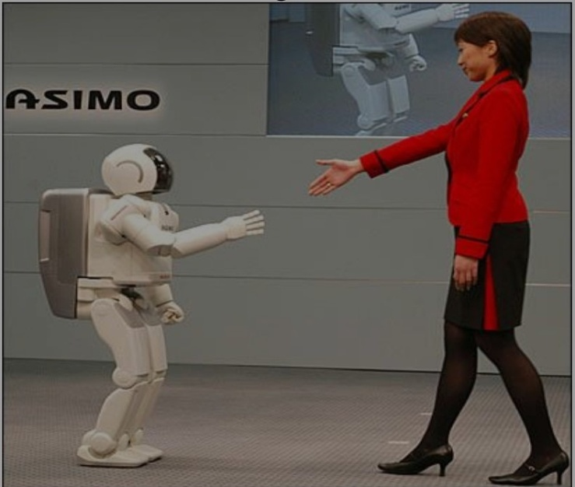
History
➢ Integration of scientific and engineering fields, has a social dimension
➢ WASEDA University- leading research sites ➢ First usable robot by HONDA in 1996
➢ HONDA Humanoid robots-brief history
➢ First high profile humanoid robot-Honda’s ASIMO- 2000

Slide 5
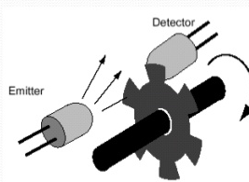
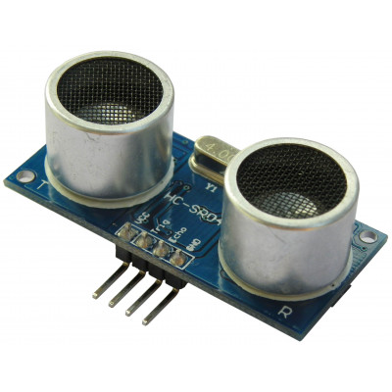
Composition
Main components
Actuators – motion motors
Sensors – measure some attribute(sensing)
proprioceptive
exteroceptive
Others
Manipulators
Power source
proprioceptive
exteroceptive

Slide 6
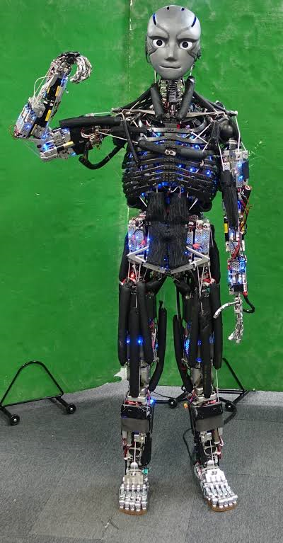
Examples of Humanoid Robots
KANGARO (Y Asano)

Slide 7
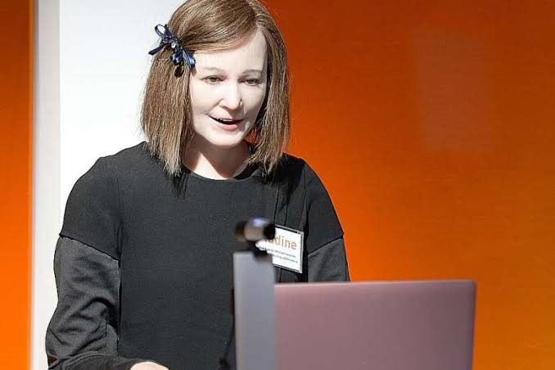
Nadline (nadia)

Slide 8

Erica (H.Ishiguro)

Slide 9
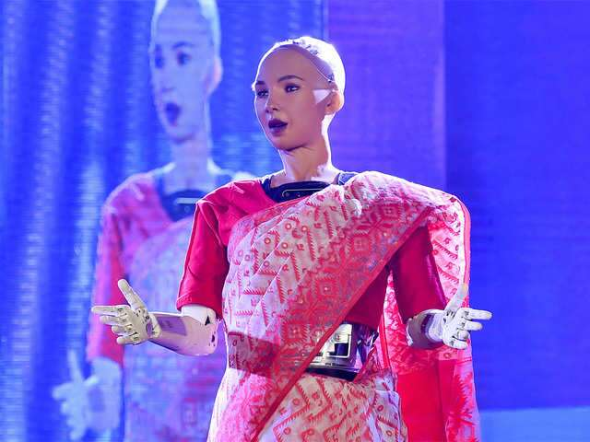
Sophia (D.Hanson)

Slide 10
Advantages and disadvantages
Advantages
Safe load carrying
Good efficiency
High accuracy
Less time consuming
Disadvantages
High cost
Requires specialized people
for maintenance

Slide 11
Conclusion
Safely move the objects co-operatively
Corrects position and speed of two robots
Smooth co-ordination
Carry objects safely on various surfaces
Scope for improvement
Design user friendly humanoids for Layman
Cost effectiveness

Slide 12
Thank You .

