Slide 1

3D INTERNET
Next World Of
Smart Internet

Slide 2
Objectives
Introduction
What is 3D Internet
Why 3D Internet
Architecture and Components
Evolution of 3D Internet
2D Technology --> 3D Technology
Future of Internet
Applications
Advantages and Disadvantages
Examples of 3D Internet
Conclusion
References

Slide 3
Introduction
The Internet is evolving to become the de-facto cyberspace or virtual environment facilitating communication, business and entertainment on a global scale.
A typical 2D website is an extremely abstract entity and consists of nothing but a bunch of documents and pictures.
With in the Website at every level of interaction the developers have to provide the user immediate navigational help. Otherwise the user would get lost sooner or later.
3D Internet is actually a much better alternative way of organizing data which everybody knows and uses.

Slide 4
What is 3D internet
Combination of two Powerful forces,
» The Internet
» 3D Graphics
• The result is interactive, real time 3D graphics delivered over the
web.
• “Images” instead of “Words”.
• It is a powerful new way to reach customers, partners,
co-workers and students.

Slide 5

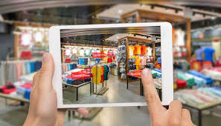
Why 3d internet
Easy Social Interactions
Interesting 3D Shopping

Slide 6
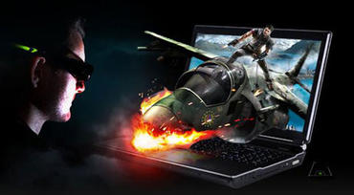

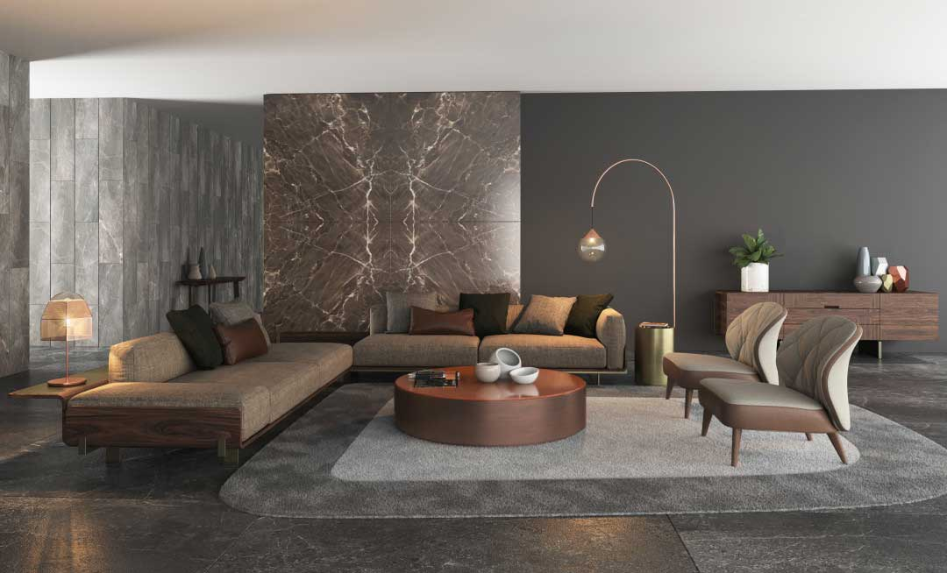
Game mode more interesting
Distance learning is a Joyous Experience
To represent Interior Design effectively

Slide 7
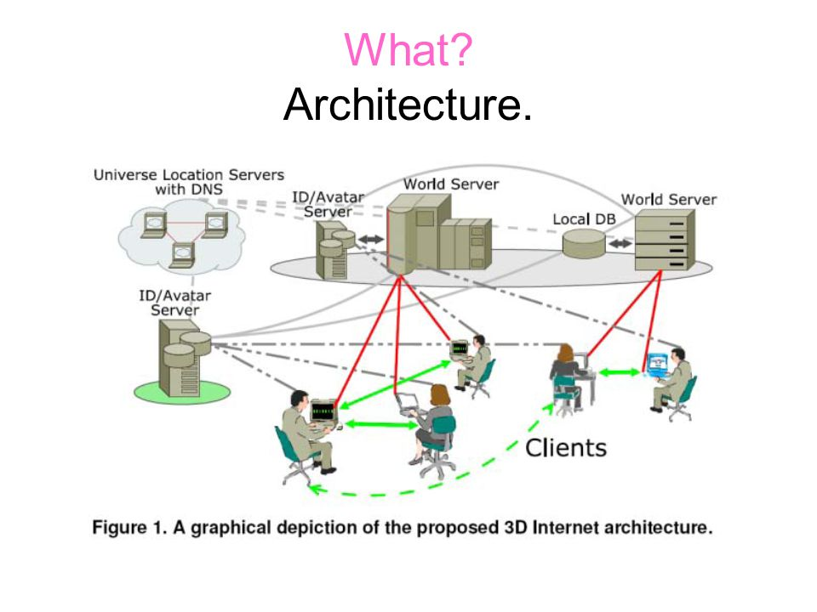
Architecture and components

Slide 8
World Servers
• Provide user – or server side created, static and
dynamic content making up the specific web place (3D
Environment).
• It includes visuals, physics engine, avatar data, media
and more to client programs.
Avatar/ID Server
• Virtual identity management system containing identity,
avatar information and inventory of registered users.
• Providing these to individual world servers and relevant
client programs, while ensuring privacy and security of
stored information.

Slide 9
Universal Location Servers
• Virtual location management systems similar and including
current DNS providing virtual geographical information as well
as connection to the internet via methods similar to SL URL.
• They can also act as a distributed directory of the world,
avatar servers and users.
Clients
• Browser like viewer programs running on users computers with
extensive networking, caching and 3D rendering capabilities.
• Additional components of the 3D Internet include web places
and 3D object creation/editing.

Slide 10
Evolution of 3D internet
Web 1.0
• First face of the World Wide Web.
• Edited only by Web Masters.
• Similar to a hand - written notebook.
• Threatened to paranoid perception
Web 2.0
• Everyone can contribute to the web.
• Rich user interface and best in class graphics.
• 85% majority websites in web 2.0
• Change is inevitable.

Slide 11
Web 3.0
• Use of met averse in web technology.
• The rise of intelligent systems.
• Birth of the most awaited future internet.
• WebPages and Web places.
 | Web 1.0 | Web 2.0 | Web 3.0
Functionality | Companies publish limited WebPages for large number of users. | People publish information for other users. | Integration of data over the internet from various means.
Usage | Adobe.com for graphics, Microsoft.com for windows, CNN.com for news. | YouTube, Wikipedia. | Integration of devices: Cell phone, Cars, etc., High Accessibility.
Extensibility | Up to ‘n’ users | Up to ‘n’ users. | Up to ‘n*n ’ users.

Slide 12
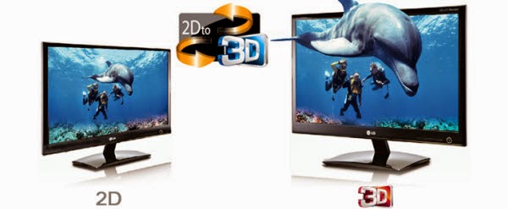
2d technology → 3d technology

Slide 13
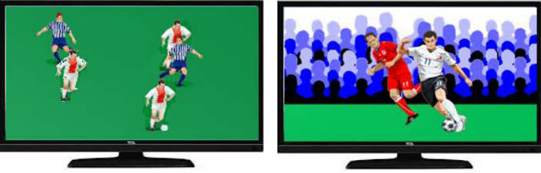
2D Technology
• Less interactive.
• More wastage of time.
• Lack of proper representation (Ex: Online shopping).
3D Technology
• More interactive.
• Reduced mouse movements.
• Simple yet effective representation.
• Increased speed of working.

Slide 14
Future of internet
Using the web and controlling information will be very easy and
effective by using 3D internet.
Right now this might seem like FANTASY, but ten year in the
future this might be a serious invention.

Slide 15


applications
E-Commerce
• Product Visualization
• 3D Virtual Shops
• Interactive demo
• Banner ads in 3D
Training
• Heartwood’s 3D Interactive
training empowers students
to practice on virtual equipment,
allowing them to ‘learn by doing’
anytime, anywhere.
• Web-based training using Interactive 3D.

Slide 16
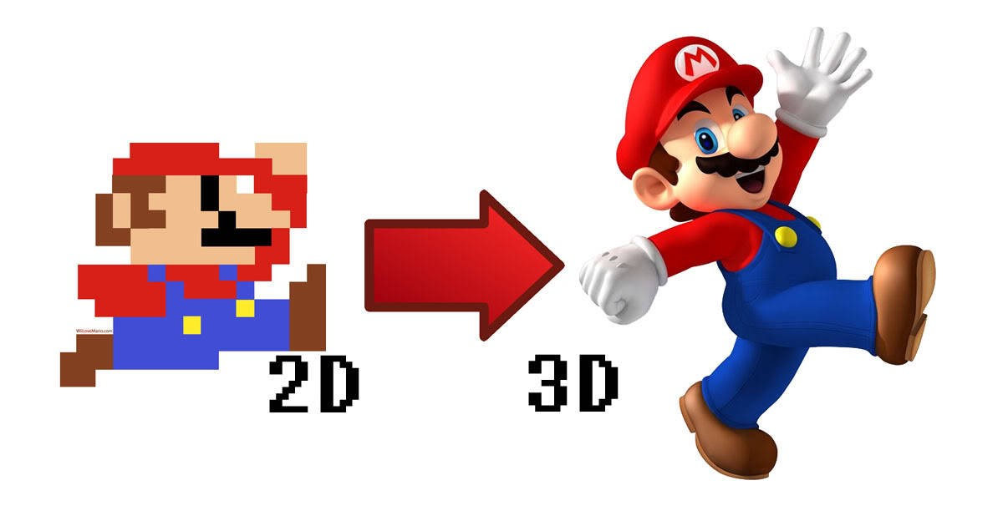
Gaming
• First person shooters may feature a multiplayer
mode, taking place on specialized levels.
• Multiplayer, fully 3D.
• Let us see the 2D and 3D Visualizations.

Slide 17

Entertainment
• 3D computer graphics use a three dimensional representation
for performing calculations and rendering 2D images.
• Streaming 3D Animation.

Slide 18
Advantages and disadvantages
Advantages
• More interactive.
• Reduced mouse movements.
• Simple yet effective representation.
• Increased speed of working.
Disadvantages
• The limited effectiveness of traditional media techniques.
• Lack of an effective way for enabling people in virtual
world.
• An inconsistent enabling in world participants to easily
interact with a access video, rich multimedia and web
content.

Slide 19
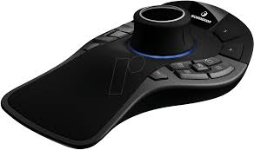
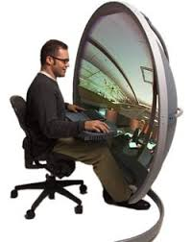
Examples of 3d internet
3D Mouse
• Time saving
• Easy to handle.
• Increased design performance.
• Sensitive controller cap.
Vision Station
• Display device in 3D Internet.
• Uses a Computer display technology.
• Provides 180 degrees of viewing angles.

Slide 20
conclusion
Provided an overview of concept of 3D Internet.
One venue that stands out for its ability to attract highly
motivated audience is the – 3D INTERNET.
At this point of time we are facing an unique opportunity of
evolution of internet towards much more versatile, interactive
and usable version i.e. 3D INTERNET.
There are still many research challenges on the way.

Slide 21
references
http://www.google.com
http://world.std.com/~walthowe
http://www.science.widener.edu/~withers/pyramid.htm
http://netways.shef.ac.uk/index.htm

Slide 22
THANK YOU

