Slide 1
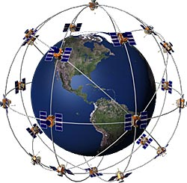
Global Positioning System (GPS)
The Global Positioning System (GPS)
is a satellite-based navigation system made up of a network of 24 satellites placed into orbit by the U.S.Department of Defense.
GPS satellites
24 Satellites in 6 planes, each plane has 4 satellites
These space vehicles (SVs) send radio signals from space.

Slide 2
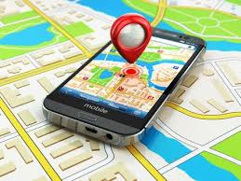
What does the GPS do
Satellite signals can be processed in a GPS receiver.
GPS receiver will show your EXACT location on the Earth (latitude and longitude).
Helps you find your way to a specified location
Let’s you know what direction you are heading and how fast you are going

Slide 3
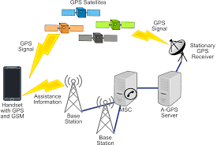
GPS- How it works
Measuring the distance from a satellite by measuring travel time of radio signals seconds
Distance = speed of light * latency in time
Four GPS satellite signals are used to compute positions in three dimensions and the time offset in the receiver clock.

Slide 4
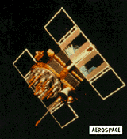
for your location to be accurately measured. You should have at least four satellites.
YOUR ARE DEFFINATELY RIGHT HERE
NEXT

Slide 5
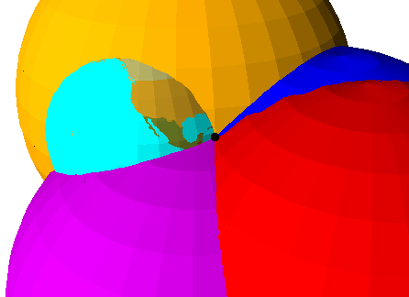
“”
The GPS receiver compares the time a signal was transmitted by a satellite with the time it was received. The time difference tells the GPS receiver how far away the satellite is.
With four or more satellites in view, the receiver can determine the user's 3D position (latitude, longitude and altitude).

Slide 6
When GPS receives a signal
It compares that signal with all the known codes (there are currently 37).
The receiver determines which satellite it is.
It decodes the timing information, multiplies by the speed of light to find the radius of the sphere.
Once it has done that for 3 satellites, it can determine the location.

Slide 7
How do GPS signals send all this information?
They use codes! Binary codes.
Each satellite has a different code.

Slide 8
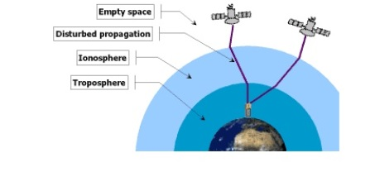
Issues that affect accuracy
Radio signals travel at different velocities through the atmosphere.
It changes the speed of the GPS signals unpredictably as they pass through the ionosphere.
The amount of humidity in the air has also a delaying effect on the signal.

Slide 9
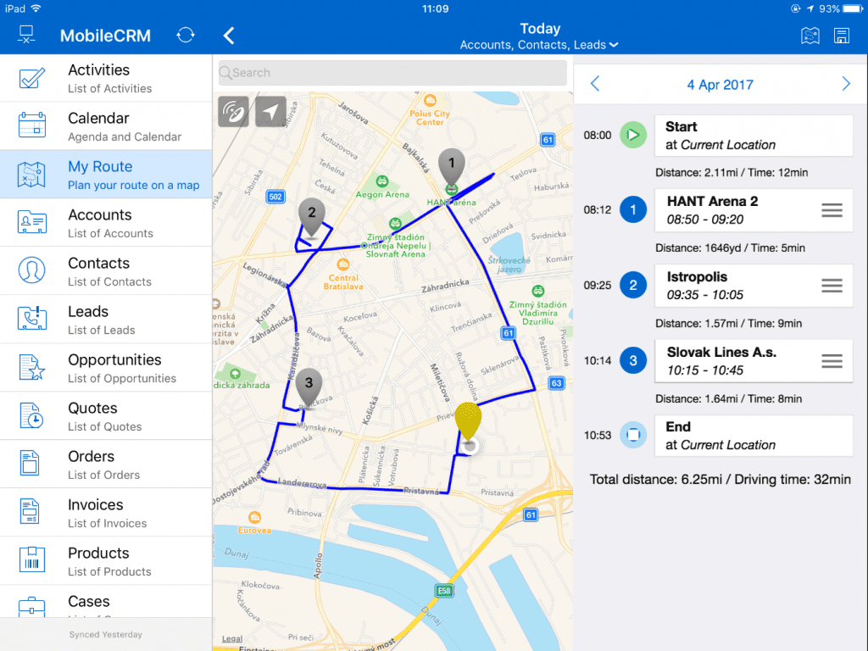
Google Maps
Google Maps offers
satellite imagery,aerial
photography, street map,
360° interactive
panoramic views of
streets (Street View),
real-time traffic conditions,
and route planning for
traveling by foot, car, bicycle,
air and public transportation.

Slide 10
Google Earth
Google Earth renders a 3D representation of Earth based primarily on satellite imagery, allowing users to see cities and landscapes from various angles.
Now, Google Earth can also give us the images of geographical features of Moon and Mars also.
Google Earth is not allowed in many countries so as to keep the privacy of the areas with military importance.

Slide 11
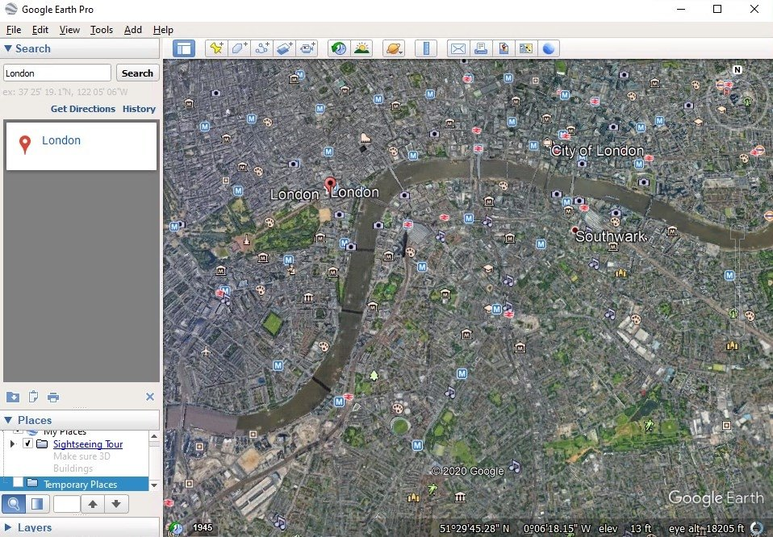
Google Earth

Slide 12
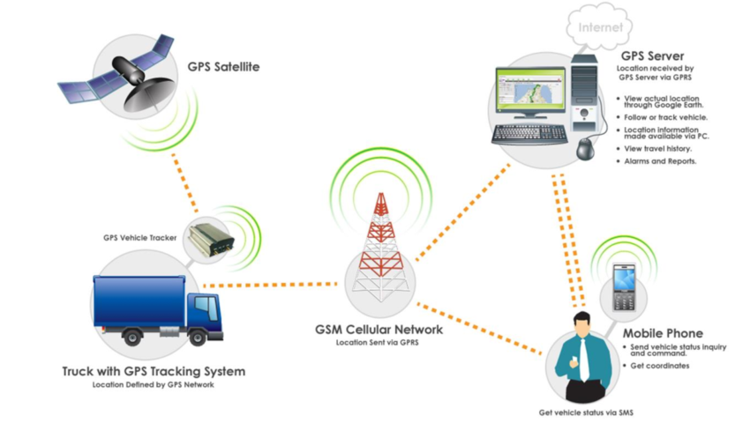
Automated Vehicle Location System
Where is the bus
What direction is
the bus traveling to
What is the travel
speed
Where is stop
How long is the stop

Slide 13
Automated Vehicle Location System
How Do GPS Relate?
GPS receiver calculates its position (latitude and
longitude) and record the information at fixed time
interval
GPS transmitter transmits location and vehicle
dynamic data to control center at prescribed interval
Control center system process data according to customer specifications

Slide 14
Applications – Military
Military GPS user equipment has been integrated into fighters, bombers, tankers, helicopters, ships, submarines, tanks, jeeps, and soldiers' equipment.
To prevent GPS interception by the enemy, the government controls GPS receiver exports.

Slide 15
Another GPS application?
Besides being used by the military, GPS is used in forestry, fishing, boating, racing, nursing, and many other fields.
GPS can be used to share our live location.
With the help of GPS we can also find the places of interest.

