Slide 1
Hyper-Personalization
Presented by
Lokesh A. Choudhari

Slide 2
CONTENTS
• Introduction to Hyper-Personalization
• Personalization VS Hyper-Personalization
• Importance of hyper-personalization
• How can advertisers use hyper personalization
• Examples of Hyper-Personalization
• Hyper-Personalization and privacy considerations
• Doing Hyper-Personalization the right way
• Advantages of Hyper-Personalization
• Conclusion

Slide 3
Introduction to Hyper-Personalization
It is defined as the use of big data to provide more specialized and personalized products, services and information to the targeted segment.
It is more advanced next step to personalized marketing where it leverages AI and real-time data to supply more relevant content, product, and service information to every user.
In simple word, Hyper-personalization is the use of data to provide more personalized and targeted products, services, and content.

Slide 4
Personalization VS Hyper-Personalization
Personalization might include advertising a customer’s name, location, or purchase history.
Hyper-personalization also considers browsing, purchasing, and other real-time behavioral data to interpret what the consumer wants or needs.
For example, personalization may include advertising winter weather gear to consumers who purchased similar gear online the year prior.
Hyper-personalization, on the other hand, could include advertising that same winter gear with optimized ads based on the exact purchase location and time, payment method, coupons used, social media activity, and more.

Slide 5
We see our customers as invited guests to a party, and we are the hosts. It’s our job every day to make every important aspect of the customer experience a little bit better’’
-Jeff Bezos, CEO, Amazon

Slide 6
Importance of hyper-personalization
According to research from Accenture, 81% of customers think it’s important for brands to approach them in a timely, personalized manner. Businesses customized their marketing using demographics and manual customer segmentation, but these techniques were lacking because they were not personalized enough.Hyper personalization solves for this, by ensuring that campaigns carefully target each customer’s individual interests and expectations.

Slide 7
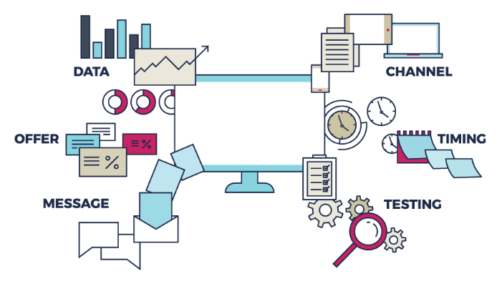
How can advertisers use hyper personalization
Data Collection
Various Channels
A customized offer
Perfect Timing
Personalized Messaging
Consistent testing

Slide 8
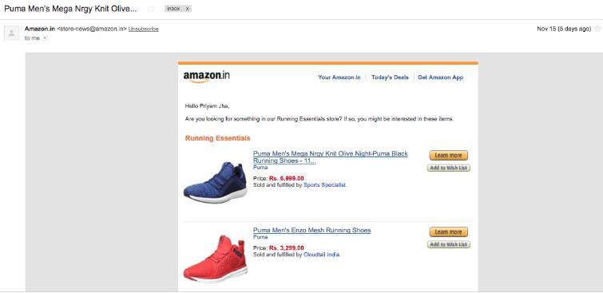
Examples of Hyper-Personalization
1. Amazon
Amazon has access to a vast amount of data points including (but not limited to):
• Full name
• Search query
• Average time spent on search
• Past purchase history
• Brand affinity
• Category browsing habits
• Time of past purchases
• Average spend amount

Slide 9
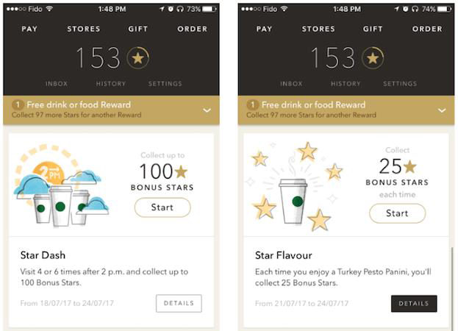
2. Starbucks
• Starbucks stepped up their personalization game with AI, using real-time data to send over 400,000 variants of hyper personalized messages (food/beverage offers) to users.
• Every offer is unique to each user’s preferences, based on their past activity on the app.
Starbucks’ results from this campaign include:
• 3 increase in marketing campaign effectiveness
• 2X increase in email redemptions
• 3X increase in incremental spends via offer redemptions
• 24% of total transactions coming from the mobile app

Slide 10
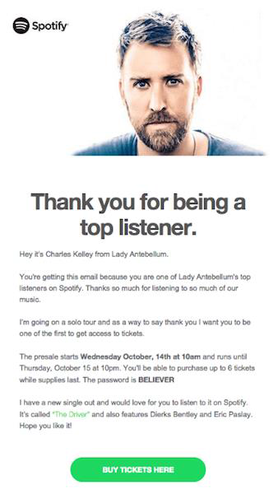
3. Spotify
• Spotify implements hyper personalization in their marketing campaigns with the Discover Weekly feature.
• This feature considers individual music choices, cross-analyzes that with the preferences of others who listened to the same songs, and then creates a highly-personalized playlist for each user.
• The brand also has a Live Concert feature, which sends emails about live events with their favorite artists, along with an option to buy tickets.
• This feature is also personalized based on individual music preferences.

Slide 11
Hyper-Personalization and privacy considerations
• Due to dependence of hyper-personalization on customers’ personal information, it requires scrupulous attention to data security.
• A 2017 breach at credit reporting agency Equifax dwarfed even these massive break-ins, exposing the personal information of nearly 150 million people.
• Thus, one of the most important challenges facing the new technological scenarios is the protection of users’ privacy and personal data. Customer data is highly valuable to hackers, making it attractive to obtain illicitly.

Slide 12
Doing Hyper-Personalization the right way
• Anticipate and plan for tighter regulations on data security.
For brands looking to hyper-personalize their product or content offerings, it is necessary to respect individuals’ right to privacy.
• Make users aware of how their data may be used.
Many consumers are keen to give away personal data in exchange for free services, as evidenced by the popularity of social networks and digital services. The challenge for enterprises is to improve users’ awareness of how their data is collected, stored and utilized in service provisioning.
• Empower users to view and manage their data .
Giving consumers full visibility into their data profiles can enhance privacy and make them feel more in control.

Slide 13
Advantages of Hyper-Personalization
• First, it eliminates obstacles in the sales funnel that may complicate customers’ shopping experience, which lessens the effort customers have to do to get what they want.
• Hyper-personalization can prevent choice overload by only showing items, based in many instances on product recommendation algorithms, pertinent to the customer.
• Last but not least, it can be an effective way for your brand to quickly attract and keep the customer’s attention through acknowledging their pain points and saving them time by offering your best solutions.
Many different types of personalization can and do provide these benefits as well – but hyper-personalization aims to reach a level of granularity, specificity and scale that usually only comes with advanced automation and the requisite data and customer knowledge.

Slide 14
Conclusion
Creating an effective personalization strategy can be key to building customer trust and loyalty, which directly leads to improved revenue growth. In an atmosphere of tougher data privacy protections—such as the EU’s Global Data Protection Regulation (GDPR)—brands must tread carefully in how they gather and use customer data. Summing it up, hyper-personalization can help the brands stand out and increase engagement and conversions with their target audience. Many different types of personalization can and do provide these benefits as well – but hyper-personalization aims to reach a level of granularity, specificity and scale that usually only comes with advanced automation and the requisite data and customer knowledge.

Slide 15
Thank you

