Slide 1

Social Media Security and Privacy
Mohit Madhav Naik
10303320181124511001

Slide 2

Introduction
The popularity of social networking media Facebook, Twitter, Instagram, Snapchat and LinkedIn have been growing exponentially within the past few years.
Social networks can be described as web applications. People may use social networking services for dierent reasons including
To network with new contacts
Reconnect with former friend
Maintain current relationships
Build or promote a business or project
Participate in discussions about a certain topic

Slide 3
Social Media Users Globally
Social Media | Current active monthly users Globally
Facebook | 2.701 billion
Instagram | 1.16 billion
Twitter | 353 million
Youtube | 2 billion

Slide 4
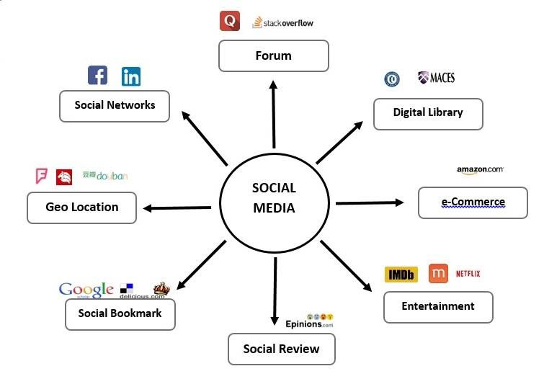
Types of Social Networks

Slide 5
Personal Networks
Status update Networks
Location Networks
Content sharing networks
Shared interest networks

Slide 6
What Information is Public?
1. Information a User shares
• Photos and other media.
• Age and gender.
• Biographical information
• Contacts and interests.
• Geographical location.

Slide 7
2. Information Gathered Through Electronic Tracking
Tracking which websites a user has viewed
Storing information associated with specic websites (such as items in a shoppingcart).
Tracking movement from one website to another.
Building a prole around a user.

Slide 8
This information becomes public in a variety of ways:
A user may choose to post information as public" (without restricting access viaavailable privacy settings).
Approved contacts may copy and repost information { including photos without a user's permisssion, potentially bypassing privacy settings}.
Third-party applications that have been granted access may be able to view information that a user or a user's contacts post privately.

Slide 9
Who can access this Information?
Entities that collect personal information for legal purposes include:
Advertisers interested in personal information so they can better target their ads to those most likely to be interested in the product.
Third-party software developers who incorporate information to personalize applications, such as an online games that interact with the social network.

Slide 10
Entities that collect personal information for illegal purposes include:
Identity thieves who obtain personal information either based on information a user posts or that others post about the user.
Other online criminals, such as people planning to scam or harass individuals, or infect computers with malware.

Slide 11
Threats associated with Social Media
Classic Threats
Spam Attacks
Malware
Phishing Attacks
Cross-Site Scripting

Slide 12
Modern Threats
Fake Profiles
Identity Theft
Information Leakage
Cyber Stalking

Slide 13
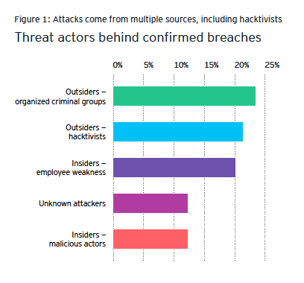
Who are the attackers?

Slide 14
Recommendations
Tips to stay private and secure while registering an account
Use a strong password dierent from the passwords you use to access other sites.
Consider creating a new email address strictly to connect with your social networking profiles.
Review the privacy policy and terms of service before signing up for an account.
Be sure to keep strong antivirus and spyware protection on your computer.

Slide 15
General Tips for using Social Networks
Stay aware of changes to a social network's terms of service and privacy policy.
Be very cautious of random pop-up windows.
Delete cookies, including ash cookies, every time you leave a social networking site.
Prune your "friends" list on a regular basis. It's easy to forget who you've friended over time, and therefore who you are sharing information with.

Slide 16
Conclusion
We have rules and guidelines of computer ethics that we should follow to avoid problems that will occur beyond our expectations.
In addition, all parties should take responsibility in order to secure internet users' personal information.
The users themselves should aware of this concern because they are the one who reveal their personal data to public.
Besides tighten the law, they also enforce the law so that any social networking site and advertiser will not violates users right.

Slide 17
Thank YOU
Mohit Madhav Naik
10303320181124511001

