Slide 1
Seminar on
E - Ball
Guided By
Prof. Kavita Aher
Dr. Babasaheb Ambedkar Technoogical University, Lonere
Submitted By,
Omkar Dundappa Wani
(10303320181124510039)

Slide 2
Content
Introduction
Features of E-ball
Virtual Keyboard
Display unit of E-ball
Working of E-Ball
Applications
Advantages
Disadvantages
Future Scope
Conclusion

Slide 3
Introduction
The E-Ball concept PC is a sphere shaped pc which is the smallest design among all the laptops and desktops.
This PC was invented by Apostol Tnokovski.
This is a modern concept PC which includes all traditional features of computers.
It is spherical in shape having diameter of 6 inches and has motherboard of 120*120 mm.
According to Apostol it is the best shape in nature and it draws everybody attention. It is the smallest PC ever made.

Slide 4
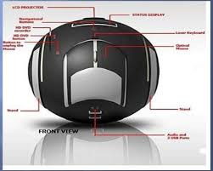
Features of E - Ball
Virtual keyboard
Dual core processor
5GB RAM
350-500GB hard drive
Integrated graphics and sound card
Two 50W Speakers
Wireless optical mouse
LAN & WLAN card
Modem
LCD projector
Paper holder

Slide 5
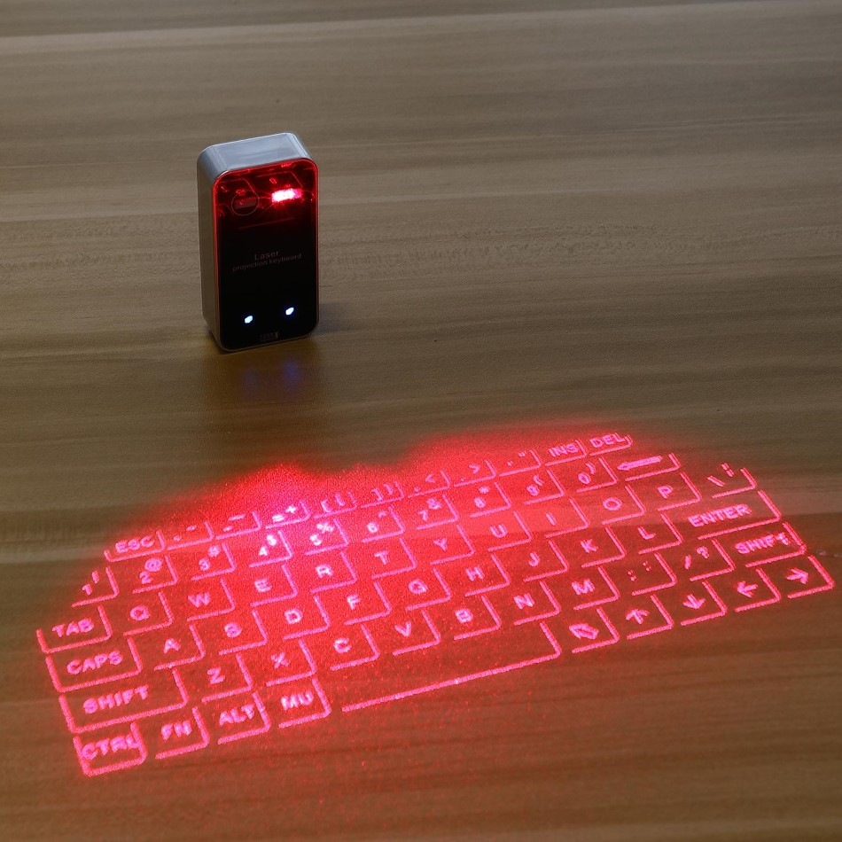
Virtual Keyboard
A virtual keyboard is a projection keyboard that is projected and touched on any flat surface.
Virtual Keyboard is small, handy, well designed and easy to use application.
It features platform independent and multilangual support built in language layouts and settings.
It supports user defined interface and design which adds to its benefit.

Slide 6
Virtual keyboard basically consists of three components:-
1. The Sensor Module:- The sensor module serves as the eyes of the Keyboard Perception technology.
The Sensor Module operates by locating the user's fingers in 3-D space and tracking the intended keystrokes.
2. IR-light source:- The Infrared Light Source emits a beam of infrared light. This light beam is designed to overlap the area on which the keyboard pattern projects.
This is done so as to illuminate the users fingers by the infra-red light beam.

Slide 7
3. The Pattern Projector:- The Pattern Projector basically presents the image of the keyboard. This image can be projected on any flat surface.
The projected image is that of a standard qwerty-keyboard, with all the keys and control functions as in the keyboard.

Slide 8
Display unit of E - Ball
E Ball concept PC don't have any external display unit, it has a button when you press this button a projector will pop and it focus the computer screen on the wall which can be adjusted with navigation keys.
If there is no wall then it has a paper sheet holder that divides into three pieces like an umbrella just after popping upland it will show desktop on the paper sheet.

Slide 9
Working of E - Ball
It has two stands which can be opened by pressing and holding the buttons at each side of it.
Once you open the stand and turn the E Ball on, you can connect the optical mouse from the body of the
E - ball by simply pressing the connecting button of mouse.
It has a button for its laser keyboard to operate, it is suggested to have a flat surface to operate.
E-Ball doesn’t have any external display unit. It has another button when pressed a projector is popped up
and it focus the screen on the wall which can be adjusted using navigation keys.
The software interface of E Ball concept pc is most stylized with icons that can be remembered easily which support all type of windows operating system.

Slide 10
E Ball pc work very easy while you are making video presentations, listening music, watching movies, and chatting on the net.
There are five simple steps to ON pc that are you can use press and hold the power button for 5 second, adjust the LCD Projector and detach the optical mouse. Activate the virtual keyboard and do whatever you want.

Slide 11
Applications
Working in Office
General Usage
Watching Movies
Video Presentation
Worling on Internet

Slide 12
Advantages
Its small in size hence easily portable.
It has large memory so can do heavy work.
Its very useful for making video presentation.
It does not require any special display and can use wall or sheet as display screen.
Its easy to use.
Keyboard layouts can be changed by software i.e. user defined layouts.
It doesn’t require much space as compared to old PCs.
Its having good storage space to do work.

Slide 13
Disadvantages
Cost of E-Ball is very high.
Designed for Windows operating system only.
The room in which E-Ball is used should not be very bright as virtual keyboard and projected screen might not be clearly visible.
Its difficult to understand if any problem occurs in hardware component.

Slide 14
Future Scope
This technology will be very useful in office work.
It will be used for presentation work.
No need of projectors it will do the work.
PCs will be in our pocket.

Slide 15
Coclusion
As the year passes, the computer size is becoming smaller.
Today’s technology is at its peak point beyond what we could ever imagine.
New inventions and innovations are emerging on daily basis.
Our imaginations have dressed into reality and today it has become possible to
have a whole computer in our pocket all the time.
At last this ball technology has taken the computer technology to new horizons

Slide 16
Thank You

