Slide 1


Seminar On
Opinion of World about Internet & How Internet is Playing with World
Prof. Vinayak Mukkawar
Guide
Department of Computer Engineering

Slide 2
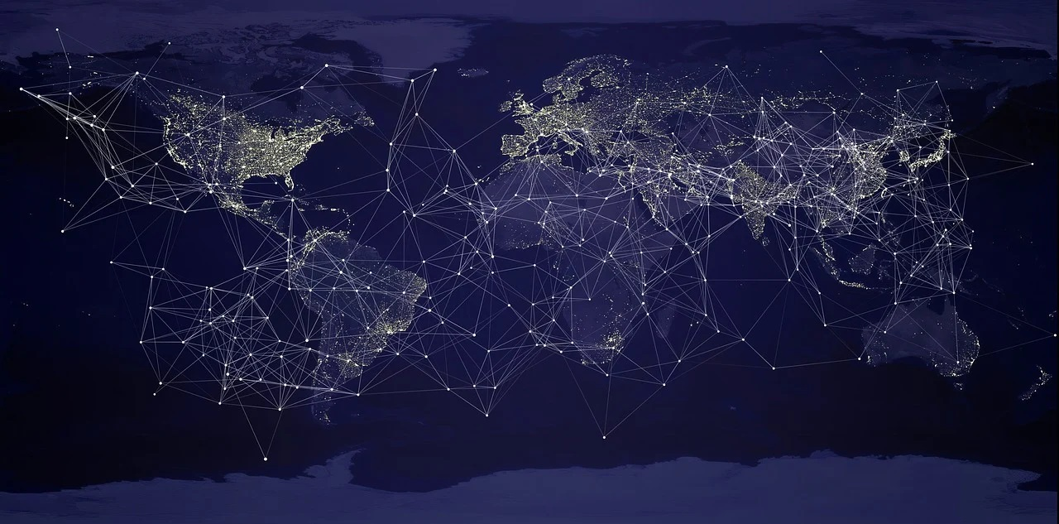
Introduction
What is the Internet?
Objective.
Motivation.
Problem Statement.
Journey Of Internet.

Slide 3



Journey of internet

Slide 4

Advantages Of internet
Address, mapping & contact information
Selling & making money
Banking, bills & shopping
Connectivity, communication & sharing
Information, knowledge & learning
Donations and funding
Entertainment
Work from home & collaboration
Internet of Things
Cloud computing & cloud storage

Slide 5

Disadvantages Of internet
Pornographic & Violent images
Identity theft hacking & cheating
Viruses & Malwares
Addiction, time-waster & causes distractions
Bullying, trolls, stalkers & crime
Health issues & obesity
Spam & advertising
Buying things that you don’t need
Depression, loneliness, and social isolation
Never being able to disconnect from work

Slide 6


Slide 7

Cyber security
Cases Reported under Cyber Crime in 2015 Over 2014
Sr. No. | Top 3 State | 2014 | 2015
1 | Maharashtra | 1879 | 2195
2 | Uttar Pradesh | 1737 | 2208
3 | Karnataka | 1020 | 1447
Total | India | 9622 | 11592
The NCRB's data stated that 4,4546 cases of cyber crimes were registered in 2019 as compared to 28,248 in 2018.
Highest number of cyber crime cases were registered in Karnataka (12,020) followed by Uttar Pradesh (11,416), Maharashtra (4,967),Telangana (2,691) and Assam (2,231). Among the Union Territories, Delhi alone accounted for 78 percent of cyber crimes.
37% increase in cyberattacks in India in Q1 2020
The data showed in 60.4 percent of cases, registered fraud was the motive followed by sexual exploitation (5.1%) and causing disrepute (4.2%).

Slide 8


Slide 9

Submitted By
Mr. Madhav Vitthal Aneraye
PRN:10303320191124510062

