Slide 1
Cloud computing
A seminar on

Slide 2

A Seminar Presentation on Cloud computing by Arsalan A.Sattar Dafedar. PRN:-10303320191124510067 under guidance of Prof. Pramod Patil sir. Dr. Babasaheb Ambedkar Technological University Lonere, Mangaon Raigad-402103.

Slide 3
Abstract
The term "Cloud Computing" is a recent buzzword in the IT world. Behind this fancy poetic phrase, there lies a true picture for the future of computing for both in technical prospective and social prospective. However, the term "Cloud Computing" is recent but the idea of centralizing computation and storage in distributed data centers maintained by third party companies is not new but it came in the way back in 1990s along with distributed computing approaches like grid computing.
Cloud computing aimed at providing IT as a service to the cloud users on-demand basic with greater flexibility, availability, reliability and scalability with utility computing model. This new paradigm of computing has animmense potential in it to be used in the field of e-governance and in rural development perspective in the developing country like India.

Slide 4
Key Points :-
Introduction
What Is Cloud Computing?
Types of Cloud Computing
Components of Cloud Computing
Architecture of Cloud Computing
Advantages of Cloud Computing
Disadvantages of Cloud Computing
Conclusion
References

Slide 5
Introduction:-
Cloud computing is Internet-based computing, whereby sharedresources, software, and information are provided to computers andother devices on demand, like the electricity grid. Cloud computing is a paradigm shift following the shift from mainframeto client-server in the early 1980s. Details are abstracted from theusers, who no longer have need forexpertise in, or control over, thetechnology infrastructure "in the cloud" that supports them. Cloud Computing is the use of remote servers on the internet to store, manage and process data rather than local servers. Cloud computing is Internet-based computing, whereby shared resources, software, and information are provided to computers and other devices on demand, like electricity grid. It is a recently developing paradigm of distributed computing. Cloud services are provided to the cloud users as utility services like water, electricity, telephone using pay-as-you use business model.

Slide 6
What is Cloud computing?
cloud computing means storing and accessing data and programs over the internet instead of your computer's hard drive.
Cloud computing is the delivery of different services through the Internet.
These resources include tools and applications like data storage, servers, databases, networking, and software
The word "cloud" often refers to the Internet, which more precisely means a datacenter full of servers connected to the Internet performing a service.
However, the term "cloud computing" refers to the software and services that have enabled the Internet to become so prominent in everyday life

Slide 7
Types of Cloud Computing:-
There are three types of Cloud Computing:
Public Cloud
Private Cloud
Hybrid Cloud

Slide 8
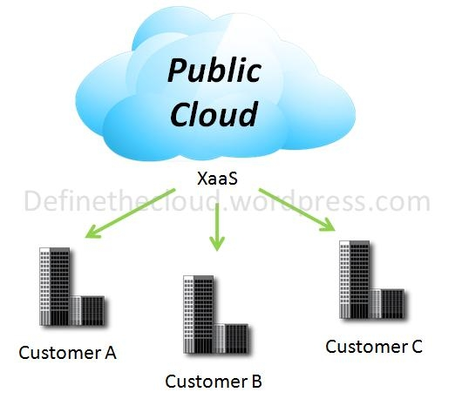
Public Cloud:-
Public clouds are made available to the general public by a service provider who hosts the cloud infrastructure.
Generally, public cloud providers like Amazon AWS, Microsoft and Google own and operate the infrastructure and offer access over the Internet.
The public cloud is defined as computing services offered by third-party providers over the public Internet, making them available to anyone who wants to use or purchase them.
They may be free or sold on-demand, allowing customers to pay only per usage for the CPU cycles, storage, or bandwidth they consume.

Slide 9
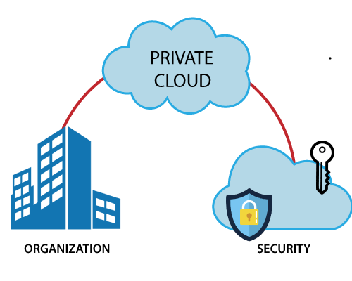
Private Cloud:-
Private cloud is cloud infrastructure dedicated to a particular organization.
Private clouds allow businesses to host applications in the cloud, while addressing concerns regarding data security and control, which is often lacking in a public cloud environment.
It is not shared with other organizations.
Private clouds are more expensive but also more secure when compared to public clouds.
An Info-Tech survey shows that 76% of IT decision- makers will focus exclusively on the private cloud, as these clouds offer the greatest level of security and control.

Slide 10
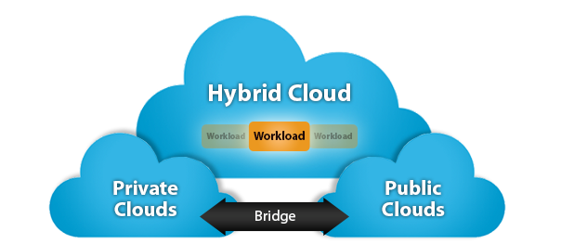
Hybrid Cloud:-
A hybrid cloud is a computing environment that combines a public cloud and a private cloud by allowing data and applications to be shared between them.
Hybrid cloud architecture requires both on-premise resources and off- site server based cloud infrastructure.
In a hybrid cloud, you can leverage third party cloud providers in either a full or partial manner; increasing the flexibility of computing.

Slide 11
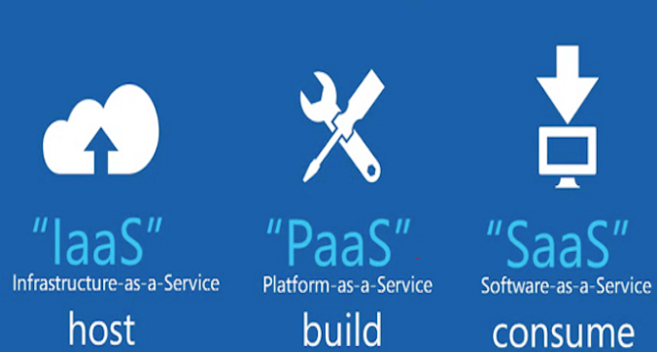
Components of cloud computing:-
The Components of Cloud Computing are as follows:
IaaS(Infrastructure as Services)
PaaS(Platform as Services)
SaaS(Software as Services)

Slide 12
laaS (infrastructure as a service): IaaS refers to computer infrastructure (e.g., virtualization) that's delivered as a service. datacenter that offers outsourced software and servers may use laaS for its operations. The cloud computing vendors offer infrastructure as a service. One may avail hardware services such as processors, memory, networks etc on agreed basis for specific duration and price. PaaS (Platform as a Service):- Cloud vendors are companies that offer cloud computing services and products. One of the services that they provide is called PaaS. Under this a computing platform such as operating system is provided to a customer or end user on a monthly rental basis. Some of the major cloud computing vendor are Amazon, Microsoft, Google etc.

Slide 13
SaaS (software as a service):
SaaS refers to software that's made available as a web-based service. Because you can access the software remotely, you don't need additional hardware to use or run it. Furthermore, you dont have to worry about the software's installation, setup, maintenance or upgrades. An example of SaaS is a site that allows you to create, save and access documents .

Slide 14
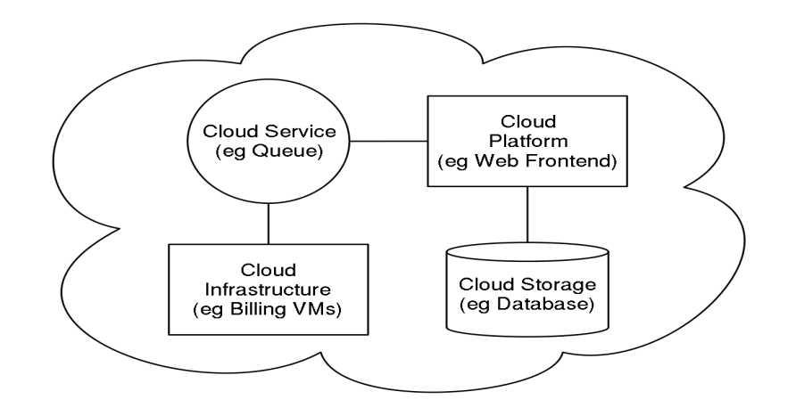
Architecture of Cloud Computing:-
The systems architecture of the software systems involved in the delivery of cloud computing, typically involves multiple cloud components communicating with each other over application programming interfaces, usually web services.
The two most significant components of cloud computing architecture are known as the front end and the back end
The front end is the part seen by the client, ie. the computer user. This includes the client's network (or computer) and the applications used to access the cloud via a user interface such as a web browser.
The back end of the cloud computing architecture is the 'cloud' itself, comprising various computers, servers and data storage devices.

Slide 15
Advantages of Cloud Computing:-
Flexibility:
There is a high rate of flexibility when using cloud computing because people can opt out of A using it whenever they want too.
One of the A major benefit of cloud computing is that there is no limitation of place and medium.
Low Cost:
Companies can save big by employing cloud computing as it eliminates cost for hardware and software.
With cloud computing, company uses the resources of the hosting company to store their data and applications.

Slide 16
Easier Management of Data and Information:
Since all data are located on a centralized location, data are more organized making it easy to manage. All transactions are also recorded so management can easily track activities of their employees.
Increased Storage Capacity:
Increased Storage Capacity is another benefit of the cloud computing, as it can store more data as compared to a personal computer.
Automatic Updating :
It saves companies time and effort to update multiples server. On the other hand, it also helps users to download updates for the software. Once the server gets updated the users can get the updates without doing anything.

Slide 17
Disadvantages of Cloud Computing:-
Dependency:
One major disadvantages of cloud computing is user's dependency on the provider. Internet users don't have their data stored with them.
Risk:
Cloud computing services means taking services from remote servers. There is always insecurity regarding stored documents because users do not have control over their software. Nothing can be recovered if their servers go out of service.
Requires a Constant internet connection:
The most obvious disadvantage is that Cloud computing completely relies on network connections. If you do not have an Intemet connection, you can't access anything, even your own data. A dead internet connection means no work.

Slide 18
Conclusion:-
So, while cloud computing is really great and you're probably already using it, either for business of for personal means, here's what we've learned from taking a look at the pros and cons:
Cloud computing is a really cheap way for companies to have all the resources they need in once place. It's a much better way to spread your resources, and it becomes
easier to access things from longer distances.
But...
Is cloud computing really all that safe? For instance, while cloud computing has backups, if something was to go wrong... do you have your own personal backup?
Is cloud computing as private as you think it is? Is your data secured or can anyone access it?
So there you have it! Everything you need to know about cloud computing; what it is, how to use it, and some pros and cons!

Slide 19
REFERENCES
https://en.wikipedia.org/wiki/Cloud_computin
V. Josyula, M. Orr, and G. Page, Cloud Computing: Automating the Virtualized Data Center, Cisco Systems, Inc., Indianapolis, USA, 2011.
Architecting the Cloud: Design Decisions for Cloud Computing Service Models (SaaS, PaaS, and IaaS) Book by Michael Kavis
www.slideshare.net

Slide 20


Slide 21


