Slide 1
ADAS (Advanced Driver Assistance System)
Presented by :-
Prajwal Rajesh Allewar
Guided by :-
Prof. Heena Gangrekar

Slide 2
Introduction
Advanced Driver Assistance Systems, commonly called ADAS, are the systems to help the driver in the driving process. When designed with a safe and appropriate Human-Machine Interface, they should increase the safety of car and more generally the road safety. Advanced driver assistance systems (ADAS) are technologies that provide a driver with needed information, automate difficult and repetitive tasks, and lead to the overall increase in safety of the car for. Some of these technologies have proven to an improved driving experience and better overall road safety.
GPS navigation, taking an example, has become increasingly the most common in OEM infotainment systems since first being introduced in the 1990s. However, a lot more of ADAS are right on the cutting edge of the emerging automotive technologies. Some of these systems will have staying power to stick around, and you can expect to see at least a few of them in future car.

Slide 3
History
Advanced driver assistance systems were first being used around 50 years ago with the adoption of the anti-lock braking system. Early ADAS include electronic stability control, anti-lock brakes, blind spot information systems, lane departure warning, adaptive cruise control, and traction control. These systems can be affected by mechanical alignment adjustments or damage from a collision. This has led many manufacturers to require automatic resets for these systems after a mechanical alignment is performed. The Google Car in 2010 and Mercedes’ “Bertha” in 2013 were amongst the first. Now, dozens of cars with vehicle-to-vehicle and vehicle-to-infrastructure communications have been launched all over the world.

Slide 4
Levels
ADAS are categorized into different levels based on the amount of automation, and the scale provided by The Society of Automotive Engineers (SAE).
ADAS can be divided into six levels :
Level 0 - No automation
Level 1 - Driver assistance
Level 2 - Partial automation
Level 3 - Conditional driving automation
Level 4 - High driving automation
Level 5 - Full driving automation

Slide 5
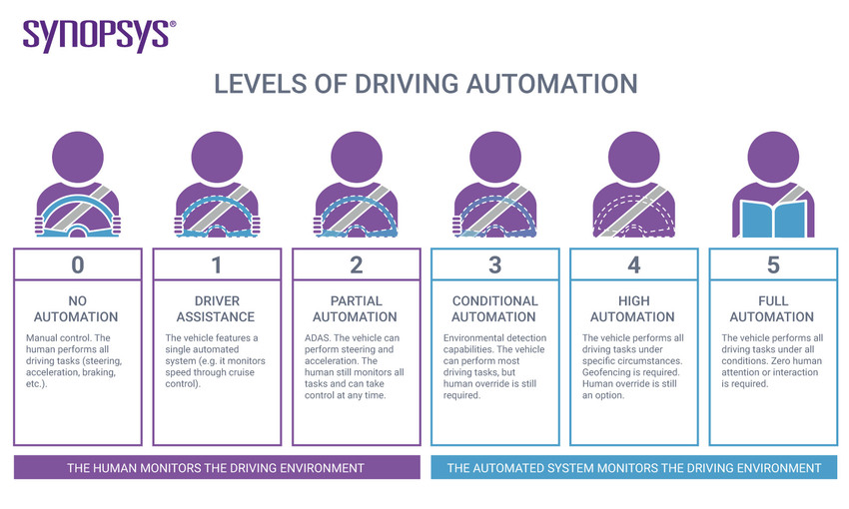

Slide 6
Level 0 - No automation
As the name suggests, Level 0 relies completely on the driver to perform all longitudinal and lateral tasks, such as acceleration or steering. The driver is in complete control of – and responsible for – the act of driving.
Most vehicles on the road today are Level 0: manually controlled. The human provides the "dynamic driving task" although there may be systems in place to help the driver. An example would be the emergency braking system―since it technically doesn’t "drive" the vehicle, it does not qualify as automation.

Slide 7
Level 1 - Driver assistance
This is the lowest level of automation. The vehicle features a single automated system for driver assistance, such as steering or accelerating (cruise control). Adaptive cruise control, where the vehicle can be kept at a safe distance behind the next car, qualifies as Level 1 because the human driver monitors the other aspects of driving such as steering and braking. At this level, the vehicle only controls or intervenes to control the speed or steering of the vehicle, but not both at the same time.
An example of such an ADAS function is adaptive cruise control, where the car will keep a set speed and safe distance between the car ahead by automatically applying the brake when traffic slows and resuming its original speed when traffic clears.

Slide 8
Level 2 - Partial automation
Moving up to Level 2, the driving task is shared between the vehicle and the driver. The vehicle usually takes over the two primary driving functions of lateral and longitudinal control. This can be achieved, for example, by combining adaptive cruise control with lane keeping. In this case, the driver is allowed to temporarily take their hands of the wheel. However, the driver still needs to have constant situational awareness and monitor the surrounding environment.
Some of the most notable examples of carmakers using Level 2 automation are GM’s Super Cruise, the Mercedes-Benz Drive Pilot, the Tesla Autopilot, Volvo’s Pilot Assist and the Nissan ProPilot Assist 2.0.

Slide 9
Level 3 - Conditional driving automation
At Level 3, the vehicle can accelerate past a slow-moving vehicle, monitoring its surroundings, changing lanes, and controlling the steering, throttle, and braking. All the driver has to do is keep paying attention and be ready to take back control when the vehicle calls for it.
Level 3 automation allows you to take your hands off the wheel and eyes off the road – as long as you remain alert. The result is a relaxed driver on certain occasions, like when driving in traffic jams. Most car manufacturers allow such a traffic jam pilot function to operate only on specific controlled access highways and operate when traffic is relatively slow – below 40 miles per hour.

Slide 10
Level 4 - High driving automation
At Level 4, the interaction between human and machine lowers as the vehicle’s capability increases. Steering, braking, accelerating and monitoring the environment are taken out of the driver’s hands, as well as changing lanes, turning and signalling.
The vehicle can handle highly complex driving situations, such as the sudden appearance of construction sites, without any driver intervention. At the moment, this is allowed for specific, predefined circumstances, such as on controlled access highways.
However, a human still has the option to manually override. For the driver, this means she can safely relax and even read a book, while the car responsibly and safely drives on the highway and, possibly, even on city roads. The car can still prompt the driver to take back control, but if it receives no response, the car is able to bring itself to a safe stop. An example of Level 4 autonomy is the Waymo test car.

Slide 11
Level 5 - Full driving automation
Now we’re getting to the really good stuff: autonomous driving.
Level 5 autonomy requires zero human attention. There’s no need for a steering wheel, no need for brakes and no need for pedals. The autonomous vehicle controls all driving tasks under all conditions, including the monitoring of environment and identification of complex driving conditions like busy pedestrian crossings. This also means that the vehicle can perform a combination of several tasks simultaneously, whether adaptive cruise control, traffic sign recognition, lane departure warning,

Slide 12
Need for Standardization
According to PACTS, lack of full standardization might make one system difficultly understandable by the driver who might believe that the car behave like another car while it does not.
ADAS might have many limitations, for instance a Pre-Collision System might have 12 pages to explain 23 exceptions where ADAS may operate when not needed and 30 exceptions where ADAS may not operate when a collision is likely.
Buttons and dashboard symbols might change from car to car due to lack of standardization.
ADAS behaviour might change from car to car, for instance ACC speed might be temporarily overridden in most cars, while some switch to standby after one minute. Names for ADAS features are not standardized. For instance, Adaptive Cruise Control is called Adaptive Cruise Control by Fiat, Ford, GM, VW, Volvo and Peugeot, but Intelligent Cruise Control by Nissan, Active Cruise Control by Citroen and BMW, and DISTRONIC by Mercedes.

Slide 13
Pros
Adaptive Features.
Improves road safety for everyone.
Helps to drive down costs (fewer accidents = less money spent).
Quick development, debugging and testing of multisensory applications by i0ntegrating virtual studio.
Sensors have the potential to self-calibrate in the future to focus on the inherent safety and dependability of these systems.
Automated adaptation and enhancement of safety systems to improve driving among the population.
Complete and Universal ADAS tool chain consisting of tools, software components, algorithms framework and hardware.

Slide 14
Cons
Design of probabilistic algorithms.
ADAS Collision Repair Considerations.
Sensor data fusion.
Object Validation.
Automated evaluation of large quantities of data.
Integrating image processing.

Slide 15
Feature Examples
Adaptive Cruise Control.
Lane Centering.
Automatic Parking.
Automotive Heads up Display
Automotive Navigation System.
Automotive Night Vision.
Backup Camera.
Blind Spot Monitor.
Collision Avoidance System.
Parking Sensor
Electronic Stability Control.
Forward Collision Warning.

Slide 16
THANK YOU

