Slide 1
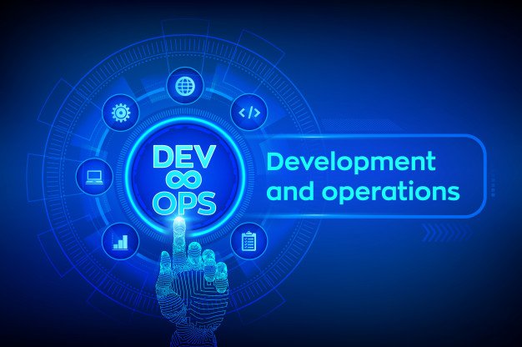
By Pranali Narkhede
(Guide- Prof. Heena Gangrekar)

Slide 2

WHAT IS DEVOPS ?
Approach to build the gap between Devlopment and Operations.
A software development method that allows communication, collaboration and integration between the devlopers team and the operations team.
It targets product delivery, quality testing, feature development and maintenance releases to –
• improve reliability and security
• faster development and development cycles
Dev
Ops
DevOps

Slide 3

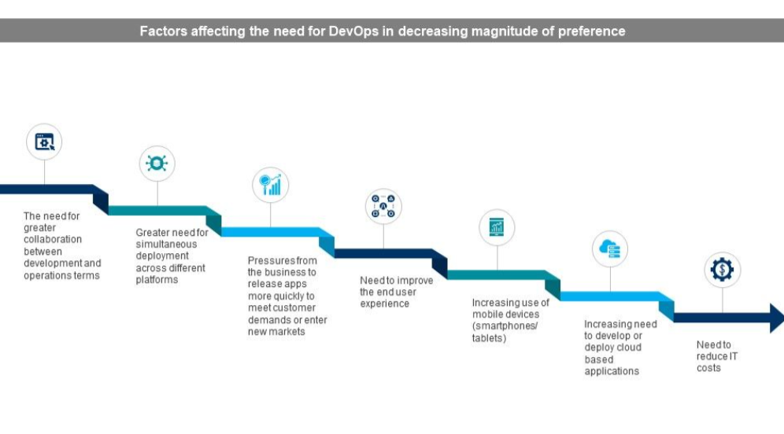
WHY DEVOPS…

Slide 4

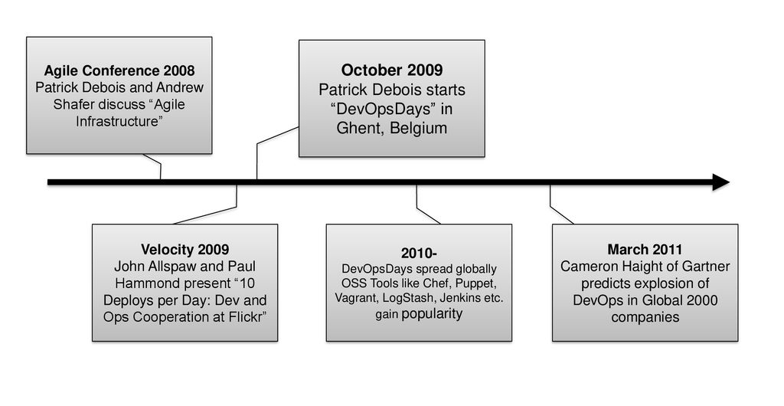
HISTORY

Slide 5
ARCHITECTURE FEATURES
DevOps Architecture is the solution to mend the gap between the Development and Operations teams so that the delivery of applications can be faster with fewer issues.
It effectively decreases the deployment time.
It enables :
• Automation
• Collaboration
• Integration
• Configuration Management

Slide 6
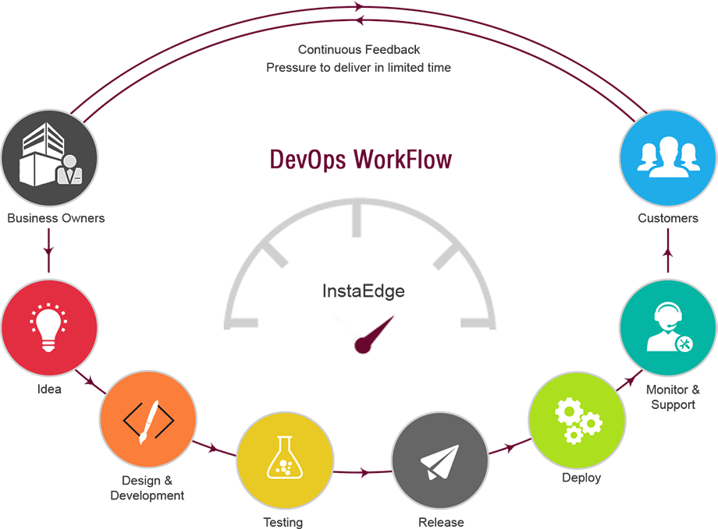
WORKFLOW
The DevOps workflow is about efficientyly producing useful outcomes – in both software and process – that inform and improve the next cycle of work from day-to-deploy.
It enables team members to deliver value faster.

Slide 7

PRINCIPLES
Foster a collaborative environment
Impose end-to-end responsibility
Automate (Almost) everything
Focus on the customers’ needs
Embrace failure and learn from it
Unite teams and “Expertise”

Slide 8
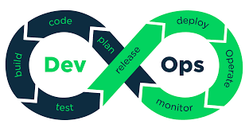
COMPONENTS
DevOps builds the gap between development and operations teams.
They work together in a systematic way.
DevOps has following components which are involved in the whole process.

Slide 9
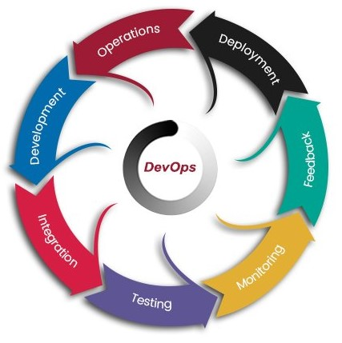
LIFECYCLE
DevOps is the process practiced by the development team and operational engineers together from beginning to the final stage of the product.A lot can be achieved with the right implementation of DevOps lifecycle, making the production of apps more effective and secured.

Slide 10
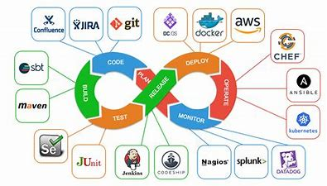
TOOLS
Teams, today are looking for faster delivery, quick feedback from customers, providing quality software, less recovery cycle time from any crashes and minimize defects from more and more automation.
To ensure all this various tools are used at various stages of DevOps lifecycle – to make teams collaborate and communicate in a better way.

Slide 11

DEVOPS AUTOMATION
# Benefits -
Removes manual errors
Team members are empowered
Dependency removed
Latency removed
Increases no. of deliveries
Reduces the lead time
Increases frequency of releases
Provides faster feedback

Slide 12
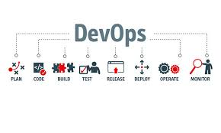
PIPELINE
Every software development company needs an effective DevOps pipeline to keep up with customers’ demands and requirements.
A Devops pipeline is a set of practices that the development (Dev) and operations (Ops) teams implement to build, test and deploy software faster and easier.
One of the primary purposes of a pipeline is to keep the software development process organized and focused.

Slide 13

ADVANTAGES
Improved effectiveness
Faster Delivery of applications
Lower failure rates
Digital transformation
Optimizing the process
Eliminate human errors
Reduced cost of production
Improved quality of products
Better collaboration between teams

Slide 14
DISADVANTAGES
- Experts are less available
- Expensive
- Lack of domain knowledge(can cause problems in projects).
- DevOps driven automation projects are generally
Adopting new technology in industries is hard to manage in short time.

Slide 15

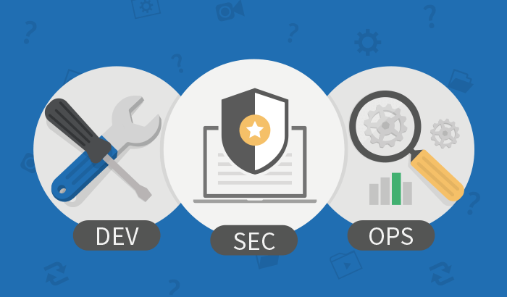
DEVOPS AND SECURITY
In DevOps, security is a shared responsibility integrated from end-to-end. DevSecOps (Dev+Sec+Ops) means thinking of application and infrastructure security from start.
DevSecOps is a practice of integrating security objectives into the DevOps methodology. Security automation in DevOps is an aspect that requires new approaches, technologies and tools. DevSecOps builds on all these requirements.
It automates some security gates to keep the DevOps workflow from slowing down.

Slide 16
REAL-LIFE DEVOPS APPLICATIONS
In Online trading financial companies
In network cycling
In car manufacturing industries
In airline industries

Slide 17


DevOps is helping business in tremendous way. It’s bridging the gap between developers and operations, thus creates smooth path for Continuous Development and Continuous Integration. It takes some efforts to integrate DevOps in your process, but eventually it will help to create an agile and scalable system that’s ready for rapid change and growth.

Slide 18


