Slide 1
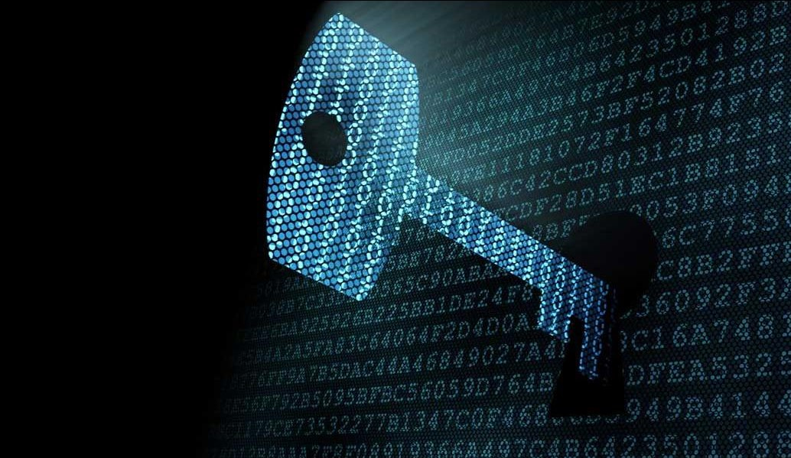
QUANTUM CRYPTOGRAPHY
GIVEN BY
Mr. Rishikesh Sutar
(10303320181124510024)
Under the guidance of
Prof. Iram R. A. Jhetam

Slide 2
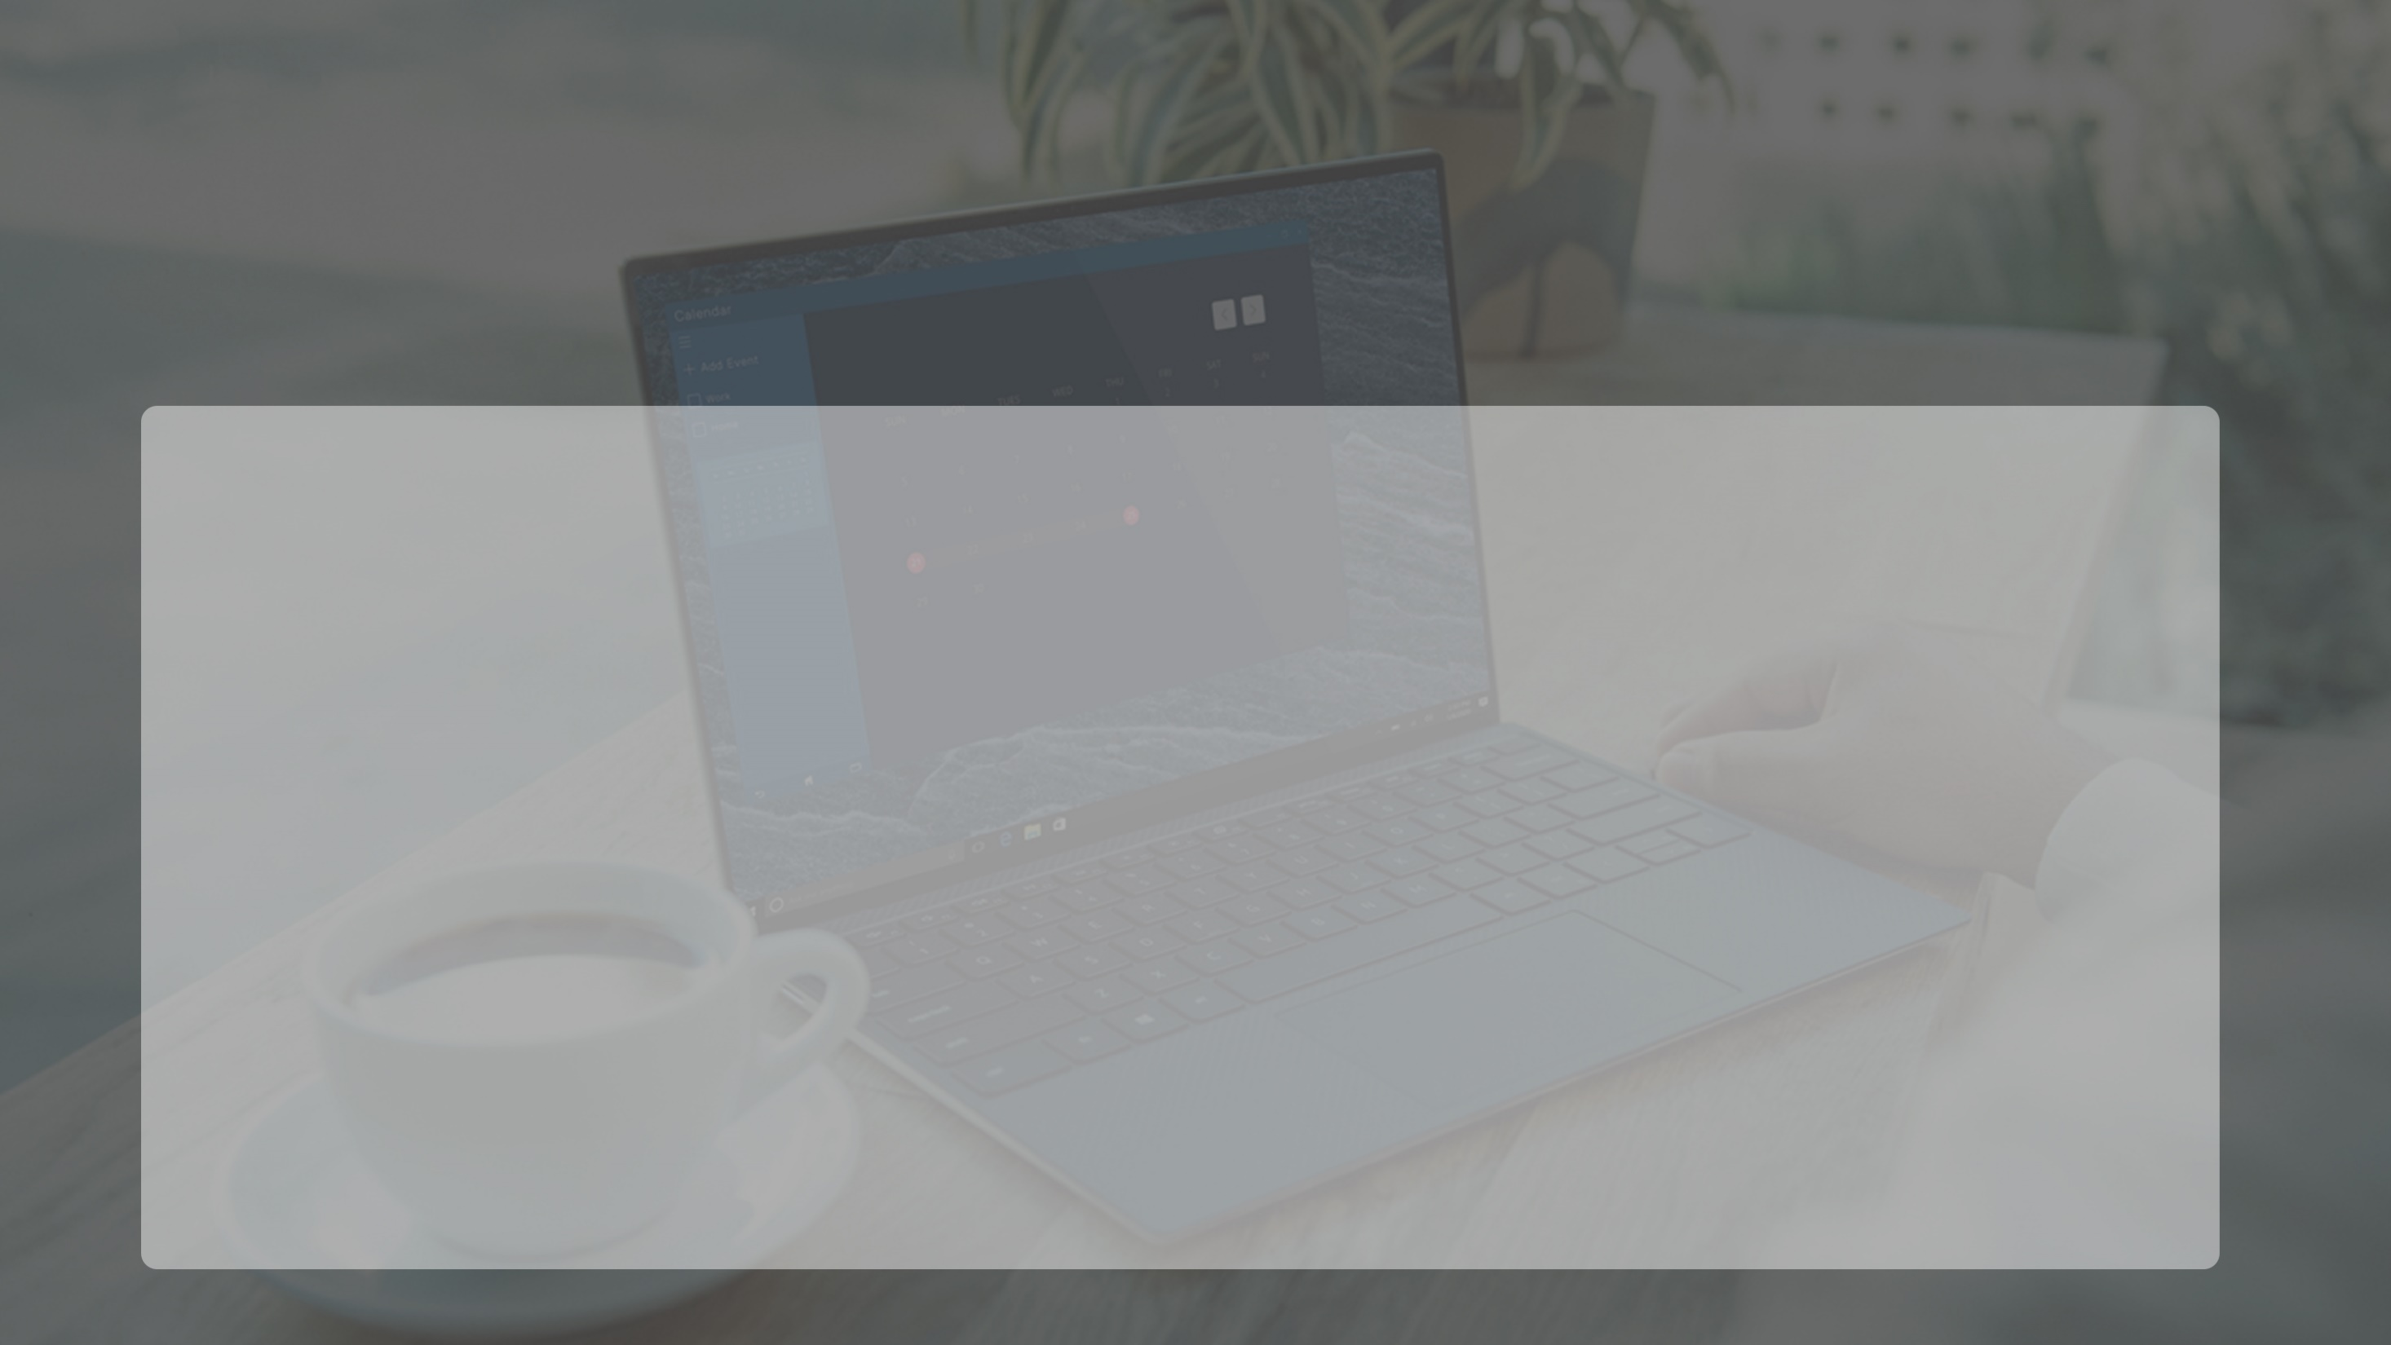
Agenda
Introduction
History
Quantum v/s Conventional Cryptography
How Quantum Cryptography Works
An example of how quantum encryption works
Advantages
Application
Conclusion and Future Scope

Slide 3

Introduction
Cryptography is the process of encrypting data, or converting plain text into scrambled text so that only someone who has the right “key” can read it.
Quantum cryptography, by extension, simply uses the principles of quantum mechanics to encrypt data and transmit it in a way that cannot be hacked.

Slide 4

Quantum cryptography is different from other symmetric and asymmetric cryptography techniques as instead of mathematics; it relies more on the concepts of physics as a key aspect of its security model.
Due to Quantum Computers, cracking mathematics based encryption has become easier.
This type of cryptography uses photons (particles/waves of light) and their intrinsic properties to develop an unbreakable cryptosystem. It works by sending photons across an optical link, ensuring high security from hacking.
Why need of Quantum Cryptography

Slide 5

Elements of the Quantum Theory
Light waves are propagated as discrete quanta called photons.
They are massless and have energy, momentum and angular momentum called spin.
Spin carries the polarization.
If on its way we put a polarization filter a photon may pass through it or may not.
We can use a detector to check of a photon has passed through a filter.

Slide 6
The sender transmits photons through a filter (or polarizer) which randomly gives them one of four possible polarizations and bit designations: Vertical (One bit), Horizontal (Zero bit), 45 degree right (One bit), or 45 degree left (Zero bit).
The photons travel to a receiver, which uses two beam splitters (horizontal/vertical and diagonal) to “read” the polarization of each photon. The receiver does not know which beam splitter to use for each photon and has to guess which one to use.
Once the stream of photons has been sent, the receiver tells the sender which beam splitter was used for each of the photons in the sequence they were sent, and the sender compares that information with the sequence of polarizers used to send the key. The photons that were read using the wrong beam splitter are discarded, and the resulting sequence of bits becomes the key.
How Quantum Cryptography Works ??

Slide 7
Suppose Alice uses 0-deg/90-deg polarizer sending photons to Bob. But she does not reveal which.
Bob can determine photons by using filter aligned to the same basis.
But if he uses 45deg/135 deg polarizer to measure the photon he will not be able to determine any information about the initial polarization of the photon.
The result of his measurement will be completely random
Sender-Receiver of Photons

Slide 8
Eavesdropper Eve
If EVE uses the filter aligned with Alice’s she can recover the original polarization of the photon.
If she uses the misaligned filter she will receive no information about the photon .
Also she will influence the original photon and be unable to retransmit it with the original polarization.
Bob will be able to deduce Ave’s presence.

Slide 9
Each photon carries one qubit of information
Polarization can be used to represent a 0 or 1.
In quantum computation this is called qubit.
To determine photon’s polarization the recipient must measure the polarization by ,for example, passing it through a filter.
A user can suggest a key by sending a stream of randomly polarized photons.
This sequence can be converted to a binary key.
If the key was intercepted it could be discarded and a new stream of randomly polarized photons sent.
Binary Information

Slide 10
Alice communicates with Bob via a quantum channel sending him photons.
Then they discuss results using a public channel.
After getting an encryption key Bob can encrypt his messages and send them by any public channel.
Quantum Key Distribution

Slide 11

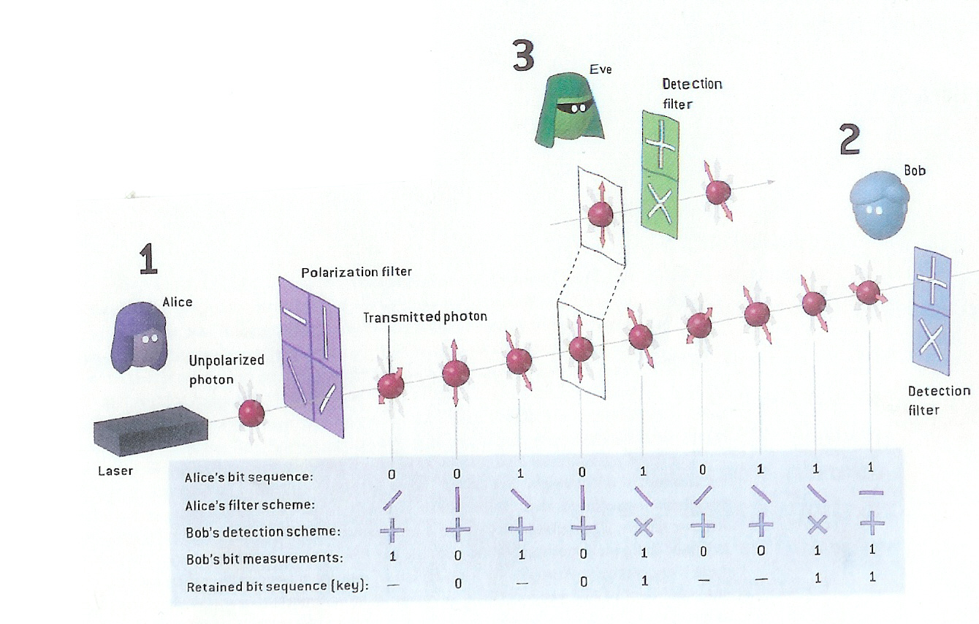
Example of how Quantum Cryptography works

Slide 12
Both Alice and Bob have two polarizers each.
One with the 0-90 degree basis (+) and one with 45-135 degree basis ( )
Alice uses her polarizers to send randomly photons to Bob in one of the four possible polarizations 0,45,90,135 degree.
Bob uses his polarizers to measure each polarization of photons he receives.
He can use the( + )basis or the ( ) but not both
simultaneously.

Slide 13

Advantages and Disadvantages
Advantages of Quantum cryptography:
Virtually un-hackable
Simple to use
Less resources needed to maintain it
Used to detect eavesdropping in quantum key distribution.
Disadvantages of Quantum cryptography:
The signal is currently limited to 90 miles
Could replace a lot of jobs

Slide 14
Quantum cryptography promises to revolutionize secure communication by providing security based on the fundamental laws of physics, instead of the current state of mathematical algorithms or computing technology.
The devices for implementing such methods exist and the performance of demonstration systems is being continuously improved.
Within the next few years, if not months, such systems could start encrypting some of the most valuable secrets of government and industry.
Conclusion and Future scope

Slide 15
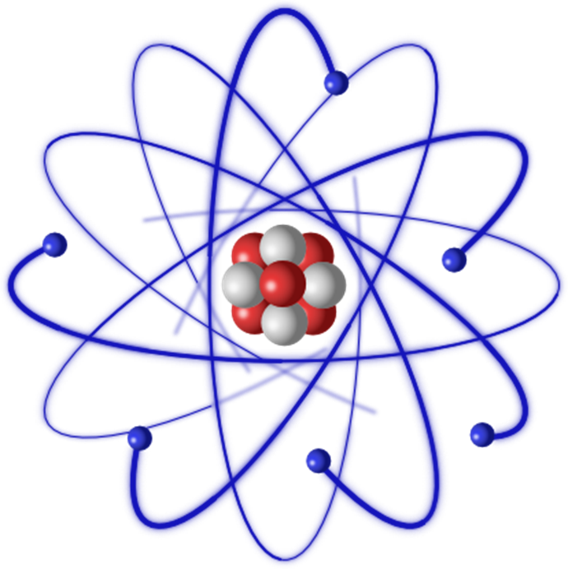
THANK YOU

