Slide 1

SOFT ROBOTICS
Sayali Sanjay Dudhane
10303320181124510009

Slide 2
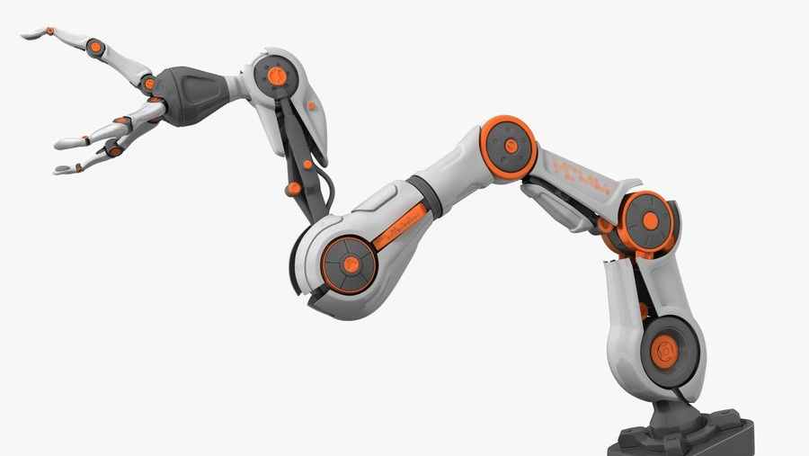
What is a ROBOT?
A robot is a machine especially one programmable by a computer capable of carrying out a complex series of actions automatically.
Machine that replaces human effort, though it may not resemble human beings in appearance or perform functions in a humanlike manner.

Slide 3
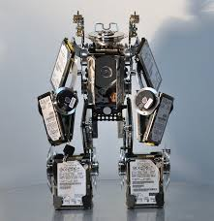
Hard Robot
Reduce human effort and minimize cost in Industries.
Problem in their Architecture.
Real world interactions are difficult
Need to make small measurements Can cause destruction
Low level of behavioral diversity as lacks flexibility.
Low level of bio-inspiration as it cannot mimic humans and other animals.

Slide 4
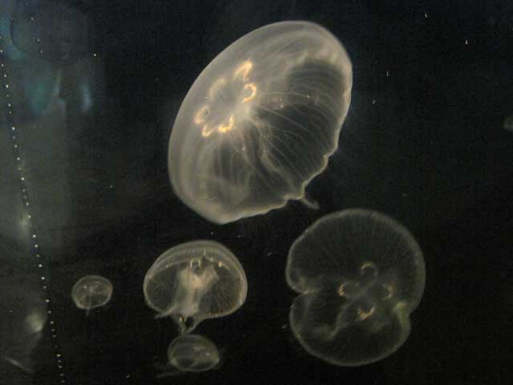
Soft Robotics
Soft Robotics is the specific subfield of robotics dealing with constructing robots from highly compliant materials, similar to those found in living organisms.
Inspired from Nature.

Slide 5
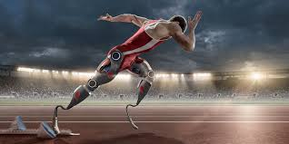
Types of Robots
HARD Robotics
SOFT Robotics
Made of flexible, stretchable materials with reversible and variable properties
Compliant body
Infinite DoF
Made of hard materials with invariable properties
Rigid Body
finite DoF

Slide 6

Soft Components for building Soft Robots
Soft Fluidic Actuation- pressurized fluid
Alternative Soft Actuation Methods- Elastic energy
Soft Smart Structures- soft but not controlled by fluids
Soft Rigid Hybrid Systems- hybrid of soft and hard materials.
Electric Field- Dielectric Elastomer Actuator
Thermal- Shape memory polymers
Pressure Difference- Pneumatic artificial muscles

Slide 7

Shaping Soft structure
Molding (case of thermoplastic material molding)
Reinforcements (Hard polymers for final shape)
Additive Manufacturing (electroconductive materials for circuits)
Shape Manufacturing (Complex structures)
Architectural Considerations(mounting soft actuators)

Slide 8
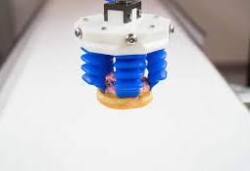
Manufacturing

Slide 9

Types and Designs
Nature is an inspiration for its design.
Look similar to the creatures.
Mathematics fails so we use EVOULTIONARY algorithms.

Slide 10
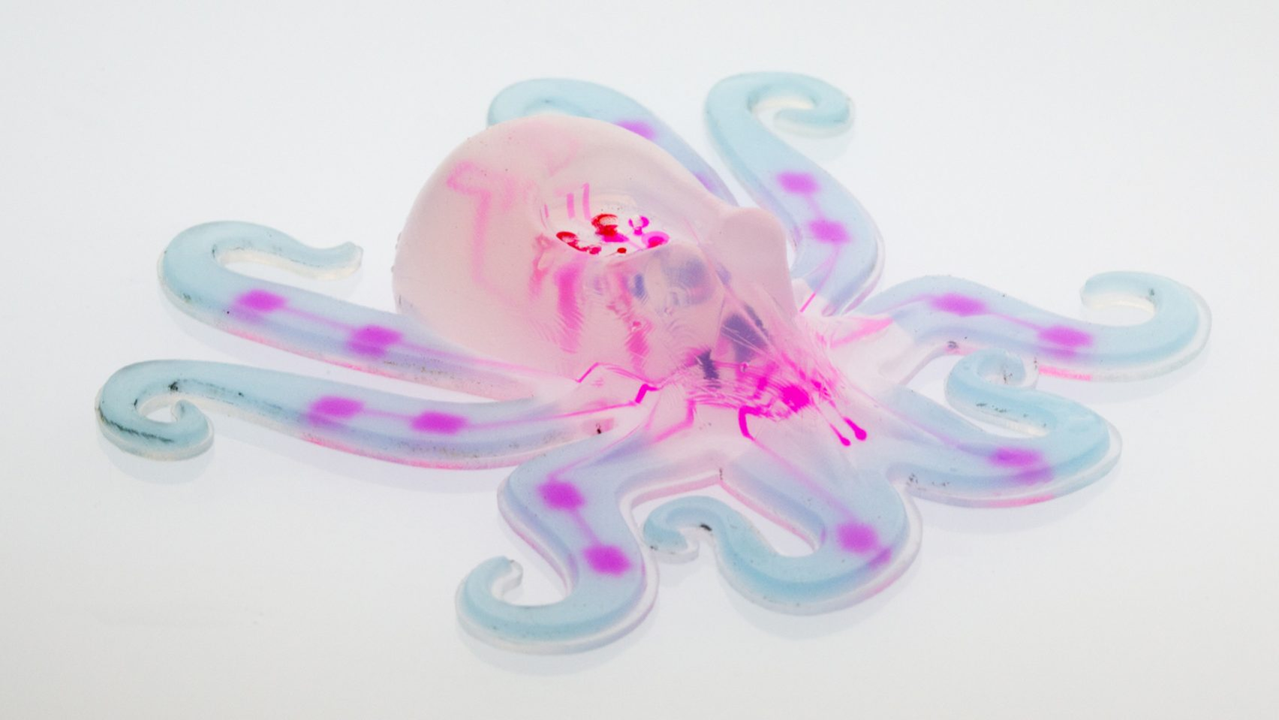
OCTOBOT The First Soft Robot

Slide 11
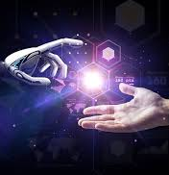
Applications Of Soft robotics
Surgical Assistance
Exosuits
Collaborative Robots
Bio mimicry

Slide 12
Surgical Assistance
Surgeries – especially in neuroscience(MINIR) for brain tumors.
Easily navigate in the body.
Artifical Muscles

Slide 13
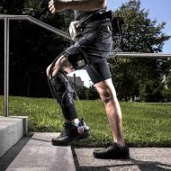
Exosuits
Provide Energetic Movements

Slide 14
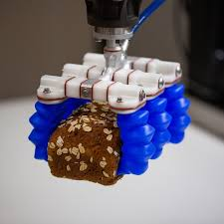
Collaborative Robots

Slide 15
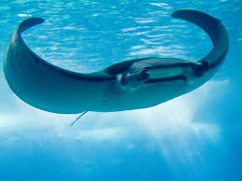
Biomimcry
Bio inspired Robots is the greatest application of soft robots.
They are inspired by the Nature and copy the concept of Embodied intelligence.

Slide 16
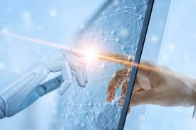

Conclusions and Future Scope
Soft Robotics recent technology and emerging field.
Medical and Industries
Soft and rigid robotic systems could work together in unprecedented ways.
Humanoids

Slide 17
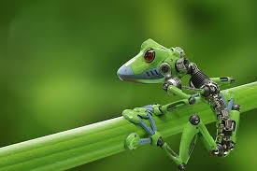
Thank You

