Slide 1
Silent Sound Technology
Presented By: Guided By:
Shreya Rajesh Thalkar Mr. Vinayak Mukkawar

Slide 2

What it is…..?

Slide 3
Need for Silent Sound
Silent Sound Technology will put an end to embarrassed situation.
For better way communication in noisy places.
Gives a better and new way of communication for those peoples who have lost their voices.

Slide 4
Origination
Humans are capable of producing and understanding whispered speech.
The idea of interpreting silent speech was popularized in the 1968 Stanley Kubrick sci-fi film “2001 – A Space Odyssey”.
A major focal point was the DAPRA Advanced Speech Encoding Program (ASE) of the early 2000’s.

Slide 5
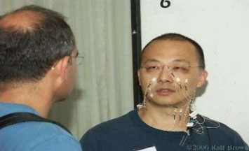
Recent Events
In 2010 at CeBIT, one of the largest trade fair, a new concept called “Silent Sound Technology” was demonstrated.
This technology is being developed by scientists of Karlsruhe Institute of Technology (KIT), Germany.

Slide 6
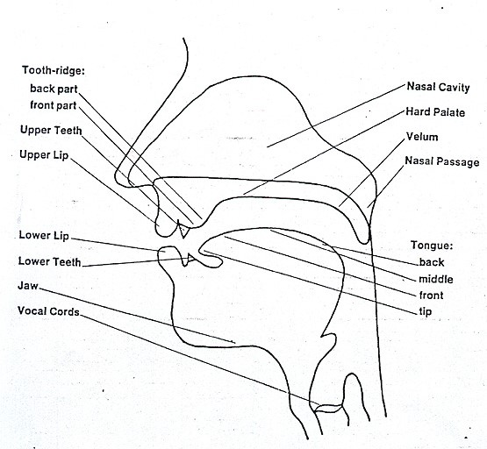
How we speak…..?
When we generally speak aloud, air passes through larynx and the tongue. Words are produced using articulator muscle in the mouth and jaw region.

Slide 7
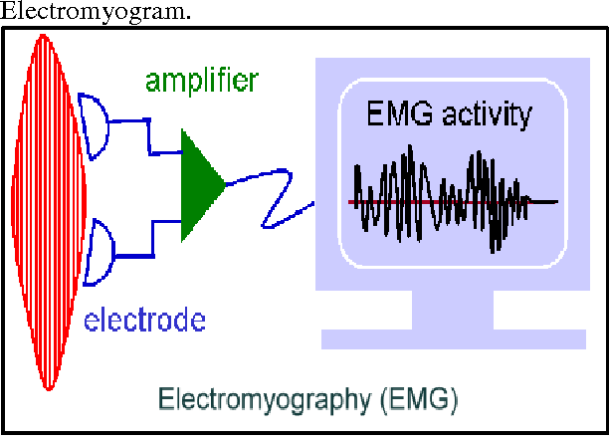
Now imagine a technology that could allow everyone to make phone calls, and talk, without making a sound…….. Peacefully.
These electrical signals are known as ELECTROMYOGRAMS.

Slide 8
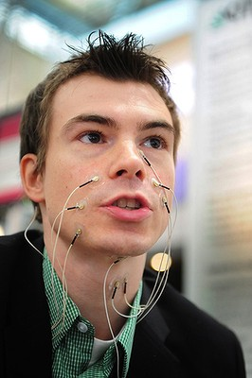
ELECTROMYOGRAPHY
It is a technique which monitors tiny muscular movements and pulses generated by it.
The transducers involved converts the pulses into electric signals.
Compare them with pre-recorded signal pattern of spoken words.
Transmitted on to the other end of the line.

Slide 9
APPLICATION
This technology can be best utilized by astronauts.
We can make silent calls even if we are standing in a crowded place.
Helping people who have lost their voice.
This technology can be used for communication in nasty environment.
Sharing confidential information.

Slide 10
RESTRICTIONS
Translates into majority of languages but for languages such as Chinese. Hence this technology is difficult to apply in such situations.
Even differentiating between people and emotions cannot be done.
This device presently needs nine leads to be attached to our face which is quite impractical to make it usable.

Slide 11
FUTURE PROSPECTS
Silent sound technology gives way to a bright future to speech recognition technology.
Without having electrodes hanging all around your face, these electrodes will be incorporated into cellphones.
Nano technology will be a mentionable step towards making the device handy.

Slide 12
Conclusion
Silent Sound Technology, one of the recent trends in the fields of Information Technology implements “Talking without Talking”.
Engineers claim that the device is working with 99% of efficiency.
It will be one of the innovation and useful technology and in mere future this technology will be in our day to day life.

Slide 13
THANK YOU!!!

