Slide 1
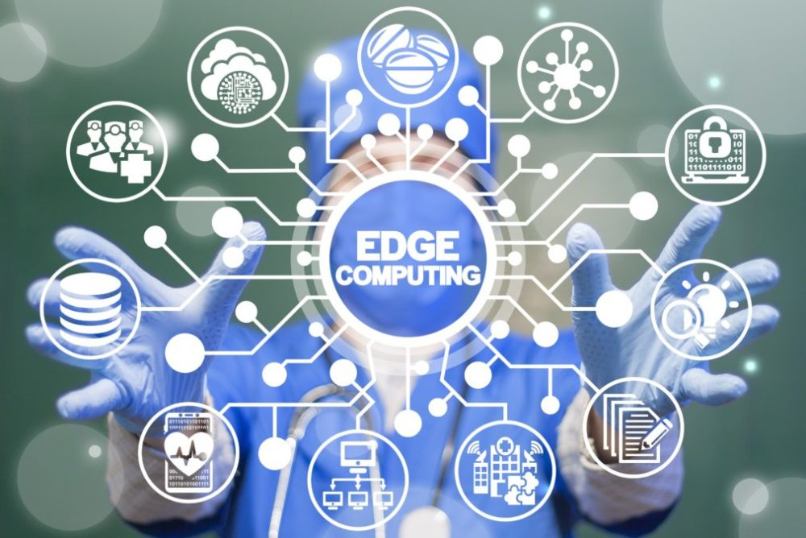
Seminar Report On Smart Healthcare with Edge Computing

Slide 2
What is Edge Computing?
Edge Computing is computing that done at or near the source of data.
i.e it is the practice of capturing,storing, processing and analyzing data near the client,where the data is generated,instead of in a centralised data processing warehouse.
It is also known as Fog computing.

Slide 3

Introductory Video

Slide 4
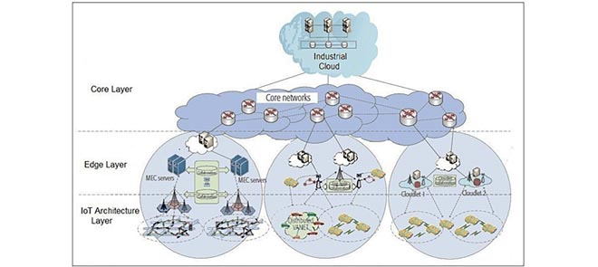
Proposed System Model

Slide 5
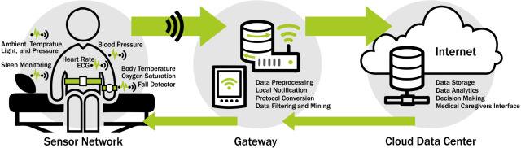

Slide 6
Infrastructure Layer: also called IOT enabled healthcare architecture layer.
It is composed of low powered embedded sensors and IOT Devices. These devices are either attached to patients body or installed in the Hospital
Edge Computing Layer:This layer consist of different kinds of edge servers.This layer performs functions such as data exchange,storage, processing and job migration between different edge servers.The data come from IOT layer may suffer from man in middle,confidentiality,data integrity and spoofing attacks which cause a higher delay and control overhead in the network.
Core computing layer: It has two parts ,the core networks and cloud services.The core network responsible for hosting various applications that provide different services and manages architecture of IOT.

Slide 7
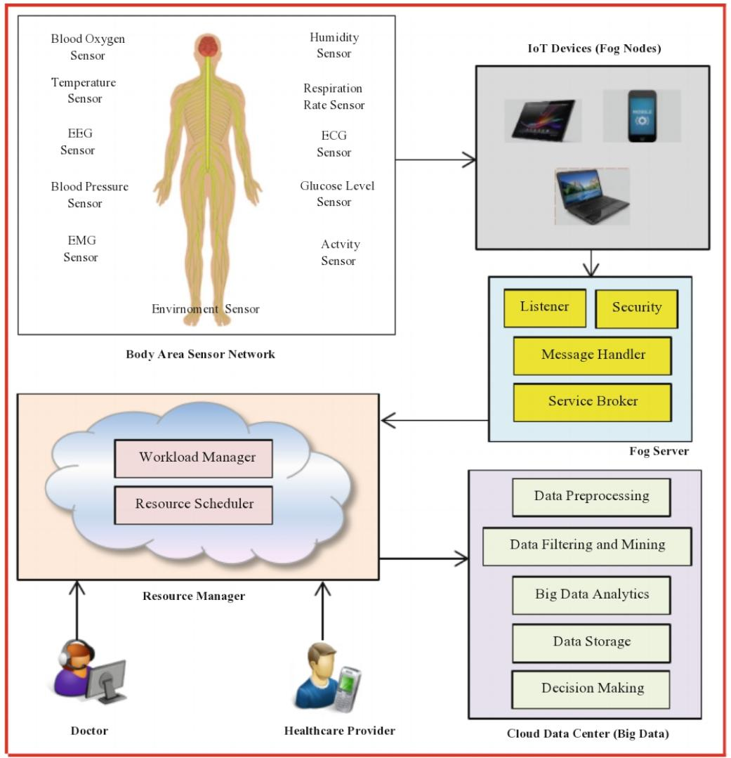

Slide 8
1. BODY AREA SENSOR NETWORK: sences data from patient and transfer to attach IOT devices. 2. IOT DEVICES: collect sensed data from different sensors and forward for further processing. 3. EDGE SERVER:In this there are four modules. 1.listner module: receive request from edge device 2.security module: provide secure communication. 3.Message Handler: manages the received data along with patient details. 4.service broker:provides patient data in term of workloads for further processing. 4.RESOURCE MANAGER:contains two main modules. i.workload manager:handles patient data in term of bulk of workloads and maintain workload queue. ii.Resource Scheduler: schedule resources for processing workloads. 5.CLOUD DATA CENTER:This component perform data processing. Based on health it makes decisions automatically,which recommend medication and sutaible checkup.

Slide 9
Advantages/Use cases:
Rural Medicine Patient Generated Health Data Improved patient experience
Supply chain
Cost savings

Slide 10
Disadvantages/Challenges:
It requires more storage capacity.
Security challenges in edge Computing is high due to huge amount of data.
It only analyse the data.
Cost of edge Computing is very high.
It requires advanced infrastructure.

Slide 11
Conclusion
In this presentation smart healthcare with edge Computing is proposed.
The IOT devices can authenticate data.After authentication, data from patient are sent to edge server for processing.
The edge Computing has better edge collaboration and efficient resource utilisation via optimal network configuration.

Slide 12
References
www.researchgate.net
www.ncbi.nlm.nih.gov
M.bizcommunity.com
www.saguna.net
Healthtechmagazine-net.cdn.ampproject.org

Slide 13
Thank
You!!

