Slide 1

Cloud Storage
Submitted By Siddhant A. Tompe
PRN-10303320181124510068
Under the Guidance of
Prof. Rasika Kalyane

Slide 2
Content
Introduction
What is cloud storage?
How does cloud storage work?
Cloud Storage - Business Benefits
What does it cost to users?
Types of Cloud Storage
Advantages of Cloud Storage
Disadvantages of Cloud Storage
Conclusion
References

Slide 3
Introduction
With Cloud storage, data is stored on multiple servers, rather than on the dedicated servers used in traditional networked data storage.
Data is stored on virtual servers from the users point of view and seems like it has been stored to a particular place, but it isn’t.
The user’s data could be stored on any one or more of the computers used to create the cloud.
The actual storage location may even differ from day to day or even minute to minute, as the cloud dynamically manages available storage space.

Slide 4
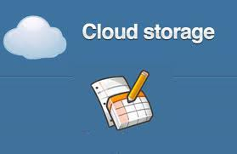
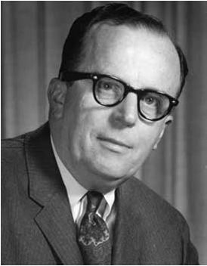
What is cloud storage?
History
J.C.R. Licklider – One of the fathers of the cloud based computing idea.
Global network that allows access from anywhere at anytime.
Concept
Cloud storage is a service model in which data is maintained, managed and backed up remotely and made available to users over a network (typically the Internet).

Slide 5

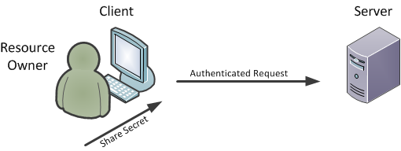
How does cloud storage work?
Cloud storage involves at least one data server that a user connects via the internet.
The user sends files manually over the Internet to the data server which forwards the information to multiple servers.
The stored data is then accessible through a web-based interface.

Slide 6

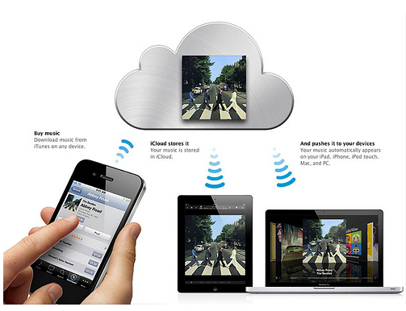
Cloud Storage - Personal Use Benefits
iCloud
iCloud is a service provided by Apple
5GB storage space is free of cost
Once the iCloud is used you can share your stored data on any of your different Apple devices
Aceess to all files, music, calendar, email
Only works for iOS,Mac Devices

Slide 7

Cloud Storage - Business Benefits
With cloud storage, there's no need for CDs, external hard drives, or localized servers
Data is quickly and automatically updated in the cloud and available for your retrieval whenever you need it
Should your office become the victim of a burglary, fire, or natural disaster, your data is safe and secure in the cloud, even if your physical assets are destroyed.
One of the greatest benefits of cloud storage is its ability to grow with its users
With no need for physical, on-site storage space, you can have a smaller workspace, less equipment to buy, and fewer IT employees to maintain your equipment and manage your data
IT staff's can spend more time to focusing on other important tasks to help your business growth.

Slide 8
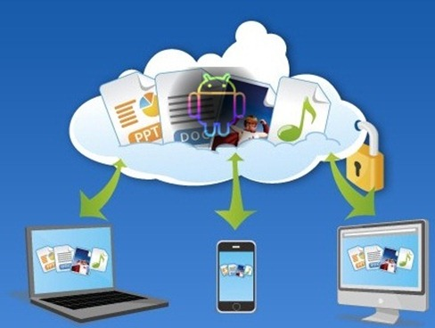

What are the negatives to cloud storage?
Security: Many companies may not want to hand over their data to an external organization to store, fearing that they may not have the right security software to protect the company’s data.
Performance: There were several incidents that some cloud-service providers temporarily went down or lost customer’s data.

Slide 9
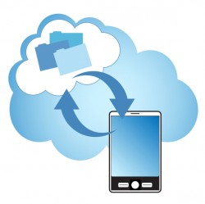
What does it cost to users?
GOOGLE DRIVE
-15GB Free and later charges 100GB- $1.99 per month
DROPBOX
-2gb free and later charges 1TB- $9.99 per month
iCLOUD
-5GB- Free and later charges 20GB- $0.99 per month
ONEDRIVE
-15GB- Free 100GB- $1.99 per month

Slide 10
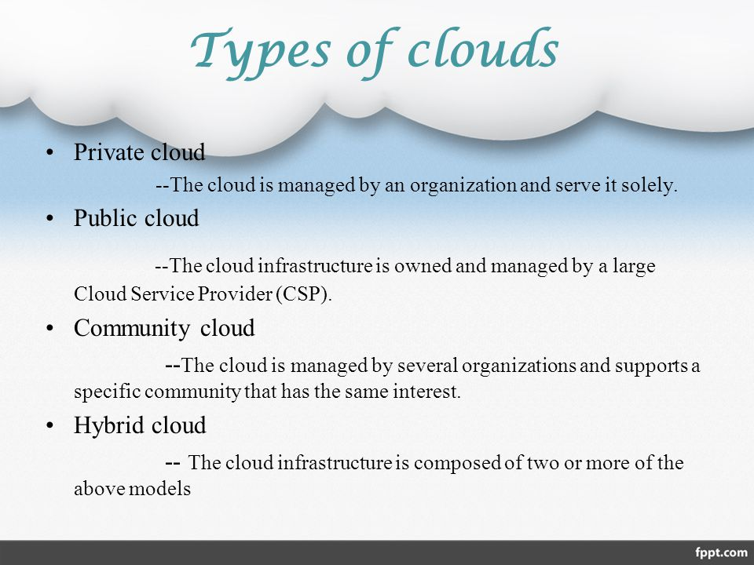
Types of Cloud Storage

Slide 11
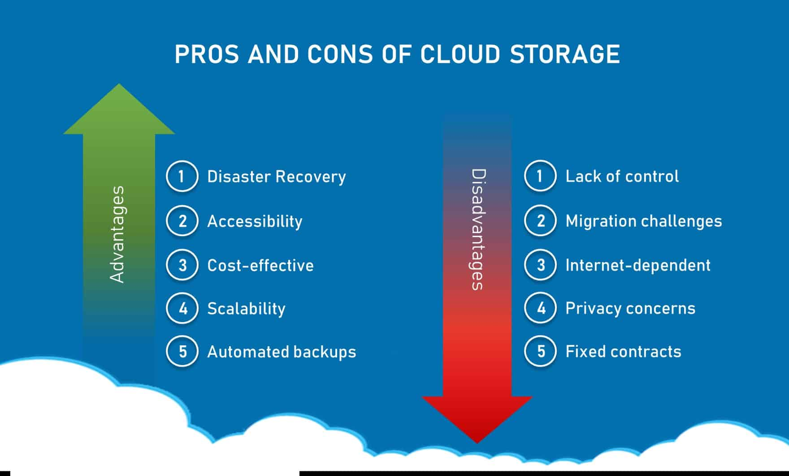

Slide 12
Conclusion
In the very near future, the thought of storing data on physical machines may seem outlandish.
It’s difficult to ignore the multiple benefits received from cloud drives such as flexibility, backup, mobility, connectivity, and scalability.
As the ideal way for delivering applications, cloud storage is the preferred means for organizations extending their infrastructure or developing new technologies.

Slide 13
References
www.google.com
www.wikipedia.com
www.studymafia.org
www.pptplanet.com

Slide 14
Thanks

