Slide 1
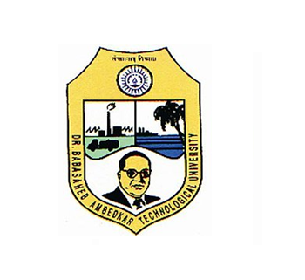
A Seminar on,
Gesture Recognition Technology
Guided By,
Prof. Rasika Kalyane
Dr. Babasaheb Ambedkar Technogical University, Lonere
Submitted By,
Siddhi Rajan Kolekar
(10303320181124510066)

Slide 2
Contents
Introduction
Gesture Types
Input Devices
Challenges
Applications
Future Development

Slide 3
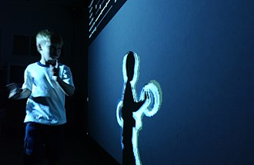
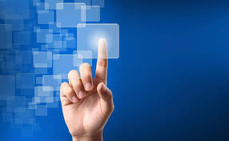
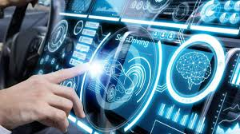

Slide 4
Introduction
What are gestures?
A form of non verbal communication
Gestures are expressive, meaningful body motions i.e., physical movements of the fingers, hands, arms, head, face, or body with the intent to convey information or interact with the environment.
What is Gesture Recognition?
Interpreting Human gestures via mathematical expressions.
Gestures are input to control devices or applications.

Slide 5
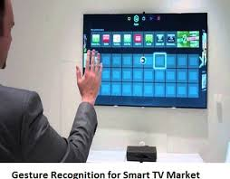
Example
A smart TV recognizing the hand movement to control the channels or to select a option from a menu

Slide 6
Gesture Types
In computer interfaces, two types of gestures are distinguished:
OFFLINE GESTURES: Processed after the user interaction with the object.
Ex. gesture to activate a menu.
ONLINE GESTURES: Direct manipulation like scaling and rotating.

Slide 7
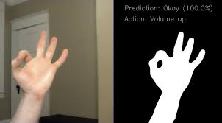
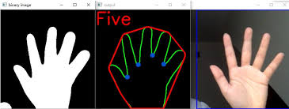
Key Technology based on Computer Vision
Hand detection and segmentation
Hand tracking and segmentation are the primary steps for any hand gesture recognition system.
Hand tracking and segmentation algorithm (HTS) is found to be most efficient to handle the challenges of vision based system such as skin color detection, complex background removal and variable lighting condition.

Slide 8
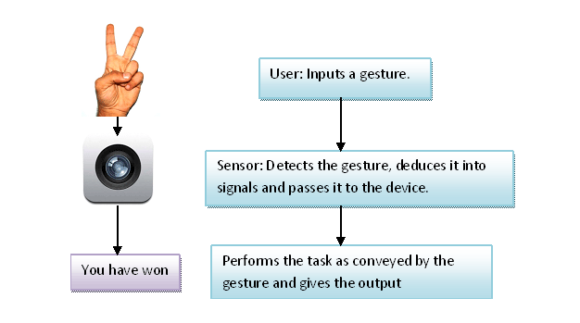
Basic Working of Gesture Recognition Technology

Slide 9
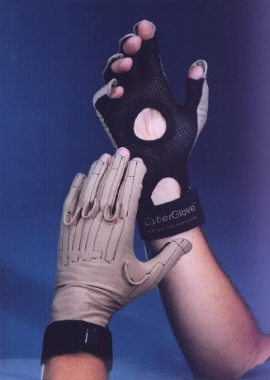
Tracking Technologies
Data gloves/Cyber gloves:
Use of gloves equipped with sensors
Use of fiber optic cables
Advantages
Provides data at a high sampling frequency
Easy to use
Relatively low cost versions available
Data is translation-independent (within the range
of motion).

Slide 10
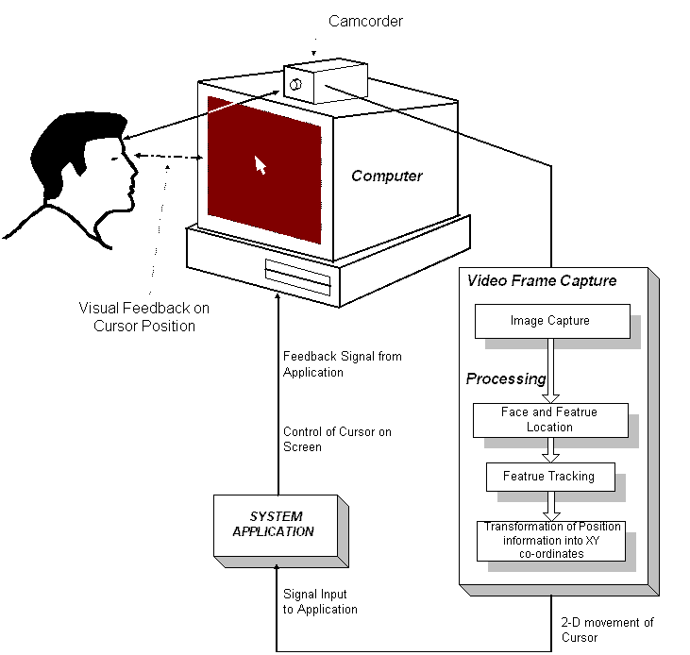
Vision based Gesture Recognition
Use of cameras:
Depth Cameras
Stereo Cameras
Normal Cameras.

Slide 11
Input Devices
Tools to track a persons movement
Depth aware cameras
Stereo cameras
Gestures Based controller
Single camera

Slide 12
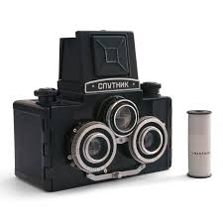
Technology Behind it…
Stereo Camera :
It has two lenses about the same distance apart as your eyes
and take two pictures at a same time.
A 3D representation can be approximated by the output
of the cameras.

Slide 13
Challenges
Lack of Gesture Language:
Different Users make gestures differently , causing
difficulty in identifying motions.
Robustness:
Many gesture recognition systems do not read motions
accurately or optimally due to factors like insufficient
background light, high background noise, etc.

Slide 14
Applications
Sign Language Recognition
Virtual Controllers
Aid to Physically Challenged
Immersive Gaming Technology

Slide 15
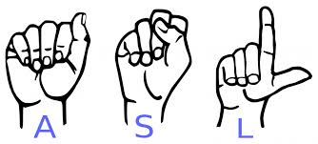
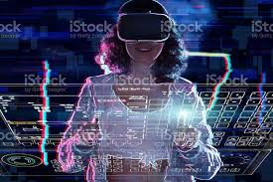
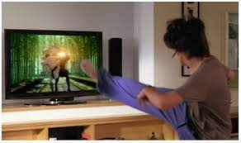

Slide 16
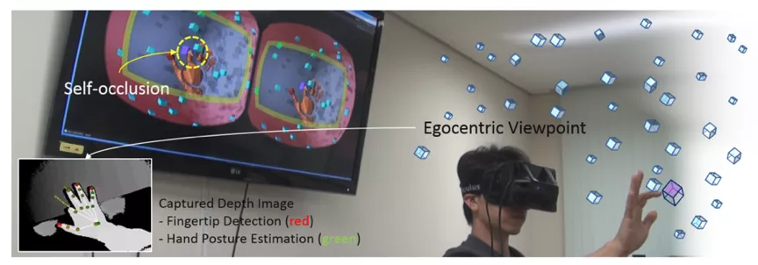
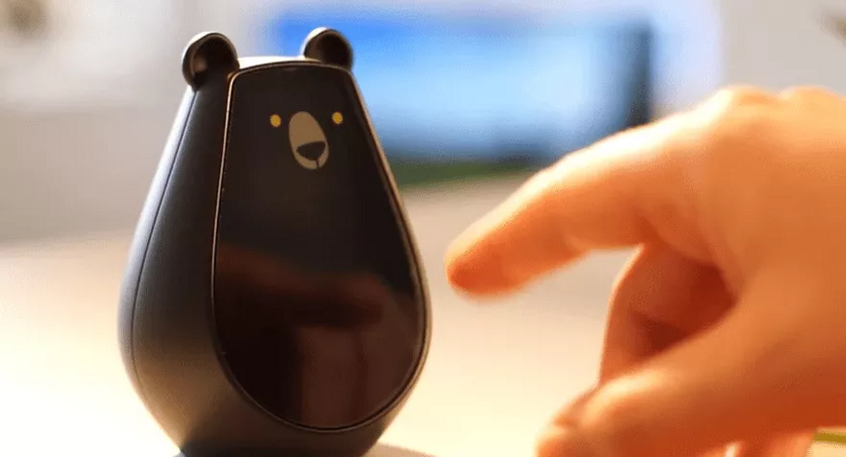
Future Development
Rise of 3D Hand Posture Estimation
The application of gestures in IoT Scenarios
The Application of Gestures in Education Scenarios
3D hand posture manipulation launched by Oculus Quest this year
Bearbot gesture remote control

Slide 17
Conclusion
The importance of gesture recognition lies in building efficient human machine interaction. Its application range from sign language recognition through medical rehabilitation to virtual reality Gesture recognition 35 soft computing tools pose another promising application to static hand gesture identification.
Thus, gesture recognition promises wide-ranging applications in fields from photojournalism through medical technology to biometrics.

Slide 18


