Slide 1
Presentation on FOG COMPUTING
~ By Supriya Mahesh Tawade

Slide 2
CONTENTS
Introduction
What is Fog Computing
Need Of Fog Computing
Architecture
Comparison Fog Vs Cloud
Applications
Pros & Cons
Conclusion
References

Slide 3
Introduction
Fog computing is a service started by networking giant, CISCO. It would be very difficult to define fog computing without first defining cloud computing, since fog computing is basically an extension of the cloud.
Cloud computing is the process of running ICT tasks and services and storing computer resources over the Internet. This makes it possible for people and businesses to make use of third-party hardware and software hosted online. Cloud computing makes it quite easy to access information and computer resources from anywhere so far as internet connection is available. With the all-round availability of shared/pooled computing resources, cloud computing offers advantages over traditional on-site hosted services in terms of speed, cost, and efficiency.
Fog computing (also known as fogging), on the other hand, is the extension or lowering of cloud computing capabilities to the bottom/edge of the network in order to provide faster ICT (communication, storage, software, etc.) services to the lower end users. Therefore, what distinguishes fog computing from cloud computing is its closer proximity to small end users, its wider consumer reach, and better mobility.

Slide 4
What Is fog Computing
Fog computing is a decentralized computing infrastructure in which data, compute, storage and applications are located somewhere between the data source and the cloud. Like edge computing, fog computing brings the advantages and power of the cloud closer to where data is created and acted upon.
Many people use the terms fog computing and edge computing interchangeably because both involve bringing intelligence and processing closer to where the data is created. This is often done to improve efficiency, though it might also be done for security and compliance reasons.

Slide 5
NEED OF FOG COMPUTING
TO OVERCOME ALL LIMITATIONS OF CLOUD COMPUTING WE NEED FOG COMPUTING
LIMITATIONS OF CLOUD COMPUTING
CONNECTIVITY
LATENCY
BANDWIDTH
NO REDUNDANCY
SECURITY

Slide 6
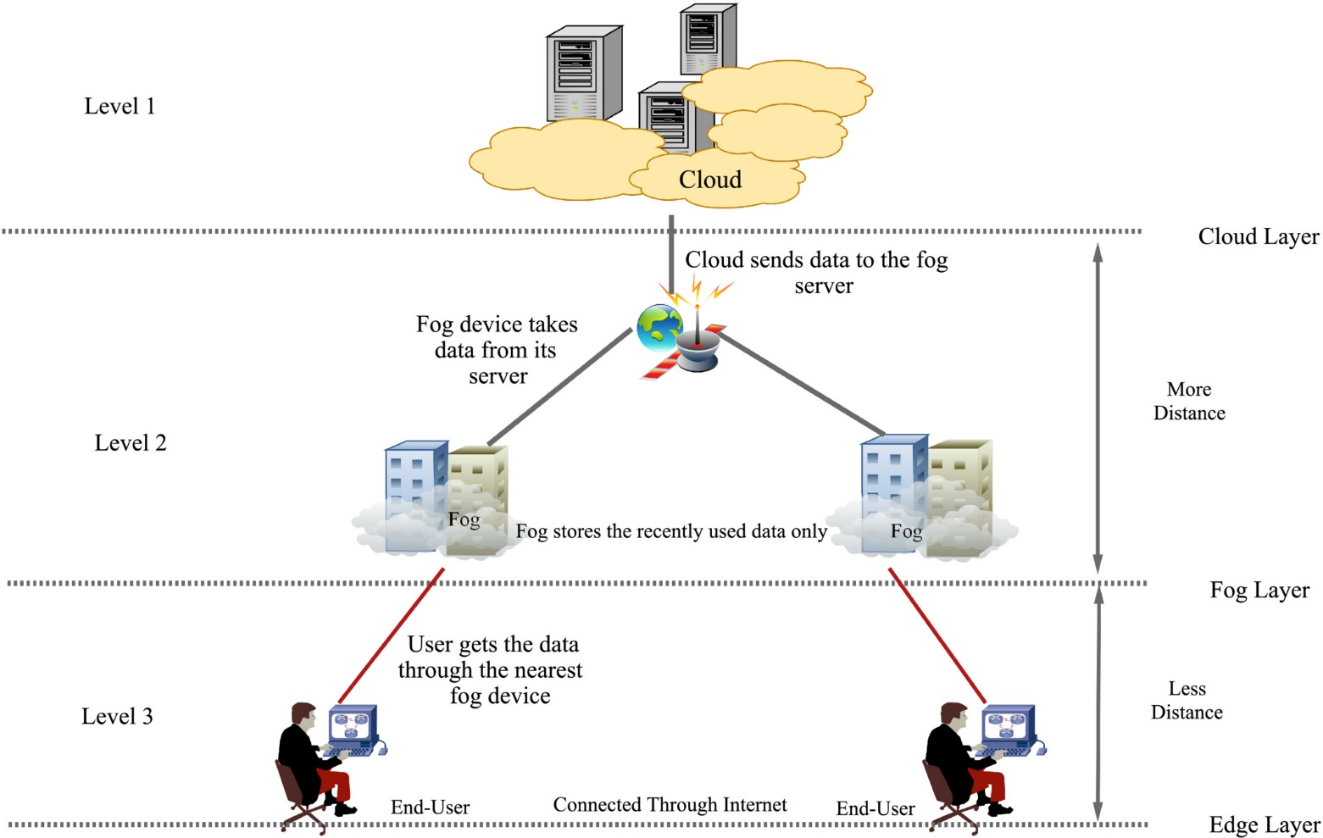
Architecture

Slide 7
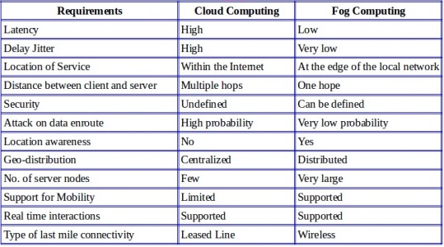
Comparison Cloud Vs Fog

Slide 8
Applications
Smart grid
Health care system
Traffic control system
Video streaming system

Slide 9
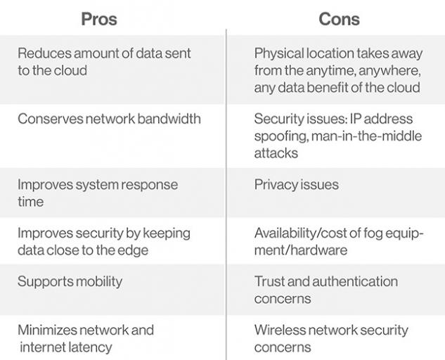

Slide 10
Conclusion
Fog Computing is not a replacement for Cloud Computing but may be a future of cloud computing.. Fog Computing is a big step to a distributed cloud – by controlling data in all node points, fog computing allows turning datacenter into a distributed cloud platform for users.
Fog is an addition which develops the concept of cloud services. Fog computing is proposed to enable computing directly at the edge of the network, which can deliver new applications and services especially for the future of Internet

Slide 11
References
Andrew Froehlich: “IoT: Out Of The Cloud & Into The Fog”; Information Week Network Computing, 08-19-2014 Available online at: http://www.networkcomputing.com/cloud-infrastructure/iot-out-cloud-fog/345618829
*Christopher Mims: Forget ‘the Cloud’; ‘the Fog’ Is Tech’s Future; Wall Street Journal, 18-05-2014. Available online at: http://www.wsj.com/articles/SB10001424052702304908304579566662320279406
*John Apostolopolos: From the Cloud to the Fog; Cisco Technology Radar, Available online at https://techradar.cisco.com/technology/fog-computing

Slide 12


Slide 13


