Slide 1
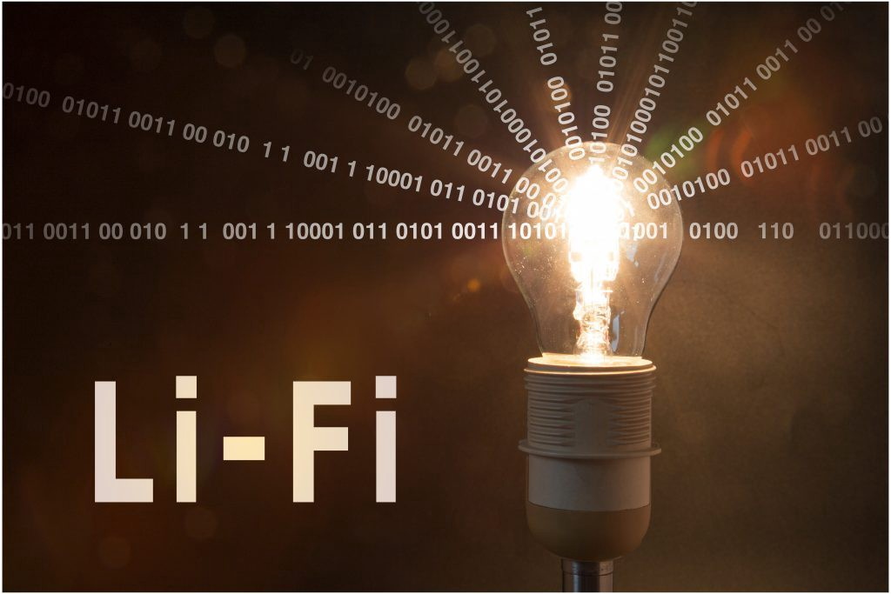
Seminar on Lifi Technology
Submitted by: Submitted to:
Surabhi S. Pednekar Dr. Arwind W. Kiwlekar

Slide 2
Content
Introduction
History
How Li-Fi Works?
Real Time Usage of Li Fi
Wifi vs lifi
Application
Advantages
Disadvantages
Conclusion

Slide 3
Introduction
LiFi is a wireless optical networking technology that uses light-emitting diodes (LEDs) for data transmission.
LiFi is designed to use LED light bulbs similar to those currently in use in many energy-conscious homes and offices.

Slide 4
History
Professor Harald Haas, from the University of Edinburgh in the UK, is widely recognised as the original founder of Li-Fi.
He coined the term Li-Fi

Slide 5
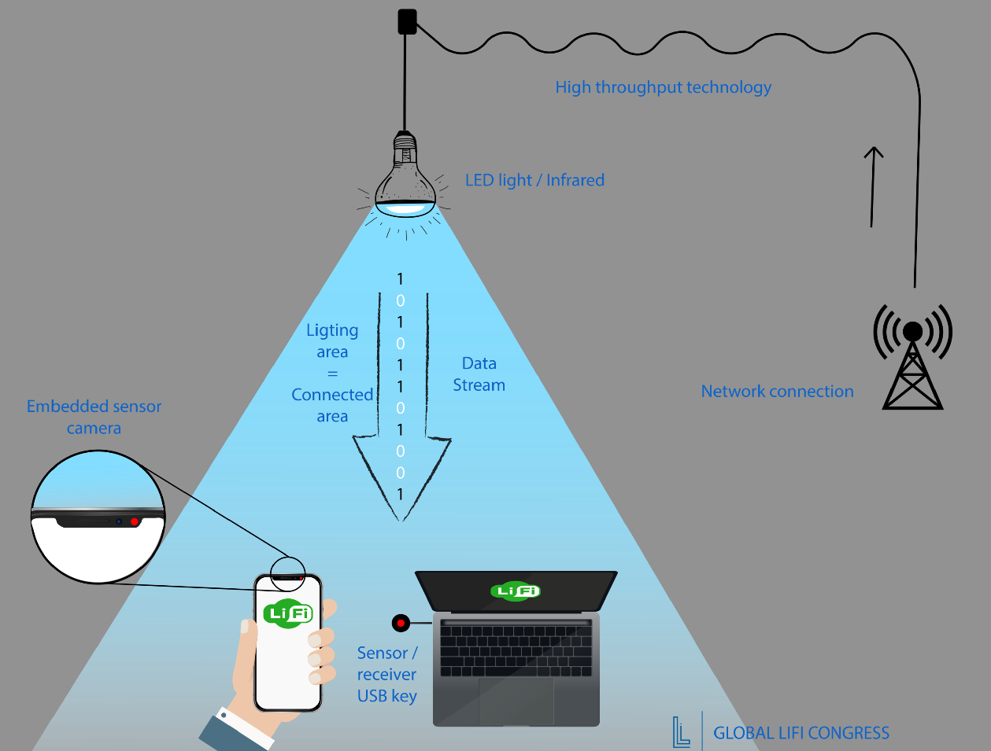
Working : (Pictorial view)

Slide 6
Comparision between various technologies:
Fire wire | 800 Mbps
USB 3.0 | 5 Gbps
Thunderbolt | 20 Gbps
WiFi | 150 Mbps
Bluetooth | 3 Gbps
IrDA | 4 Gbps
Lifi | 10 Gbps
Giga- IR | 1 Gbps
Wi-Gig | 2 Gbps

Slide 7
How it is different?
Li-Fi technology is based on LEDs for the transfer of data.
The transfer of the data can be with the help of all kinds of light, no matter the part of the spectrum that they belong.

Slide 8
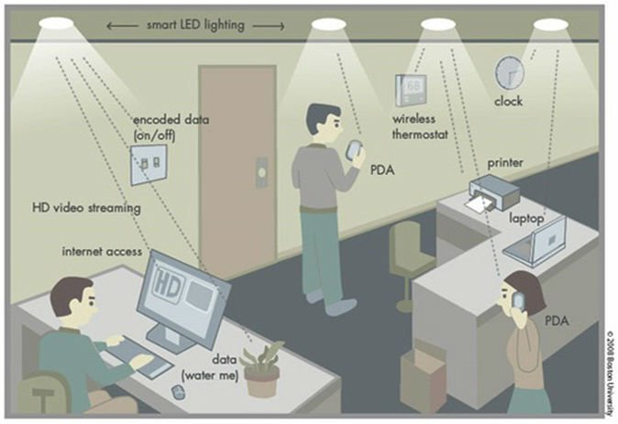
Real life use of Lifi

Slide 9
WIFI vs LIFI
.
Instead of Wi-Fi modems, Li-Fi would use transceiver-fitted LED lamps that can light a room as well as transmit and receive information.
Wi Fi is great for general wireless coverage within building and Li-Fi is ideal for high density wireless date coverage in confined area and for relieving radio interference issues.
So the two technologies can be considered complimentary.

Slide 10
Applications
You Might Just Live Longer
Airlines
Smarter Power Plants

Slide 11
Advantages of Lifi
High data transmission rates of up to 10Gbps can be achieved.
Since light cannot penetrate walls, it provides privacy and security that Wi-Fi cannot.
Li-Fi has low implementation and maintenance costs.

Slide 12
Disadvanteges
Light can't pass through objects.
High installation cost of the VLC systems.

Slide 13
Conclusion
The possibilities are numerous and can be explored further.
If this technology can be put into practical use, every bulb can be used something like a Wi-Fi hotspot to transmit wireless data and we will proceed toward the cleaner, greener, safer and brighter future.

Slide 14
References
http://teleinfobd.blogspot.in/2012/01/what-is-lifi.html
seminarprojects.com/s/seminar-report-on-lifi
http://en.wikipedia.org/wiki/Li-Fi

Slide 15
Thanks
Surabhi Suhas Pednekar
Third year computer
Dr.Babasaheb Ambedkar Technological University,Lonere

