Slide 1
Class Attendace System with Smart Card Technique
Submitted by: Submitted to:
Swaraj Shelavale Ass. Prof. Ankita Amburle

Slide 2

A Seminar Presentation on
Class Attendance System with Smart Card Technique by Swaraj Dnyaneshwar Shelavale. PRN:- 10303320181124513003
under guidance of Ass. Prof. Ankita Amburle.
Dr. Babasaheb Ambedkar Technological University Lonere, Mangaon Raigad-402103.

Slide 3
Contents
What is Smart Card Attendance System ?
Existing System
Proposed System
System Requirement
System Architecture
Advantages and Disadvantages
Conclusion

Slide 4
Smart Card Attendance System is a way to take attendance of students using ID card and fingerprint technique.

Slide 5
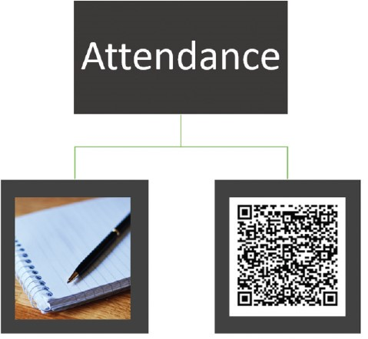
Existing Systems
PAPER BASED SYSTEM
Calling out the names and surnames of students.
Pass around a sheet of paper, asking students to sign in attendance sheet
BARCODE TECHNOLOGY
Retrieve in shape of symbol generally in bar, vertical, space, square.

Slide 6
Proposed System
We can use automated student attendance system RFID through SMART CARD system to improve the student monitoring system.
There will RFID transponders installed in every classroom.
When a student enters any of them the transponder will detect and store the students last known position in the database.
The software managing all these will be designed using JAVA will share a common database of MySQL.
If student are not present then send the message to guardian.
For the security purpose, we are used thumb detection
of the user.

Slide 7
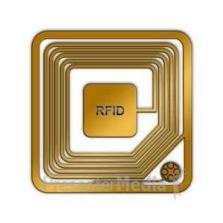
System Requirement
Hardware Components
Radio Frequency Identification (RFID) Reader
Biometrics
Smart Card
Software Requirement
JAVA
MySQL Database
Mat lab

Slide 8
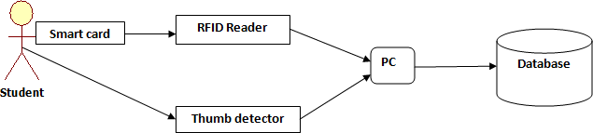
System Architecture
The thumb detection is meant to prevent a student from giving his/her RFID-card to a classmate who attends the lecture, scanning the other student’s RFID-card to make it appear as if s/he had also attended.
When a student enters class, the RFID reader reads his/her student ID card, while the thumb detection simultaneously detects thumb expression and sends it to the PC.
After some time, the professor submits all data for storage in a database.

Slide 9
Workflow of System
Our system starts after the login of admin and by initializing the RFID reader. When the RFID reader gets initiated they starts emitting the frequency with respective range of their own and they detect the RFID tag.
The RFID readers reads the tag information and fetch the information of student.
Simultaneously, thumb detector match fingerprint if both condition satisfy then mark the attendance.
The usage of Java is very important and the main function to build the system is because Java functions as a link between hardware and software.
Additionally, it functions to send information to the online networking system through intermediary MySQL database system.

Slide 10
Advantages & Disadvantages
Advantages
More Secure
Adaptable
Disadvantages
Slow Adoption And Cost
Security Concerns

Slide 11
Conclusion
Multifunction smart ID cards with RFID offer several easy and cost-effective ways for campuses to raise the level of protection and quality of education.
Todays smart access card technologies provide superior range and read performance so that educational institutions can improve efficiency and security at multiple levels.

Slide 12
References
www.google.com
www.wikipedia.com
www.studymafia.org

Slide 13

Thank You !
Swaraj Dnyaneshwar Shelavale
Third Year ( Computer )
Dr. Babasaheb Ambedkar Technological University, Lonere

