Slide 1

LJMU MSDS/ML C30

Slide 2


Course: MSDS/ML
Live Session On: Agentic AI for Research Applications
Instructor: Dr. Jyoti Dabass

Slide 3
Welcome
Welcome Everyone 👋 • Today’s session is practical • Learn to read & critique agentic AI papers • Identify gaps and generate research ideas • Move from “using AI” → “researching AI”
Notes:
Note to SMEs: Start the session with a recall of the concepts taught in core content would help build a connection between the two
For example, if teaching a session on e-skills, asking the learners what they understood from the first module or the core concepts that were taught in module

Slide 4
Why are we doing this session?
Agentic AI is evolving fast:
• Models now plan, use tools, and act • Research paper volume is exploding • Quality varies widely • We need structured evaluation skills
Notes:
Note to SMEs: Start the session with a recall of the concepts taught in core content would help build a connection between the two
For example, if teaching a session on e-skills, asking the learners what they understood from the first module or the core concepts that were taught in module

Slide 5
What You Will Learn Today
By the end of this session, you can:
• Understand key agentic AI patterns • Use a structured review rubric • Compare success, cost, robustness, and safety • Identify research gaps • Propose follow-up experiments
Notes:
Note to SMEs: Start the session with a recall of the concepts taught in core content would help build a connection between the two
For example, if teaching a session on e-skills, asking the learners what they understood from the first module or the core concepts that were taught in module

Slide 6
How Today’s Session Works
Format:
• Short explanations • Live critique of two papers • Group review activities • Gap mining • Clear takeaways
Notes:
Note to SMEs: Start the session with a recall of the concepts taught in core content would help build a connection between the two
For example, if teaching a session on e-skills, asking the learners what they understood from the first module or the core concepts that were taught in module

Slide 7
Agenda Overview
I. Warm-up & Context II. Agentic AI Landscape III. Review Rubric IV. Group Review 1 V. Group Review 2 VI. Gap Mining VII. Wrap-Up
Notes:
Note to SMEs: Start the session with a recall of the concepts taught in core content would help build a connection between the two
For example, if teaching a session on e-skills, asking the learners what they understood from the first module or the core concepts that were taught in module

Slide 8
Before We Begin
We need a shared foundation. We will quickly cover: • LLMs • Prompting • RAG • Tool Calling

Slide 9
Prerequisites Overview
Four concepts power modern AI agents: • LLMs → foundation model • Prompting → instruction layer • RAG → retrieval + grounding • Tool Calling → action-taking ability

Slide 10
What is an LLM?
Large Language Model = • Trained on massive text datasets • Predicts next word using patterns • Built on transformer architecture • Uses attention to track relationships • Supports reasoning, planning, summarizing

Slide 11
LLM in Simple Technical Terms
Simplest accurate meaning: “An LLM is a pattern-based model that generates text using statistical knowledge learned from huge datasets.”
Not a database.
Not a search engine.
A text generator with learned structure.

Slide 12
What is Prompting?
Prompting = giving clear instructions. Good prompts define: • Task • Context • Output format • Steps • Constraints

Slide 13
Types of Prompts
• Role prompts • Few-shot prompts • Step-by-step prompts • Structured prompts (tables, JSON)
Prompting = control mechanism for the model.

Slide 14
What is RAG?
Retrieval-Augmented Generation: • Retrieves relevant documents • Adds them to the prompt • LLM generates grounded output • Reduces hallucination • Improves accuracy

Slide 15
How RAG Works?
Break documents into chunks
Convert chunks into embeddings
Store them in vector DB
Search based on similarity
Add top results into prompt
LLM produces final answer

Slide 16
Why RAG Matters
Useful for: • manuals • policies • reports • FAQs • institutional knowledge Ensures answers are based on real data.

Slide 17
What is Tool Calling?
LLM + Tools = Agent. Tools allow the model to: • call APIs • query databases • calculate • read files • process images • run workflows

Slide 18
How Tool Calling Works
User gives instruction
LLM decides a tool is needed
LLM outputs JSON tool call
System runs the tool
Tool returns result
LLM completes the response

Slide 19
Why Tool Calling is Important
Enables: • accurate actions • automation • real-world integration • multi-step workflows • reliable enterprise systems
This transforms an LLM into an agent.

Slide 20
Prerequisite Summary
Now you understand: • LLM → engine • Prompting → control • RAG → grounded knowledge • Tools → action layer
We can move into the main session.

Slide 21
Poll 1
Question: “Which of the following statements is MOST accurate about how an LLM works?”
Options: A. An LLM is a database that stores facts and retrieves them when asked B. An LLM predicts the next most likely word using patterns learned from large text datasets C. An LLM is a search engine that always looks up answers online D. An LLM executes code directly to produce answers

Slide 22
Poll 1(Answer)
Question: “Which of the following statements is MOST accurate about how an LLM works?”
Options: A. An LLM is a database that stores facts and retrieves them when asked B. An LLM predicts the next most likely word using patterns learned from large text datasets C. An LLM is a search engine that always looks up answers online D. An LLM executes code directly to produce answers

Slide 23
Warm-Up —Why We Are Here
Learn to judge agentic AI papers
Build a researcher mindset
Not just understand → evaluate

Slide 24
Where Agents Fail ?
Don’t follow long instructions
Forget steps
Take wrong actions
Misuse tools
Lose context
Break in long workflows

Slide 25
What an Agent Is
LLM brain
Memory
Tools
Loop: Observe → Think → Act → Repeat
Evaluation

Slide 26
How Researchers Read Paper
Inspect, don’t admire. Check:
Problem clarity, Loop design
Memory use
Tools
Metrics
Failures, Gaps

Slide 27
What to Look For
LLM policy, Loop quality
Tool access
Success measures
Baseline fairness
Claims vs evidence
Failure cases
Research gaps

Slide 28
Why This Warm-Up Matters
Makes papers easy
Reveals strengths
Exposes missing parts
Generates research ideas
Builds deep understanding

Slide 29
Poll 2
Question: “What is the main reason we need agentic AI instead of just normal LLMs?”
Options:
A. Because LLMs already solve all tasks perfectly B. Because agents can take actions using tools and follow multi-step workflows C. Because agents store more data than LLMs D. Because agents are only used for coding tasks

Slide 30
Poll 2 Answer
Question: “What is the main reason we need agentic AI instead of just normal LLMs?”
Options:
A. Because LLMs already solve all tasks perfectly B. Because agents can take actions using tools and follow multi-step workflows C. Because agents store more data than LLMs D. Because agents are only used for coding tasks
The correct answer is Option B — because agents can actually take actions, use tools, follow steps, and handle real work. LLMs alone cannot do that.”

Slide 31
Why Agentic AI Became a Big Research Topic
LLMs = good at text. Real-world needs = actions. Companies want AI that can: • use tools, follow workflows • read rules, check safety • complete long tasks
This shift → Agentic AI

Slide 32
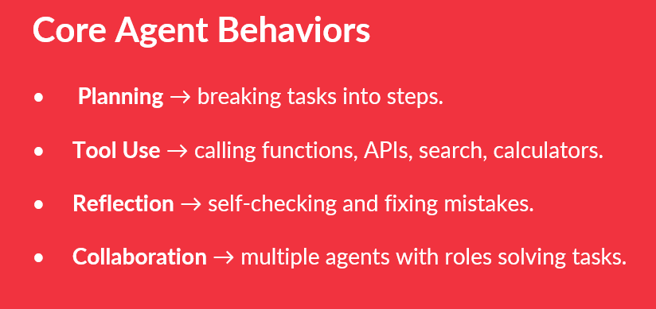
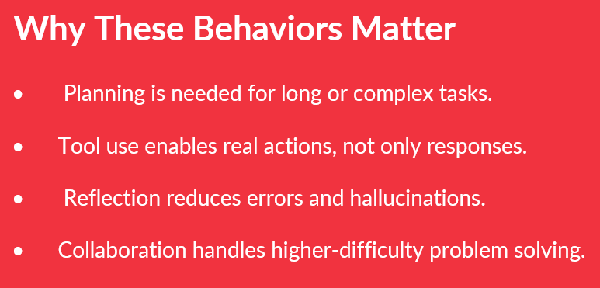

Slide 33
What Agentic Research Aims to Prove
Capability Lift → Can agents do harder tasks than LLMs?
Generalisation → Does it work across unseen tasks?
Robustness → Does performance stay stable?
Safety → Does the agent avoid harmful or illegal actions?

Slide 34
Typical Failure Modes in Agents
Compounding Errors → one mistake grows across steps.
Memory Drift → The agent forgets earlier instructions.
Tool Unreliability → tools return incomplete/incorrect outputs.
Hallucinated Actions → agent invents steps that never happened.

Slide 35
The Leadership Analogy
AI = worker
Human = direction
Agents need: clear rules, boundaries, and error reporting
Helps explain agent behaviors simply

Slide 36
How This Landscape Prepares Us for the Two Papers
AGENTIF → tests instruction following + planning + tools
FIELDWORKARENA → real-world tasks, safety, perception
Helps identify: • behaviors tested, problems addressed • failures exposed, research gaps remaining

Slide 37
Poll 3
Question: “What is the main capability that makes an AI system an agent instead of just an LLM?”
Options:
A. It generates longer responses B. It uses tools and follows multi-step action loops C. It stores more data D. It has a bigger model size

Slide 38
Poll 3 (Answer)
Question: “What is the main capability that makes an AI system an agent instead of just an LLM?”
Options:
A. It generates longer responses B. It uses tools and follows multi-step action loops C. It stores more data D. It has a bigger model size
✅ Correct Answer
✔ Answer: B : “Because agents can use tools and execute multi-step action loops.”

Slide 39
Why We Need a Structured Review Rubric
Casual reading makes everything look good. Research reading must check: • real problem • assumptions • agent design • fairness, missing pieces • possible improvements
Rubric = clear, repeatable method

Slide 40
The Structured Review Framework
Problem Clarity
Agent Architecture
Experimental Setup
Evaluation Metrics
Validity
Failure Analysis
Future Work

Slide 41
Problem Clarity
What exact problem is solved?
Is it realistic + relevant?
Why is it important?
What gap exists?
Many papers fail here → vague or broad problem statements

Slide 42
Agent Architecture
Identify: • LLM policy, memory • allowed tools • action loop design • planning / reflection • multi-agent setup
Many papers hide weak architecture details

Slide 43
Experimental Setup
Check: • dataset / benchmark • realism of tasks • sequence length, difficulty level • constraints, tool environment • docs / APIs / videos included
Tells if experiment is serious or toy-level

Slide 44
Evaluation Metrics
What is measured? Look for: • accuracy • step-level success, tool error rate • reasoning, safety, robustness • cost, latency, partial credit
One metric only = red flag

Slide 45
Validity of the Results
Ask: • Is test set too simple? • Overfitting?, Prompt leakage? • Cherry-picked examples? • Missing negatives?
Does evidence really support the claim?

Slide 46
Failure Analysis
Look for: • where agent broke • patterns of failure, hardest tasks • faulty tools, loop collapse • hallucinations • error snowballing
Critical for identifying research gaps

Slide 47
Future Work
What authors admit is missing
What assumptions they want to relax
What can be extended
Limitations openly stated
Shows vision + honesty

Slide 48
Demo: How to Critique a Paper
Apply rubric step-by-step: Problem clarity, Agent architecture, Setup realism, Baseline fairness, Missing ablations, Robustness issues
Example critiques (generic): • unclear success definition, shallow loop design • unrealistic dataset, unfair baselines • no ablations on memory/tools, breaks in long tasks

Slide 49
How to “Think Like a Reviewer”
Always ask: Does evidence support the claim?
Ignore: pretty charts, tables, hype
Focus on: clarity, fairness, truth, logic, transparency, reproducibility

Slide 50
Applying This Rubric to Our Session Papers
Same rubric will be used for: AGENTIF, FIELDWORKARENA
You will judge: what they solve, how well they solve it • where they fail, what gap remains • What future experiments are possible

Slide 51
Poll 4
Question: Which part of the paper review rubric helps you judge whether the experiment was realistic and serious rather than a simple toy demo?
Options: A. Problem Clarity B. Agent Architecture C. Experimental Setup D. Future Work

Slide 52
Poll 4 (Answer)
✅ Correct Answer: C. Experimental Setup
Why:
The Experimental Setup section tells you:
what dataset/benchmark is used, whether tasks are realistic
how many steps/actions are required, what tools the agent can use
whether inputs include real-world complexity, whether the environment is challenging
This section clarifies whether the research is a serious, real evaluation or merely a demonstration of a toy-level nature.

Slide 53
PART IV — Group Review Sprint No. 1 Paper A: AGENTIF: Benchmarking Instruction Following of Large Language Models in Agentic Scenarios (Link of Paper)

Slide 54
Why This Activity
Why we are doing this • Practice reviewing a real AI paper • Apply the structured rubric • Learn how to critique like a researcher • Prepare for comparison with Paper B

Slide 55
Group Output Tasks
Your 4 Outputs
3-line method summary
Strengths
Weaknesses
Follow-up experiment idea

Slide 56
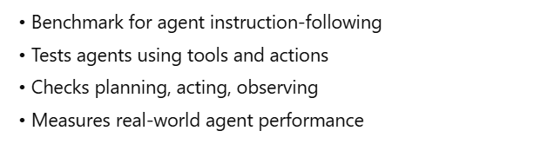
What AGENTIF Is

Slide 57
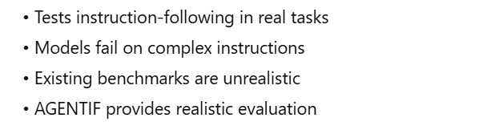
What Problem the Paper Solves

Slide 58


Slide 59
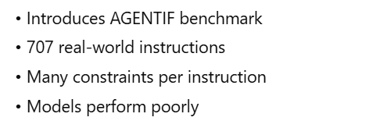
Abstract

Slide 60
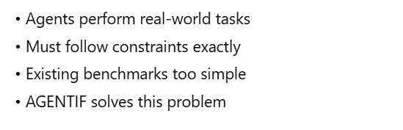
1. Introduction

Slide 61
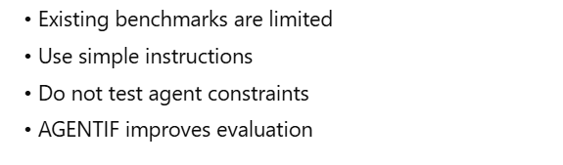
2 Related Work

Slide 62
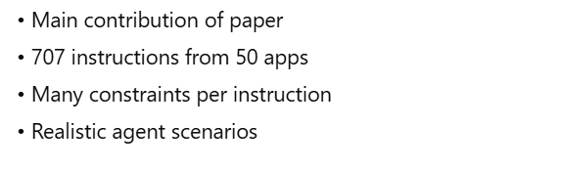
3. AGENTIF Benchmark

Slide 63
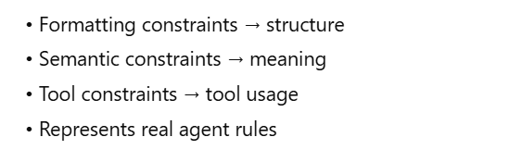
3.1. Constraint Taxonomy

Slide 64
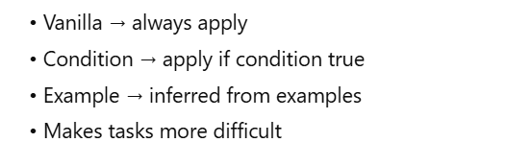
3.2. Constraint Presentation Type

Slide 65
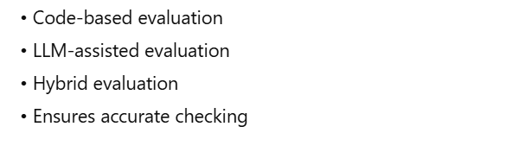
3.3. Evaluation Methods

Slide 66
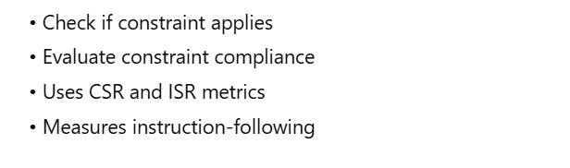
3.4. Evaluation Protocol

Slide 67
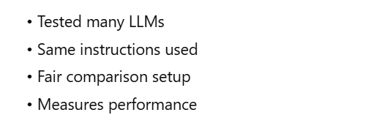
4. Experiments

Slide 68
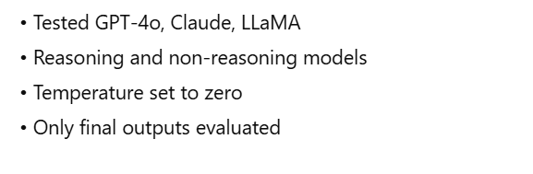
4.1. Experimental Setup

Slide 69
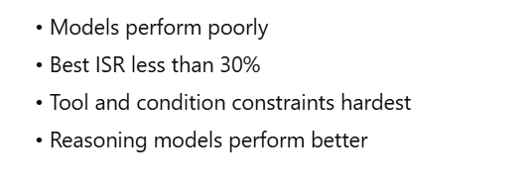
4.2. Main Results

Slide 70
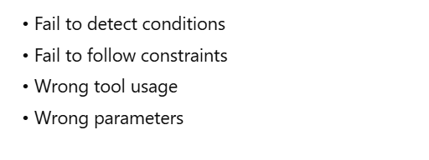
4.3. Error Analysis

Slide 71
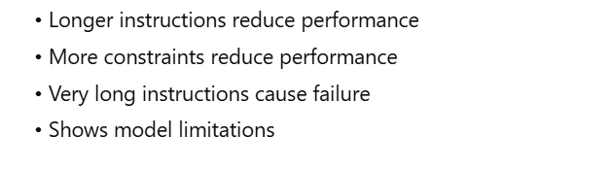
4.4. Analysis of Instruction Length and Constraint Quantity

Slide 72
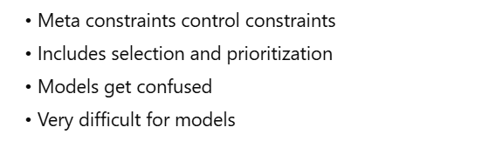
4.5 Analysis of Meta Constraints

Slide 73
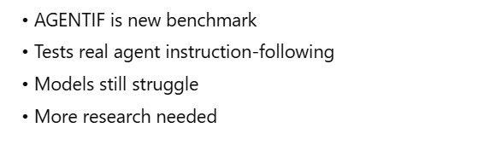
5. Conclusion

Slide 74
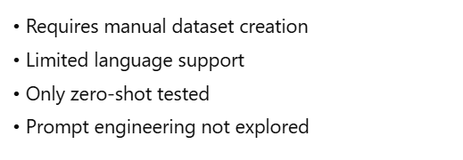
Appendix A Limitations

Slide 75

Appendix B Ethical Considerations

Slide 76
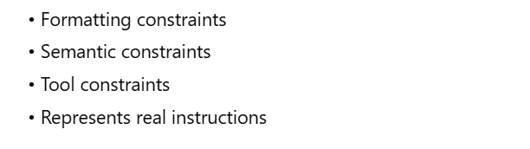
Appendix C Details of Constraint Taxonomy

Slide 77
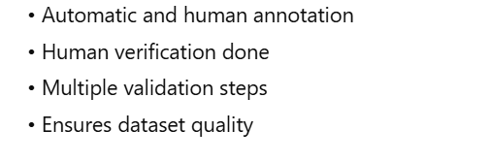
Appendix D Dataset Construction

Slide 78
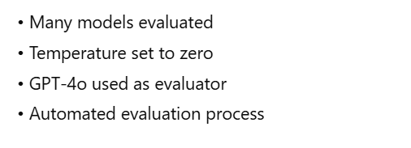
Appendix E Experimental Details

Slide 79
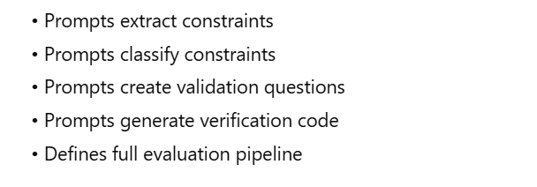
Summary of Appendix-E Tables

Slide 80
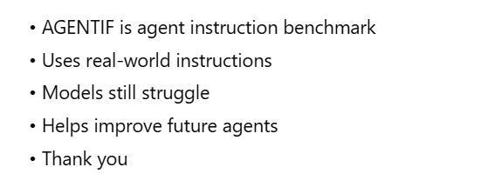
Final Closing 🎯

Slide 81
Review Rubric Reminder
Use This Rubric • Problem Clarity • Agent Architecture • Experimental Setup • Evaluation Metrics • Validity • Failure Analysis • Future Work

Slide 82
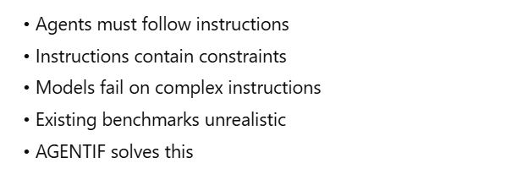
Problem Clarity

Slide 83
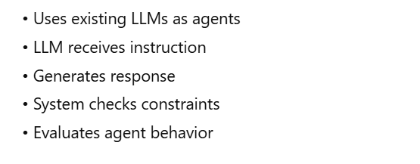
Agent Architecture

Slide 84
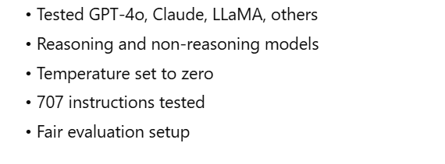
Experimental Setup

Slide 85
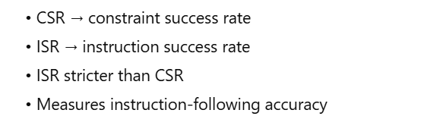
Evaluation Metrics

Slide 86
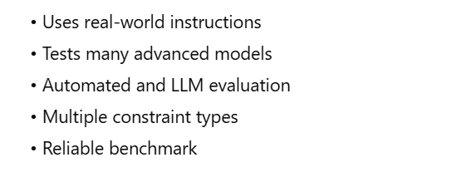
Validity

Slide 87
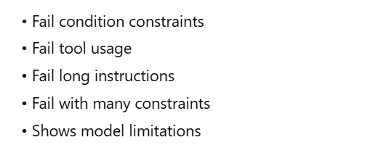
Failure Analysis

Slide 88
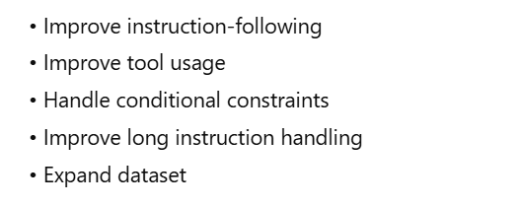
Future Work

Slide 89
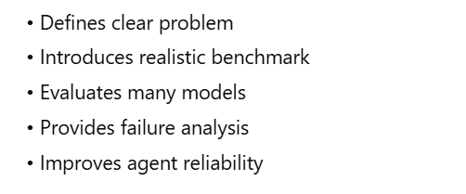
Rubric-Level Conclusion

Slide 90

3-line method summary

Slide 91
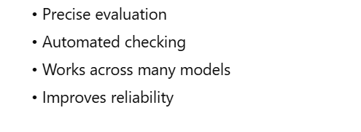
Strengths

Slide 92
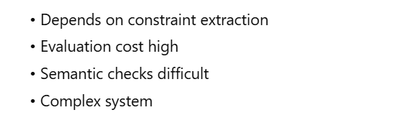
Weaknesses

Slide 93
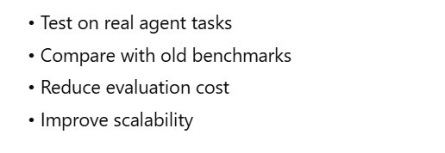
Follow-up experiment idea

Slide 94
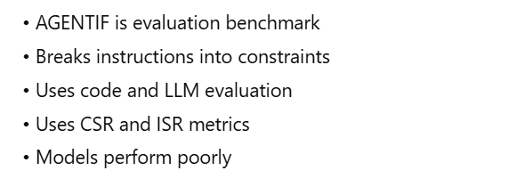
What is directly from the AgentIF paper

Slide 95
Poll 5
Question: What does AGENTIF mainly evaluate?
Options: A. How well LLMs detect safety violations in real videos B. How well LLMs follow instructions in browser-based agent tasks C. How well LLMs collaborate as multi-agent systems D. How well LLMs generate long research summaries

Slide 96
Poll 5 (Answer)
✅ Correct Answer: B. How well LLMs follow instructions in browser-based agent tasks
Why this is the BEST option:
AGENTIF = instruction-following benchmark; Environment = browser-based tasks; Focus = step-by-step agent actions
Completely different from video or safety benchmarks (A)
Not about multi-agent systems (C), Not about summarization (D)
This makes B the only correct answer

Slide 97
(Group Review Sprint No. 2)
Paper B: FieldWorkArena: Agentic AI Benchmark for Real Field Work Tasks (Link of Paper)

Slide 98
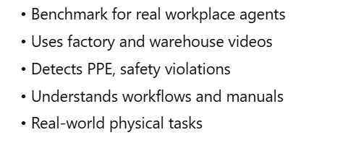
What FieldWorkArena Is

Slide 99
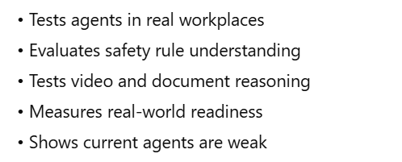
What Problem the Paper Solves

Slide 100
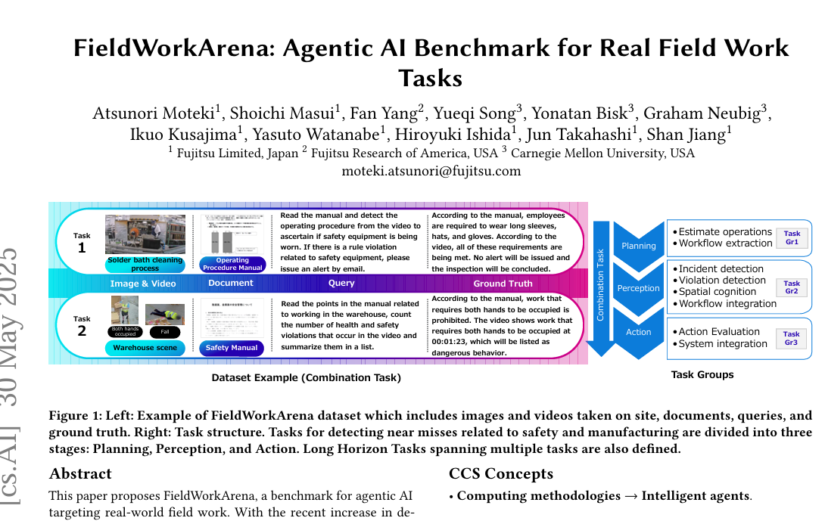

Slide 101
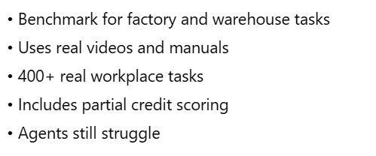
Abstract

Slide 102
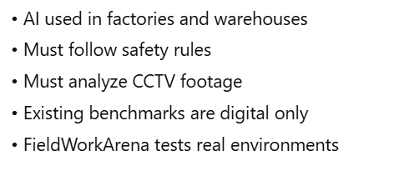
1. Introduction

Slide 103
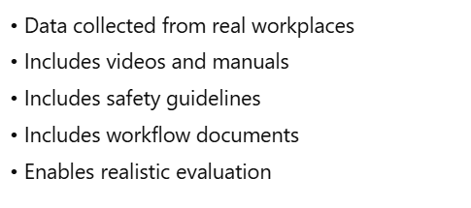
2. FieldWorkArena Data Collection

Slide 104
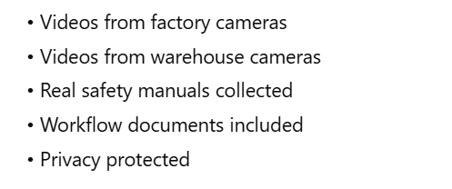
2.1 Input Data Acquisition

Slide 105
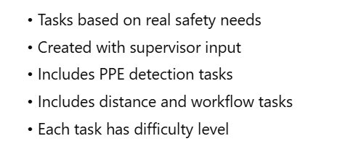
2.2 Query Generation

Slide 106
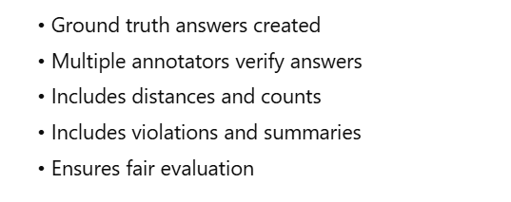
2.3 Annotation

Slide 107
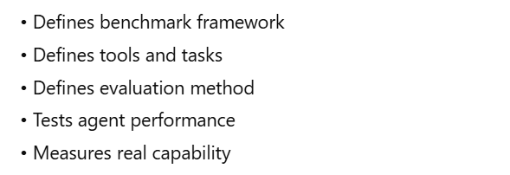
3 Benchmarking and Evaluation Methodology

Slide 108
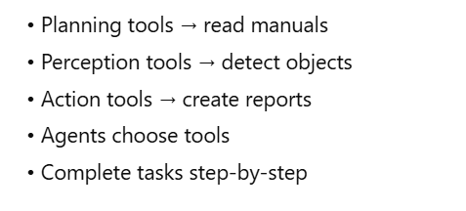
3.1 Definition of Action Space

Slide 109
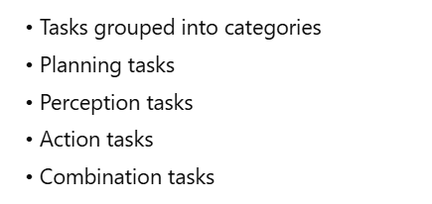
3.2 Tasks

Slide 110
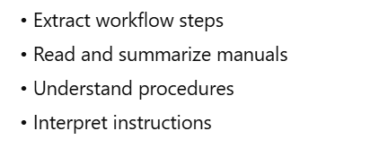
Planning Tasks

Slide 111

Perception Tasks

Slide 112

Action Tasks

Slide 113

Combination Tasks

Slide 114

3.3 Evaluation Environment

Slide 115

3.4 Evaluation Method

Slide 116

4 Experiments

Slide 117

4.1 Experimental Condition

Slide 118

4.2 Results

Slide 119

4.3 Discussion

Slide 120

5 Related Work

Slide 121

5.1 Multimodal LLMs

Slide 122

5.2 LLM Agents for Edge AI

Slide 123

5.3 Benchmark Suite for Agentic AI

Slide 124

5.4 Contribution

Slide 125

6 Conclusion and Future Work

Slide 126


Step 2 — Apply the Rubric (Guided Walkthrough)

Slide 127

1. Problem Clarity — What problem does FieldWorkArena solve?

Slide 128

2. Agent Architecture — What does the agent look like?

Slide 129

3. Experimental Setup — What tasks does FieldWorkArena use?

Slide 130

4. Evaluation Metrics — How do they score the agent?

Slide 131

5. Validity — Are results meaningful?

Slide 132

6. Failure Analysis — Where do agents break?

Slide 133

7. Future Work — What limitations do authors admit?

Slide 134

Step 3 — Guide the Groups to Produce Outputs

Slide 135

Output 1 — 3-Line Summary

Slide 136

Output 2 — Strengths

Slide 137

Output 3 — Weaknesses

Slide 138

Output 4 — Follow-up Experiment Ideas

Slide 139
Step 4 Comparing AGENTIF vs FieldWorkArena
REALISM — Which benchmark is closer to real-world conditions?
2. GENERALISATION — Which benchmark generalises better across domains and tasks?
3. Which benchmark gives more reliable evaluation results?
4. The Overall Comparison — Final Summary

Slide 140

Compare AGENTIF vs FieldWorkArena

Slide 141


Realism Comparison — AGENTIF vs FieldWorkArena

Slide 142

Realism Conclusion

Slide 143


Generalisation Comparison — AGENTIF vs FieldWorkArena

Slide 144

Generalisation Conclusion

Slide 145


Evaluation Reliability — AGENTIF vs FieldWorkArena

Slide 146

Evaluation Conclusion

Slide 147


AGENTIF vs FieldWorkArena — Final Comparison

Slide 148

Final Verdict

Slide 149

Final One-Line Conclusion

Slide 150


Comparison Slide

Slide 151
Conclusion
AGENTIF → Best for digital agent testing
FieldWorkArena → Best for real-world deployment testing
Both important
Test different skill sets

Slide 152
Poll 6
Question: Which benchmark is more realistic for testing AI agents in real-world physical environments? A. AGENTIF B. FieldWorkArena
C. Both equally D. Neither

Slide 153
Poll 6 (Answer)
Question: Which benchmark is more realistic for testing AI agents in real-world physical environments? A. AGENTIF B. FieldWorkArena
C. Both equally D. Neither

Slide 154
PART VI: Synthesis — Gap Mining & Application Mapping
Goal of This Section • Combine insights from both papers • Identify common failures • Convert failures → gaps → experiments → applications

Slide 155
Common Problems in Both Papers
Agents struggle with: • Long tasks, forgetting steps • Skipping steps, Repeating steps • Wrong tool choice, Misunderstanding instructions • No recovery from mistakes, no human help-seeking
Core Insight: Agents are not stable on long, real tasks.

Slide 156
Gap Board Overview
Gap → Experiment → Application We convert every failure into:
A research gap
A simple experiment
A real-world domain

Slide 157
GAP 1: Stability
Gap: Agents lose accuracy in long tasks.
Experiment: Long tasks (20–50 steps), measure breakdown points.
Applications: Office workflows, form filling, support tickets.

Slide 158
GAP 2: Long-Horizon Planning
Gap: Agents cannot plan across multiple stages.
Experiment: Tasks with 3–5 stages, test stage-to-stage linkage.
Applications: Scientific discovery, logistics, audits.

Slide 159
GAP 3: Tool Reliability
Gap: Wrong tool selection or wrong timing.
Experiment: Multi-tool tasks → measure correct tool choices.
Applications: Enterprise systems, factory tools, data entry.

Slide 160
GAP 4: Human Oversight
Gap: Agents do not ask for help when unsure.
Experiment: Tasks requiring clarification prompts.
Applications: Healthcare triage, safety checks, legal workflows.

Slide 161
Why These Gaps Matter
Because agents must be: • Stable, Safe • Sequentially correct, Tool-aware, Human-guided
Otherwise: • No automation, No safety, No reliability

Slide 162
Domain Mapping
Scientific Discovery • Needs long planning + accuracy + stability
Healthcare Triage • Needs safety + oversight + correct tools
Enterprise Workflows • Needs memory + sequencing + tool reliability

Slide 163
Final Message
AGENTIF → Digital failures FieldWorkArena → Physical-world failures
Both reveal the same gaps: • Stability, Long-horizon reasoning • Tool reliability, Human oversight
Outcome: Gaps → Experiments → Applications → Real research direction

Slide 164
Poll 7
Question: Which gap is the MOST important blocker for deploying AI agents in real-world tasks across both AGENTIF and FieldWorkArena?
A. Agents skip or repeat steps B. Agents make spelling mistakes in outputs C. Agents refuse to answer simple questions D. Agents generate long responses instead of short ones

Slide 165
Poll 7 (Answer)
✅ Correct Answer: A — Agents skip or repeat steps
Why this is correct: Skipping or repeating steps shows instability in long tasks, which both papers highlight as the #1 reason agents fail in real-world workflows.

Slide 166
PART VII — WRAP-UP & NEXT STEPS
Bringing all insights together + preparing for real research thinking

Slide 167
Group Sharing: Two Things
Each Group Shares: 1️⃣ One Key Insight (most important learning) 2️⃣ One Research Gap (what the papers did NOT solve)
Format: • One sentence each • Clear & simple

Slide 168
Principle 1 — Check Claims vs Evidence
Questions to ask: • Do results support the claims? • Are claims exaggerated? • Is the evidence strong or weak?

Slide 169
Principle 2 — Evaluate Experiment Design
Ignore the pretty figures — focus on: • Is the problem clear? • Are tasks realistic? • Are baselines fair? • Are metrics appropriate? • Is failure analysis included?

Slide 170
Principle 3 — Look for Gaps, Not Just Successes
Good research = • finding what didn’t work • spotting weaknesses • turning failures into new ideas

Slide 171
Why Today’s Learning Matters
You now know how to: • break a paper into parts; analyze an agent loop • judge experimental setups; inspect metrics • identify hidden limitations • compare two papers • turn gaps into research ideas

Slide 172
Post-Class Task
Choose One Paper (AGENTIF or FieldWorkArena). Then pick ONE:
Option A — Short Mini-Survey • Find 2–3 similar papers • Identify shared gaps • Explain why they matter
Option B — Propose a Simple Experiment • Pick one gap • Describe experiment • Explain expected insight

Slide 173
Final Closing Message
Big Takeaway: Learning to evaluate agent papers is the skill that separates readers from researchers.
Future of agents = digital + real-world workflows.
Your job is to judge, question, and design better agents.

Slide 174
Poll 8
Question: Which of the following is the MOST important principle when evaluating an agentic AI research paper?
A. How visually appealing the figures, diagrams, and charts look B. Whether the paper proposes a completely new architecture C. Whether the experiment design, metrics, and evidence actually support the paper’s claims D. How long the paper is and how many authors worked on it

Slide 175
Poll 8 (Answer)
Question: Which of the following is the MOST important principle when evaluating an agentic AI research paper?
A. How visually appealing the figures, diagrams, and charts look B. Whether the paper proposes a completely new architecture C. Whether the experiment design, metrics, and evidence actually support the paper’s claims D. How long the paper is and how many authors worked on it

Slide 176
Thank You!

