Slide 1

Last-Mile Delivery Operations Analytics
MySQL Business Analytics Project | QuickRoute Logistics
Prepared by: SHIBUN BISWAL & JYOTI PRAKASH MOHARANA
Notes:
Introduce the project: last-mile delivery analytics for QuickRoute Logistics, built in MySQL.

Slide 2
Project Overview & Company Background
Company: QuickRoute Logistics, last-mile delivery across 20 zones with 80 drivers and 50 vehicles
Business problem: the last mile is costly and unpredictable; failed and repeat attempts add cost and delay
Role of the data analyst: design the database, load and validate data, write SQL, turn results into findings
Objectives: demand, customer behavior, delivery, driver and vehicle performance, delivery problems
Expected outcomes: better resource allocation, route planning and customer focus
Notes:
State the business problem, your role as data analyst, the objectives and the outcomes you expect.

Slide 3
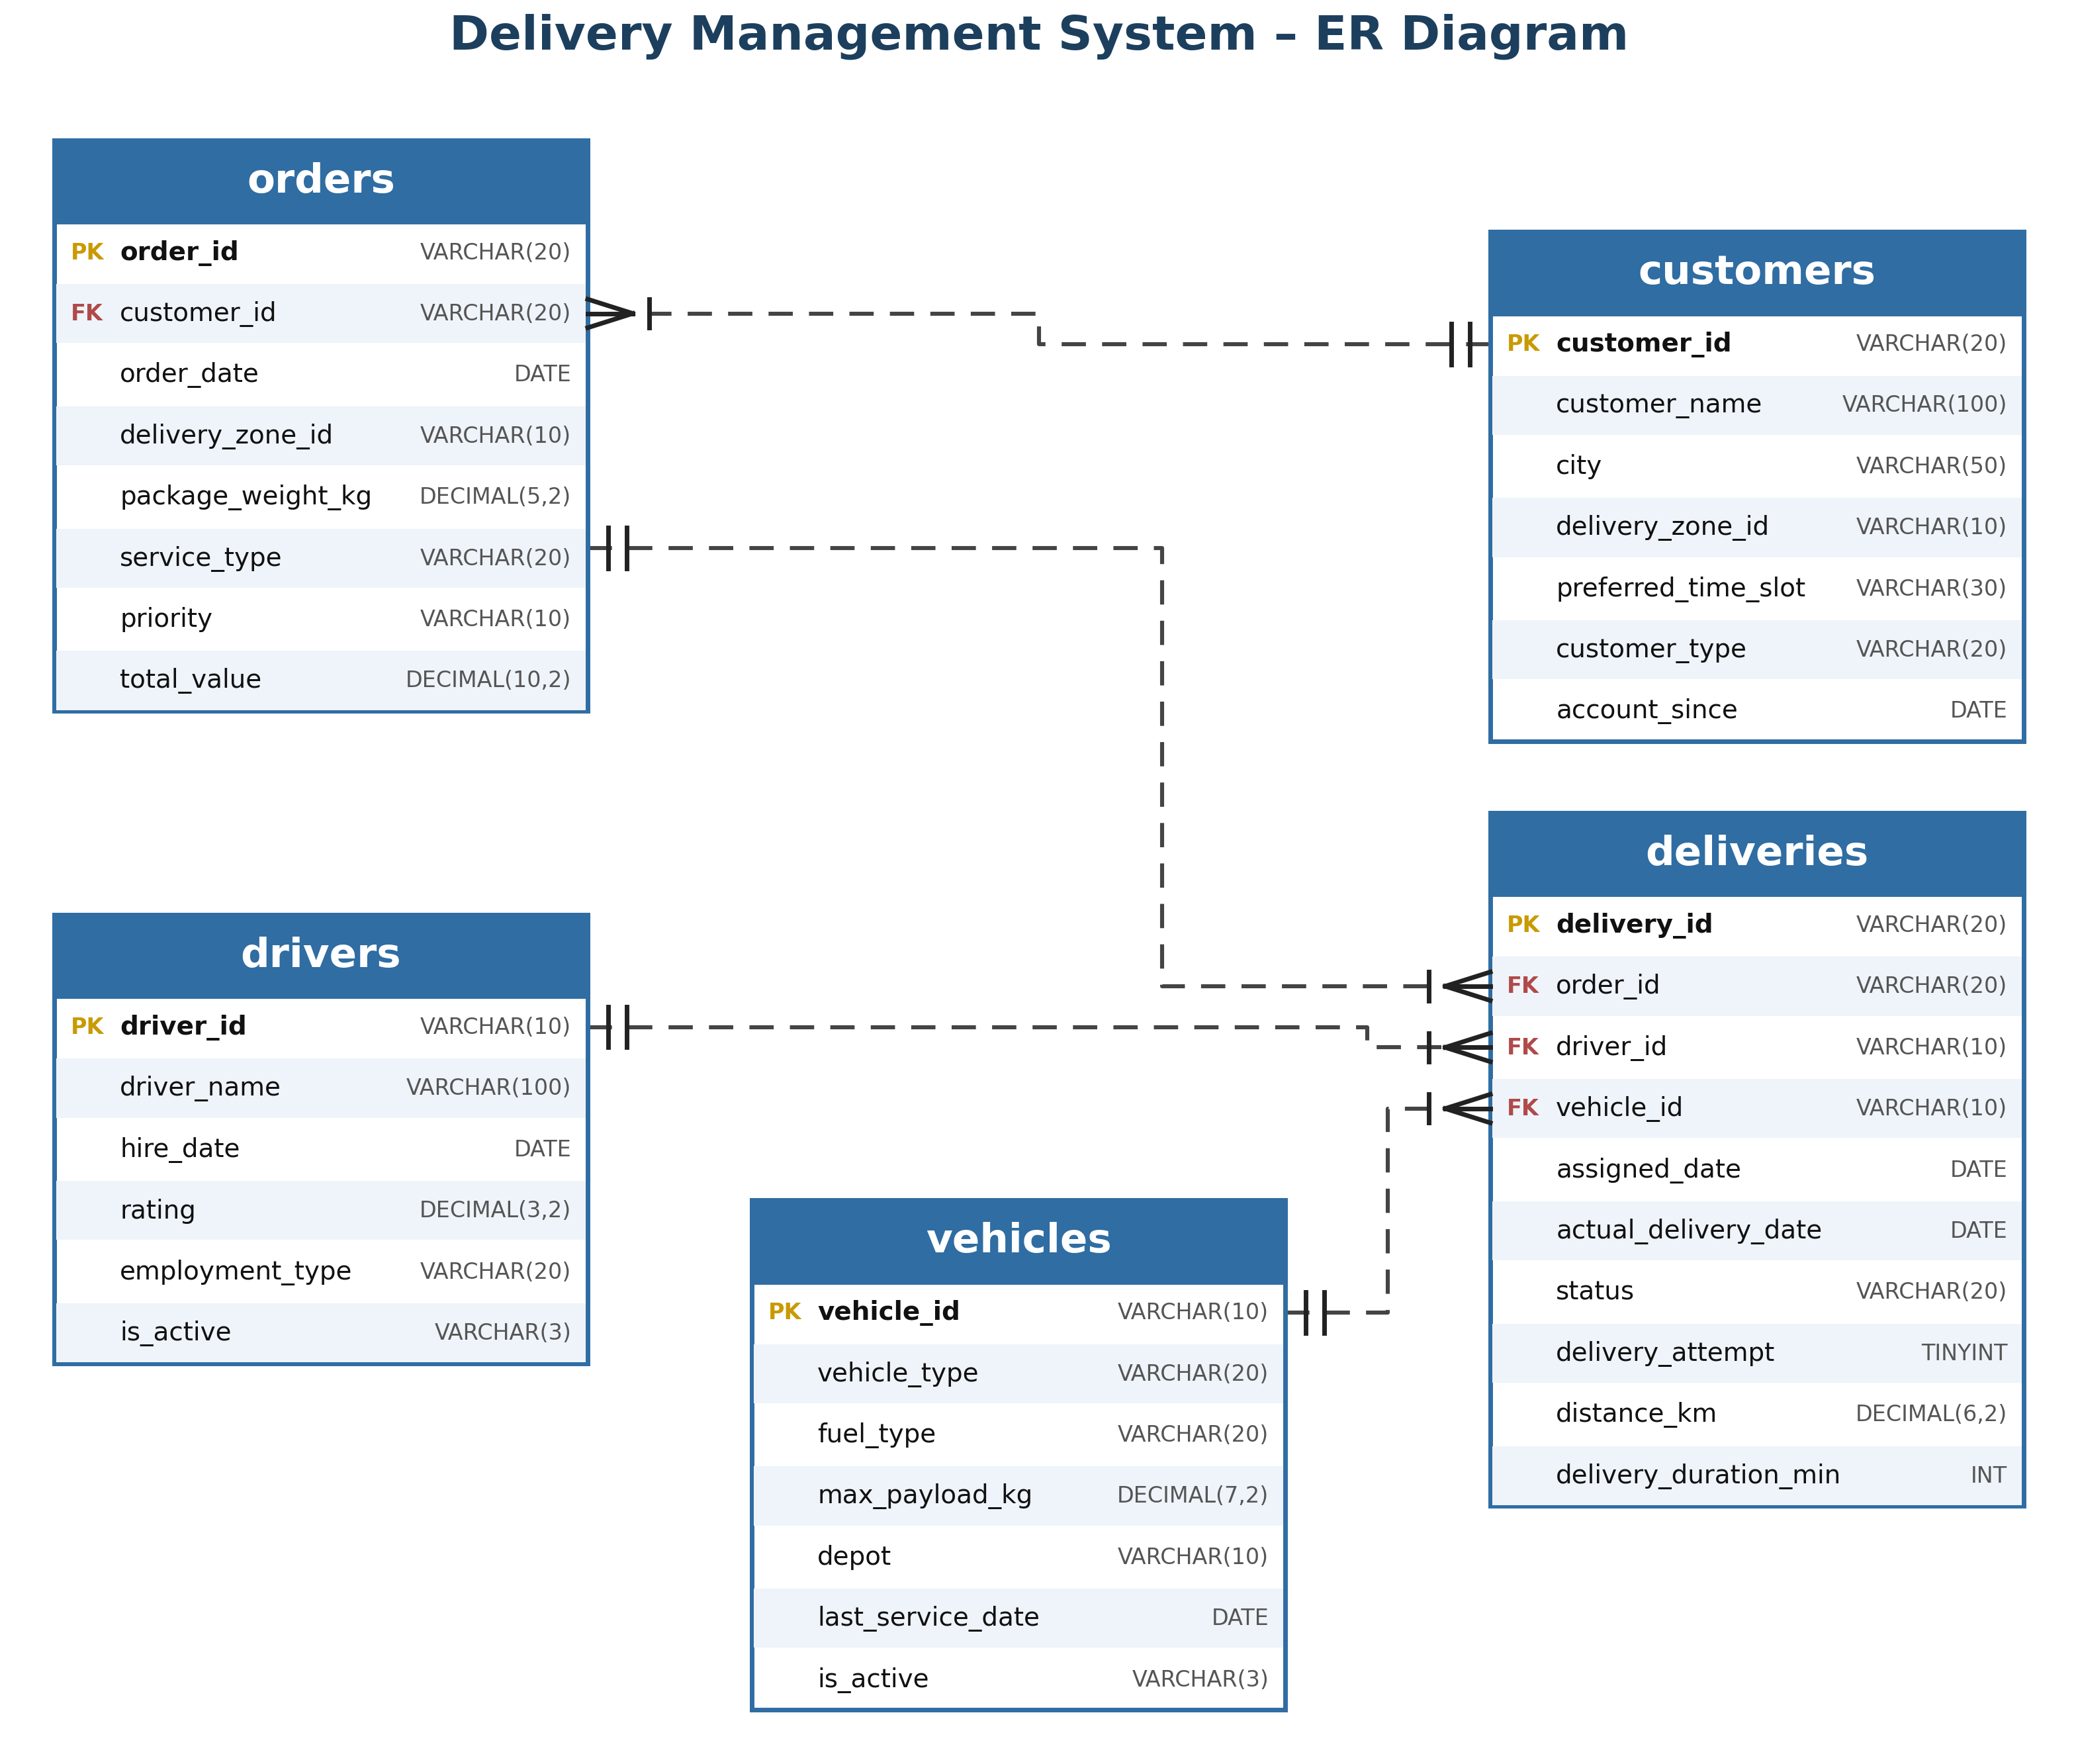
Database Design & ER Diagram
Database structure: five main tables
  Customers
  Orders
  Deliveries
  Drivers
  Vehicles
Key relationships between tables
  Customers place orders
  Orders get deliveries
  Drivers and vehicles carry out the deliveries
Notes:
Walk through the five tables and how they connect: customers place orders, orders get deliveries, drivers and vehicles carry them out.

Slide 4
Dataset Overview
Table | Records | What it holds | Keys
Customers | 400 | Who places orders: city, zone, time slot, type | PK: customer_id
Orders | 3,000 | What was ordered: zone, weight, service, priority, value | PK: order_id; FK: customer_id
Deliveries | 3,500 | Each attempt: status, distance, duration | PK: delivery_id; FK: order_id, driver_id, vehicle_id
Drivers | 80 | Who delivers: rating, employment type, active | PK: driver_id
Vehicles | 50 | What delivers: type, fuel, payload, depot | PK: vehicle_id
Data observation: 3,500 deliveries against 3,000 orders: 949 orders have more than one delivery record.
Notes:
Point out the scale: 3,000 orders and 3,500 deliveries, which suggests some orders have more than one delivery attempt.

Slide 5
Database Setup & Data Exploration
Database Setup
Database and 5 tables created in MySQL
Primary keys and 4 named foreign keys
CSVs imported in dependency order
Row counts and constraints validated
Key numbers
Customers 400, orders 3,000, deliveries 3,500
5 service types, 6 vehicle types
75 of 80 drivers active
Total order value: 7.52 million
Average order: about 2,507
Average package: 25.1 kg
Notes:
Explain how you created the database and tables, set keys, imported the CSVs and validated the data.

Slide 6
Analysis of Objectives
Objective 1: Delivery Demand Analysis
Findings
  Top zone ZONE0005: 240 orders (average zone: 150)
  Top 5 of 20 zones produce 33% of orders
  Service types are balanced: 582 to 620 orders each
  Orders: 608 (2022), 1,163 (2023), 1,229 (2024); peak 128 in Jul 2024
Key insight
  Demand varies by zone, not by service type
Notes:
Show where and when demand is highest. Add your actual top zones and service types here.

Slide 7
Analysis of Objectives
Objective 2: Customer Order Behavior
Findings
  Top customer DLVCUST0000055: 19 orders, 43.8K value
  Top 8 customers = 4.2% of revenue; top 10% = 18%
  Individuals: 2,050 orders (5.08M); Business: 950 orders (2.44M)
  Business orders are about 4% higher in value
Key insight
  Revenue is spread across the customer base, not a few accounts
Notes:
Show who the top customers are and how business and individual customers differ. Add the share of revenue from your top customers.

Slide 8
Analysis of Objectives
Objective 3: Delivery Performance
Findings
  73.7% of 3,500 delivery records were delivered
  Rescheduled 318, pending 306, failed 295
  Failed deliveries take 49.7 min vs 46.9 min delivered
  Success by zone: 79.3% (ZONE0010) to 68.3% (ZONE0020)
Key insight
  Performance differs by zone, so fixes can be targeted
Notes:
Cover delivery statuses and durations by zone. Add your success rate here.

Slide 9
Analysis of Objectives
Objective 4: Driver Performance
Findings
  75 of 80 drivers active; workload from 13 to 68 deliveries
  Busiest driver DRV00073: 68 deliveries, rating 2.69
  Ratings from 2.3 to 4.4, average 3.05
  Per-driver success rate ranges from 55% to 90%
Key insight
  Workload and performance vary widely and are not aligned
Notes:
Compare drivers by workload, efficiency and outcomes. Name the strongest and weakest groups if you have them.

Slide 10
Analysis of Objectives
Objective 5: Vehicle Performance
Findings
  Cargo Bike 717 and Truck 716 deliveries; Electric Van only 448
  Average duration is similar: 45.7 min (Motorbike) to 49.0 min (Van)
Key insight
  Usage is uneven but speed is similar: rebalance the fleet
Notes:
Compare vehicle types by usage and delivery duration to spot allocation opportunities.

Slide 11
Analysis of Objectives
Delivery Problems Analysis
Findings
  949 orders (nearly 1 in 3) have more than one delivery record
  Failed + rescheduled = 613 records (17.5%); 26% not completed
  Highest non-delivery: ZONE0020 31.7%, ZONE0001 31.1%, ZONE0016 30.8%
Key insight
  Repeat attempts add cost and delay; ZONE0016 and ZONE0014 combine high demand and high failure
Notes:
Explain failed and rescheduled deliveries and why repeat attempts raise cost and delay.

Slide 12
Key Business Findings
Demand is concentrated by zone: top 5 of 20 zones = 33% of orders
Revenue is spread: top 10% of customers = 18%
73.7% of deliveries succeed; zones range from 68% to 79%
Driver workload (13 to 68) and ratings (2.3 to 4.4) vary widely
Vehicle usage is uneven (448 to 717 deliveries per type)
ZONE0016 and ZONE0014 combine high demand and high failure
Notes:
Summarise the six main findings from the analysis.

Slide 13
Recommendations
Allocate drivers and vehicles by zone demand (ZONE0005, ZONE0013, ZONE0018 first)
Improve route planning in high-volume, high-risk zones
Protect high-value customers with service commitments
Reduce repeat attempts: confirm address and time slot before dispatch
Monitor and balance driver workload and ratings
Raise service levels in the weakest zones (ZONE0020, ZONE0001, ZONE0016)
Forecast demand using the monthly order trend
Notes:
Link each recommendation back to a finding. Prioritise two or three if time is short.

Slide 14
Conclusion
Database successfully designed and implemented
Operational insights generated using MySQL
Business decisions supported through data analysis
Opportunities identified for efficiency improvements
Foundation established for future analytics
Notes:
Recap what was built, what was learned and how it can support future analytics.

Slide 15

THANK YOU
Notes:
Invite questions and add your contact details.

