Slide 1
USER INTERFACE DESIGN FOR FRONTEND
Home Page
Book
Search
Customer
Shopping Cart
Order
Checkout

Slide 2
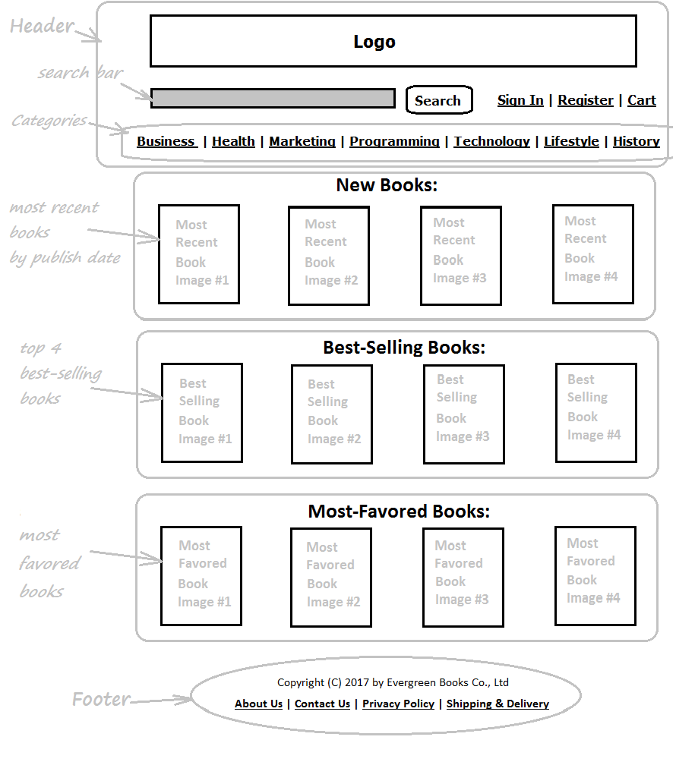
HOME PAGE

Slide 3
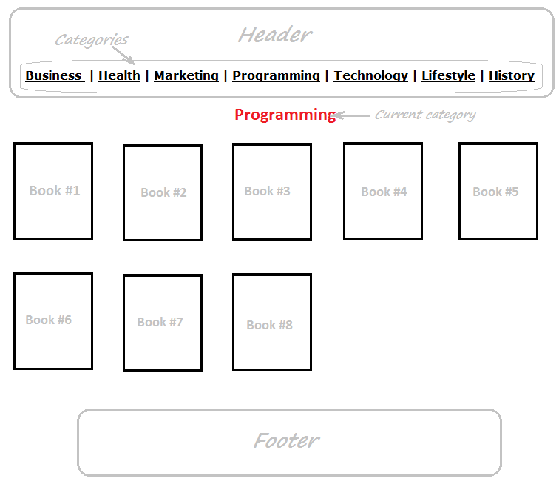
BOOK LISTING BY CATEGORY PAGE

Slide 4
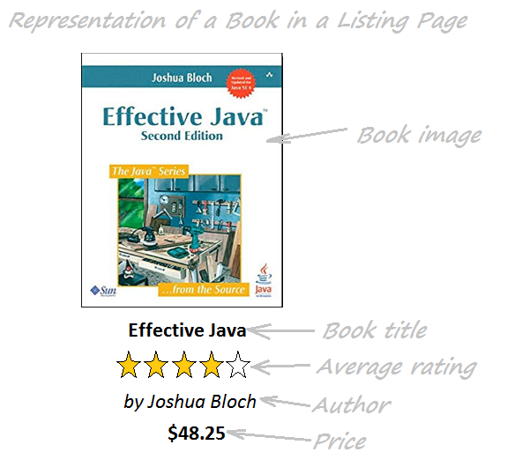
A BOOK IN LISTING PAGE

Slide 5
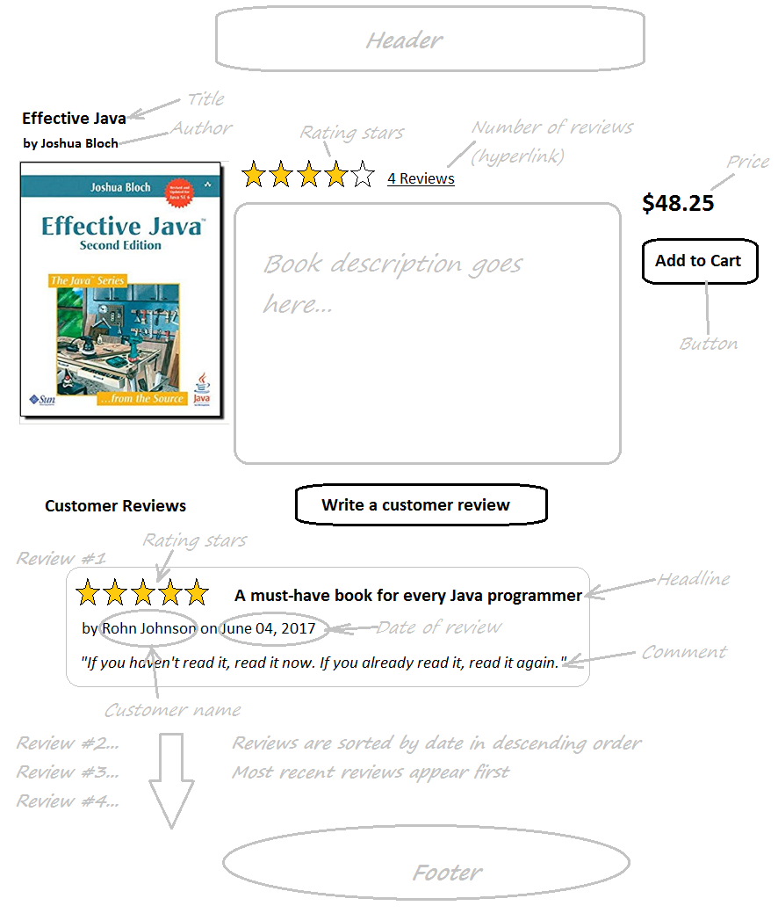
BOOK DETAIL PAGE

Slide 6
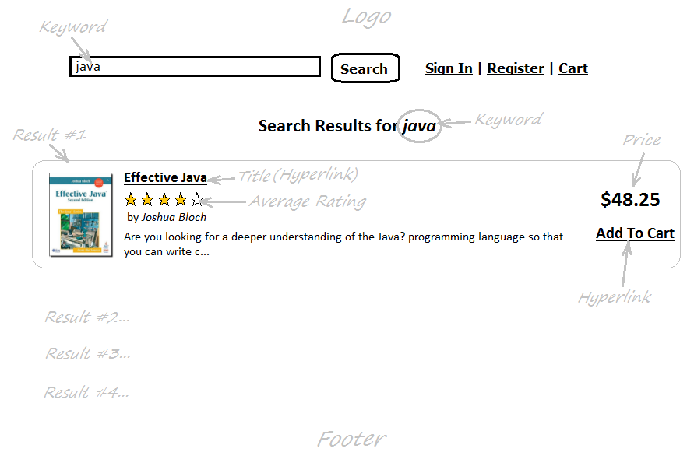
BOOK SEARCH RESULT PAGE

Slide 7
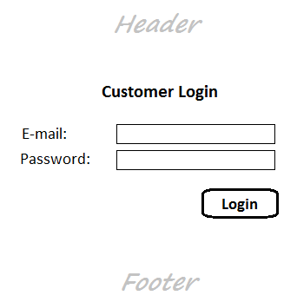
CUSTOMER LOGIN FORM

Slide 8
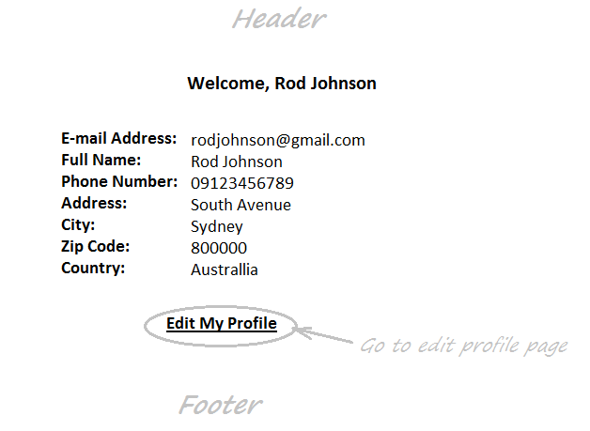
CUSTOMER PROFILE PAGE

Slide 9
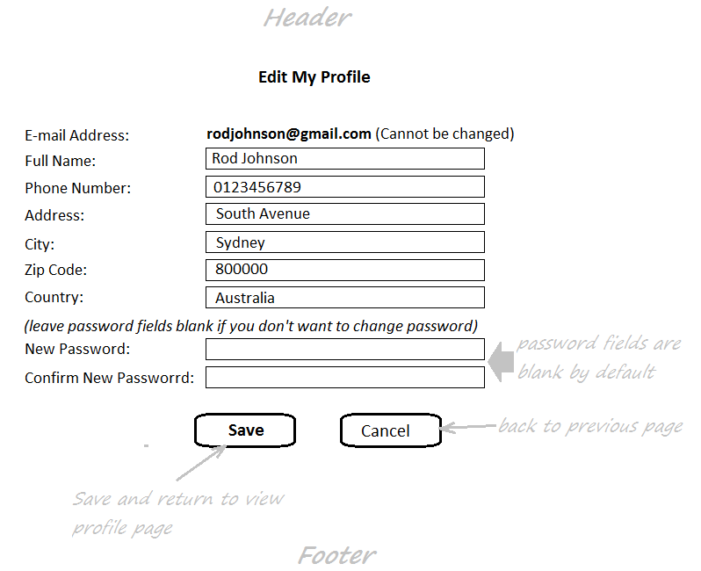
EDIT CUSTOMER PROFILE PAGE

Slide 10
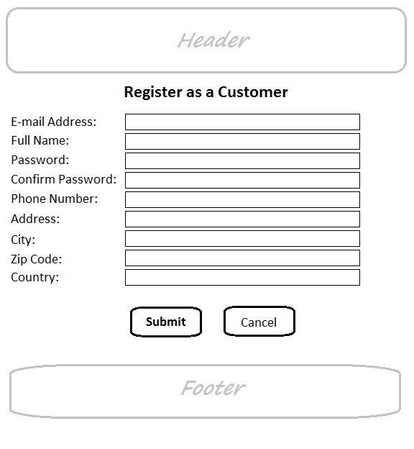
CUSTOMER REGISTRATION FORM

Slide 11
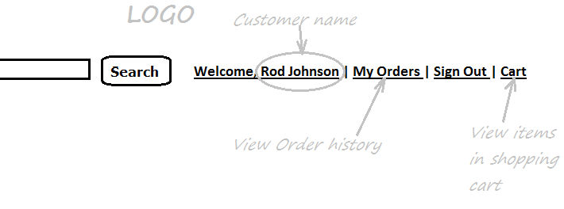
CUSTOMER MENU

Slide 12
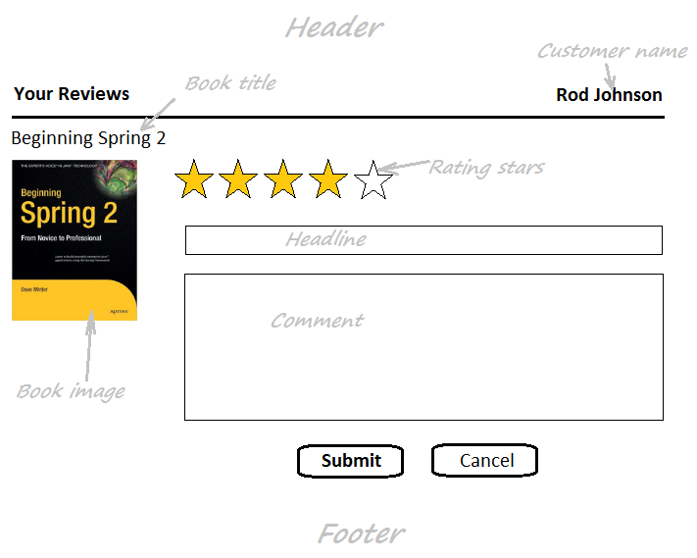
CUSTOMER REVIEW FORM (NEW)

Slide 13
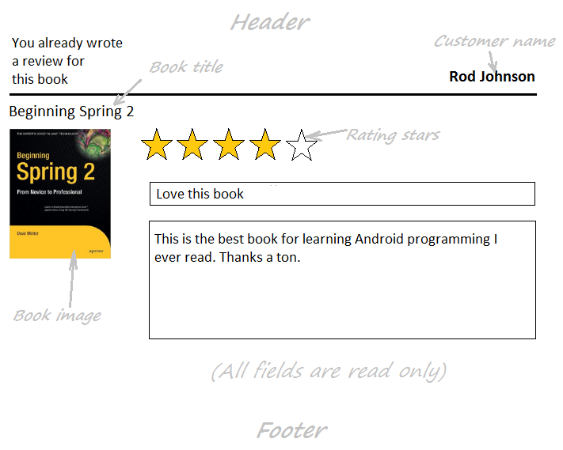
CUSTOMER REVIEW FORM (EXISTING REVIEW)

Slide 14
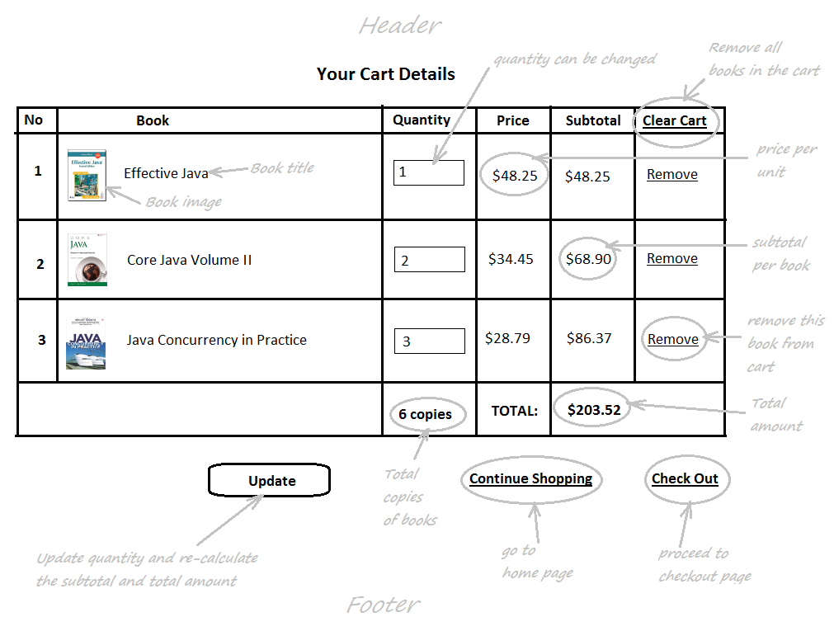
SHOPPING CART PAGE

Slide 15
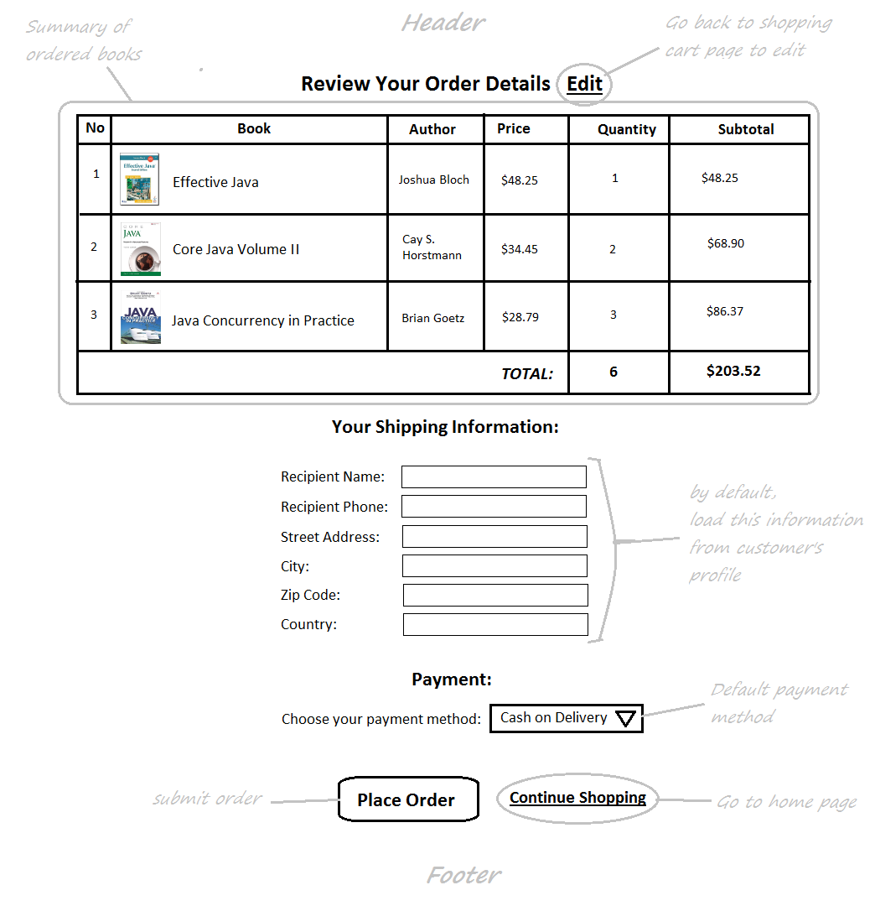
CHECKOUT PAGE

Slide 16
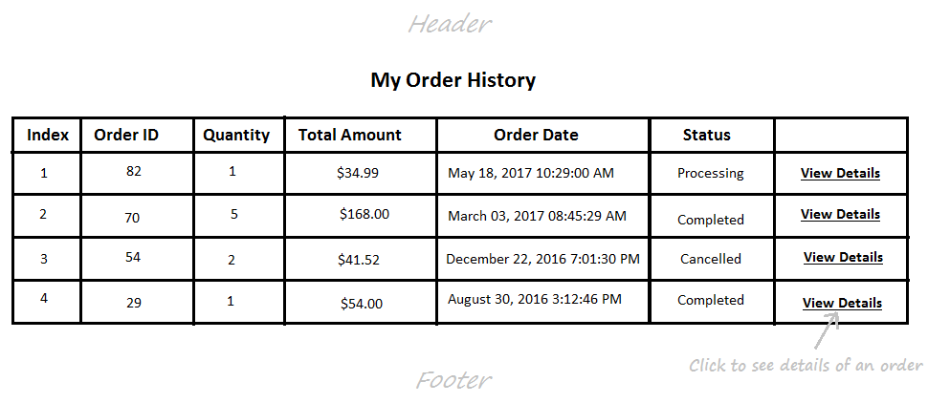
ORDER HISTORY PAGE

Slide 17
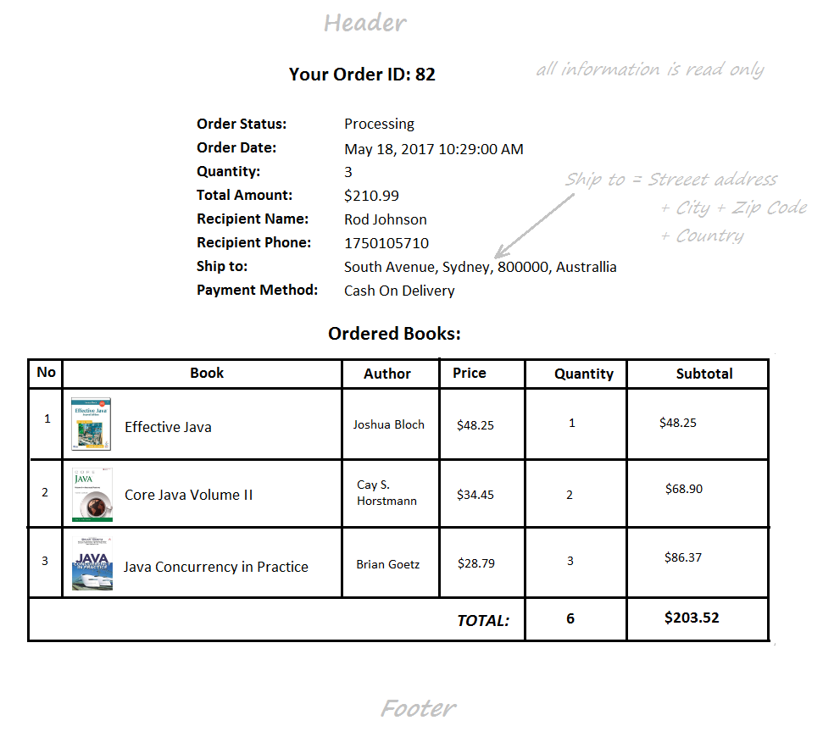
ORDER DETAIL PAGE

Slide 18
END

