Slide 1
DATA ENGINEERING • GROCERY ANALYTICS
+
Grocery Sales Pipeline
+
From raw retail data to trusted sales, inventory and customer insights.
+
ADLS
Databricks
Delta Lake
Airflow
+
+
Daily batch • Data Quality • Medallion Architecture • Alerts

Slide 2
01 • PROJECT
Project Overview
02
SOURCE
PROCESSING
CONSUMPTION
Kaggle Grocery Sales datsets
Raw path pattern: abfss://bucket/raw/grocery_records/YYYY/MM/DD/
Databricks + PySpark process grocery data through Bronze, Silver and Gold Delta layers.
Gold datasets power category, sales and inventory analytics with dashboards and alerts.
The pipeline is designed for reliable daily processing with validation, error handling and orchestration.
01
INGEST
02
CLEAN
03
ANALYZE
04
MONITOR
Capture retail data
Standardize & validate
Calculate sales metrics
Alert & troubleshoot
GROCERY RETAIL ANALYTICS • DATA ENGINEERING PROJECT

Slide 3
02 • OBJECTIVES
What the solution achieves
03
01
Reliable ingestion
02
Medallion design
03
Data quality
Bring retail transactions and reference files into ADLS with controlled ingestion.
Implement Bronze → Silver → Gold for progressively trusted data.
Handle missing values, duplicates, invalid records and schema issues.
04
Sales Performance analytics
05
Monitoring
06
Automation
Create sales, inventory and customer performance metrics.
Use Slack alerts and logs for failures and anomalies.
Orchestrate and validate the pipeline with Airflow and PyTest.
GROCERY RETAIL ANALYTICS • DATA ENGINEERING PROJECT

Slide 4
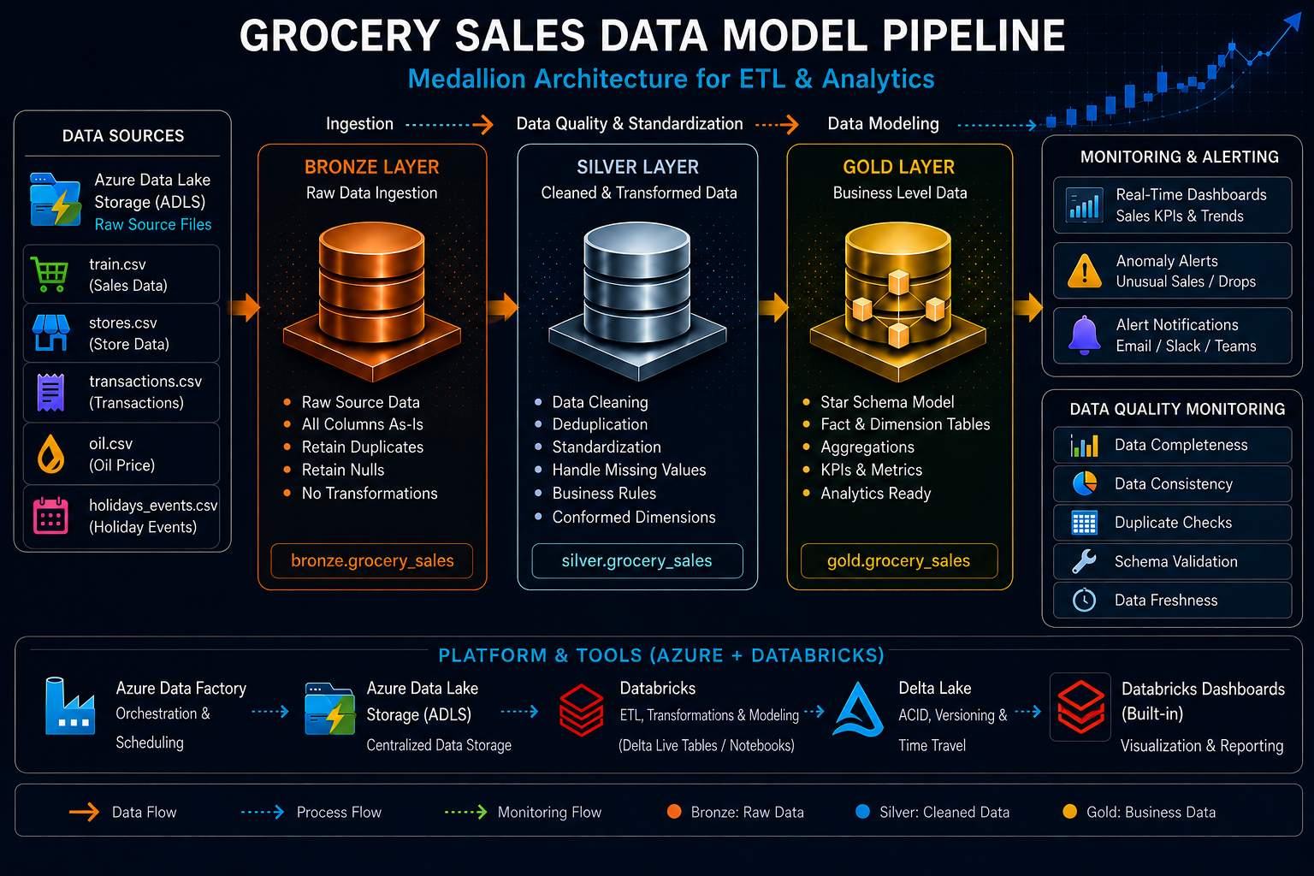
04 • ARCHITECTURE
04 • HIGH-LEVEL ARCHITECTURE
05
Grocery Retail Architecture
Grocery Sales Data Model Pipeline
CSV
ADLS
ADF
DBX
SILVER
GOLD
BI
Retail
Sources
Raw / Data
Lake
Ingestion +
Parquet
Databricks
Bronze
Clean +
Enrich
Metrics +
Insights
Dashboards
& Insights
CROSS-CUTTING CONTROLS
Unity Catalog
dbt
Airflow
PyTest
Slack Alerts
Error Logs
GROCERY RETAIL ANALYTICS • DATA ENGINEERING PROJECT

Slide 5
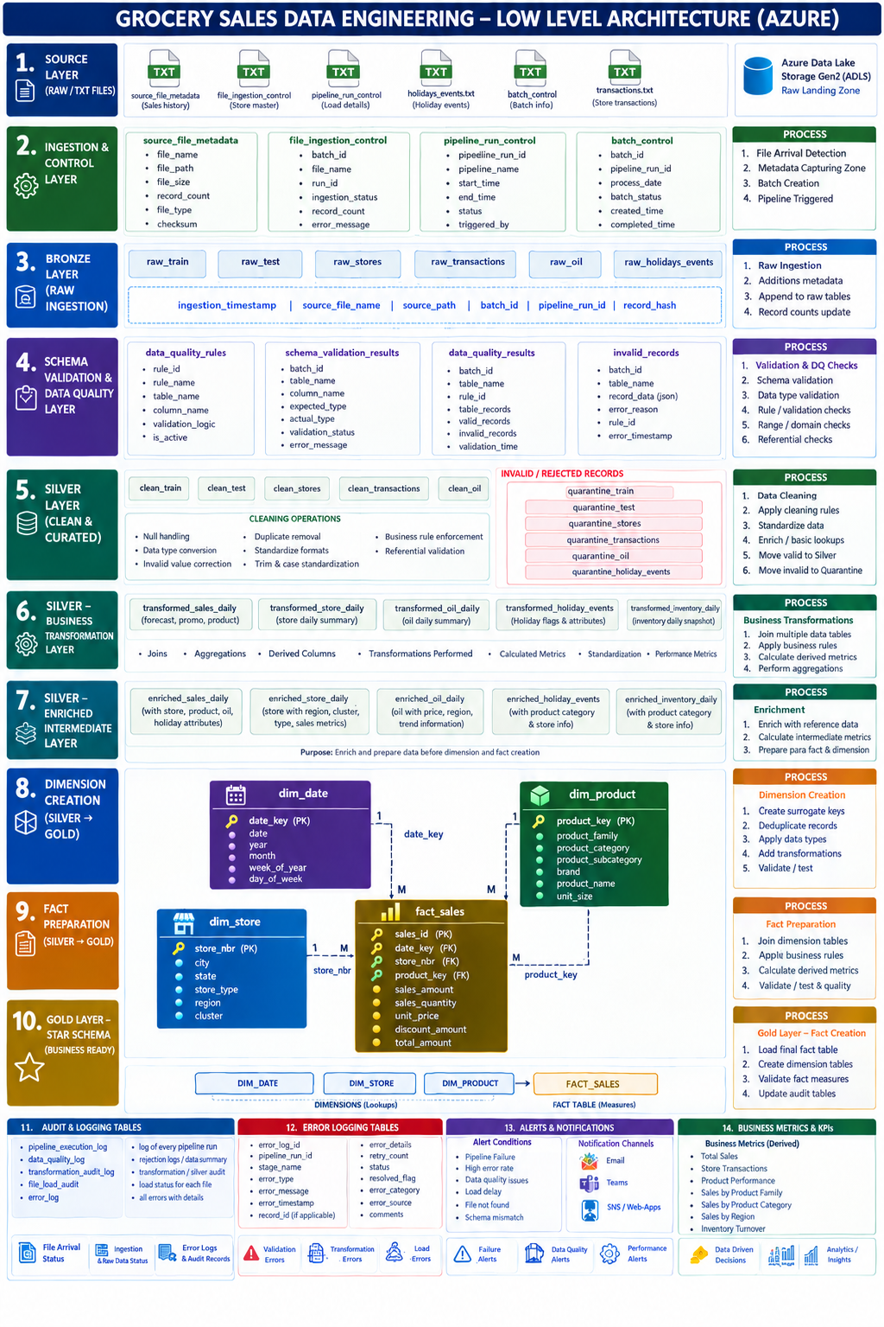
05 • LOW-LEVEL GROCERY SALES DATA ENGINEERING ARCHITECTURE

Slide 6
05 • DATA LAKE
Storage & Target Design
06
RAW
Original CSV
abfss://raw@grocerylake.dfs.core.windows.net/YYYY/MM/DD/
PARQUET
Ingested format
Columnar files for scalable processing
BRONZE
grocery_catalog.raw.transactions
Raw Delta table
SILVER
grocery_catalog.silver.clean_transactions
Cleaned & standardized
GOLD
grocery_catalog.gold.sales_metrics
Aggregated sales and inventory metrics
LOGS
grocery_catalog.logs.etl_errors
Errors & monitoring details
GROCERY RETAIL ANALYTICS • DATA ENGINEERING PROJECT

Slide 7
06 • MEDALLION
Bronze → Silver → Gold
07
BRONZE
SILVER
GOLD
RAW FOUNDATION
TRUSTED DATA
BUSINESS READY
Preserve source data
Traceability & reprocessing
Unity Catalog / Delta
Clean & deduplicate
Standardize formats
Join dimensions
Sales metrics
Inventory aggregates
Dashboards & analytics
GROCERY RETAIL ANALYTICS • DATA ENGINEERING PROJECT

Slide 8
07 • BRONZE
Bronze Layer — Raw Data Preservation
08
TARGET TABLE
IMPLEMENTATION
KEY PRINCIPLE
grocery_catalog.raw.transaction_records
Delta table containing raw transaction records after ingestion.
• Unity Catalog governance
• External location where applicable
• Preserve source structure
• Capture ingestion metadata
• Support reprocessing
Bronze preserves raw retail data for traceability and downstream processing.
GROCERY RETAIL ANALYTICS • DATA ENGINEERING PROJECT

Slide 9
08 • SILVER
Silver Layer — Cleansing & Transformation
09
1
2
3
4
DEDUPLICATE
VALIDATE
STANDARDIZE
ENRICH
Remove duplicate transaction records
Check schema and acceptable values
Dates, product codes and types
Join store, product and category dimensions
OUTPUT
grocery_catalog.silver.clean_transactions
GROCERY RETAIL ANALYTICS • DATA ENGINEERING PROJECT

Slide 10
03 • SOURCE & QUALITY
Source Dataset & Data Quality
04
QUALITY CHECKS
SOURCE DATASET
• Sales, stores, products and transaction CSV files
• Product, category, price and quantity attributes
• Daily cloud landing pattern
• Source metadata captured for traceability
• Raw data preserved for reprocessing
✓
Missing / NULL values
Detect and handle incomplete records
✓
Duplicates
Remove duplicate transaction records
✓
Schema
Validate columns and data types
✓
Formats
Standardize dates, categories and store codes
✓
Malformed rows
Isolate invalid input records
GROCERY RETAIL ANALYTICS • DATA ENGINEERING PROJECT

Slide 11
09 • GOLD
Gold Layer — Retail Analytics
10
+
+
+
+
RISK
TRENDS
QUALITY
DASHBOARD
Sales performance metrics
Population / health trends
Validated analytical outputs
Consumption-ready tables
TARGET
grocery_catalog.gold.sales_metrics
GROCERY RETAIL ANALYTICS • DATA ENGINEERING PROJECT

Slide 12
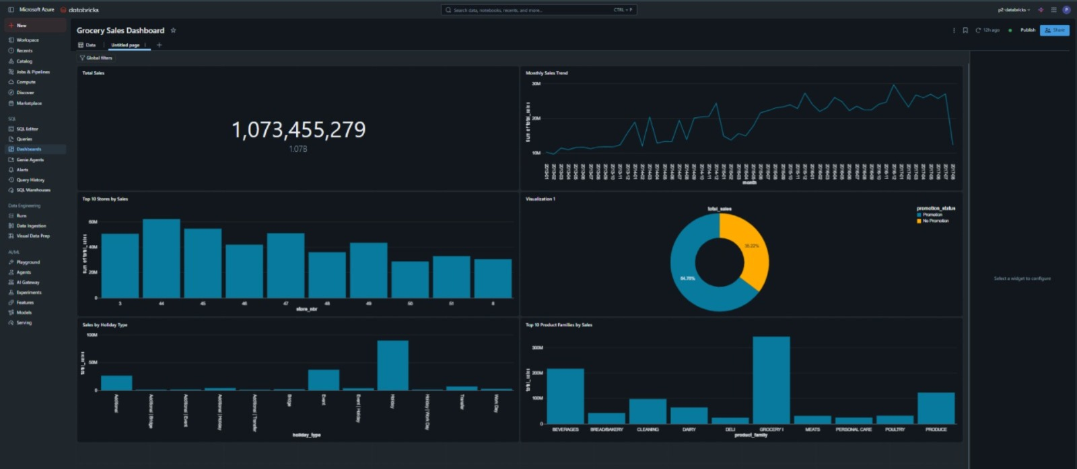
Dashboards

Slide 13
14 • TESTING
PyTest & Data Validation
15
✓
✓
✓
✓
✓
TABLES
COUNTS
SCHEMA
DUPLICATES
VALUES
Required tables created
Outputs are non-empty
Columns & types validated
Duplicate detection
Invalid values filtered
QA GATE
Only validated datasets move forward to analytics consumption.
GROCERY RETAIL ANALYTICS • DATA ENGINEERING PROJECT

Slide 14
12 • OPERATIONS
Alerts, Monitoring & Logging
13
!
PIPELINE FAILURE
!
DATA ANOMALY
Notify the team when ETL jobs fail.
Flag quality or unexpected data conditions.
!
SLACK
!
ERROR LOG
Send operational notifications in real time.
Store failures and abnormal records for troubleshooting.
grocery_catalog.logs.etl_errors
GROCERY RETAIL ANALYTICS • DATA ENGINEERING PROJECT

Slide 15
13 • ORCHESTRATION
Airflow Pipeline Automation
14
START
INGEST
BRONZE
SILVER
GOLD
ALERT
Daily trigger
ADF / storage
Raw Delta
Clean + enrich
Metrics
Slack / logs
ORCHESTRATION RESPONSIBILITIES
Schedule daily execution and manage dependencies.
Trigger Databricks notebooks/jobs for each medallion layer.
Monitor task status and route failures to alerting.
Provide a repeatable, automated production workflow.
GROCERY RETAIL ANALYTICS • DATA ENGINEERING PROJECT

Slide 16
FINAL • BUSINESS VALUE
Business Outcome
A scalable, automated grocery data platform that turns raw retail data into trusted business insights.
✓
Scalable
Supports daily retail data processing.
✓
Reliable
Improves data quality and traceability.
✓
Actionable
Produces sales, inventory and customer metrics for analytics.
✓
Automated
Reduces manual monitoring and operational effort.
✓
Extensible
Ready for additional datasets and predictive use cases.
RAW → TRUSTED → ANALYTICS → DECISION SUPPORT

Slide 17
THANK YOU

