Slide 1
Introduction to Devops

Slide 2
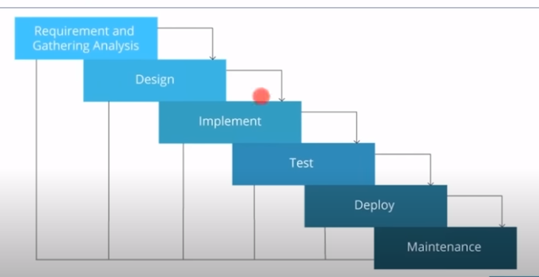
Traditional Model

Slide 3
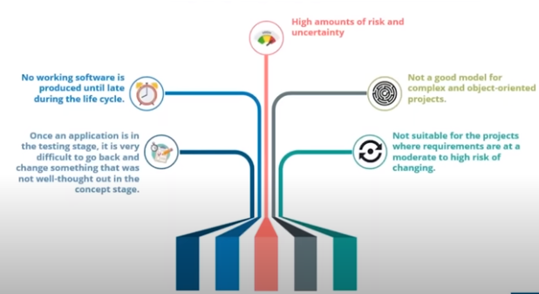

Slide 4
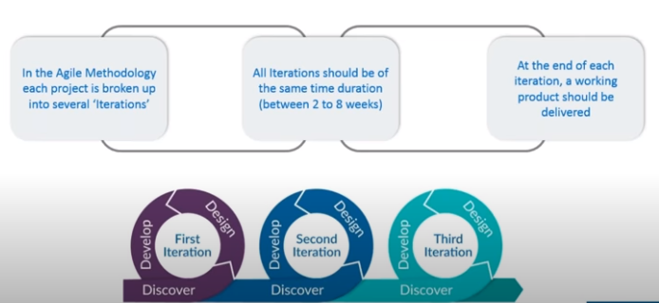
Agile Methodology

Slide 5
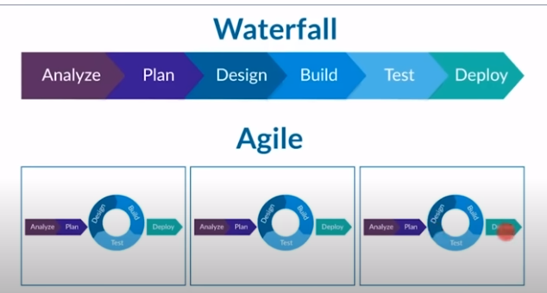

Slide 6
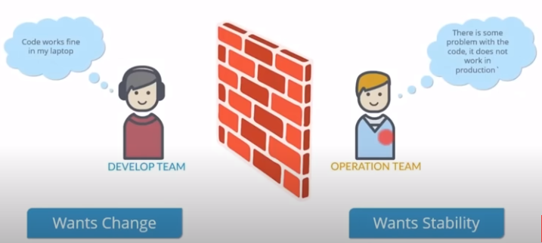
Limitations

Slide 7
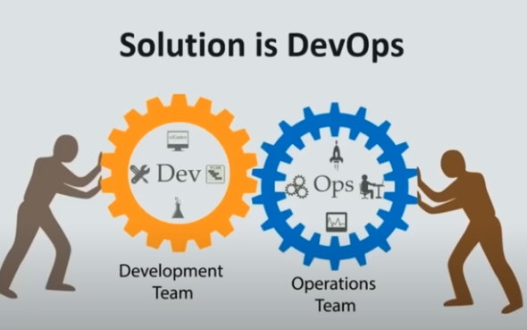

Slide 8
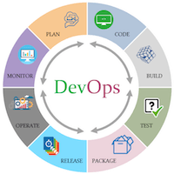
The DevOps is the combination of two words, one is Development and other is Operations. It is a culture to promote the development and operation process collectively.

Slide 9
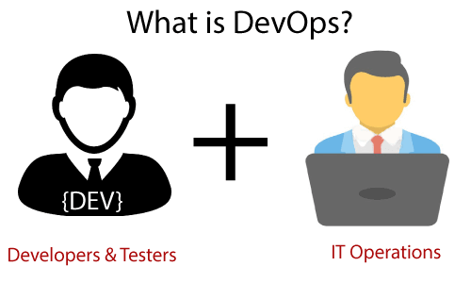
This allows a single team to handle the entire application lifecycle, from development to testing, deployment, and operations. DevOps helps you to reduce the disconnection between software developers, quality assurance (QA) engineers, and system administrators.

Slide 10
development team is responsible for developing, designing, and building the application. The operation team deals with the deployment and testing of the application. If there are problems with the application, the operation team also provides feedback to the development team. Now let us get to the history of DevOps.

Slide 11
DevOps promotes collaboration between Development and Operations team to deploy code to production faster in an automated & repeatable way.
DevOps helps to increase organization speed to deliver applications and services. It also allows organizations to serve their customers better and compete more strongly in the market.
DevOps can also be defined as a sequence of development and IT operations with better communication and collaboration.
DevOps has become one of the most valuable business disciplines for enterprises or organizations. With the help of DevOps, quality, and speed of the application delivery has improved to a great extent.

Slide 12
History of Devops
Let us see some important events of DevOps :
2007-2008: The DevOps idea was started
2009: In the initial stage the first conference was ” Deploys a day: Dev and Ops cooperation of flicker.” Another conference called “DevOps Days in Ghent, Belgium” also happened.
2010:DevOps days conference happened in the United States at mount view, calif.
2012: Allana browns at puppet creates a state of DevOps report
2014: Publishing the annual “State of DevOps report”
2017: Forrester Research calls 2017 “The Year of DevOps”
2018: 30 DevOps day conferences were scheduled across the united states.

Slide 13
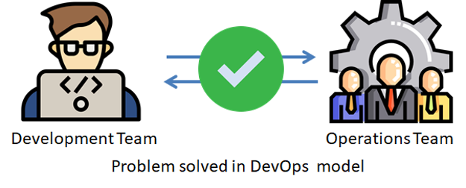
Why did we need DevOps?
Traditional Model Problem
Agile methodology problem
Delay in Project feedback
DevOps is a practice or a methodology in which the development and operations teams work together by including automation at the initial stages. So they can work on rapidly changing systems, fix bugs, and help to deliver a good quality of software in time.

Slide 14
Why Learn DevOps?
Improved Quality: DevOps can help ensure that your applications are delivered on time and with high quality, and it can also help reduce the number of errors and defects in your code.
Faster Development Processes: With DevOps in place, you can deploy new features faster and more efficiently. It will help you release new versions of your applications more frequently, leading to a higher level of customer satisfaction.
Increased Agility: DevOps quickly respond to changes in the market or regulatory environment. This will enable you to stay ahead of the competition and maintain a leadership position in your field.
Reduced risk: Operators can take over specific tasks or processes previously handled by developers, leading to a decrease in the number of errors and increased efficiency.
Improved communication: When developers and operators work together closely, they can identify problems early on and make necessary changes before they become major issues.

Slide 15
Applications of DevOps
Online Financial Trading Company
Use of DevOps in Network cycling
Application in Car Manufacturing Industries
Benefits to Airlines Industry
It helps to decrease Computation Cost and Operation Time
Able to provide a better quality of applications to their customers
DevOps helps in faster delivery of applications

Slide 16
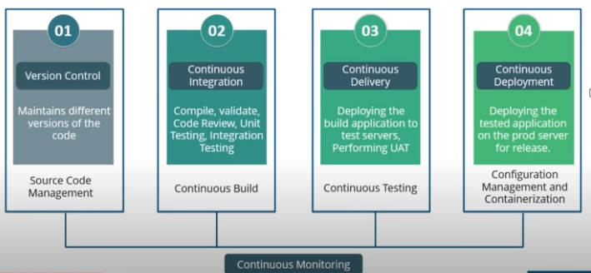
Stages in Devops

