Slide 1


CONSUMER GOODS Ad_Hoc Insights

Slide 2
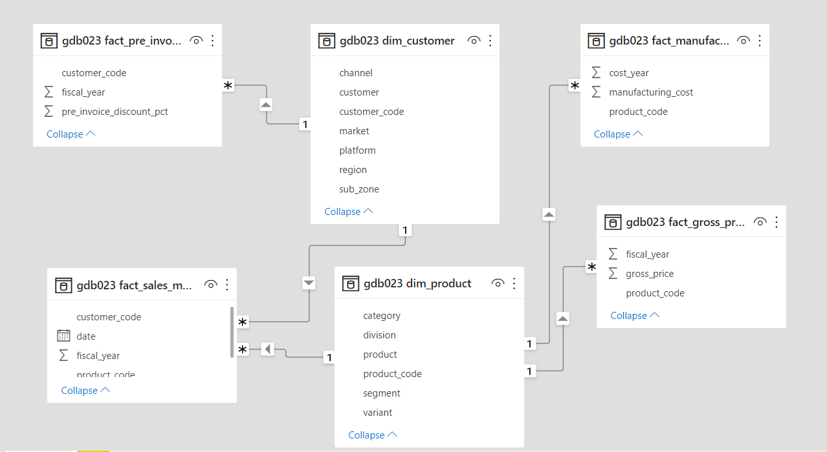
Dataset Connections

Slide 3
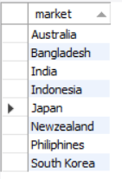
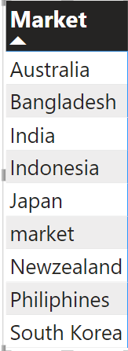
1. Provide The List Of Markets In Which Customer "Atliq Exclusive" Operates Its Business In The APAC Region.
Output :
SELECT DISTINCT market
FROM dim_customer
WHERE customer="Atliq Exclusive" AND region="APAC" ;

Slide 4
2. What Is The Percentage Of Unique Product Increase In 2021 Vs. 2020? The Final Output Contains These Fields, Unique_products_2020 Unique_products_2021 Percentage_chg
Output :
WITH CTE AS(
SELECT count(DISTINCT fs.product_code) AS unique_product_2020
FROM fact_sales_monthly fs
JOIN dim_product dp
ON fs.product_code=dp.product_code
WHERE fiscal_year=2020),
CTE2 AS(
SELECT count(DISTINCT fs.product_code) AS unique_product_2021
FROM fact_sales_monthly fs
JOIN dim_product dp
ON fs.product_code=dp.product_code
WHERE fiscal_year=2021)
To be continued …

Slide 5

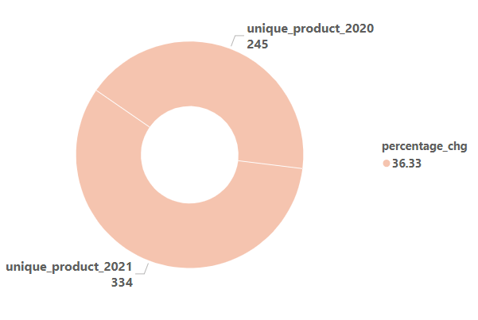
SELECT *, round(((unique_product_2021-unique_product_2020)/unique_product_2020)*100,2) as percentage_chg FROM CTE,CTE2 ;

Slide 6
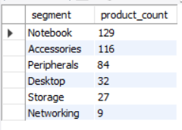
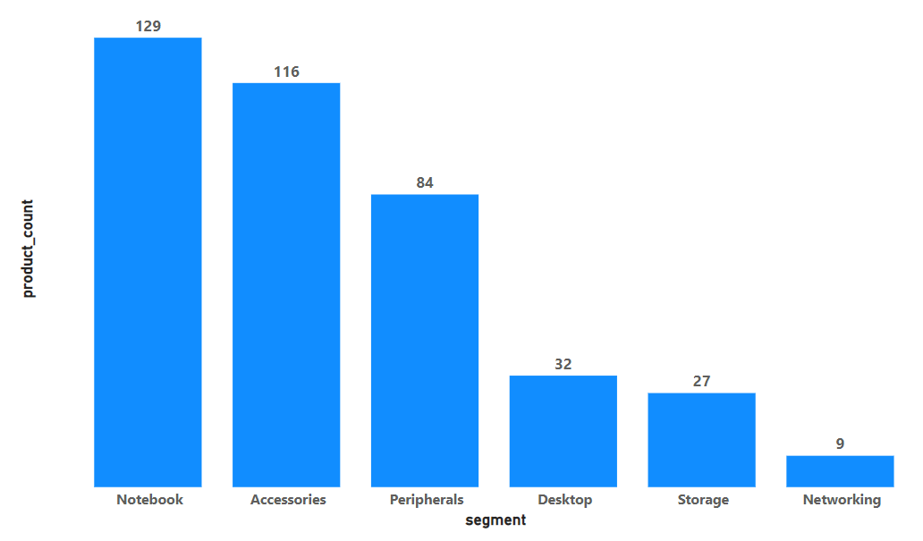
3. Provide A Report With All The Unique Product Counts For Each Segment And Sort Them In Descending Order Of Product Counts. The Final Output Contains 2 Fields, Segment Product_count
Output :
SELECT segment, count(DISTINCT product_code) AS product_count
FROM dim_product
GROUP BY segment
ORDER BY product_count DESC ;

Slide 7
4. Follow-up: Which Segment Had The Most Increase In Unique Products In 2021 Vs 2020? The Final Output Contains These Fields, Segment Product_count_2020 Product_count_2021 Difference
Output :
WITH CTE AS(
SELECT dp.segment,count(DISTINCT dp.product_code) AS product_count_2020
FROM dim_product dp
JOIN fact_sales_monthly fs
ON dp.product_code=fs.product_code
WHERE fiscal_year=2020
GROUP BY segment
ORDER BY product_count_2020 DESC),
To be continued …

Slide 8
CTE2 AS (
SELECT dp.segment,count(DISTINCT dp.product_code) AS product_count_2021
FROM dim_product dp
JOIN fact_sales_monthly fs
ON dp.product_code=fs.product_code
WHERE fiscal_year=2021
GROUP BY segment
ORDER BY product_count_2021 DESC)
SELECT a.segment,
a.product_count_2020,
b.product_count_2021,
b.product_count_2021-a.product_count_2020 AS diff,
round(((b.product_count_2021-a.product_count_2020)/a.product_count_2020)*100,2)
FROM CTE a
JOIN CTE2 b
ON a.segment = b.segment ;
To be continued…

Slide 9
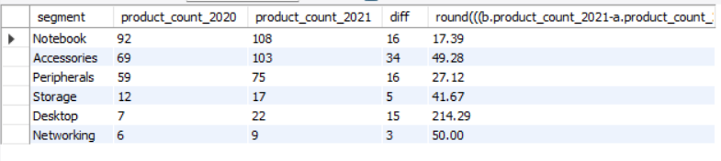
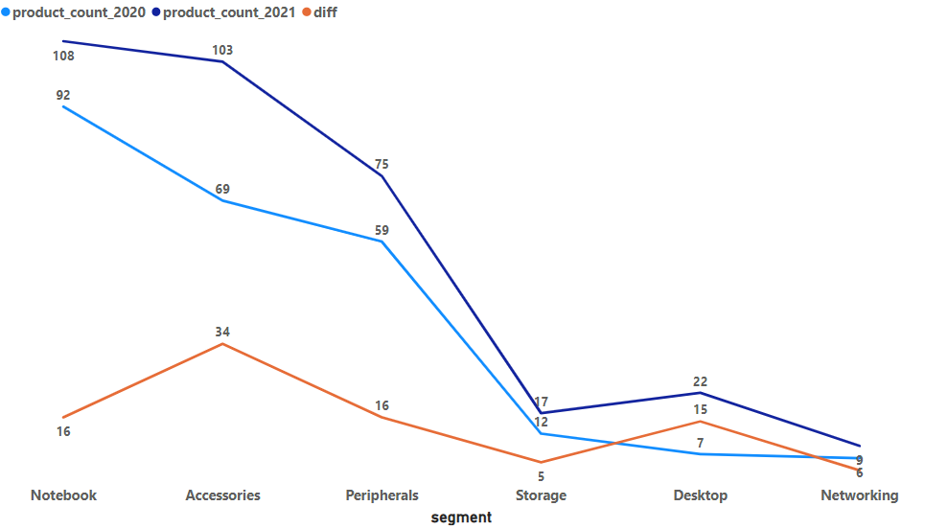
Result

Slide 10
5. Get The Products That Have The Highest And Lowest Manufacturing Costs. The Final Output Should Contain These Fields, Product_code Product Manufacturing_cost
Output :
SELECT dp.product , dp.product_code, manufacturing_cost
FROM fact_manufacturing_cost fm
JOIN dim_product dp
ON fm.product_code=dp.product_code
WHERE manufacturing_cost= ( SELECT max (manufacturing_cost) FROM fact_manufacturing_cost)
UNION
SELECT dp.product, dp.product_code, manufacturing_cost
FROM fact_manufacturing_cost fm
JOIN dim_product dp
ON fm.product_code = dp.product_code
WHERE manufacturing_cost = (SELECT min(manufacturing_cost) FROM fact_manufacturing_cost) ;
To be continued …

Slide 11

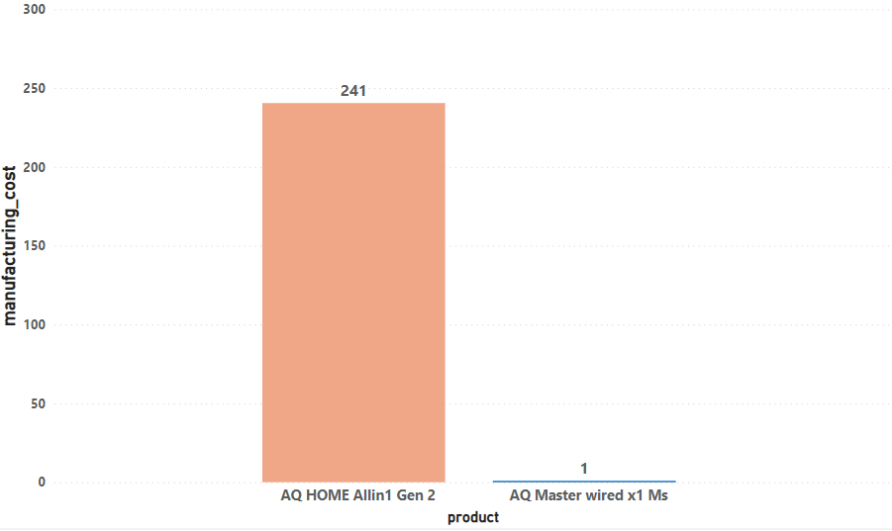
Result

Slide 12
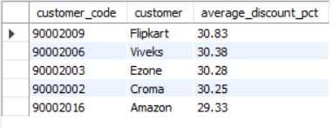
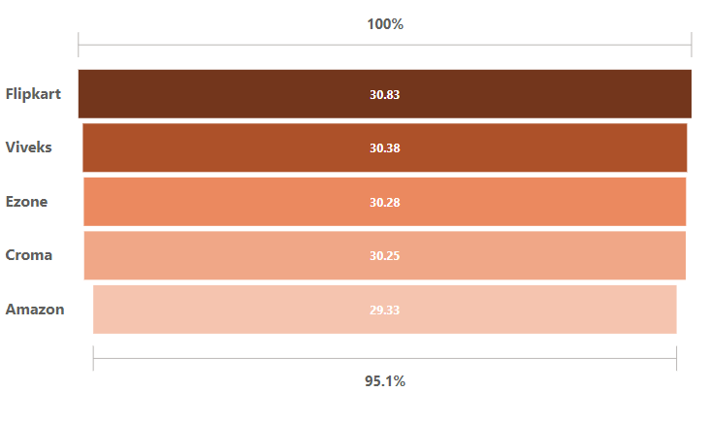
6. Generate A Report Which Contains The Top 5 Customers Who Received An Average High Pre_invoice_discount_pct For The Fiscal Year 2021 And In The Indian Market. The Final Output Contains These Fields, Customer_code Customer Average_discount_percentage
Output :
SELECT dc.customer_code, dc.customer,
round(AVG(fp.pre_invoice_discount_pct)*100,2)
AS average_discount_pct
FROM fact_sales_monthly fs
JOIN dim_customer dc
ON fs.customer_code= dc.customer_code
JOIN fact_pre_invoice_deductions fp
ON fs.customer_code=fp.customer_code
AND fs.fiscal_year=fp.fiscal_year
WHERE fs.fiscal_year=2021 AND dc.market="India"
GROUP BY dc.customer, dc.customer_code
ORDER BY average_discount_pct DESC LIMIT 5 ;

Slide 13
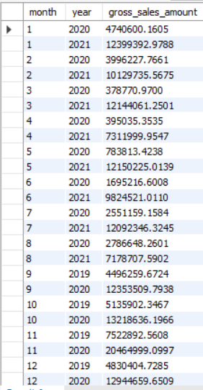
7. Get The Complete Report Of The Gross Sales Amount For The Customer “Atliq Exclusive” For Each Month. This Analysis Helps To Get An Idea Of Low And High-performing Months And Take Strategic Decisions. The Final Report Contains These Columns: Month Year Gross Sales Amount
Output :
SELECT month(date) as month, year(date) as year, sum(sold_quantity * gross_price) AS gross_sales_amount
FROM fact_sales_monthly fs
JOIN dim_customer dc
ON fs.customer_code= dc.customer_code
JOIN fact_gross_price fg
ON fg.fiscal_year= fs.fiscal_year AND
fg.product_code=fs.product_code
WHERE dc.customer="Atliq Exclusive"
GROUP BY month,year
ORDER BY year ;

Slide 14
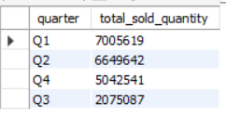
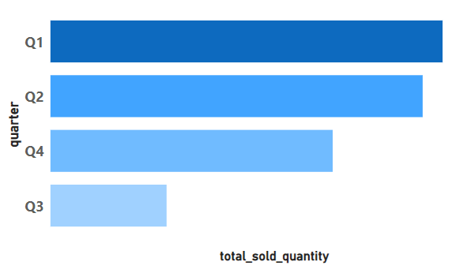
8. In Which Quarter Of 2020, Got The Maximum Total_sold_quantity? The Final Output Contains These Fields Sorted By The Total_sold_quantity, Quarter Total_sold_quantity
Output :
SELECT CASE
WHEN MONTH(date) IN(9,10,11) THEN 'Q1’
WHEN MONTH(date) IN(12,1,2) THEN 'Q2'
WHEN MONTH(date) IN(3,4,5) THEN 'Q3'
WHEN MONTH(date) IN(6,7,8) THEN 'Q4’
END AS quarter,
SUM(sold_quantity) AS total_sold_quantity FROM fact_sales_monthly
WHERE fiscal_year= 2020
GROUP BY quarter
ORDER BY total_sold_quantity DESC;

Slide 15
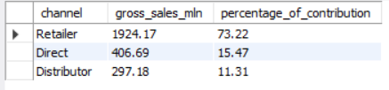
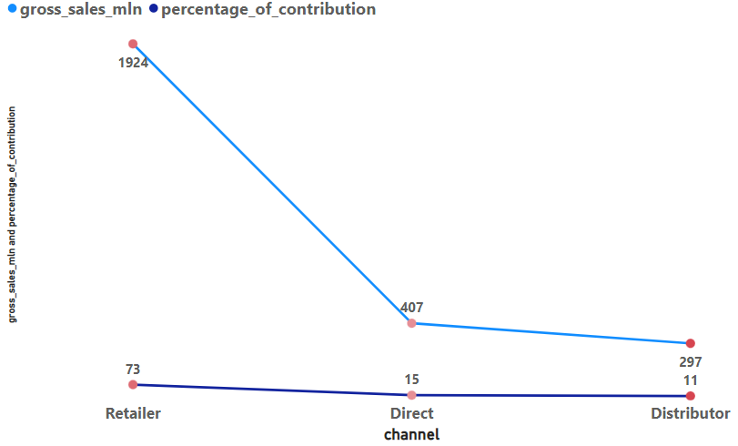
9. Which Channel Helped To Bring More Gross Sales In The Fiscal Year 2021 And The Percentage Of Contribution? The Final Output Contains These Fields, Channel Gross_sales_mln Percentage
Output :
WITH CTE AS
( SELECT channel,SUM(gross_price*sold_quantity) AS gross_sales
FROM fact_sales_monthly fs
JOIN fact_gross_price fg
ON fs.product_code = fg.product_code
JOIN dim_customer dm
ON fs.customer_code = dm.customer_code
WHERE fs.fiscal_year = 2021
GROUP BY channel
ORDER BY gross_sales DESC )
SELECT channel, ROUND(gross_sales/1000000,2) AS gross_sales_mln,
ROUND(gross_sales/(SELECT SUM(gross_sales) FROM CTE)*100,2) AS percentage_of_contribution
FROM CTE ;

Slide 16
10. Get The Top 3 Products In Each Division That Have A High Total_sold_quantity In The Fiscal_year 2021?
The Final Output Contains These Fields,
Division
Product_code
Product
Total_sold_quantity
Rank_order
Output :
WITH sales AS (
SELECT division, fs.product_code,product, sum(sold_quantity) AS total_sold_quantity
FROM fact_sales_monthly AS fs
LEFT JOIN dim_product AS dp
ON fs.product_code = dp.product_code
WHERE fiscal_year = 2021
GROUP BY fs.product_code, division,product), rank_ov AS
(SELECT product_code, total_sold_quantity,
DENSE_RANK () OVER(PARTITION BY division ORDER BY total_sold_quantity desc)
AS Rank_order FROM sales AS S)
To be continued…

Slide 17
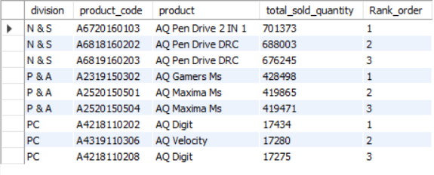
SELECT division,
S.product_code,
product ,
S.total_sold_quantity,
Rank_order
FROM sales AS S
INNER JOIN rank_ov AS R
ON R.product_code = S.product_code
WHERE Rank_order BETWEEN 1 AND 3 ;
Result

Slide 18


