Slide 1
INVESTMENT ASSIGNMENT SUBMISSION
Name: Jyoti Patel

Slide 2
Spark Funds – Investment Analysis
Spark Funds, an asset management company, is searching for best investment.
The overall strategy is to invest where others are investing, implying that the 'best' sectors, countries and investment type where most investors are investing.
Business strategy:
Spark Funds wants to invest between 5 to 15 million USD per round of investment.
Spark Funds wants to invest only in English-speaking countries.
Business objective: To identify the best sectors, countries, and a suitable investment type for making investments.
Goals of data analysis:
• Investment type analysis
• Country analysis
• Sector analysis

Slide 3
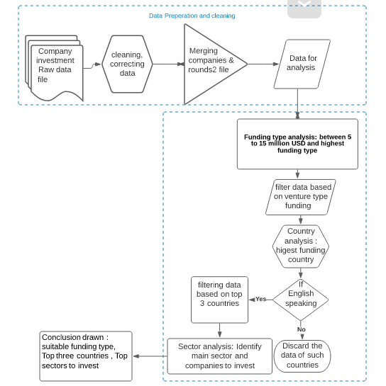
Problem solving methodology

Slide 4
Data Preparation and cleaning
Data for analysis is real investment data from crunchbase.com.
Company Data, A file with basic data of companies
Rounds Data, companies past investment round details
Mapping File, Contains main sector of subsectors in round data.
Data cleaning performed:
• Removing columns having null values which are not required for the current analysis.
• Removing rows having null value in the required analysis fields.
• Correcting incorrect or missing data wherever required to make data clean for analysis and filling the null values.
Merging the data after cleaning to perform the analysis on data.

Slide 5
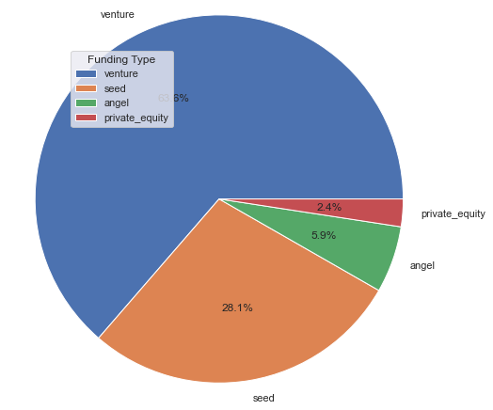
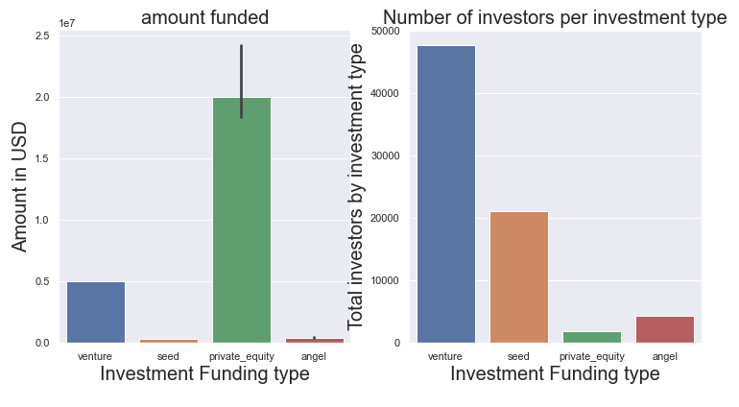
Funding Type Analysis

Slide 6
Considering the points:
Spark Funds wants to invest between 5 to 15 million USD.
Spark Funds wants to invest venture, angel, seed, and private equity.
The observation drawn from graph:
Avg. amount invested in private equity is beyond the 15M USD investment limit.
Avg. investment amount for seed and angel type are well below the 5M USD starting limit of Spark Fund.
Venture is the only investment funding type which is >=5M and <= 15M USD.

Slide 7
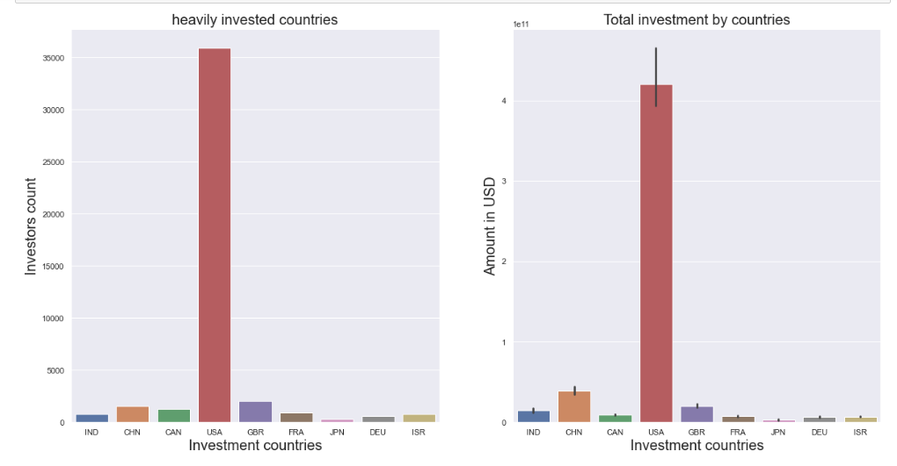
Country Analysis

Slide 8
Considering points: Spark Funds wants to see the top nine countries which have received the highest total funding (across ALL sectors for the chosen investment type) and heavily invested.
Identify the top three English-speaking countries in the data.
The observation drawn from graph:
USA amounts as the most invested county with a total of 420068029342 USD.
China follows USA, but is NOT a English speaking country which does not fit in the criteria.
United Kingdom and India are among the Top 3 countries to attract investments.
Canada, France, Germany, Israel and Japan are other among the top 9 invested countries.
The top three countries are USA , UK and India.

Slide 9
Sector Analysis
Country Name | Top 3 sectors | Count of investment | Company Name highest Amount
USA | Others | 2950 | /organization/virtustream
 | Social,Finance,Analytics,Advertising | 2714 | /organization/shotspotter
 | Cleantech/Semiconductor | 2350 | biodesix
GBR (United Kingdom) | Others | 147 | /organization/electric-cloud
 | Social,Finance,Analytics,Advertising | 133 | /organization/celltick-technologies
 | Cleantech/Semiconductor | 130 | eusa-pharma
IND | Others | 110 | /organization/firstcry-com
 | Social,Finance,Analytics,Advertising | 60 | /organization/manthan-systems
 | News, Search and Messaging | 52 | upshup-technology-india-pvtltd

Slide 10
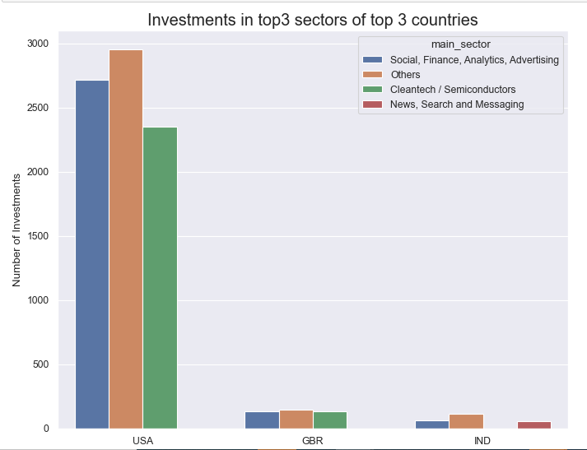
Number of Investment in top 3 Sectors among the top 3 countries

