Slide 1
SupportSim AI
The Future of Private AI Customer Support Training
Full Architecture & System Design

Slide 2
System Mission & Vision
A local-first, privacy-focused SaaS platform for training support agents.
🛡️ 100% Data Privacy: Local AI inference via Ollama.
💰 Zero API Costs: High-performance open LLMs (Llama 3.2).
⚙️ Enterprise Scalability: Kafka-backed distributed processing.
🤖 Intelligent Agents: Multi-agent state management with LangGraph.

Slide 3
Core Platform Features
• Advanced RAG: Multi-tenant document isolation.
• Dynamic Simulation: Evolving emotional personas.
• Automated Evaluation: Multi-metric performance scoring.
• SaaS Monetization: Integrated Stripe billing & credits.

Slide 4
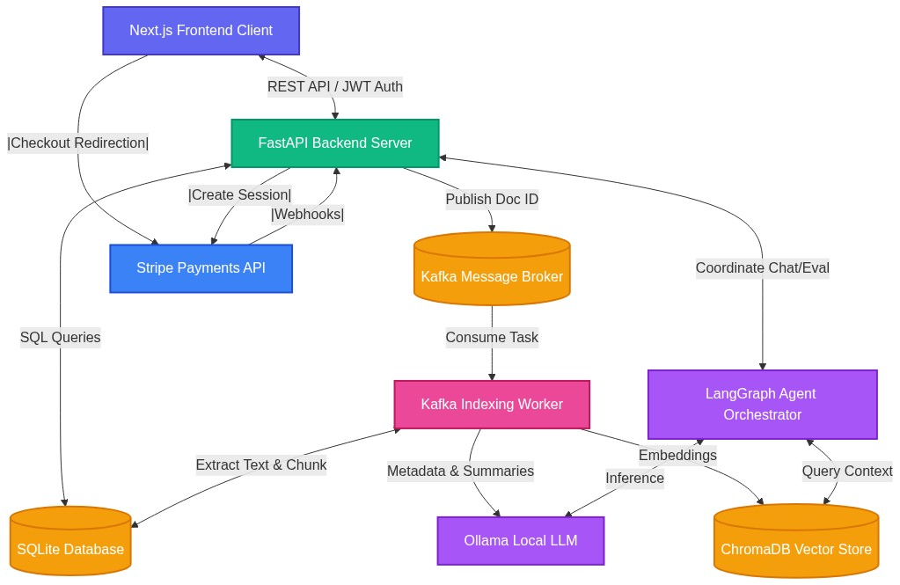
High-Level Architecture

Slide 5
Modern Tech Stack
• Frontend: Next.js 15, Tailwind CSS, Framer Motion
• Backend: FastAPI (Python 3.11+), JWT Auth
• AI Engine: Ollama, LangGraph, LlamaIndex
• Data: SQLite (Relational), ChromaDB (Vector)
• Messaging: Kafka Message Broker

Slide 6
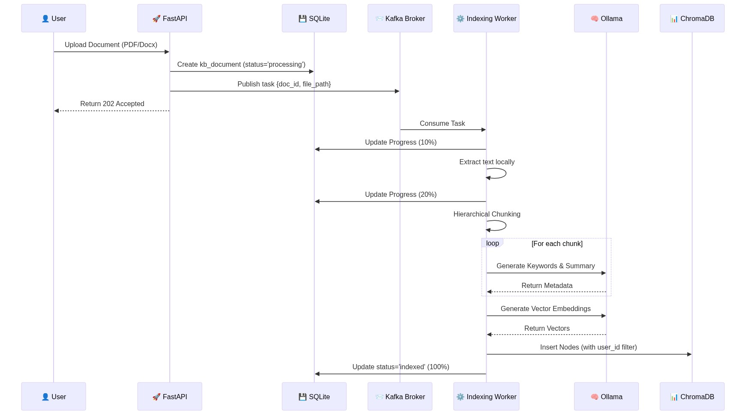
Document Indexing Pipeline (Kafka)

Slide 7
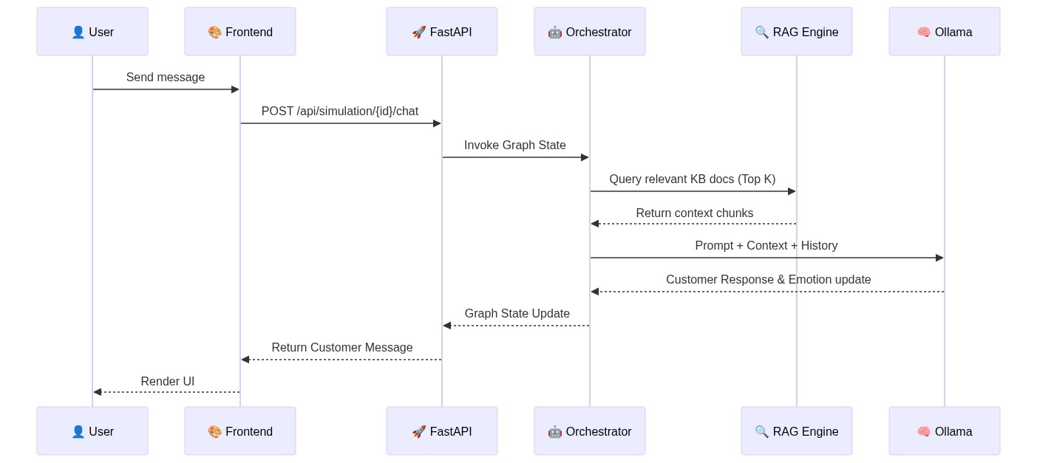
Training Session Workflow (LangGraph)

Slide 8
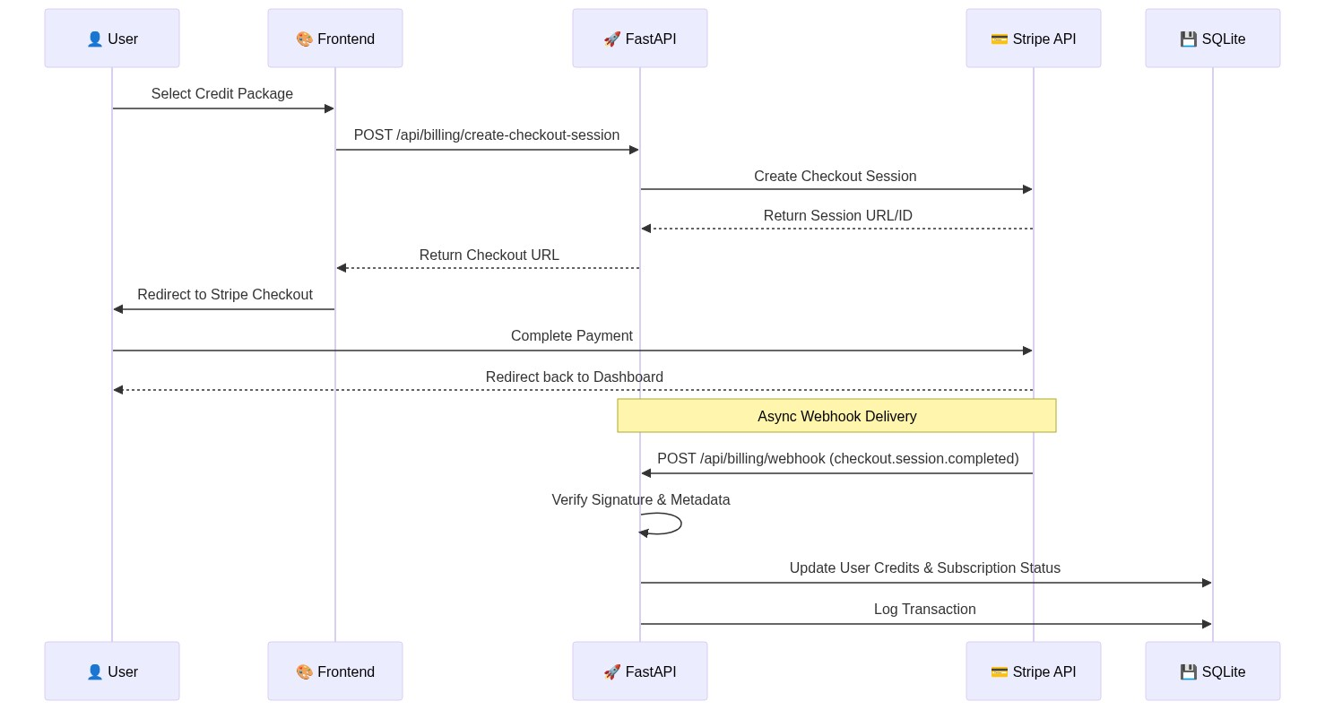
Billing & Credit Fulfillment (Stripe)

Slide 9
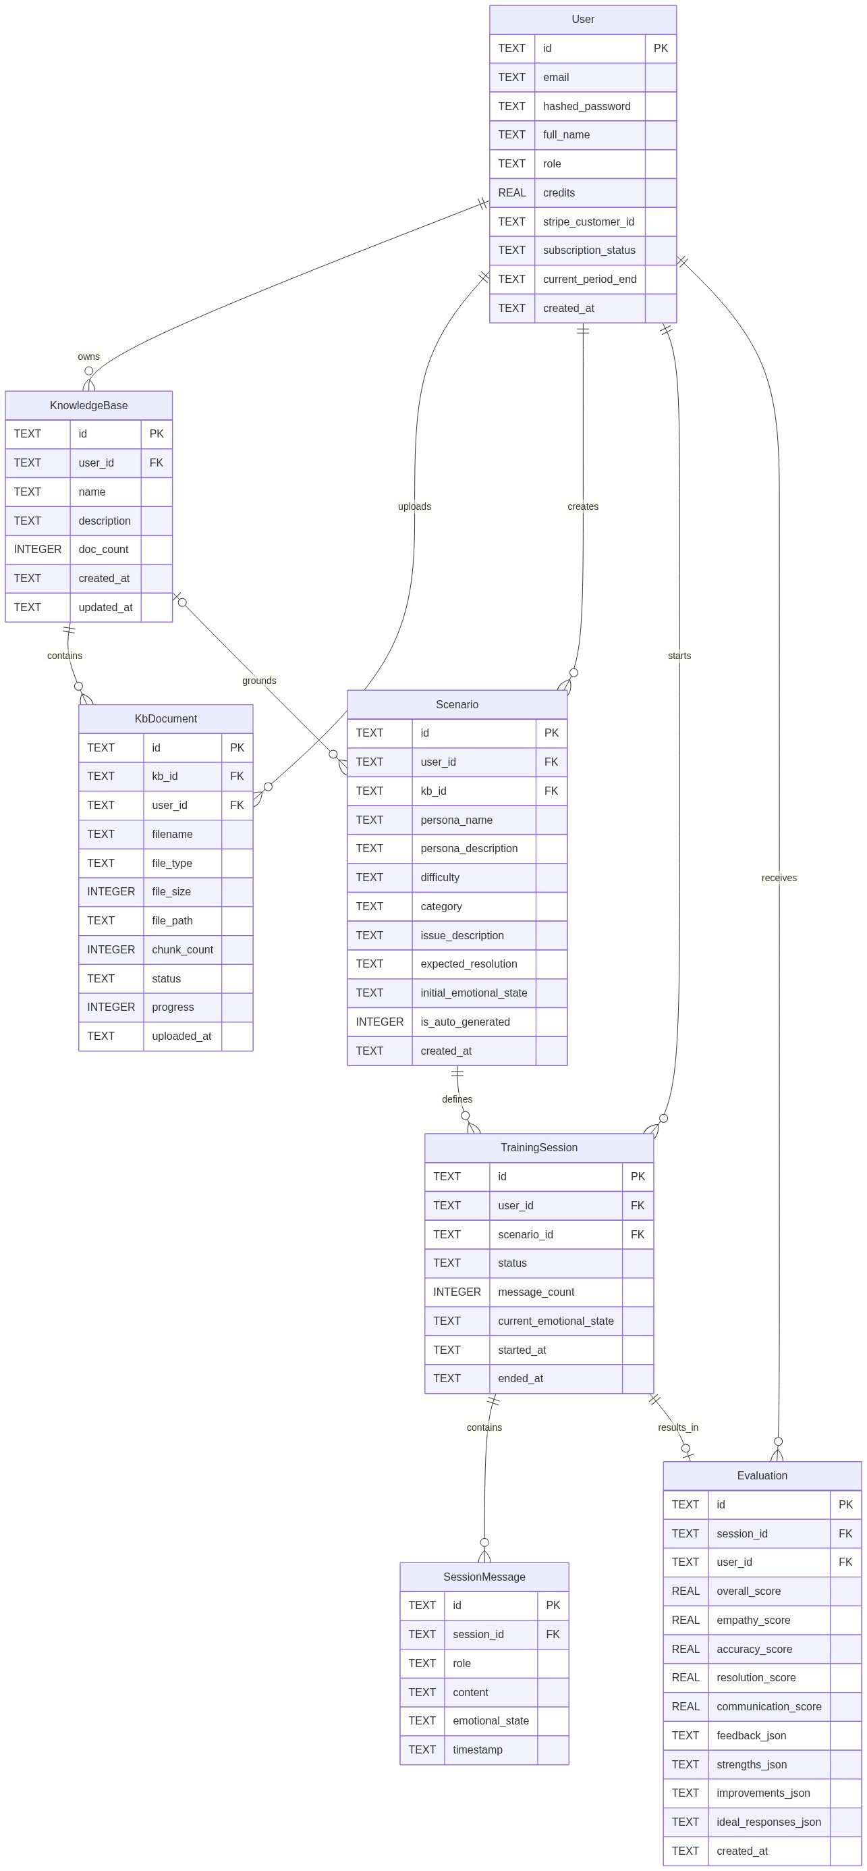
Relational Database Schema (ERD)

Slide 10
Conclusion: The Private AI Edge
SupportSim AI provides a premium, scalable foundation for enterprise training without compromising data privacy.
Thank You!

